Slide 1
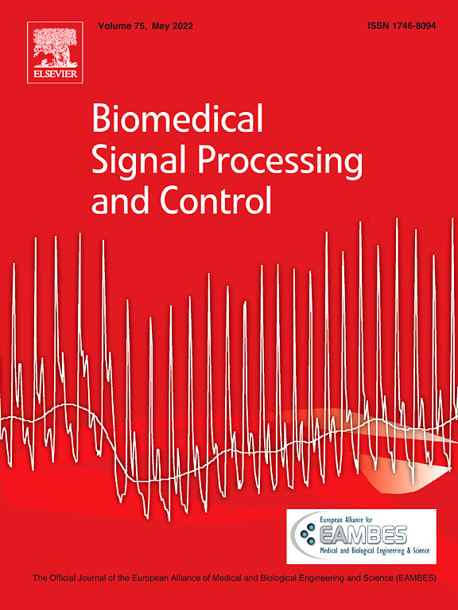
Supervisor: 教授 丁建均
Presenter: 周群翔
June 10, 2022

Slide 2
BIOMEDICAL
SIGNAL PROCESSING & CONTROL
Introduction
Material & methods
Results
Discussion
Conclusion
Contents
Biomedical Signal Processing and Control Volume 76,
July 2022, 103659

Slide 3
INTRODUCTION

Slide 4
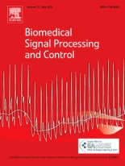
HUMAN MEMORY SYSTEM
The neurobiology of memory has not been fully discovered.
Classifying memory by storage capacity and duration to
three primary storage areas in human memory system:
Sensory memory:
Temporary storage location for information via human senses
Allowing individuals to process and recall the sensations
Critical for consciousness, individual differences, memory control
Short-term memory:
A small amount of information stored in mind for 20 to 30 s
People retain 5 to 9 items in short memory (George Miller, 1956)
Humans can hold four chunks of information (Nelson Cowan, 2001)
Long-term memory:
Relatively stable and can last for an extended periods of time (e.g., years)
Short-term memories are automatically retained in long-term memory

Slide 5
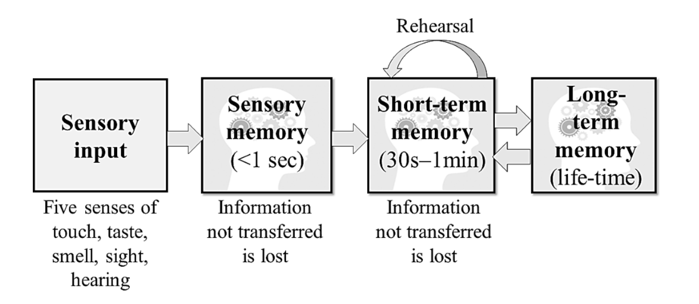
Fig. 1. The flow of information in human memory.

Slide 6
ELECTROENCEPHALOGRAPHY (EEG)
EEG is a non-invasive brain imaging technique that is widely used
to study and diagnose brain diseases and functions.
Advantages: non-harmful, painless, short acquisition time,
inexpensive, excellent temporal resolution
Disadvantages: high noise level, poor spatial resolution
A method for removing artifacts and enhancing the quality
of EEG signals is required.

Slide 7
WAVELET-BASED METHOD
Wavelet method is a time–frequency analysis technique,
based on the Wigner-Ville distribution and linear transformation.
Decomposing the input signal into low-frequency and high-frequency domains.
Brain rhythms must be extracted from recorded EEG signals
in order to ascertain individuals’ responses to provided stimulation,
and then investigate the brain’s behavior and activities.

Slide 8
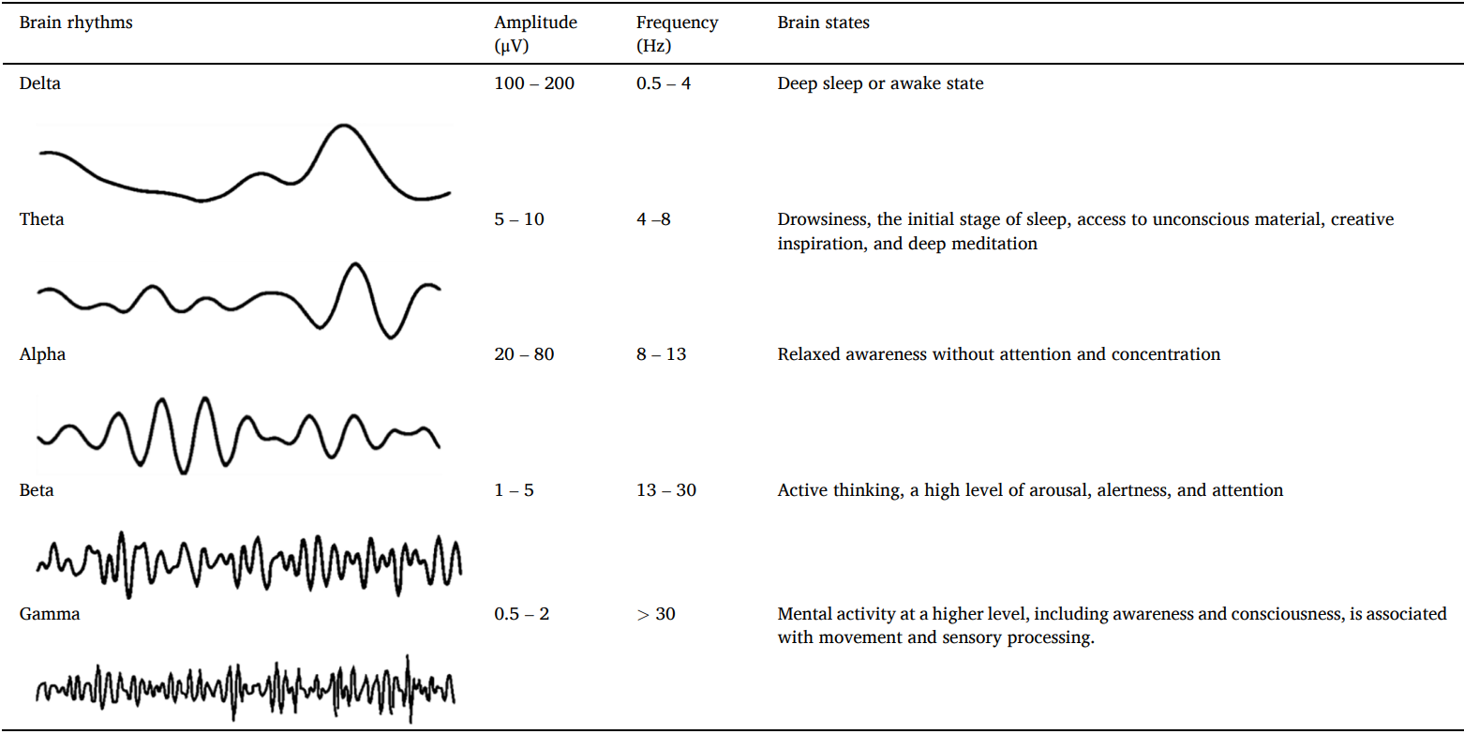
Table 1. Classification of EEG brainwaves with their properties.

Slide 9
AUDIOVISUAL STIMULATION
The audiovisual stimulation is selected as a factor to explore
the brain activities based on the EEG analysis.
Mozart’s Sonata music and pure white noise have been chosen as
audio stimulation in this research.
Previous researches revealed that Mozart’s music improves many
aspects of cognitive performance:
spatial reasoning abilities, spatial-temporal performance,
visuospatial rotation task, science test
White noise has also been shown to boost some aspects of
cognitive performance:
visuospatial working memory, verbal memory tests

Slide 10
STUDY PURPOSE
The majority of past research has examined the effect of
Mozart’s music and white noise on visuospatial skills.
Visual memory:
A person’s capacity to recall or recollect information or events
captured in the past, required for the majority of daily activities.
This study employs visual memory assessments of varying degrees
of difficulty as a form of visual stimulation or cognitive testing.

Slide 11
STUDY PURPOSE
Mozart’s music and white noise，which is more effective?
Previous studies evaluate the influence of audios was mostly
established on task score performance, regardless of brain activity.
Brain analysis and task score performance are used as the researched factors in order to determine their relationship.

Slide 12
MATERIAL & METHODS

Slide 13
Fig. 2. Stage of data processing in this research.

Slide 14
EXPERIMENTAL SETUP & DATA ACQUISITION
60 Volunteers: 40 females and 20 males with mean age of 23 years.
(Assigned into Group A & B with both 20 females and 10 males)
The participant is urged to maintain a relaxed demeanour with little
movement in order to avoid unnecessary changes in the wave
patterns caused by bodily activity.
Fp1, Fz, Pz, T3, T4, these five electrodes were chosen because
they are associated with human memory and auditory region.
Data acquisition sensitivity: 10μV
Time constant: 0.3 s
High pass filter: 70 Hz
Signal sampled: 500 Hz

Slide 15
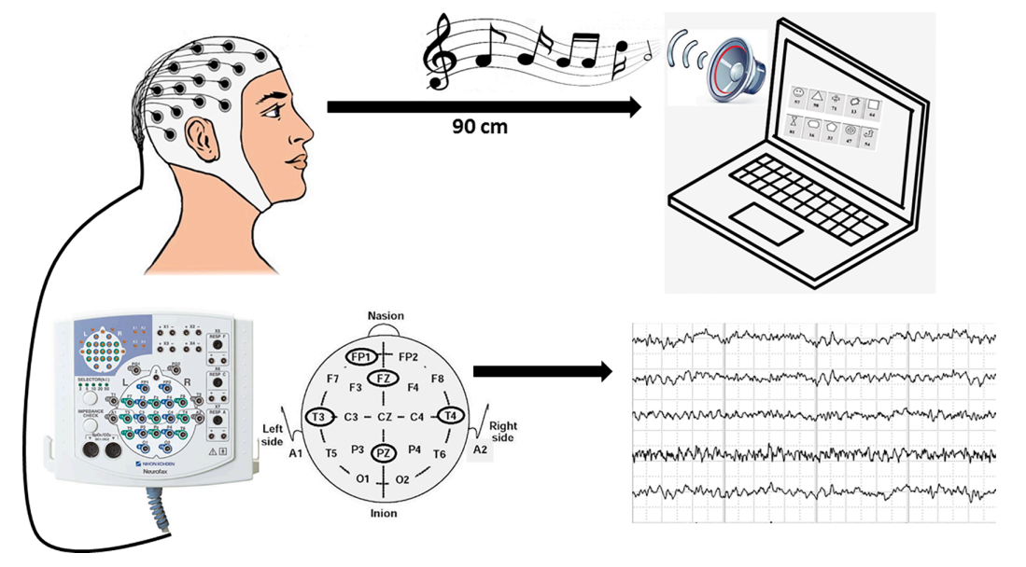
Fig. 3. Illustration of the data acquisition process.

Slide 16
Fig. 4. Visual assessment at various levels: a) First level and b) Second level

Slide 17
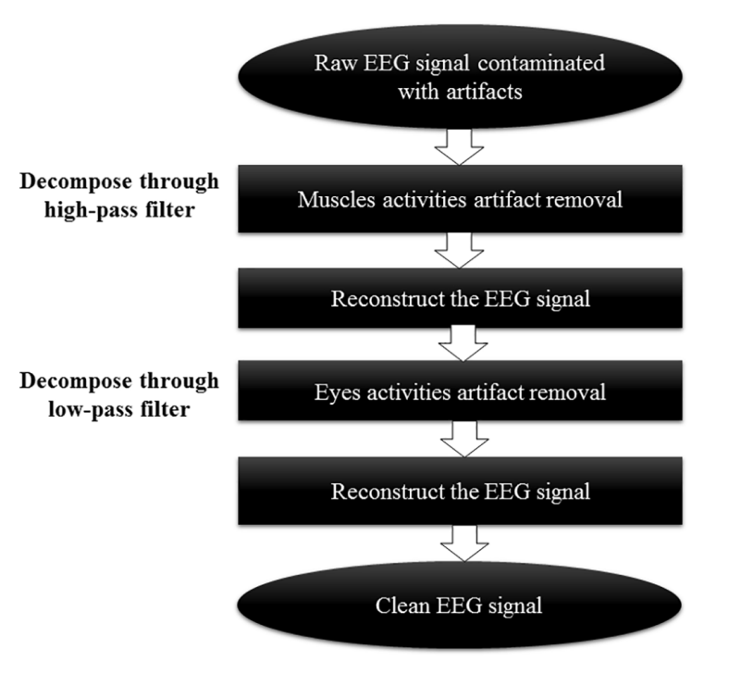
Fig. 5. Artifacts elimination process from EEG signal using a stationary wavelet transform filter.

Slide 18
ELIMINATION OF ARTIFACTS FROM EEG DATASETS
Raw datasets denoising from the Fp1, Fz, Pz, T3, T4, which were
performed using the stationary wavelet transform (SWT) in Matlab
Convolution procedure:
EEG signal was broken into low-pass and high-pass filters
with impulse responses dependent on selected wavelet criteria.
Low-pass filters: generate approximation coefficients
High-pass filters: yield detail coefficients
Since the input EEG signal was 500 Hz, thus the frequency of signal
was divided in half for each filter.
The low-pass & high-pass filters will have a frequency of 250 Hz.
Final output is still 500 Hz, which has an initial frequency sampling by upsampling by 2 as it goes through the sample.

Slide 19
STATIONARY WAVELETS TRANSFORM (SWT)
Properties of SWT:
providing improved time resolution (for artifacts identification,
pattern recognition, change detection, and feature extraction)
and time-invariant
Utilizing SWT filter to remove artifacts from EEG datasets
It may retain the signal’s original frequency sampling,
which contains the actual information.
Preserve the signal’s time-invariance properties,
which are critical for localizing and identifying the changes or transient properties in the EEG signal.
Its db3 mother wavelet has spiky characteristics,
making it well-suited for removing muscle movements and
eye movements/blinks artifacts.

Slide 20
MOTHER WAVELET & DECOMPOSITION LEVEL
Any Daubechies(db) type higher than 3 is undesirable for EEG
denoising due to its sinusoidal shape and more stretch in time-axis.
(Sarkela 2007)
The best decomposition level of 5 was determined based on the
lowest mean square error (MSE) value.
The decomposition level of the SWT filter was chosen from
levels 2 to 8.
(Level 1 decomposition was omitted because to its inadequacy for
EEG denoising.)

Slide 21
Table 2. Mean square error of decomposition level for Fp1, Fz, T3, T4 and Pz using stationary wavelet transform filter of db3 mother wavelet.

Slide 22
DECOMPOSITION OF BRAIN RHYTHMS
Properties of discrete wavelet transform (DWT):
more computationally efficient than others
its superior localization properties resulting in
a higher extraction accuracy (previous researches have proven)
The db4 mother wavelet and 7 levels of decomposition was chosen.
Four distinct brain rhythms are obtained:
alpha, beta, theta, gamma

Slide 23
DISCRETE WAVELETS TRANSFORM (DWT)
The DWT method has a similar execution process as SWT,
but the input signal of DWT will be downsampled by 2
as each time passes through the low-pass and high-pass filters.
Low-pass filters:
generates approximation (A) coefficients with low-frequency components
High-pass filters:
produces the detail (D) coefficients, which contain components with a high-frequency components
DWT is an appropriate method for obtaining brain rhythms
with different frequency components.

Slide 24
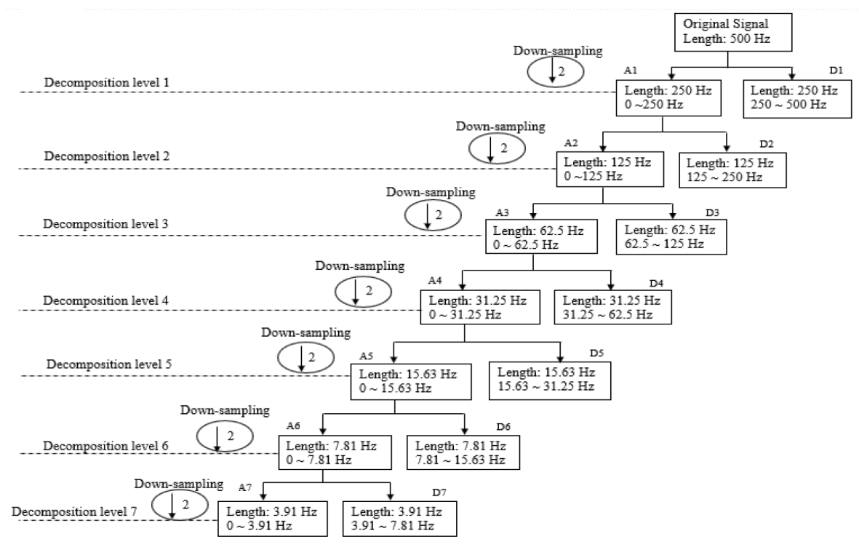
Fig. 6. Decomposition of brain rhythms using the discrete wavelet transform method for an EEG signal with a sampling rate of 500 Hz.

Slide 25
FEATURES EXTRACTION
Two primary parameters are used as benchmark features based on
EEG datasets analysis and score evaluation.
We extracts four major features from EEG signals in order to
ascertain the influence of audiovisual stimulation on adult memory.
EEG signal amplitude
standard deviation of the EEG signal amplitude
peak-to-peak of EEG signal amplitude
absolute rhythms power
The score evaluation is used to test the subject’s memory
following audiovisual stimulation, in other words,
assessing the ability to accurately recall the given material.

Slide 26
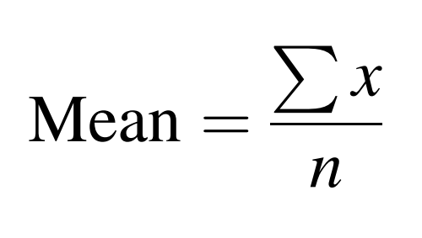
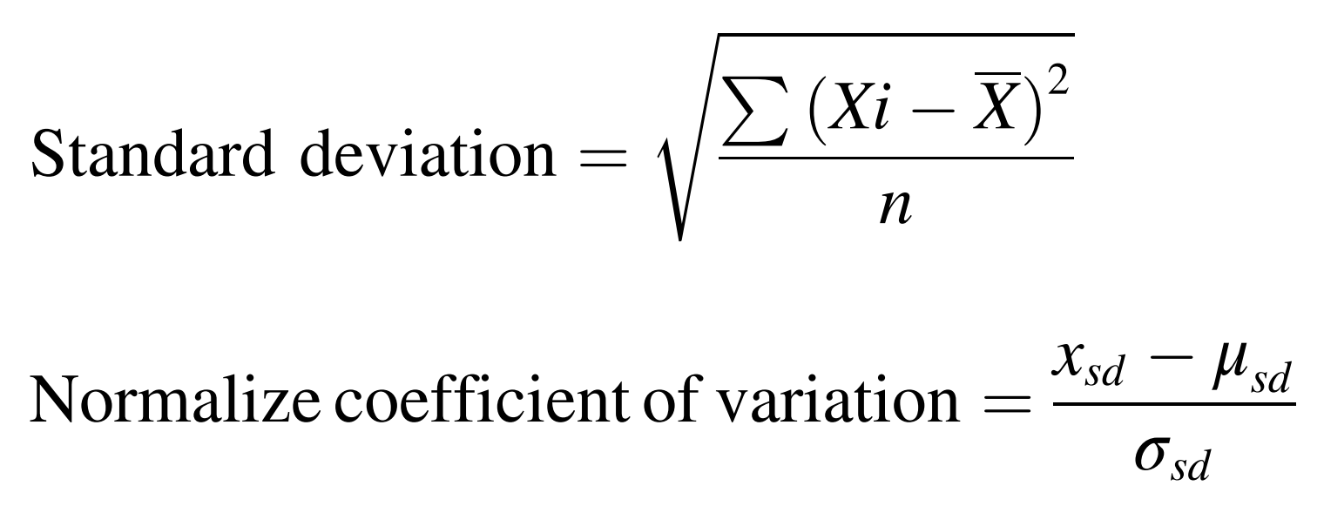

Slide 27
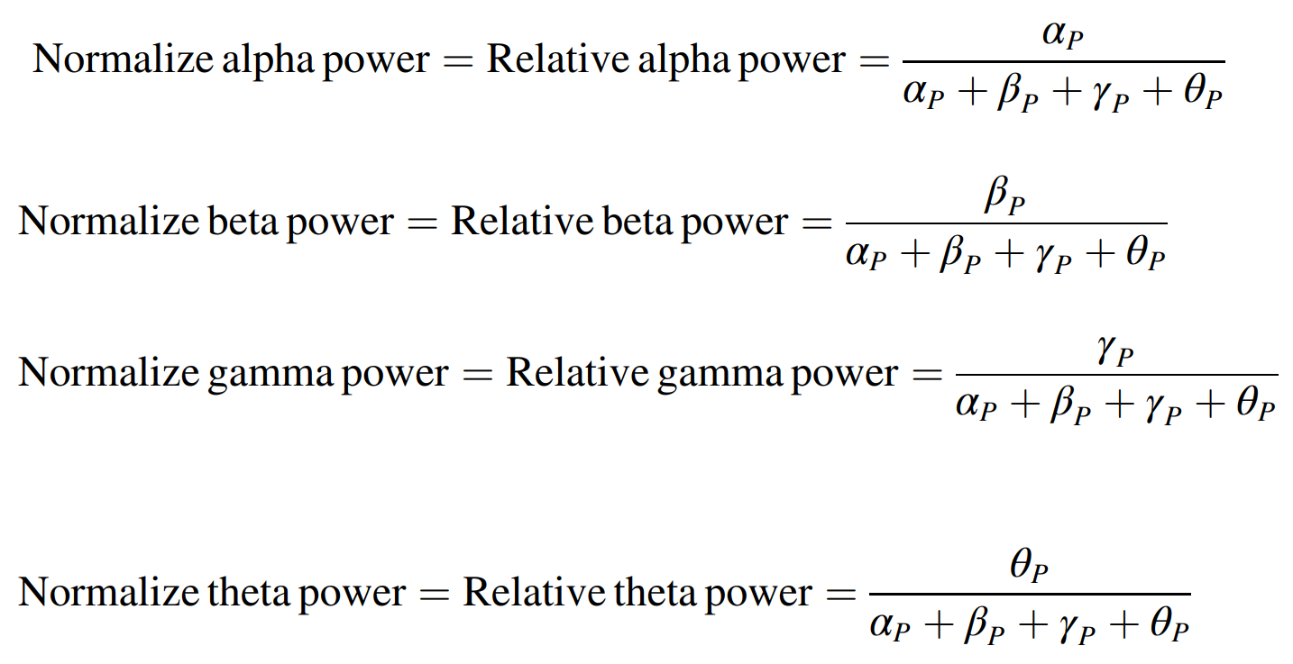

Slide 28
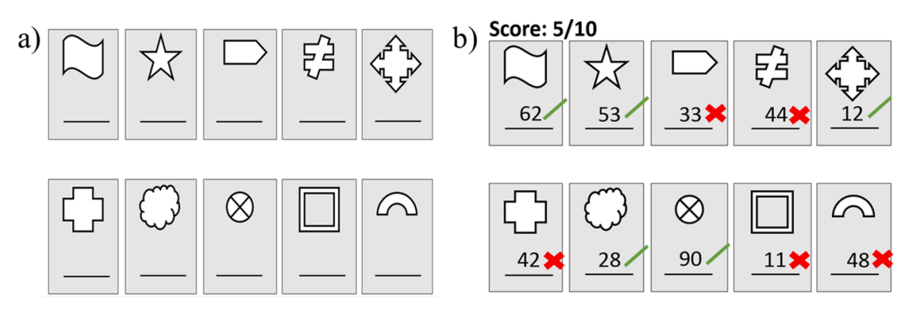
Fig. 7. Example of visual assessment: a) answer sheet and b) score evaluation.

Slide 29
RESULTS

Slide 30
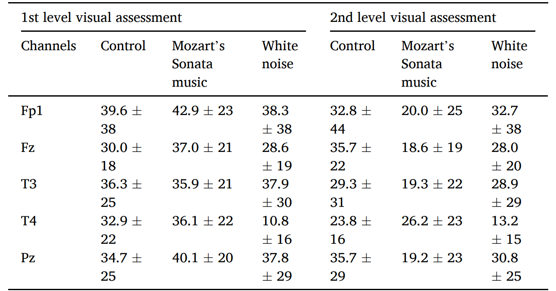
Table. 3. Normalize mean ± standard deviation of EEG voltage under audiovisual stimulation.

Slide 31
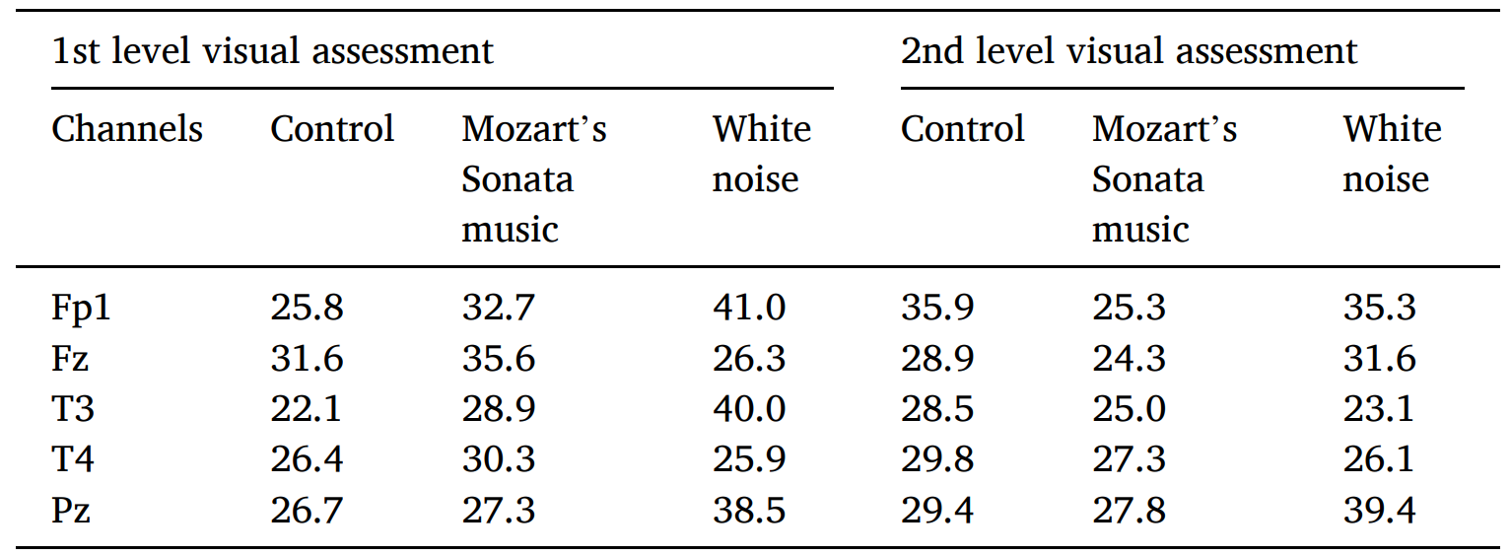
Table. 4. Normalize peak-to-peak amplitude of EEG voltage under audiovisual stimulation.

Slide 32
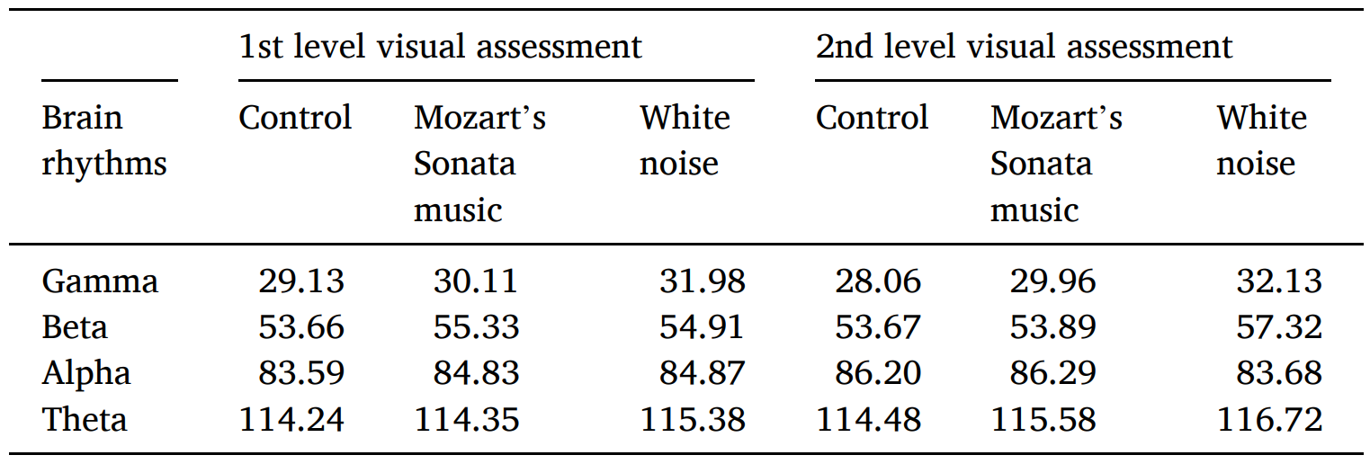
Table. 5. Relative power of brain rhythms in response to various audiovisual stimulation.

Slide 33
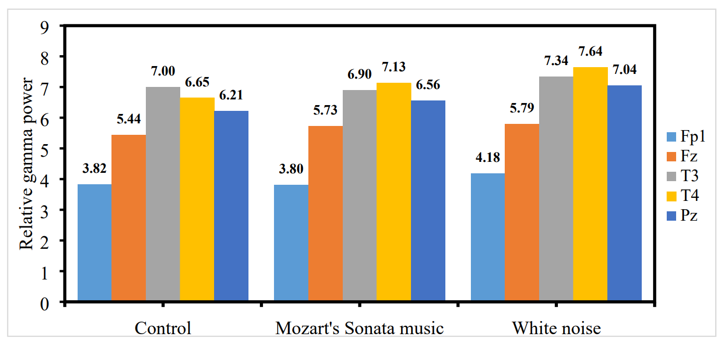
Fig. 8. Relative gamma power for 1st level visual assessment at different audio stimulation.

Slide 34
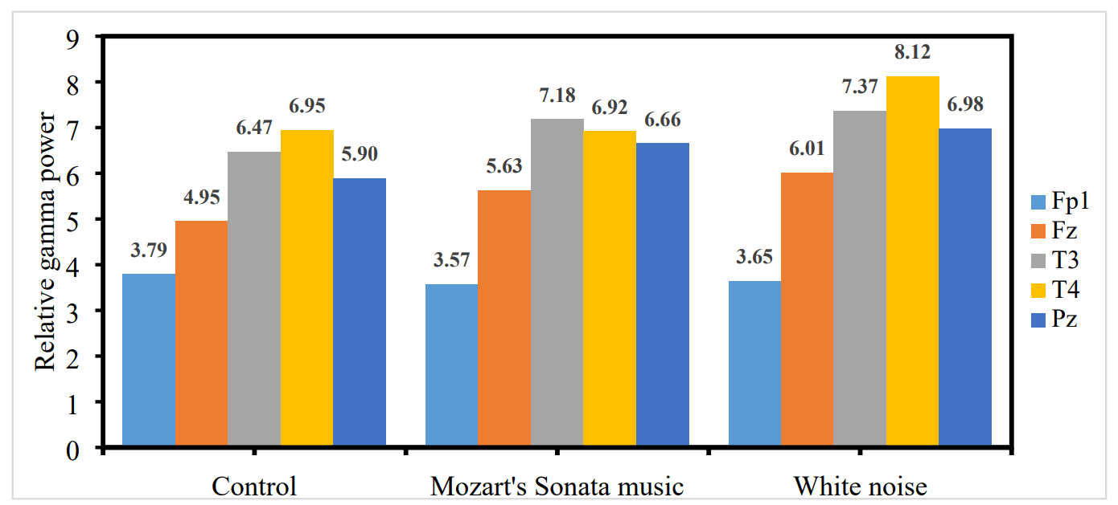
Fig. 9. Relative gamma power for 2nd level visual assessment at different audio stimulation.

Slide 35
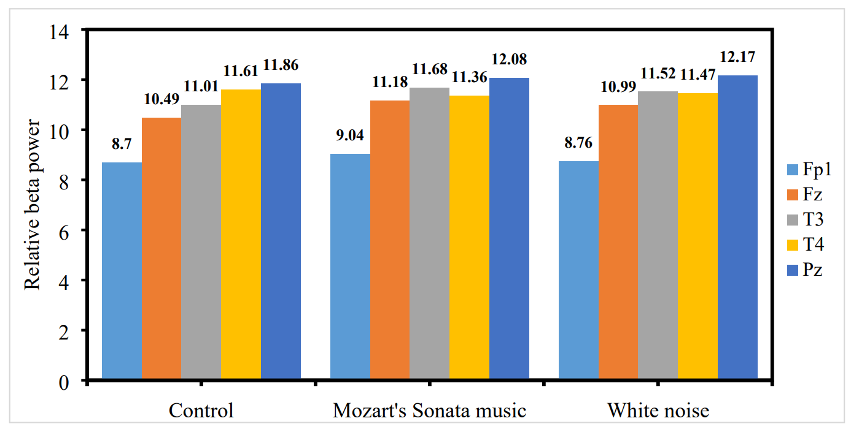
Fig. 10. Relative beta power for 1st level visual assessment at different audio stimulation.

Slide 36
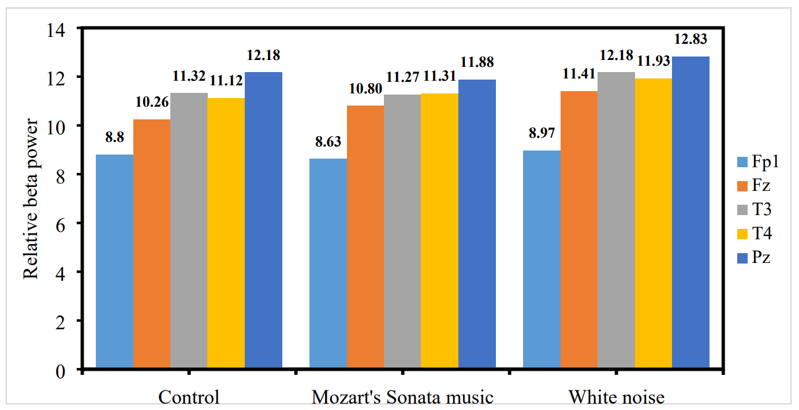
Fig. 11. Relative beta power for 2nd level visual assessment at different audio stimulation.

Slide 37
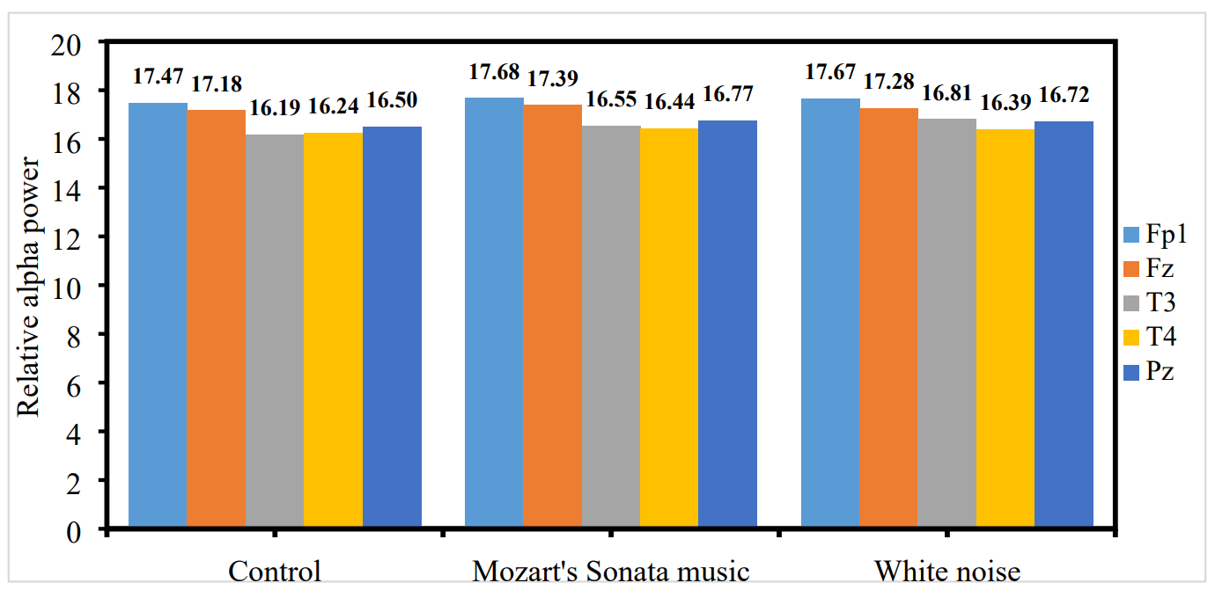
Fig. 12. Relative alpha power for 1st level visual assessment at different audio stimulation.

Slide 38
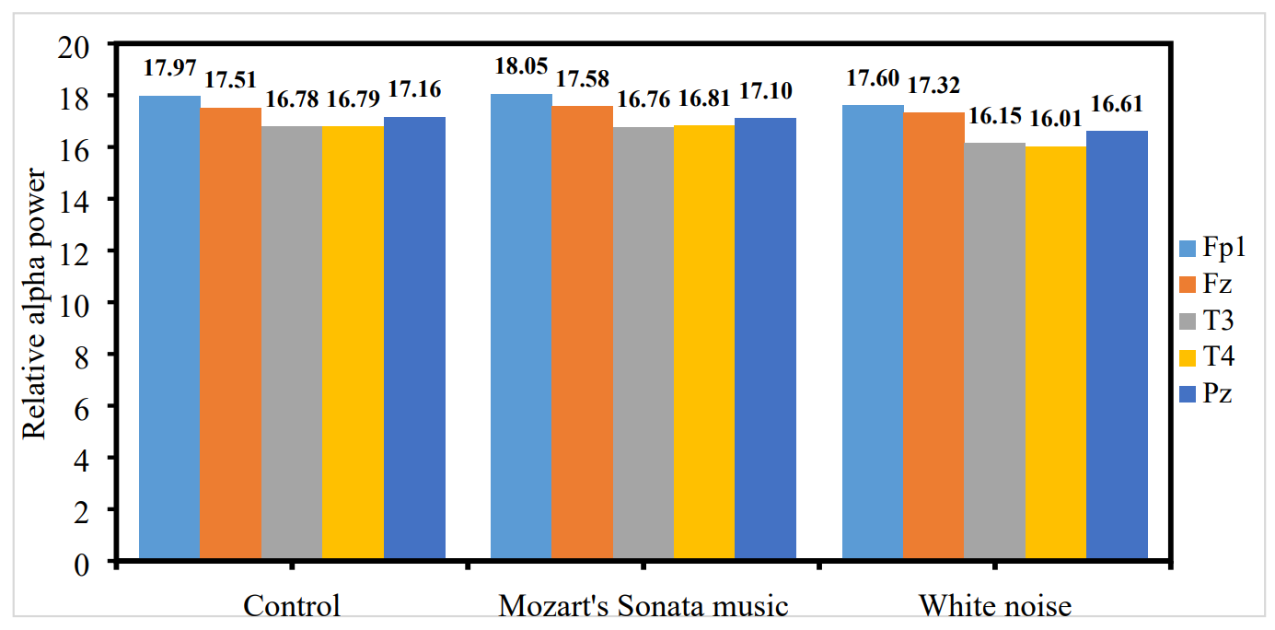
Fig. 13. Relative alpha power for 2nd level visual assessment at different audio stimulation.

Slide 39
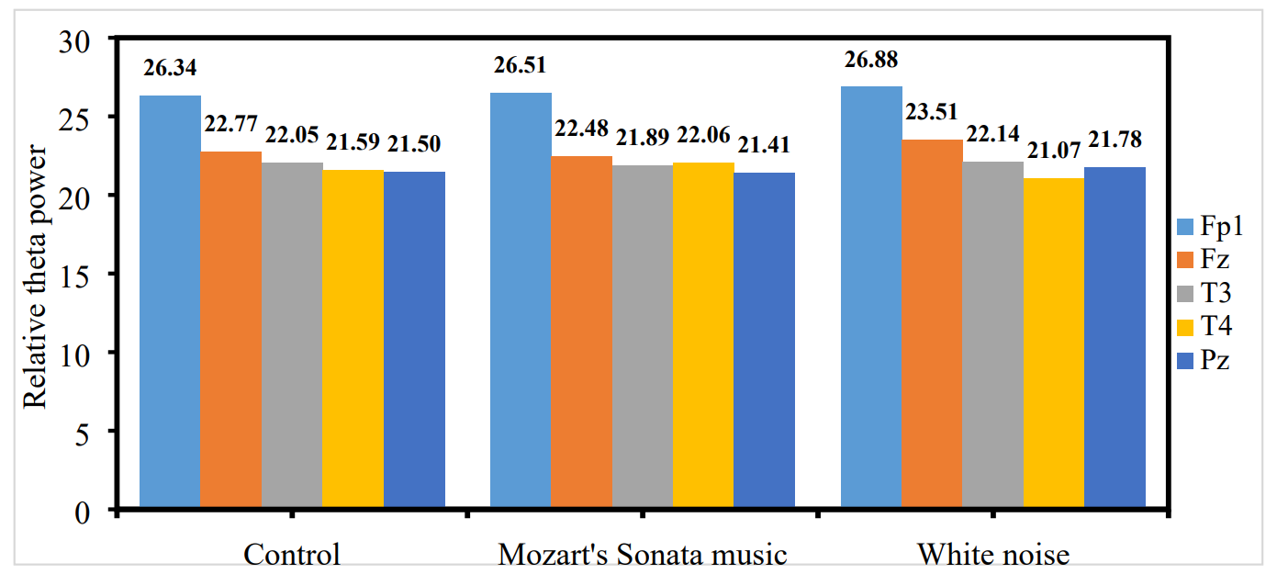
Fig. 14. Relative theta power for 1st level visual assessment at different audio stimulation.

Slide 40
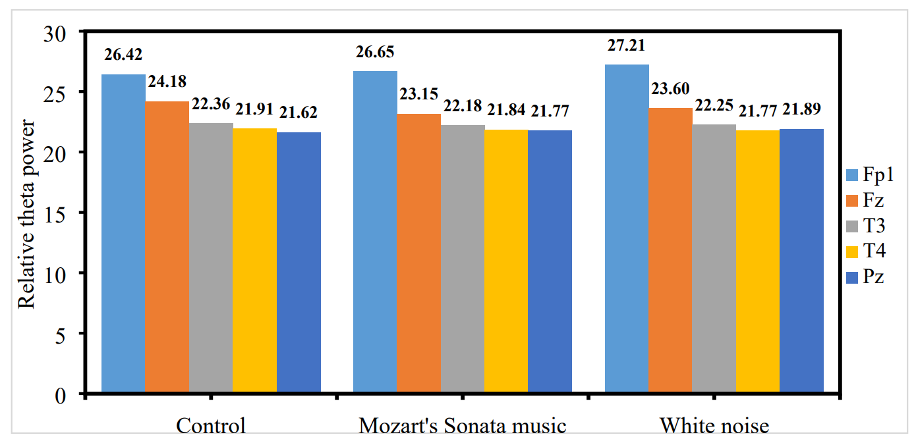
Fig. 15. Relative theta power for 2nd level visual assessment at different audio stimulation.

Slide 41
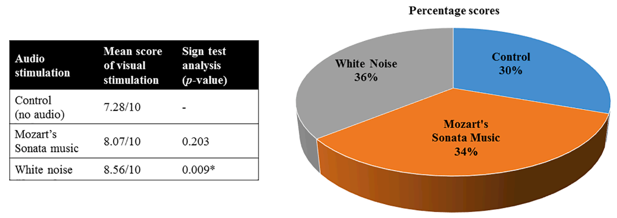
Fig. 16. Score evaluation for 1st level visual stimulation.

Slide 42
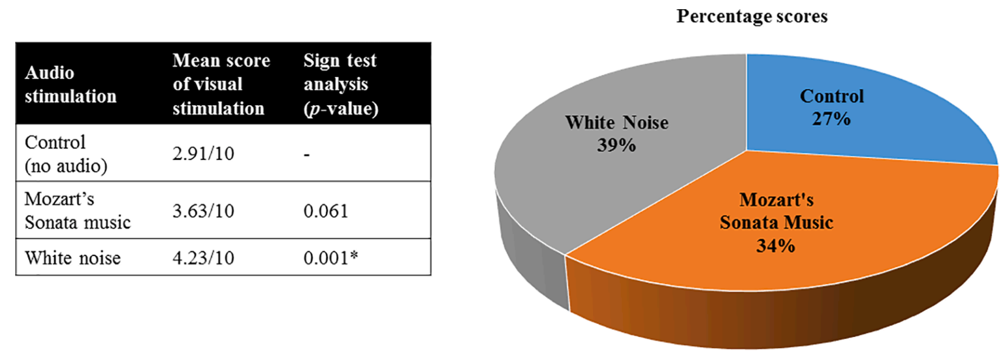
Fig. 17. Score evaluation for 2nd level visual stimulation.

Slide 43
DISCUSSION

Slide 44
VISUAL MEMORY
Visual memory:
One of the vital parts of brain that stores visual information.
Improving visual memory is crucial for increasing the ability to remember or recall previously viewed information such as words, pictures, and activities that have been viewed in the past.
The memory capacities of subjects are determined using
EEG features and assessment test scores.
From score evaluation, the subjects performed better in white noise
stimulation than Mozart’s Sonata music and control condition
at both levels of visual assessment.

Slide 45
SCORE EVALUATION
Sign test analysis revealed the 2nd level had more impact than
the 1st level, which indicates the white noise assists people in
focusing their attention on the job.
Contributing to the increased quantity of items that need to be remembered in the 2nd level.
In comparison to control conditions, both audio stimulation
positively influenced adult memory as their scores are better.

Slide 46
EEG FEATURES
The audiovisual stimulation produced different increasing and
decreasing patterns of mean, standard deviation, and peak-to-peak
amplitude.
Need the relative power of four major types of brain rhythms (alpha, beta, theta, gamma) to realize the effect of stimulation.
The most influential rhythms are theta and alpha,
which exhibit the highest relative power.
The activation of these rhythms may be due to the subjects’ increased internal focus, attention, and awareness in response to stimuli.

Slide 47
EEG FEATURES
White noise stimulation used in the 2nd level visual assessment
gains a lower relative alpha power than others,
indicating that subjects are paying attention to the task.
The sensation disturbs the white noise, necessitating increased concentrate to memorize the items.
In 1st visual evaluation, white noise has the highest relative alpha,
indicating that the subject is in a relaxed and tranquil state
when memorizing the items, as opposed to Mozart’s Sonata music
and the control condition.

Slide 48
EEG FEATURES
Study proved that the quiet condition is not efficient for learning.
The relative alpha power of the control condition was the lowest
among the others, which revealed that the subject feels a little bit distracted or bored.
The relative gamma power was higher in white noise than
Mozart’s Sonata music and control condition, indicating that
visual information captures by eyes can be processed more effectively in white noise at both visual assessment levels.
The relative beta power was greater under audio stimulation than under control, which suggested that subjects were more attentive and concentrated when listening to audio.

Slide 49
EXPLANATION
Mozart’s Sonata is composed of the high organization structure,
which is classified as classical music.
This kind of classical music consists of three characteristics:
eight-bar phrases of harmony
the beats are separated at a fixed tempo
a single composition of various voices and equipment

Slide 50
EXPLANATION
Trion model state that the music modified the neuron’s synaptic
weight in a particular pattern based on Hebbian learning principles,
which believes listening to music can strengthen the neuron firing.
The involvement of noises is usually associated with
stochastic resonance concept or noise improve signaling.
This concept was found in any non-linear dynamic system,
but the newest is observed in the nervous system.
The input information caught by human senses is considered a weak
signal requiring force to make it more detectable. (Soderlund, 2007)
White noise led to the interaction with weak stimuli, which increased the signal-to-noise output.
Stochastic noise improves human sensory discriminability.

Slide 51
FOCUS AND OVERVIEW
This study included three significant strengths.
Revealing the influence of different audio sources such as music and noise on adult visual memory.
(The majority of past research has relied solely on audio-based music or noise genres rather than incorporating both.)
Evaluating the effect of audiovisual stimulation using two parameters which are score performance and EEG analysis,
which offers comprehensive information about the influences.
(Overcoming the constraint of past research which only considers score performance as the major variable.)
Investigating the influence of audios on the difficulty of visual memory test, making the exact impact of audios can be discussed. (Suggesting that listening to white noise can help adults
improve their visual memory, a relatively low-cost method.)

Slide 52
LIMITATIONS
Limitations of this research:
Focusing exclusively on adult visual memory and extracts fewer
types of EEG features.
Future research should consider the influence of white noise and
Mozart’s Sonata music on other cognitive or memory abilities and
on different age groups.
Classifying EEG features into three domains: time domain,
frequency domain, and time–frequency domain should be considered as the addition of extracted features.

Slide 53
CONCLUSION

Slide 54
CONCLUSION
Brain activity and score analysis revealed that audio stimulation
improved visual memory performance when compared to the
control/no audio condition.
Mozart’s Sonata music and white noise receiving the higher score
for visual stimulation, indicating subject’s increased attention,
alertness, and internal focus.
When the number of items increases, white noise stimulation can
help the subject maintain their attention.
(relative beta rhythm associated with attention level)
White noise is the most appropriate type of noise to listen to
while memorizing visual items.
(known by gamma and alpha activation)

Slide 55
THANKS FOR YOUR ATTENTION

