Slide 1
XIV. Walsh Transform (Hadamard Transform)
· 14-A Ideas of Walsh Transforms
• 8-point Walsh transform
• Advantages of the Walsh transform:
(1) Real
(2) No multiplication is required
(3) Some properties are similar to those of the DFT
m
0
1
2
3
4
5
6
7

Slide 2
• Forward and inverse Walsh transforms are similar.
forward: , inverse:
• Alternative names of the Walsh transform:
Hadamard transform, Walsh-Hadamard transform
• Orthogonal Property
• Zero-Crossing Property
Even / Odd Property
Fast Algorithm
Useful for spectrum analysis
Sometimes also useful for implementing the convolution
if m₀ ≠ m₁

Slide 3
Walsh transform 和 DFT, DCT 有許多相似處
, DFT[m, n] = exp(−j2π m n/N),

Slide 4
References for Walsh Transforms
[1] K. G. Beanchamp, Walsh Functions and Their Applications, Academic Press, New York, 1975.
[2] B. I. Golubov, A. Efimov, and V. Skvortsov, Walsh Series and Transforms: Theory and Applications, Kluwer Academic Publishers, Boston, 1991.
[3] H. F. Harmuth, “Applications of Walsh functions in communications,” IEEE Spectrum, vol. 6, no. 11, pp. 82-91, Nov. 1969.
[4] H. F. Harmuth, Transmission of Information by Orthogonal Functions, Springer-Verlag, New York, 1972.

Slide 5
· 14-B Generate the Walsh Transform
2-point Walsh transform
4-point Walsh transform
How do we obtain the 2^{k+1}-point Walsh transform from the 2^{k}-point Walsh transform ?
Step 1
Step 2 根據 sign changes 將 rows 的順序重新排列

Slide 6
已知 每個 row 的 sign change 數，由上到下分別為
0, 1, 2, 3, ….., 2^{k}−1
則 每個 row 的 sign change 數，由上到下分別為
0, 3, 4, 7, ….., 2^{k+1}−1, 1, 2, 5, 6, ….., 2^{k+1}−2,
若 row 的index 由0 開始
則 第 n 個 row (n is even and n < N/2) 的 sign change 為 2n
(n is odd and n < N/2) 的 sign change 為 2n + 1
(n is even and n ≥ N/2) 的 sign change 為 2n+1−N
(n is odd and n ≥ N/2) 的 sign change 為 2n−N
要根據 sign change 的數目將 的 row 重新排列

Slide 7
sign changes
0
3
1
2
sign changes
0
3
4
7
1
2
5
6

Slide 8
Constraint for the number of points of the Walsh transform:
N must be a power of 2 (2, 4, 8, 16, 32, ……..)
Although in Matlab it is possible to define the 12 ⋅2^{k} point or the 20 ⋅2^{k} point Walsh transform, the inverse transform require the floating-point operation.

Slide 9
· 14-C Alternative Forms of the Walsh Transform
標準定義
from zero-crossing
• Sequency ordering (i.e., Walsh ordering) ……. using for signal processing
• Dyadic ordering (i.e., Paley ordering) ………... using for control
• Natural ordering (i.e., Hadamard ordering) ……using for mathematics
Sequency ordering | Dyadic ordering | Natural ordering | W[m, n]
 | (Gray Code) | (Bit Reversal)
row 0 = | row 0 = | row 0 = | [1, 1, 1, 1, 1, 1, 1, 1]
row 1 = | row 1 = | row 4 = | [1, 1, 1, 1, −1, −1, −1, −1]
row 2 = | row 3 = | row 6 = | [1, 1, −1, −1, −1, −1, 1, 1]
row 3 = | row 2 = | row 2 = | [1, 1, −1, −1, 1, 1, −1, −1]
row 4 = | row 6 = | row 3 = | [1, −1, −1, 1, 1, −1, −1, 1]
row 5 = | row 7 = | row 7 = | [1, −1, −1, 1, −1, 1, 1, −1]
row 6 = | row 5 = | row 5 = | [1, −1, 1, −1, −1, 1, −1, 1]
row 7 = | row 4 = | row 1 = | [1, −1, 1, −1, 1, −1, 1, −1]

Slide 10
• Dyadic ordering Walsh transform
• Natural ordering Walsh transform

Slide 11
• binary code to gray code
When N = 2^{k}
g_{k} = b_{k}, g_{q} = XOR(b_{q+1}, b_{q}) for q = k −1, k −2, …., 1
• gray code to binary code
When N = 2^{k}
b_{k} = g_{k}, b_{q} = XOR(b_{q+1}, g_{q}) for q = k −1, k −2, …., 1

Slide 12
· 14-D Properties
(1) Orthogonal Property
(2) Zero-Crossing Property
(3) Even / Odd Property
(4) Linear Property
If f[n] ⇒ F[m], g[n] ⇒ G[m], (⇒ means the Walsh transform)
then a f[n] + b g[n] ⇒ a F[m] + b G[m]

Slide 13
(5) Addition Property
註： Addition modulo 2 (denoted by ⊕)
0 ⊕ 0 = 1 ⊕ 1 = 0, 0 ⊕ 1 = 1 ⊕ 0 = 1,
Example: , therefore 3 ⊕ 7 = 4
⊕
⊕: logic addition
(similar to XOR)

Slide 14
(6) Special functions
δ[n] = 1 when n = 0, δ[n] = 0 when n ≠ 0
δ[n] ⇒ 1, 1 ⇒ N⋅δ[n]
(7) Shifting property
If f[n] ⇒ F[m], then f[n ⊕ k] ⇒ W(k, m)⋅F[m]
(8) Modulation property
If f[n] ⇒ F[m], then W(k, n)⋅f[n] ⇒ F[m ⊕ k]
(9) Parseval’s Theorem
If f[n] ⇒ F[m], If f[n] ⇒ F[m], g[n] ⇒ G[m],

Slide 15
(10) Convolution Property
If f[n] ⇒ F[m], g[n] ⇒ G[m],
then h[n] = f[n] ⬆ g[n] ⇒ F[m] G[m]
⬆ means the “logical convolution”
h[n] = f[n] ⬆ g[n] =
f[n] ⬆ g[n] =
W : Walsh transform
W⁻¹ : inverse Walsh transform
For example, when N = 8,
h[3] = f[0]g[3] + f[1]g[2] + f[2]g[1] + f[3]g[0] + f[4]g[7] + f[5]g[6] + f[6]g[5]
+ f[7]g[4]
h[2] = f[0]g[2] + f[1]g[3] + f[2]g[0] + f[3]g[1] + f[4]g[6] + f[5]g[7] + f[6]g[4]
+ f[7]g[5]

Slide 16
Comparison：In digital signal processing, we often use
linear convolution (standard form of convolution)
circular convolution
For example, when N = 8,
H[3] = f[0]g[3] + f[1]g[2] + f[2]g[1] + f[3]g[0] + f[4]g[7] + f[5]g[6] + f[6]g[5]
+ f[7]g[4]
H[2] = f[0]g[2] + f[1]g[1] + f[2]g[0] + f[3]g[7] + f[4]g[6] + f[5]g[5] + f[6]g[4]
+ f[7]g[3]

Slide 17
· 14-E Butterfly Fast Algorithm
(Method 1) John L. Shark’s Algorithm
x[0]
x[1]
x[2]
x[3]
x[4]
x[5]
x[6]
x[7]
X[0]
X[7]
X[3]
X[4]
X[1]
X[6]
X[2]
X[5]
-1
-1
-1
-1
-1
-1
-1
-1
-1
-1
-1
-1

Slide 18
(Method 2) Manz’s Sequence Algorithm
x[0]
x[4]
x[2]
x[6]
x[1]
x[5]
x[3]
x[7]
X[0]
X[1]
X[2]
X[3]
X[4]
X[5]
X[6]
X[7]
-1
-1
-1
-1
-1
-1
-1
-1
-1
-1
-1
-1
There are other fast implementation algorithm for the Walsh transform.

Slide 19
· 14-F Applications
Walsh transform 適合作 spectrum analysis，但未必適合作convolution
Applications of the Walsh transform
Bandwidth reduction
High resolution
Modulation and Multiplexing
Information coding
Feature extraction
ECG signal (in medical signal processing) analysis
Hadamard spectrometer
Avoiding quantization error
may not be better than DFT, DCT

Slide 20
The Walsh transform is suitable for the function that is a combination of Step functions
New Applications: CDMA (code division multiple access)

Slide 21
· 14-G Jacket Transform
把部分的 1 用 取代
4-point Jacket transform
2^{k+1}-point Jacket
P: row permutation
[Ref] M. H. Lee, “A new reverse Jacket transform and its fast algorithm,” IEEE Trans. Circuits Syst.-II , vol. 47, pp. 39-46, 2000.

Slide 22
· 14-H Haar Transform
N = 2
N = 4
N = 8
[Ref] H. F. Harmuth, Transmission of Information by Orthogonal Functions, Springer-Verlag, New York, 1972

Slide 23
N = 16

Slide 24
H[m, n] 的值 (m = 0, 1, …, 2^{k} −1, n = 0, 1, …, 2^{k} −1)：
H[0, n] = 1 for all n
If 2^{h} ≤ m < 2^{h+1}
H[m, n] = 1 for (m − 2^{h})2^{k−h} ≤ n < (m − 2^{h} +1/2)2^{k−h}
H[m, n] = −1 for (m − 2^{h} +1/2)2^{k−h} ≤ n < (m − 2^{h} +1)2k^{−h}
H[m, n] = 0 otherwise
運算量比 Walsh transforms 更少
Applications: localized spectrum analysis, edge detection
Transforms | Running Time | terms required for NRMSE < 10⁻⁵
DFT | 9.5 sec | 43
Walsh Transform | 2.2 sec | 65
Haar Transform | 0.3 sec | 128

Slide 25
Main Advantage of the Haar Transform
(1) Fast (but this advantage is no longer important)
(2) Analysis of the local high frequency component
(The wavelet transform is a generalization of the Haar transform)
(3) Extracting local features
(Example: Adaboost face detection)

Slide 26
附錄十六 SCI Papers 查詢方式
我們經常聽到 SCI 論文，impact factor….那麼什麼是 SCI 和 impact factor？什麼樣的論文是 SCI Papers? Impact factor 號如何查詢？
SCI 全名： Science Citation Index
(A) SCI 相關網站：ISI Web of Knowledge
連結至 ISI Web of Knowledge
http://admin-apps.webofknowledge.com/JCR/JCR?RQ=HOME
註：必需要在台大上網，或是在其他有付錢給 ISI 的學術單位上網，
才可以使用 ISI Web of Knowledge

Slide 27
(B) 在 Go to Journal Profile
輸入你想查詢的期刊 (完整名稱)
輸入

Slide 28
若有搜尋到，則代表這個期刊是 SCI 期刊
並且會顯示出這個期刊的 impact factor
Impact Factor (影響係數)

Slide 29
(C) 關於 impact factor (影響係數)：
若一個 journal 裡面的文章，被別人引用的次數越多，則這個 journal 的 impact factor 越高
一般而言， impact factor 在 3.5 以上的 journals，已經算是高水準的期刊
中等水準的期刊的 impact factors 在 1.5 到 3.5 之間
Nature 的 impact factor 為 49.962
Science 的 impact factor 為 47.728
IEEE 系列的期刊的 impact factors 通常在 2 到 13 之間

Slide 30
(D) 要查詢一個領域有哪些 SCI journals
連結至 ISI Web of Knowledge 之後，點選 「Browse Category」

Slide 31
再選擇要查詢的 category，如

Slide 32
(E) EI (Engineering Village)
官方網站： www.engineeringvillage.org
http://www.engineeringvillage.com/search/quick.url
查詢期刊或研討會是否為 EI
http://tul.blog.ntu.edu.tw/archives/4627
(F) SSCI (Social Science Citation Index)
比較偏向於社會科學
http://www.thomsonscientific.com/cgi-bin/jrnlst/jloptions.cgi?PC=J

Slide 33
(G) Conference 排名
Microsoft Academic Search 有列出各領域知名的 conferences 並加以排名
(大致上也是被引用越多的排名越前面)
和通訊與信號處理相關的 conferences，大多排名於
http://academic.research.microsoft.com/RankList?entitytype=3&topDomainID=2&subDomainID=0&last=0&start=1&end=100
或
http://academic.research.microsoft.com/RankList?entitytype=3&topDomainID=8&subDomainID=0&last=0&start=1&end=100

Slide 34
(H) H Index
論文除了量以外，也要注意 citation 的次數
將發表的論文的 citation 次數從高到低做排序
如果排名第 N 名的論文 citation 數量大於等於 N
但是排名第 N+1名的論文 citation 數量小於等於 N+1
則 H index = N
Example: 假設有一個學者發表了10篇論文， citation 由多到少分別為
33, 24, 18, 13, 9, 7, 4, 3, 1, 1
則這個學者的 H-index 為 6

Slide 35
寫論文和投稿的經驗談
研究生經常會寫論文並且投稿。要如何讓論文投稿之後能夠順利的被接受，相信是同學們所期盼的，畢竟每篇論文都是大家花了不少時間的心血結晶，若論文能夠順利的被接受，也代表了自己的成果總算獲得了肯定。然而，影響論文是否被接受的因素很多，一個好的研究成果，還是配合好的編寫技巧，才可以被一流的期刊或研討會所接受。以下是個人關於論文編寫與投稿的經驗談：
(1) 你的論文的「賣點」(優點) 是什麼？人家有沒有辦法一眼看得出來你論文的「賣點」？
寫論文其實就是在推銷商品，而所謂的「商品」，就是你的「研究成果」。要說服人家接受你的商品，首先就是要強調你的商品的「賣點」。
(2) 和既有的方法的比較是否足夠？
要證明你所提出的方法是有效的，最好的方式，就是和既有的方法相比較，而且比較的對象越多越好，越新越好。

Slide 36
(3) 和前人的方法相比，你的方法創新的地方在何處？ 審稿者是否能看得出來你論文創新的地方？
(4) 就算你的文章和理論相關，最好也多提出實際應用的例子
(5) 參考資料越多越好，越新越好
(在研究一個領域時，論文 survey 的量要足夠)
(6) Previous work (前人已經提出的概念) 精簡介紹即可，多強調自己的貢獻。Introduction 加上 Previous work 最好不要超過一篇論文的四分之一
(7) 英文表達能力要有一定的水準

Slide 37
(8)可以多用數學式和圖來解釋概念，有時會比文字還清楚
通常東方人英文表達能力有限。審稿者經常會看你們的圖表和數學式(而非文字) 來判斷你們論文的品質
(9) 同樣的道理，可以用「條列式」的方式來取代一大段文字來描述方法的觀念、流程、或優點
(10) 可以用 Conference 的期限來要求自己多寫研討會論文，之後再陸續改成期刊論文投稿，如此一年的論文量將很可觀
(11)多注意格式，不同的期刊或研討會，對格式的要求也不同
(12) 最後，問自己一個問題：
如果你是審稿者，你會滿意你寫的這一篇論文嗎？
若答案是肯定的再投稿

Slide 38
XV. Orthogonal Transform and Multiplexing
· 15-A Orthogonal and Dual Orthogonal
Any M × N discrete linear transform can be expressed as the matrix form:
Y = A X
inner product

Slide 39
Orthogonal:
when k ≠ h
orthogonal transforms 的例子：
• discrete Fourier transform
• discrete cosine, sine, Hartley transforms
• Walsh Transform, Haar Transform
• discrete Legendre transform
discrete orthogonal polynomial transforms
Hahn, Meixner, Krawtchouk, Charlier

Slide 40
為什麼在信號處理上，我們經常用 orthogonal transform?
Orthogonal transform 最大的好處何在？

Slide 41
e₁ and e₂ are orthogonal
v = (2,2)
e₂ = (0,1)
e₁ = (1,0)
e₃ and e₄ are not orthogonal
v = (2,2)
e₄ = (0,1)

Slide 42
• If partial terms are used for reconstruction
for orthogonal case,
perfect reconstruction:
partial reconstruction:
K < N
reconstruction error of partial reconstruction
由於 一定是正的，可以保證 K 越大, reconstruction error 越小

Slide 43
For non-orthogonal case,
perfect reconstruction:
partial reconstruction:
B = A⁻¹
K < N
reconstruction error of partial reconstruction
由於 不一定是正的，
無法保證 K 越大, reconstruction error 越小

Slide 44
· 15-B Frequency and Time Division Multiplexing
傳統 Digital Modulation and Multiplexing：使用 Fourier transform
• Frequency-Division Multiplexing (FDM)
X_{n} = 0 or 1
X_{n} can also be set to be −1 or 1
When (1) t ∈ [0, T] (2) f_{n} = n/T
it becomes the orthogonal frequency-division multiplexing (OFDM) in the continuous case.

Slide 45
Furthermore, if the time-axis is also sampled
t = mT/N, m = 0, 1, 2, ….., N−1
t ∈ [0,T] sampling for t-axis
(OFDM in the discrete case)
then the OFDM is equivalent to the transform matrix of the inverse discrete Fourier transform (IDFT), which is one of the discrete orthogonal transform.
Modulation:

Slide 46
Modulation:
Demodulation:
Example: N = 8
X_{n} = [1, 0, 1, 1, 0, 0, 1, 1] (n = 0 ~ 7)

Slide 47
• Time-Division Multiplexing (TDM)
(also a discrete orthogonal transform)

Slide 48
思考：
既然 time-division multiplexing 那麼簡單
那為什麼要使用 frequency-division multiplexing
和 orthogonal frequency-division multiplexing (OFDM)?

Slide 49
· 15-C Code Division Multiple Access (CDMA)
除了 frequency-division multiplexing 和 time-division multiplexing，是否還有其他 multiplexing 的方式？
使用其他的 orthogonal transforms 即 code division multiple access (CDMA)
CDMA is an important topic in spread spectrum communication
參考資料
[1] M. A. Abu-Rgheff, Introduction to CDMA Wireless Communications, Academic, London, 2007
[2] 邱國書, 陳立民譯, “CDMA 展頻通訊原理,” 五南, 台北, 2002.

Slide 50
CDMA 最常使用的 orthogonal transform 為 Walsh transform
channel 1
channel 2
channel 3
channel 4
channel 5
channel 6
channel 7
channel 8
channel 1
channel 2

Slide 51
當有兩組人在同一個房間裡交談 (A 和B交談)， (C 和D交談) ，
如何才能夠彼此不互相干擾？
(1) Different Time
(2) Different Tone
(3) Different Language

Slide 52
CDMA 分為：
(1) Orthogonal Type (2) Pseudorandom Sequence Type
Orthogonal Type 的例子： 兩組資料 [1, 0, 1] [1, 1, 0]
(1) 將 0 變為 −1 [1, −1, 1] [1, 1, −1]
(2) 1, −1, 1 modulated by [1, 1, 1, 1, 1, 1, 1, 1] (channel 1)
→ [1, 1, 1, 1, 1, 1, 1, 1, -1, -1, -1, -1, -1, -1, -1, -1, 1, 1, 1, 1, 1, 1, 1, 1]
1, 1, −1 modulated by [1, 1, 1, 1, -1, -1, -1, -1] (channel 2)
→ [1, 1, 1, 1, -1, -1, -1, -1, 1, 1, 1, 1, -1, -1, -1, -1, -1, -1, -1, -1, 1, 1, 1, 1]
(3) 相合
[2, 2, 2, 2, 0, 0, 0, 0, 0, 0, 0, 0, -2, -2, -2, -2, 0, 0, 0, 0, 2, 2, 2, 2]

Slide 53
demodulation
[2, 2, 2, 2, 0, 0, 0, 0, 0, 0, 0, 0, -2, -2, -2, -2, 0, 0, 0, 0, 2, 2, 2, 2]
[1, 1, 1, 1, 1, 1, 1, 1]
[1, 1, 1, 1, 1, 1, 1,1]
[1, 1, 1, 1, 1, 1, 1, 1]
內積 = 8

Slide 54
注意：
(1) 使用 N-point Walsh transform 時，總共可以有N 個 channels
(2) 除了 Walsh transform 以外，其他的 orthogonal transform 也可以使用
(3) 使用 Walsh transform 的好處

Slide 55
• Orthogonal Transform 共通的問題: 需要同步 synchronization
R₁ = [ 1, 1, 1, 1, 1, 1, 1, 1]
R₂ = [ 1, 1, 1, 1, −1, −1, −1, −1]
R₅ = [ 1, −1, −1, 1, 1, −1, −1, 1]
R₈ = [ 1, −1, 1, −1, 1, −1, 1, −1]
但是某些 basis, 就算不同步也近似 orthogonal
<R₁[n], R₁[n]> = 8, <R₁[n], R_{k}[n]> = 0 if k ≠ 1
<R₁[n], R_{k}[n−1]> = 2 or 0 if k ≠ 1.
這裡的shift為circular shift

Slide 56
CDMA 的優點：
(1) 運算量相對於 frequency division multiplexing 減少很多
(2) 可以減少 noise 及 interference的影響
(3) 可以應用在保密和安全傳輸上
(4) 就算只接收部分的信號，也有可能把原來的信號 recover 回來
(5) 相鄰的區域的干擾問題可以減少

Slide 57
相鄰的區域，使用差距最大的「語言」，則干擾最少
B 區
A 區
假設 A 區使用的 orthogonal basis 為 φ_{k}[n], k = 0, 1, 2, …, N−1
B 區使用的 orthogonal basis 為 μ_{h}[n], h = 0, 1, 2, …, N−1
設法使
為最小
k = 0, 1, 2, …, N−1, h = 0, 1, 2, …, N−1

Slide 58
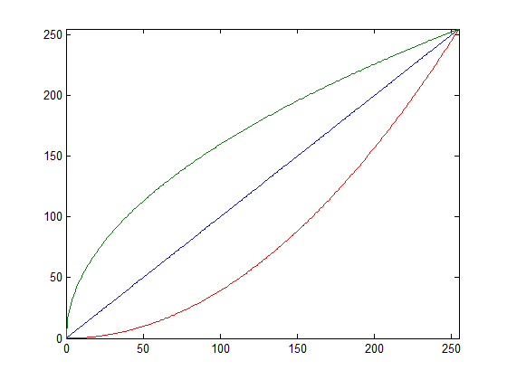
附錄十七 常用的影像修飾方法
(1) Lightening and Darkening
Input
YCbCr
Y_{o} = f(Y)
Output
RGB to YCbCr
Cb unchanged
Cr unchanged
YCbCr to RGB
Example:
α = 0.5
α < 1: lightening
α = 2
α > 1: darening

Slide 59
附錄十七 常用的影像修飾方法
original image
lighten
darken
original image
lighten
darken

Slide 60
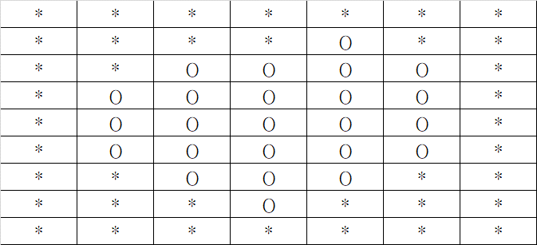
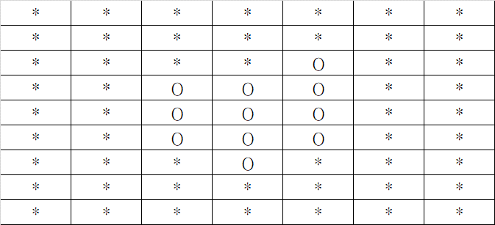
附錄十七 常用的影像修飾方法
(2) Morphology
(2-1) Erosion
(去除區域外圍)
Erosion for a Non-binary Image

Slide 61
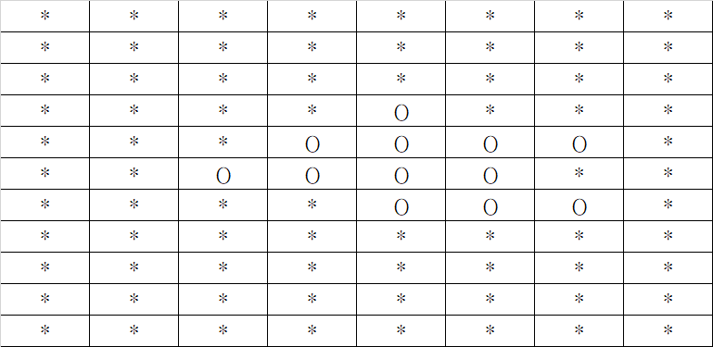
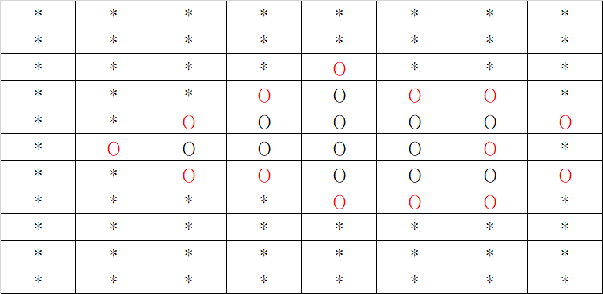
附錄十七 常用的影像修飾方法
(2-2) Dilation
(擴大區域)
Dilation for a Non-binary Image

Slide 62
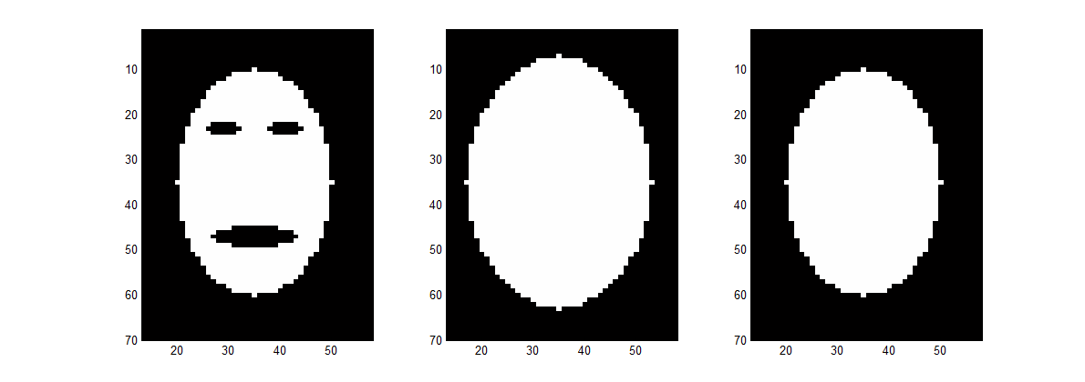
附錄十七 常用的影像修飾方法
(2-3) Closing (Hole Filling)
closing = dilation k times + erosion k times
input
dilation 3 times
then erosion 3 times

Slide 63
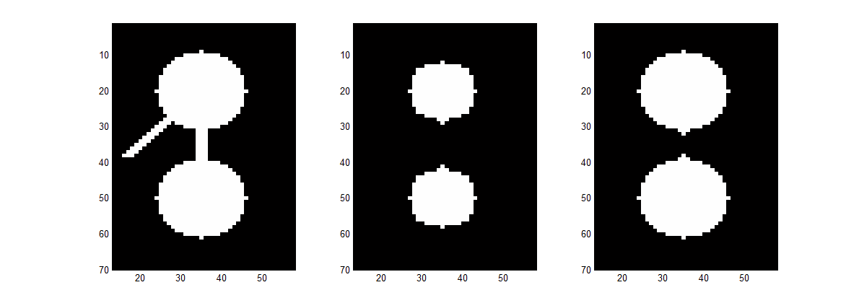
附錄十七 常用的影像修飾方法
(2-4) Opening
opening = erosion k times + dilation k times
input
erosion 3 times
then dilation 3 times

Slide 64
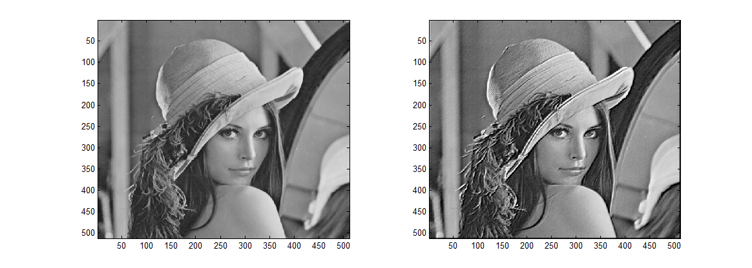
附錄十七 常用的影像修飾方法
(3) Edge enhancement
Original image
With edge enhancement

Slide 65
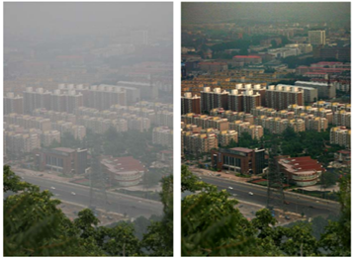
附錄十七 常用的影像修飾方法
(4) Dehaze (除霧)
He, Kaiming, Jian Sun, and Xiaoou Tang. "Single image haze removal using dark channel prior." IEEE Trans. Pattern Anal. Mach. Intell., vol. 33, pp. 2341-2353 , 2011.

Slide 66
附錄十七 常用的影像修飾方法
Haze Model
J(x): scene, I(x): observed image
t(x): transmission, A: intensity for the whole-haze case
A(1- t(x)): airlight
定義 dark channel J^{dark}(x)
Ω(x) : some patch (a small region)
Dark channel 為一個影像在一個小範圍區域當中，RGB 的最小值
一個正常影像的 dark channel 大多近於 0
一個受 haze 影響的影像，dark channel 常常不為 0

Slide 67
附錄十七 常用的影像修飾方法
Dehaze 的方法與流程
find the transmission t(x)
A: the 95% largest intensity of I(x)
recover the original image
He, Kaiming, Jian Sun, and Xiaoou Tang. "Single image haze removal using dark channel prior." IEEE Trans. Pattern Anal. Mach. Intell., vol. 33, pp. 2341-2353 , 2011.

Slide 68
期末的勉勵
• 人生難免會有挫折，最重要的是，我們面對挫折的態度是什麼
• 長遠的願景要美麗，短期的目標要務實

Slide 69
祝各位同學暑假愉快！
各位同學在研究上或工作上，有任何和 digital signal processing 或 time frequency analysis 方面的問題，歡迎找我來一起討論。

