Slide 1
時頻分析和小波轉換期末報告
R12942023
電信所
余佩真

Slide 2
Abnormality Detection in Cardiac Signals using Pseudo Wigner-Ville Distribution with Pre-trained Convolutional Neural Network
M. Zulfiqar, M. F. U. Butt, A. Rama and I. Shafi, "Abnormality Detection in Cardiac Signals using Pseudo Wigner-Ville Distribution with Pre-trained Convolutional Neural Network," 2019 13th International Conference on Signal Processing and Communication Systems (ICSPCS), Gold Coast, QLD, Australia, 2019, pp. 1-5, doi: 10.1109/ICSPCS47537.2019.9008601.

Slide 3
Abstract
Here, we propose a time-frequency (TF) and convolution neural network (CNN) based approach for identification and classification of abnormalities in ECG. The proposed methodology applies Pseudo Wigner-Ville Distribution (PWVD) on nonstationary ECG signals to obtain high resolution images and defining the signal in both time and frequency domains. The images train the multi-layer Convolution Neural Network (CNN) for classification. On testing, signatures of five abnormalities have been detected in ECG signals with high accuracy of 98.9%. The technique will facilitate the doctors to accurately diagnose and classify disease symptoms of cardiac patients.

Slide 4
Introduction
Interpretation of an ECG signal depends on frequency, shape, size, interaction and occurrence timing of the waves. Currently, cardiologists identify any abnormality in the cardiac signal by inspecting the ECG.
ECG signal has high inter-patient variations, which makes its general purpose pattern learning and modeling infeasible. ECG components QRS complex, RR intervals and P waves vary under different circumstances even for a healthy subject.

Slide 5
Introduction
In nature, ECG is a multi-component and nonstationary (NS) signal. In case of arrhythmia, ECG components are often not well defined and their detection and extraction becomes ambiguous. Cardiac signal has a complex time and frequency structure, which corresponds to multi-component diagnostic area. For nonstationary signals like ECG, time-frequency (TF) analysis provides effective spectral as well as temporal contents along with the time variations and frequency bands. TF simultaneously analyzes low frequency and high-frequency components of the cardiac signal. As compared to conventional methods which process the data in short intervals, TF analysis analyzes the data in long intervals which increases the probability of detecting arrhythmia in ECG signals.

Slide 6
Introduction
Several TF analysis techniques have already been developed. In Short Time Fourier Transform (STFT) the signal is decomposed into its sinusoidal components. For a short period of time, STFT considers the signal as a stationary signal. In STFT many short windows are constructed by which the signal is multiplied and Fourier Transform is applied to it. However, the main disadvantage of STFT is that its analysis window contains only frequency resolution. Hence, we have to make a trade-off between frequency and time resolution. TF techniques such as Wigner-Ville Distribution (WVD) and Continuous Wavelet Transform (CWT) are able to resolve this issue.
CWT has time-scale localization property which makes it a better tool to deal with transient and rapid changes in NS signals. Instead of STFT, CWT has variable window which provides finefrequency at high time resolution but still has a tradeoff between frequency and time resolution.

Slide 7
Introduction
While, in case of NS, WVD is able to provide high TF resolution. For the classification of an ECG signal, features are selected and then fed to discriminative or generative models. Polat et al has used Support Vector Machine (SVM) for the classification of normal and abnormal signals. For the prediction of new series, these techniques require extensive computation. Since, Shallow networks like Machine Learning (ML) algorithms are not capable enough to operate multidimensional data sets. While in Deep learning (DL), CNNs have strong capabilities to learn features which makes them ideal to process multidimensional data.
In 2017, implemented Novel Neural Network with accuracy of 82% which was able to classify 3 classes. Qayyum et al. Implemented CNN in combination with STFT to classify 2 classes and achieved accuracy of 97.89%.
In 2018, Li et al. implemented convolution neural network with distance distribution matrix to classify an ECG signal and achieved 81.9% accuracy. Their technique was dependent on handed coded features. Acharya et al. classified 2 classes with 11 layers’ deep CNN and achieved accuracy of 98.97%.

Slide 8
Introduction
Following are the novel contributions of our paper:
The proposed methodology in this paper addresses the limitations in existing methods by detecting abnormalities in the presence of high inter-patient variations (QRS complex, RR intervals and P waves) without manually extracting features.
The proposed methodology applies Pseudo WignerVille Distribution (PWVD) on non-stationary ECG signals to obtain high resolution images defining signal in both time and frequency domains. Images will train a pre-trained CNN which will automatically extract the features and classify them.
Our proposed technique consists of TF distribution along with pre-trained CNN. It classifies five classes namely; Atrial Fibrillation (AFIB), Bigeminy, Left Bundle Branch blocks (LBBB), Normal Sinus Rhythm (NSR), Right Bundle Branch block (RBBB) with accuracy of 98.9%.

Slide 9
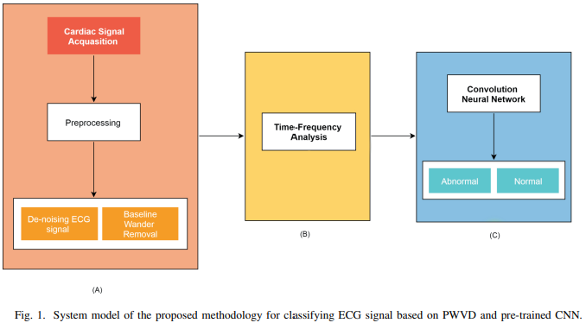
System model

Slide 10
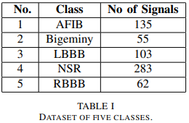
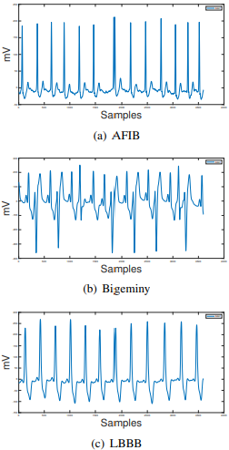
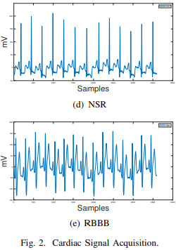
System model
Cardiac Signal Acquisition
ECG has been divided into segments and intervals directly related to cardiac conduction phases and conditions have been set for diagnosing abnormalities. ECG signals are recorded at 360 Hz with gain of 200 adu mV . Duration of each signal is 10 seconds with 3600 samples. Signals are acquired from lead 1. The dataset is in .mat format. In this stage, Median Filter is designed to eliminate power-line interference and to suppress low frequency baseline wandering. Fig. 2 shows the acquisition of cardiac signal in five classes.

Slide 11
System model
Time-Frequency Analysis
Each signal has been converted into time-frequency domain using PWVD and fed into the pre-trained CNN model for classifying ECG wave rhythms. WVD is the most suitable method for analyzing and processing NS signals for many applications in time-frequency distributions (TFD). TFD is formulated as:

Slide 12
System model
WVD has following properties:
WVD provides high-resolution representation of non-stationary signals in both time and frequency domain.
WVD has special characteristics of satisfying time and frequency margins in terms of energy spectrum in frequency and instantaneous power in time.
First conditional frequency moment at given time is the derivative of signal phase at that time.

Slide 13
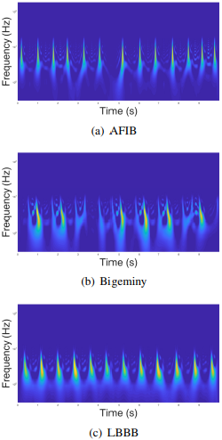
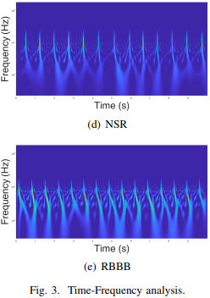
System model
As WVD is a bilinear distribution which causes crossterms. In order to reduce the cross-terms and to attain a better TF resolution soothing window, PWVD is applied which is defined as:

Slide 14
System model
Classification
For classification, pre-trained network GoogLeNet is used which is 22 layers deep when only layers with parameters are counted. GoogLeNet has nine inception layers. Inception layer covers a larger area in image while keeping resolution good for the small information. Convolution operations are performed in parallel at different sizes from 1×1, which is one of the most accurate in comparison to 5×5.
Here, performing convolution with filter of size 1×1 reduces number of feature maps by reducing the computation requirements. First, inception performs convolutions with 1×1 and then with different sizes. Furthermore, in order to summarize the content of the previous layer max pooling has been added and on the next layer, all the results are concatenated. In the middle of GoogLeNet structure, two auxiliary classifiers were used in order to avoid any gradient problem during learning.

Slide 15
System model
Divide into Training and Validation Data: The dataset is randomly divided into 3 groups one for network training, second one for validation and third one for Testing. For training and validation, 70% and 15% data is used, respectively. While another 15% data is used to test the network.
Modify GoogLeNet Network Parameters: In network architecture each layer can be considered as a filter. Common features of images, such as edges, colors and blobs are identified in earlier layers. Later layers focus on specific features to differentiate categories. To retrain GoogLeNet to ECG classification problem, the last four layers are modified to a dropout layer with probability of 60%, fully connected layer, softmax layer and a classification output layer.
Set Training Options and Train GoogLeNet: Neural network training is an iterative process involving minimizing loss function. In order to minimize loss function, the gradient descent algorithm is used. Gradient of the loss function is evaluated in each iteration and weights of descent algorithm are updated. Training can be adjusted by setting different options. InitialLearnRate sets initial step size in the direction of negative gradient of loss function. MiniBatchSize sets size of a training subset to be used in each iteration. MaxEpochs sets the maximum number of epochs to be used to train. The parameter values of MiniBatchSize is 10, MaxEpochs is 35, and InitialLearnRate is 0.0001.

Slide 16
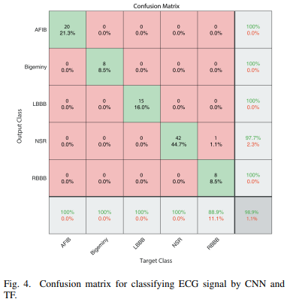
Results

Slide 17
Conclusion
TF representation is used to generate 2D images which describe signal in frequency domain along with time domain. The proposed methodology applies PWVD for the first time on non-stationary ECG signals to obtain high resolution images. Pre-trained CNN is then used to automatically extract features from images and perform classification. Five classes are classified which are AFIB, Bigeminy, LBBB, NSR and RBBB. The obtained results are also compared with recent state-of-the-art approaches. The proposed algorithm has the potential to be extended to classify other arrhythmias of heartbeat. More features from TF matrix relevant to ECG signal can be studied in order to classify more classes.

