Slide 1
High and Low Frequency Region Separation Method for Adaptive Image Expansion
Authors: Shao-Yun Luo¹, Kuei-Chen Chen ², Jian-Jiun Ding ^{3*}, Cheng-Che Lee ⁴, and Hsin-Jung Lee ⁵
台灣大學電信所甲組R13942008 趙哲聖

Slide 2
Outline
Background and Motivation
Abstract
Evolution of Signal Expansion Techniques
Variety of signal expansion methods in paper
Proposed Algorithm
Edge detection
Morphology
Adapted-DCT
Evaluation
Experiments
Conclusion
Relativity of Lecture

Slide 3
Outline
Background and Motivation
Abstract
Evolution of Signal Expansion Techniques
Variety of signal expansion methods in paper
Proposed Algorithm
Edge detection
Morphology
Adapted-DCT
Evaluation
Experiments
Conclusion
Relativity of Lecture

Slide 4
Abstract
Signal expansion
Traditional methods often suffer from artifacts, especially ringing effects
Develop a new adaptive image expansion framework that considers the frequency characteristics of image region
Separate the image into high-frequency (edge) and low-frequency (smooth) components
Apply adaptive DCT expansion to each region independently, minimizing interference between them

Slide 5
Abstract
edge detection
Adaptive region segmentation
The proposed adaptive DCT expansion effectively reduces
connectivity-based region division
Ringing effects at edges
Reconstruction error in smooth regions

Slide 6
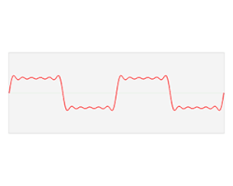
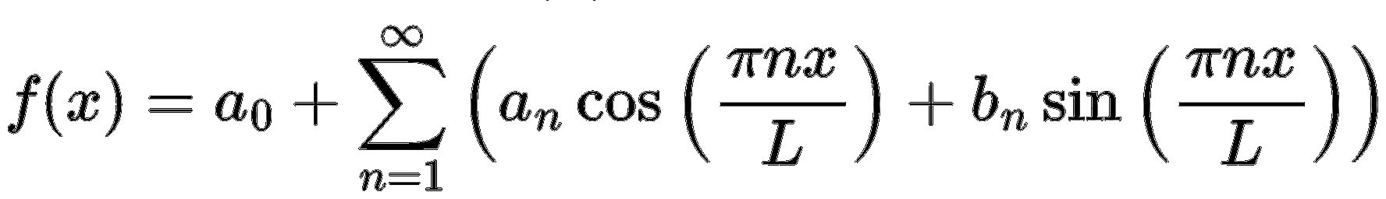
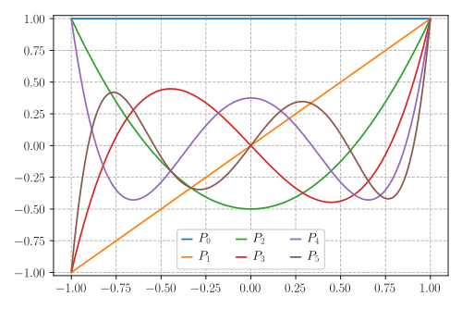
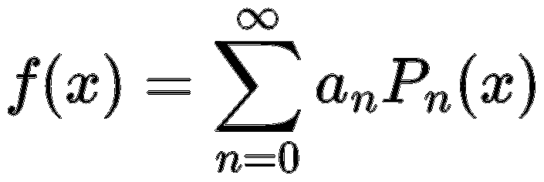
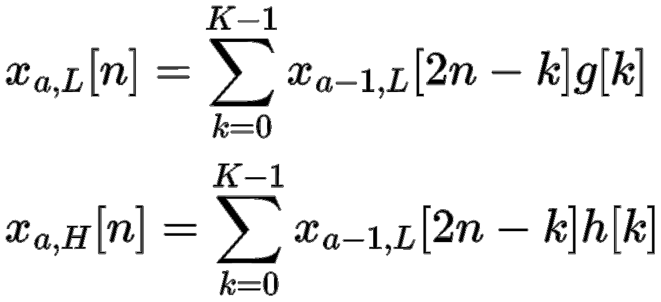
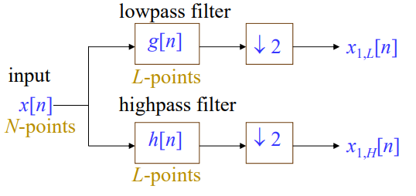
Evolution of Signal Expansion Techniques
Classical expansion techniques
Fourier Series
Legendre Polynomial Expansion
Wavelet Transform (DWT)
Notes:
https://en.wikipedia.org/wiki/Fourier_series https://www.ams.org/journals/mcom/2012-81-278/S0025-5718-2011-02549-4/S0025-5718-2011-02549-4.pdf

Slide 7



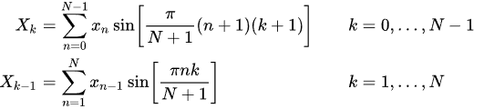



Discrete Cosine Transform (DCT)
Discrete sine transform (DST)
DCT-I
DCT-II
DCT-III
DCT-IV
DCT-I
DCT-II
DCT-III
DCT-IV
Notes:
https://en.wikipedia.org/wiki/Discrete_sine_transform

Slide 8
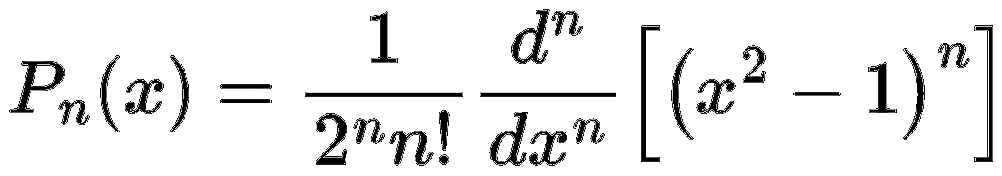
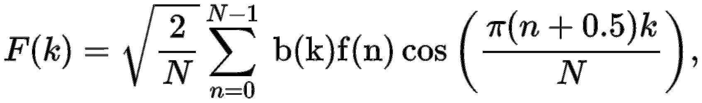

Variety of signal expansion methods in paper
Legendre polynomials
Discrete cosine transform type 2(DCT-II)

Slide 9

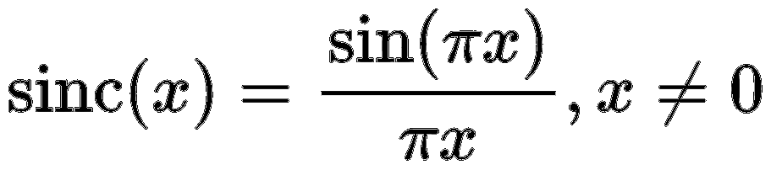
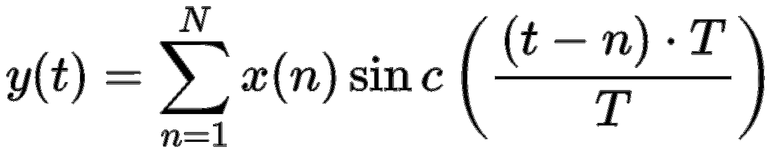
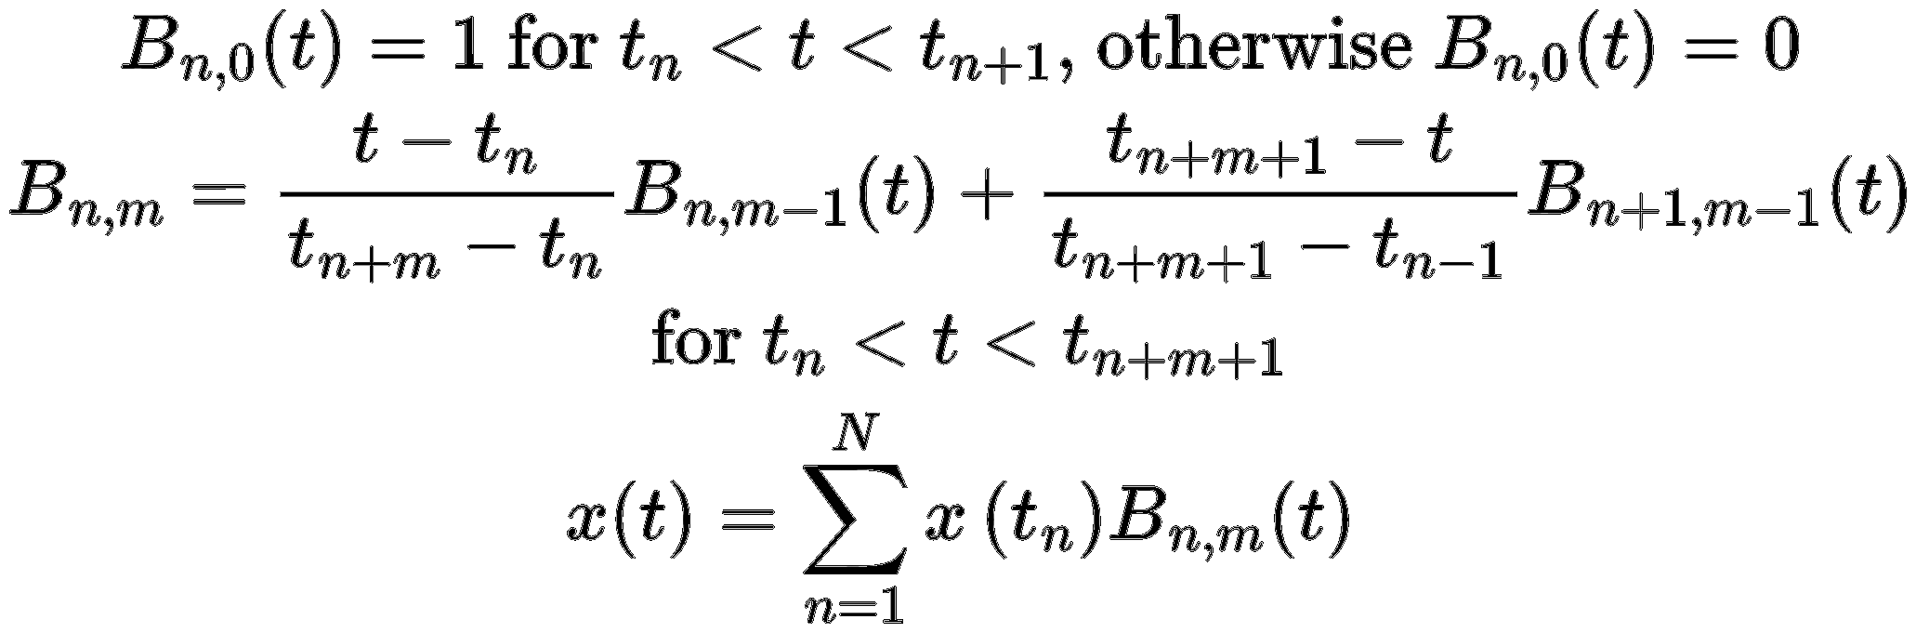
Variety of signal expansion methods in paper
Haar wavelet
Discrete wavelet transform (DWT)
Sinc interpolation
B-splines
Daubechies wavelet

Slide 10
Outline
Background and Motivation
Abstract
Evolution of Signal Expansion Techniques
Variety of signal expansion methods in paper
Proposed Algorithm
Edge detection
Morphology
Adapted-DCT
Evaluation
Experiments
Conclusion
Relativity of Lecture

Slide 11
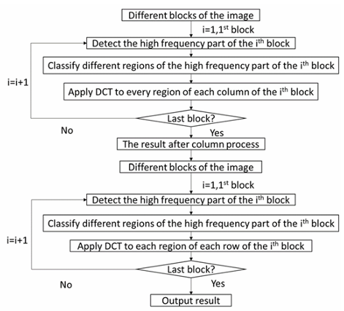
Edge Detection

Slide 12
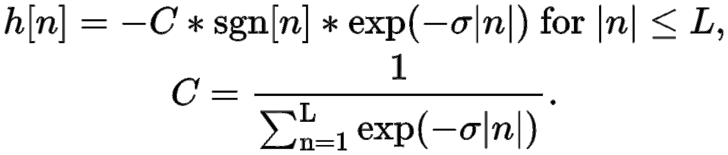

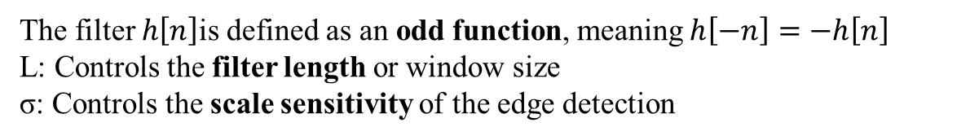
Edge Detection
The decomposition of the image into low- and high-frequency components begins with an edge detection process, where an edge detection filter serves as the frequency separation operator
The filter $h\left[n\right]$is defined as an odd function, meaning $h\left[−n\right]=−h\left[n\right]$
L: Controls the filter length or window size
σ: Controls the scale sensitivity of the edge detection
L=10 & $σ=1$
Notes:
Than we can put them into two cases A larger $σ$helps detect smaller noises or fine edges A smaller $σ$emphasizes sharper or stronger edges

Slide 13
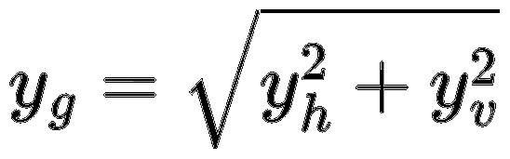


Convolution and Gradient Computation
The algorithm performs convolution on both horizontal and vertical directions of the image signal $y$
captures horizontal changes (vertical edges)
captures vertical changes (horizontal edges)
y_{g} represents the overall edge strength at each pixel

Slide 14
Morphology
Morphological operations are essential in image processing for refining binary or edge maps
erosion
dilation
each pixel value $A\left[m , n\right]$is replaced with the minimum or maximum value among its 4-connected neighborhood (up, down, left, right)
Erosion: Shrinks the bright regions (or edges) by removing pixels at the boundaries
Dilation: Expands the bright regions by adding pixels around the boundaries.
Notes:
Morphological operations are essential in image processing for refining binary or edge maps — they can remove small noise, close gaps, and make the edge structure more distinct.
Erosion: Shrinks the bright regions (or edges) by removing pixels at the boundaries. → It helps eliminate small noisy points or thin unwanted lines.
Dilation: Expands the bright regions by adding pixels around the boundaries. → It helps fill small holes and make the edges thicker and more connected.

Slide 15
Morphology
To further refine the image, erosion and dilation are combined into two compound operations
Closing operation
Opening operation
k1​ and $k_{2}$are adjustable iteration counts that control the intensity of the morphological smoothing

Slide 16
Morphology
After completing these morphological operations, the edges become cleaner and more continuous
High-frequency ➔ Corresponds to edges and fine details
Low-frequency ➔ Represents smooth regions or background areas
The image, with these components clearly separated

Slide 17
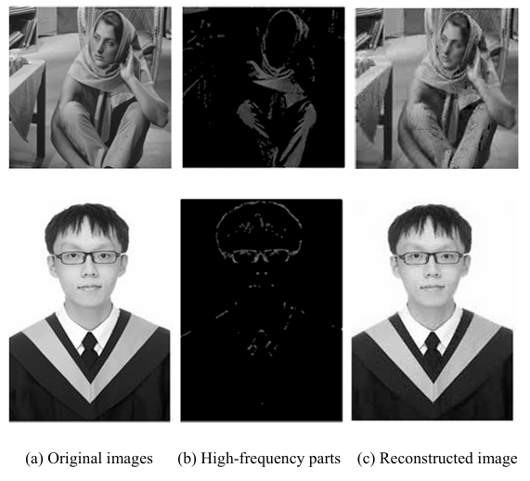
The examples of high frequency part extraction

Slide 18
Adapted-DCT
Adapted-DCT is to improve image compression efficiency by separating frequency components before transformation
Standard DCT treats the image uniformly → inefficient for mixed regions
(but morphological operations allow the image to be separated into structurally meaningful regions)
In adapted-DCT, block size or strategy may vary depending on the region
Smaller blocks for regions rich in texture or edges to capture fine local details)
Larger blocks for smooth regions (to maximize compression efficiency)
To ensure that high-frequency regions are not blurred & low-frequency regions are not overrepresented
Notes:
Alouache, D., Ameur, Z. & Kachi, D. Catadioptric images compression using an adapted neighborhood and the shape-adaptive DCT. Multimed Tools Appl 79, 6781–6797 (2020)

Slide 19
Adapted-DCT
Morphological segmentation
Thresholding Based on Target Ratio
Block partitioning
Reconstruction / Compression Output
Apply DCT per Block
Energy Ranking of Coefficients
Compute cumulative sum ratio:

Slide 20

Adapted-DCT
Compression Strategy
Define target ratio target​
Retain coefficients with largest energy
High-frequency regions → stricter threshold (preserve details)
Low-frequency regions → more aggressive compression
Benefits
Better preservation of edges & textures
Reduced blocking artifacts compared to uniform DCT
Flexible trade-off between compression ratio and visual quality

Slide 21
Evaluation
Evaluation Metrics for Signal and Image Reconstruction
In this study, they evaluate signal reconstruction and compression performance using two main criteria
These matrix jointly method
Cumulative Sum Ratio (CSR)
Structural Similarity (SSIM)
Energy efficiency (frequency-domain)
Visual fidelity (spatial-domain)
Notes:
Cumulative Sum Ratio (CSR) – Energy preservation and coefficient concentration
Structural Similarity (SSIM) – Perceptual similarity of images 簡單來說就是這篇文章的目標是用物理能量與人類感知兩種觀點，完整評估壓縮還原效果

Slide 22

Evaluation
Cumulative Sum Ratio (CSR)
Given a signal of length N, after applying a transform (such as DCT, DWT, or FFT), a set of coefficients can be obtained:
C₁, C₂, …, C_{n}
The Cumulative Signal Ratio (CSR) is defined as the ratio of the energy contained in the first s coefficients to the total energy of all coefficients, expressed as:
CSR(s)$=\frac{\sum_{k=1}^{8}{|Cn|2}}{\sum_{k=1}^{N}{|Cn|2}}$
Ex:
CSR(10%) = 0.9
Notes:
Cn可以說是地n個係數所代表的訊號在某個頻率或雞底上的能量貢獻 CSR簡單來說可以是能量保存比例，越接近1代表已保留越多的能量
Parseval’s theorem告訴我們➔在任何正交轉換中，時域能量 = 頻域能量也就是∑∣x(t)∣²=∑∣Cn​∣²
CSR也可以說是這個能量守恆概念的比例版本，他不只是檢查能量是否守恆，更是觀察能量在係數中的分布狀況 先來理解一下公式: Cn​: nth coefficient after transform
N: total number of coefficients
s: current cumulative index
從這是字可能大家會不知道這能表示甚麼
因此我先從，為甚麼要先排序在計算CSR來先講解。這邊先再次釐清一個觀念，CSR的木笛是觀察能量集中度把Cn按照絕對值大小由大到小排列是因為，在DCT或是小波轉換中，大的係數通常代表主要結構，也就是低頻訊號，而小的係數就比較可能會是雜訊或是其他諧波訊號。那麼排序完成之後再計算CSR就可以看出CSR曲線中所表示的含意，CSR曲線上聲樂快代表能量越集中
這裡舉一個值觀的例子，CSR(10%) = 0.9 → 表示前 10% 的係數就保留了 90% 能量，這也就告訴我們這種轉換方法可以有效的壓縮資訊，是一個高效率的壓縮機底，這通常會是不同transform比較壓縮效果非常中藥的工具，因為能量集中度高➔壓縮更有效率➔同樣品質下需要更少的資料

Slide 23
Evaluation
Sorting and Energy Concentration
Sort coefficients C_{n}​ in descending order of magnitude
Compute CSR progressively
Plot CSR curve → shows how quickly energy accumulates
A steeper curve means stronger energy compaction
Notes:
可想像成主成分分析中的能量累積曲線。越陡峭自然代表資訊集中效果越好，這部份我們有一值提到

Slide 24
Evaluation
Image Recovery Process
Apply inverse DCT as the main restoration method
Because Process the columns first during compression ,they have to carry out the row process first during recovery
Merge to restore full image
Image recovery ≈ Inverse of compression
Notes:
壓縮時處理列 → 還原時要先處理行，確保頻域一致性

Slide 25

Evaluation
Structural Similarity Index (SSIM)
Evaluate perceptual quality between original image x and recovered image y
μ_{x}​,μ_{y}​: mean luminance
σ_{x},σ_{y}​: variance
σ_{xy}​: covariance
L=255, c₁,c₂=√255
Notes:
They set L as 255 and set c1 and c2 as√255 in further experiments

Slide 26
Outline
Background and Motivation
Abstract
Evolution of Signal Expansion Techniques
Variety of signal expansion methods in paper
Proposed Algorithm
Edge detection
Morphology
Adapted-DCT
Evaluation
Experiments
Conclusion
Relativity of Lecture

Slide 27
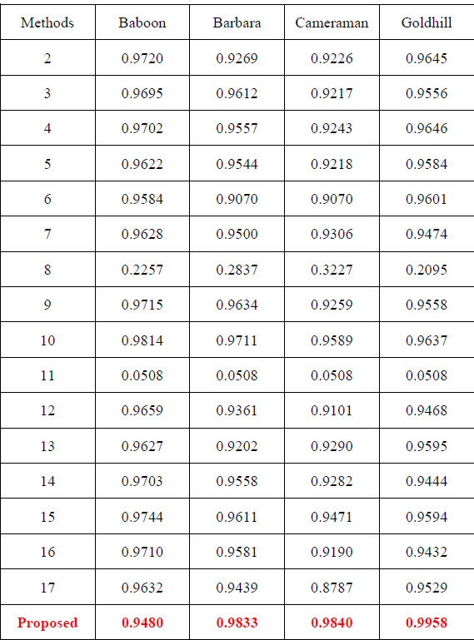
Comparison of different method with different image
The image expansion performance in terms of the cumulative sum ratio when preserving 5% of expansion basis function
Notes:
這篇文章總共用七張不同的照片來驗證與比較，另外十七種不同方法對於不同照片的CSR，而下一頁則是另外三張的照片對不同方法的比較，然後在表格的最後面再用平均來進行比較

Slide 28
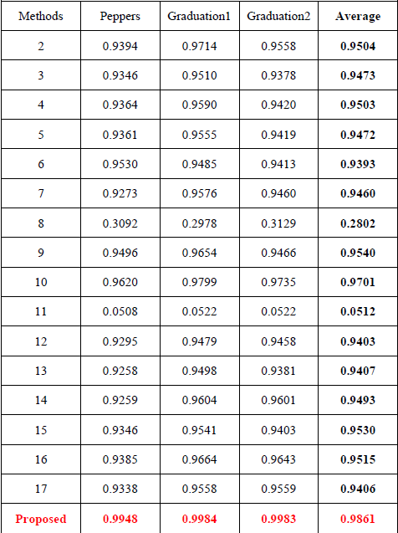
Comparison of different method with different image
The image expansion performance in terms of the cumulative sum ratio when preserving 5% of expansion basis function
Notes:
從這張比較表可以看出，這篇文章所提出來的方法，也就是我們所講的，確實較其他方法有更高的CSR， 那前面我們也有提到，對於CSR越高代表能量越集中，也表示我們在進行image壓縮時，可以有更高的效率，在同樣品質下所需要資料的資料可以更少 所提出的方法在 中的平均 CSR 為 0.9861，是所有方法中最高，Method 1 被排除，因為其 CSR 僅有 0.15 以下太低，證明了文章所提出的新方法能達到更準確的影像展開與能量保留

Slide 29
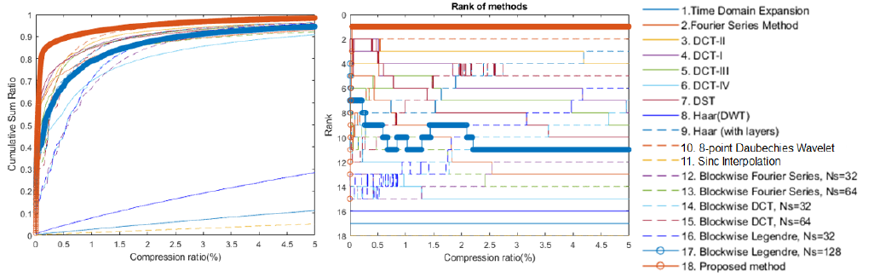
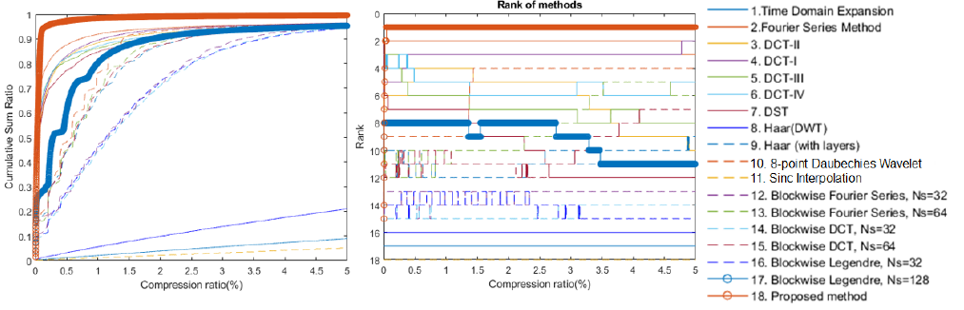
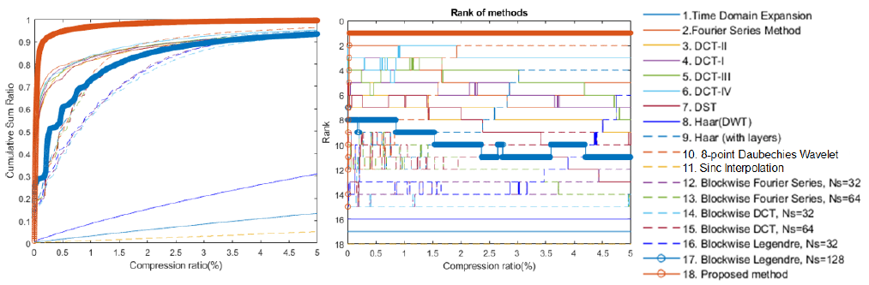
Result
Notes:
在 Figures 3–6 中，比較了 CSR 與壓縮比（compression ratio）之間的關係曲線，結果顯示 proposed method 不論在 CSR 還是 Rank 上都優於其他方法，尤其在壓縮比 0%～5% 範圍內表現最佳

Slide 30
Outline
Background and Motivation
Abstract
Evolution of Signal Expansion Techniques
Variety of signal expansion methods in paper
Proposed Algorithm
Edge detection
Morphology
Adapted-DCT
Evaluation
Experiments
Conclusion
Relativity of Lecture

Slide 31
Conclusion
Adapted-DCT-based Image Compression & Recovery
Improve image compression and recovery quality through an adapted discrete cosine transform (Adapted-DCT)
Dynamically adjust DCT weights and block sizes according to the image’s frequency distribution to achieve more targeted compression
Analysis and Contributions
Performs best on images with distinct spectral structures, effectively preserving major information with minimal distortion
Struggles when high-frequency noise or complex textures are intertwined with low-frequency regions.
Outperforms traditional DCT and JPEG methods, achieving higher compression ratios and better visual quality across datasets

Slide 32
Conclusion
Conclusion and Future Applications
The Adapted-DCT method demonstrates strong potential as a new standard for image compression and recovery
Its underlying principles can extend to audio compression, signal analysis, and edge-device image processing
Confidence remains high in its robustness and scalability across signal-processing domains

Slide 33
Reference
S. -Y. Luo, K. -C. Chen, J. -J. Ding, C. -C. Lee and H. -J. Lee, "High and Low Frequency Region Separation Method for Adaptive Image Expansion," 2024 Asia Pacific Signal and Information Processing Association Annual Summit and Conference (APSIPA ASC), Macau, Macao, 2024, pp. 1-6, doi: 10.1109/APSIPAASC63619.2025.10848888.
https://en.wikipedia.org/wiki/Fourier_series
Haiyong Wang and Shuhuang Xiang ; Math. Comp. 81 (2012), 861-877 DOI: https://doi.org/10.1090/S0025-5718-2011-02549-4 Published electronically: October 18, 2011
https://en.wikipedia.org/wiki/Discrete_sine_transform
Alouache, D., Ameur, Z. & Kachi, D. Catadioptric images compression using an adapted neighborhood and the shape-adaptive DCT. Multimed Tools Appl 79, 6781–6797 (2020)

Slide 34
Thanks for your attention

