Slide 1
Chapter 6 Series Solutions of Linear Equations
當 DE 為 linear 且 coefficients 為 polynomials
→ 假設 DE 的 solutions 為 polynomial 的型態
(和 Cauchy-Euler Method 以及 Taylor Series 的概念相近)
被稱作為 power series centered at x₀
Power series 觀念的複習 (Sec. 6-1)
x₀ is a non-singular point (Sec. 6-2)
解法
regular singular point
(Sec. 6-3)
x₀ is a singular point
irregular singular point
Examples (Sec. 6-4)

Slide 2
Section 6-1 Reviews of Power Series
6-1-1 定義
1. Power series
2. Convergence: exists
測試方法：Ratio test (test for convergence)
L < 1: converge
L > 1: diverge
L = 1: 不一定
3. Radius of Convergence R
L < 1 if |x − x₀| < R
L > 1 if |x − x₀| > R

Slide 3
Example 1 (text page 238)
For the Power series
for 1 < x < 5
Interval of convergence: (1, 5)
However, since when x = 1, the power series becomes
which is also convergent, the interval of convergence is modified as:
Interval of convergence: [1, 5)

Slide 4
6-1-2 Maclaurin Series (Taylor Series)

Slide 5
Maclaurin Series (Taylor Series) | Interval of Convergence
 | (-∞, ∞)
 | (-∞, ∞)
 | (-∞, ∞)
 | (-1, 1]
 | (-1, 1)

Slide 6
Example 2 (text page 240)
Find a power series representation of e^{x}sinx

Slide 7
Section 6-2 Solutions about Ordinary Points
Suppose that the solution is
6-2-1 方法適用情形
(1) Linear
(2) x₀ is not a singular point
(3) It is better that a₀(x), a₁(x), …., a_{n}(x), g(x) are all polynomials.
(or can be expressed by Taylor series)

Slide 8
6-2-2 解法流程
Step 1 將 代入 (x₀ 必需為 ordinary point)
Step 2 對齊 (一律變成 (x - x₀)^{k} )
不是 singular point 的
即為 ordinary point
Step 3 合併
Step 4 比較係數，將 c_{n} 之間的關係找出來
Step 5 Obtained independent solutions and general solution

Slide 9
6-2-3 例子
Example 5 (text page 246)
Set
since P(x) = 0 and Q(x) = x are analytic at 0
Step 1
set k = n −2
set k = n + 1
Step 2 對齊

Slide 10
Step 3
Step 4
2c₂ = 0
c₂ = 0
或
recurrence relation
c₀, c₁ 給定之後
k = 1
k = 2
k = 3

Slide 11
以此類推，所有的 c_{n} 的值都可以算出來 (以 c₀ 或 c₁ 表示)
k = 4
k = 5
k = 6
k = 7
group 1
k = 8
group 2
k = 9
group 3
:
:

Slide 12
Step 5
y₁
y₂
不寫在 Σ 裡面
ratio test:

Slide 13
Example 6 (text page 248)
(analytic at x = 0)
Radius of convergence?
Step 1
k = n − 2
k = n
k = n
Step 2
k = n

Slide 14
Step 3
k = 0
k = 1
Step 4

Slide 15
c₀, c₁ 給定之後
:
:

Slide 16
Step 5
y₂
y₁
不寫在 Σ 裡面
|x| < 1 (Why?)
ratio test:

Slide 17
Example 8 (text page 250)

Slide 18
6-2-4 定義
1. Analytic at x₀: If a function can be expressed as a power series and the radius of convergence of the power series is nonzero
簡單的判斷 f(x) 在 x₀ 是否為analytic 方法
(1) f(x₀) should be neither ∞ nor −∞
(2) f^{(m)}(x₀) should be neither ∞ nor −∞
m = 1, 2, 3, ……….

Slide 19
2. Ordinary Point and Singular Point:
• For the 2nd order linear DE
Definition 6.1
x₀ is an ordinary point of the 2nd order linear DE if both P(x) and Q(x) are analytic at x₀
Otherwise, x₀ is a singular point .
Theorem 6.1
If x₀ is an ordinary point of the 2nd order linear DE, then we can find two linearly independent solutions in the form of a power series centered at x₀ , i.e.,

Slide 20
• For the k^{th} order linear DE
Extension of Definition 6.2.1
x₀ is an ordinary point of the k^{th} order linear DE if P₀(x), P₁(x), P₂(x), ………. , P_{k−1} (x), are analytic at x₀
Otherwise, x₀ is a singular point .
Extension of Theorem 6.2.1
If x₀ is an ordinary point of the k^{th} order linear DE, then we can find k linearly independent solutions in the form of a power series centered at x₀ , i.e.,

Slide 21
6-2-5 Interval of Convergence 的判斷方法
判斷方法一： 找出
的條件
判斷方法二
（較快速，但較不精準
找出的收斂的範圍有時會比實際的收斂範圍小）
其中 R 是 x₀ 和最近的 singular point 的距離
Singular point can be a complex number , see Example 6
超過這個範圍未必不為 convergence

Slide 22
6-2-6 思考
(1) 對於 nonhomogeneous 的情形…..
(2) 這方法還可以用在什麼情形？

Slide 23
6-2-7 本節需注意的地方
(1) 要了解幾個重要定義： (a) convergence, (b) radius of convergence,
(c) analytic at x₀, (d) singular point, (e) ordinary point
(2) 複習一下 Taylor (Maclaurin) series (如 page 275)
(3) Index 的地方計算要小心
(a) 先都化成 x^{k} 再合併，(b) 頭幾項可能要獨立出來
(c) Index 對齊計算要小心
(4) n^{th} order linear DE 要有 n 個 linearly independent 解
(5) 有時要考慮 interval of convergence

Slide 24
Section 6-3 Solutions about Singular Points
假設解為
6-3-1 方法適用情形
(1) Linear
(2) (x −x₀)P_{n−1} (x), (x −x₀)²P_{n−2} (x), …………. , (x −x₀)^{n−1}P₁(x),
(x −x₀)^{n}P₀(x) are analytic at x₀
(比較： Section 6-2 要求 P_{n−1} (x), P_{n−2} (x), …………. ,
P₁(x), P₀(x) are analytic at x₀)
(3) It is better that P₀(x), P₁(x), …., P_{n-1}(x) are all polynomials.

Slide 25
6-3-2 定義
Singular Points 分成二種
• If x₀ is a singular point but (x −x₀)P_{n−1} (x), (x −x₀)²P_{n−2} (x),
…………. , (x −x₀)^{n−1}P₁(x), (x −x₀)^{n}P₀(x) are analytic at x₀
x₀ : regular singular point
• If (x −x₀)P_{n−1} (x), (x −x₀)²P_{n−2} (x), …………. , (x −x₀)^{n−1}P₁(x),
(x −x₀)^{n}P₀(x) are not analytic at x₀
x₀ : irregular singular point

Slide 26
Example 1 (text page 253)
x = 2 is a point
x = −2 is a point

Slide 27
6-3-3 解法
解法的關鍵：
假設解為
Theorem 6.3.1 Frobenius’ Theorem
若 x₀ 是 linear DE 當中的一個 regular singular point
則這個 linear DE 至少有一個解是 的型態

Slide 28
Process
Step 1 將 代入
Step 2 Power 對齊(以指數較小的為準)
Step 3 合併
Step 4 算出 r
Step 5 比較係數，將 c_{n} 之間的關係找出來
Step 6 將 Step 4 得出的 r 代入 Step 5
得出所有的 independent solutions 及 general solution
Step 7 (見後頁)

Slide 29
(Step 7)
當 (1) r 有重根
或 (2) r 的根之間的差為整數，且從 Step 6 得出來的解不為 independent 時
用
和長除法找出 y₂(x)
(參考 Section 6-3 的 Examples 4, 5)
當 r 的根之間的差為整數，但從 Step 6 得出來的解為 independent 時，
不需進行這個步驟

Slide 30
6-3-4 範例
Example 2 (text page 255)
Step 1 將 代入
Step 2 Power 對齊
n = k − 1
n = k
n = k
k = n + 1

Slide 31
Step 3 合併
Step 4 算出 r
Step 5

Slide 32
Step 6
當 r = 0
當 r = 2/3
:
:

Slide 33
Solution of Example 2 (別忘了將最後的解寫出）
(Set c₀ = 1)
(別忘了寫出 x 的範圍)

Slide 34
Examples 4, 5 (text pages 258, 259)
Step 1 將 代入
Step 2 對齊
n = k
n = k −1
Step 3 合併

Slide 35
Step 4
Step 5
Step 6
(-1)^{n}: from -1
(n+1)!: from k+1, k = 1~n
n!: from k, k = 1~n
當 r = 1

Slide 36
Step 6
當 r = 0
k = 1 時不能算
此時，應該根據 Step 3，由
(k = 1, r = 0 代入)
c₀ 必需等於 0, c₁ 可為任意值
………….
這地方容易犯錯，要小心
m = n − 1

Slide 37
因為前頁算出來的 y₂(x) 等於 y₁(x)，
只好另外用 Sec. 4-2“reduction of order” 的方法求解
註：若算出的 y₂(x) 等於 y₁(x) 乘上一個 constant, 則 y₂(x) 和 y₁(x) 仍視同 linearly dependent，仍需要用上方 “reduction of order” 的方法來求另外一個解

Slide 38
long division
長除法
思考：為何不是 ln|x| ?

Slide 39
6-3-5 多項式的長除法
計算
(x ⁻²)
(x ⁻¹)
(1)
(x)
(x²)
(x³)
(x⁴)
(x⁵)
(1)
(x)
(x²)
(x³)

Slide 40
6-3-6 Indicial Equation
2nd order case
If x₀ is a regular singular point
where
由於 p(x) 和 q(x) 皆為 analytic

Slide 41
將 y(x), y'(x), y''(x), p(x), q(x) 代入
其中 (x −x₀) ^{r} 的 coefficient 為
indicial equation

Slide 42
當 linear DE 為 2nd order 時，r 可以由
求出
其中
a₀ = p(x₀)
b₀ = q(x₀)

Slide 43
For the 2nd order case
two roots: r₁, r₂
(Case 1) r₁ ≠ r₂ and r₁, r₂ are real, r₂ − r₁ ≠ integer
可以找出兩組 的解
(Case 2) r₁ ≠ r₂ and r₁, r₂ are real, r₂ − r₁ = integer
有時可以找出兩組 的解
有時一個解是
另一個解是

Slide 44
(Case 3) r₁ = r₂ 時
C 一定不為 0
或寫成
(Case 4) r₁ ≠ r₂ and r₁, r₂ are complex
在此不予討論

Slide 45
6-3-7 Indicial Equation for Higher Order Case (補充)
當 linear DE 為 n^{th} order 時
當中的 r 可以由
求出
其中
k = 0, 1, 2, …., n −1

Slide 46
6-3-8 本節需要注意的地方
(1) Index 「對齊」的計算要小心
(建議可以向 power 較小的對齊，否則會出現負的 k)
例如在 page 300 的 Step 2，一律對齊為 x^{k+r– 1} 而非 x^{k+r}
(2) 若 x = 0 為 regular singular point, 設 x₀ = 0 即可
(3) 如果是 c_{k} 和 c_{k−1} (或 c_{k−1} 和 c_{k}) 的 recursive relation
其實有時可以立刻將 c_{n} 的式子觀察出來
(但是分母不可變為 0)
(4) Recursive relation 當中小心分母為 0 的情形 (如 page 306)
(5) 小心算出來的 y₂(x) 和 y₁(x) 相同的情形 (如 pages 306, 307)

Slide 47
(6)別忘了將最後的解寫出
最後的解易出錯的地方： 別忘了乘上 x^{r}
(7) Interval of solution 依然要考慮，
且 interval 不包括任何singular point，
即使是 regular singular point
(8) 複習長除法

Slide 48
Section 6-4 Special Functions
(本節這學期不在授課範圍內)
Special cases of Sections 6-2 and 6-3
• Bessel’s equation of order v
Solution:
: 1st kind Bessel function
: 2nd kind Bessel function
• Legendre’s equation of order n
One of the solution: Legendre polynomials
(See page 336)

Slide 49
其他名詞
• Gamma function
• modified Bessel equation of order v
modified Bessel equation of the 1st kind
modified Bessel equation of the 2nd kind
Bessel 的另一種變型
解
解：c₁I_{v}( x) + c₂K_{v}(x)

Slide 50
6.4.1 Bessel’s Equation
6.4.1.1 Solving for Bessel’s equation of order v
Steps 1~3 將
代入
經過一些計算 (See text pages 262, 263) 得出
Step 4
two roots: v and −v
Step 5

Slide 51
Step 6
當 r = v
當 r = −v
由於 c₁ = 0, c₃ = c₅ = c₇ = c₉ = ….. = 0
when r = v
when r = −v

Slide 52
6.4.1.2 Gamma function: a generalization of n!
(Note 1)
properties of Gamma function
(1)
when n is a positive integer
(2)
參照課本 Appendix 1

Slide 53

(3)
when n is a negative integer or n = 0
(4)
Γ(4)
Γ(x)
Γ(3)
Γ(1)
Γ(2)
x

Slide 54
6.4.1.1 回到 Solving for Bessel function
when r = v
Set

Slide 55
同理，當 r = −v
set
Two independent solutions of the Bessel’s equation
代入
When r = v
When r = −v
稱作 Bessel functions of the first kind of order v and −v

Slide 56
6.4.1.3 Bessel function of the second kind
注意，兩個 roots 的差為 2v
(1) 當 2v 不為整數時，Bessel’s equation 的解即為
c₁J_{v}(x) + c₂J_{−v}(x) (也可表示成 c₁J_{v}(x) + c₂Y_{v}(x))
(2) 當 2v 為整數，但 v = m + 1/2 (m 是一個整數) 時，Bessel’s
equation 的解亦為 c₁J_{v}(x) + c₂J_{−v}(x) (也可表示成 c₁J_{v}(x) + c₂Y_{v}(x))
(3) 當 2v 為整數，且 v 是一個整數時， Bessel’s equation 的解為
c₁J_{v}(x) + c₂Y_{v}(x)
Y_{v}(x): Bessel function of the second kind of order v
(見後頁）
(Note 2)

Slide 57
Y_{v}(x): Bessel function of the second kind of order v
當 m 為整數時， Y_{m}(x) 定義成
用 L’Hopital’s rule 來算

Slide 58
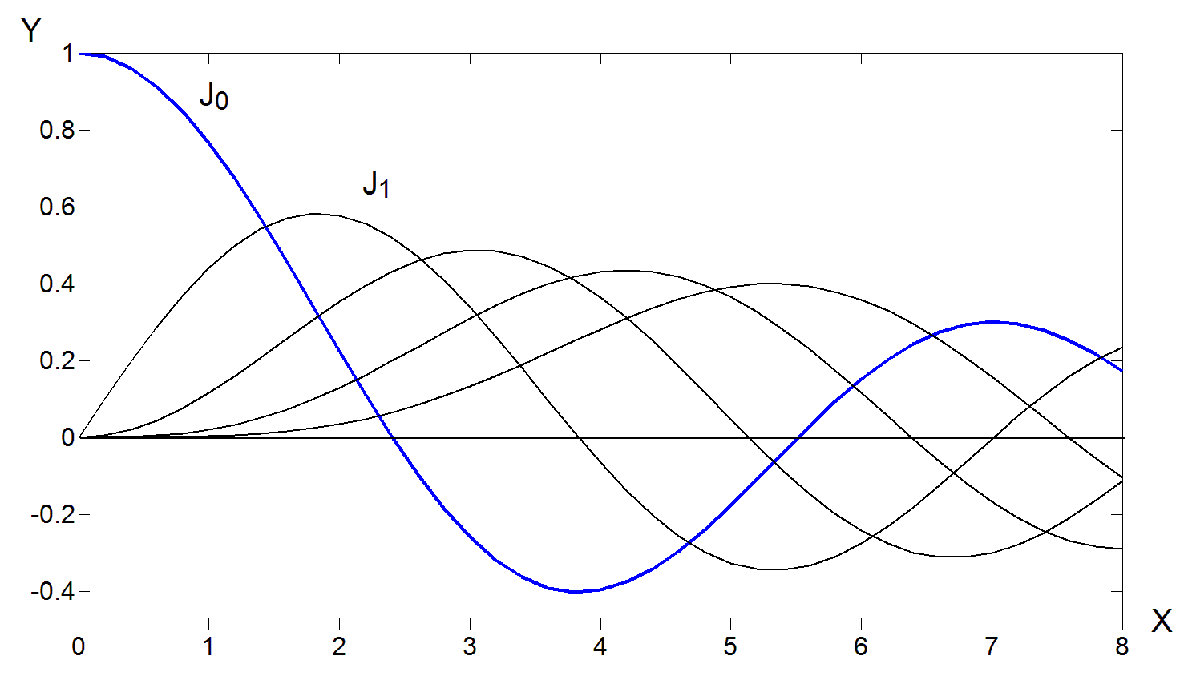
6.4.1.4 Bessel function of the 1st kind (order m 為整數時)的性質
(1) J₀(0) = 1, J_{m}(0) = 0 for m ≠ 0
(2) Zero crossing 的位置，隨著 m 增加而越來越遠 (見 Table 6.4.1)

Slide 59
(3)
(4)
(5)
(6)
when m is an integer
when m is an integer
見 Example 6, text pages 268, 269

Slide 60
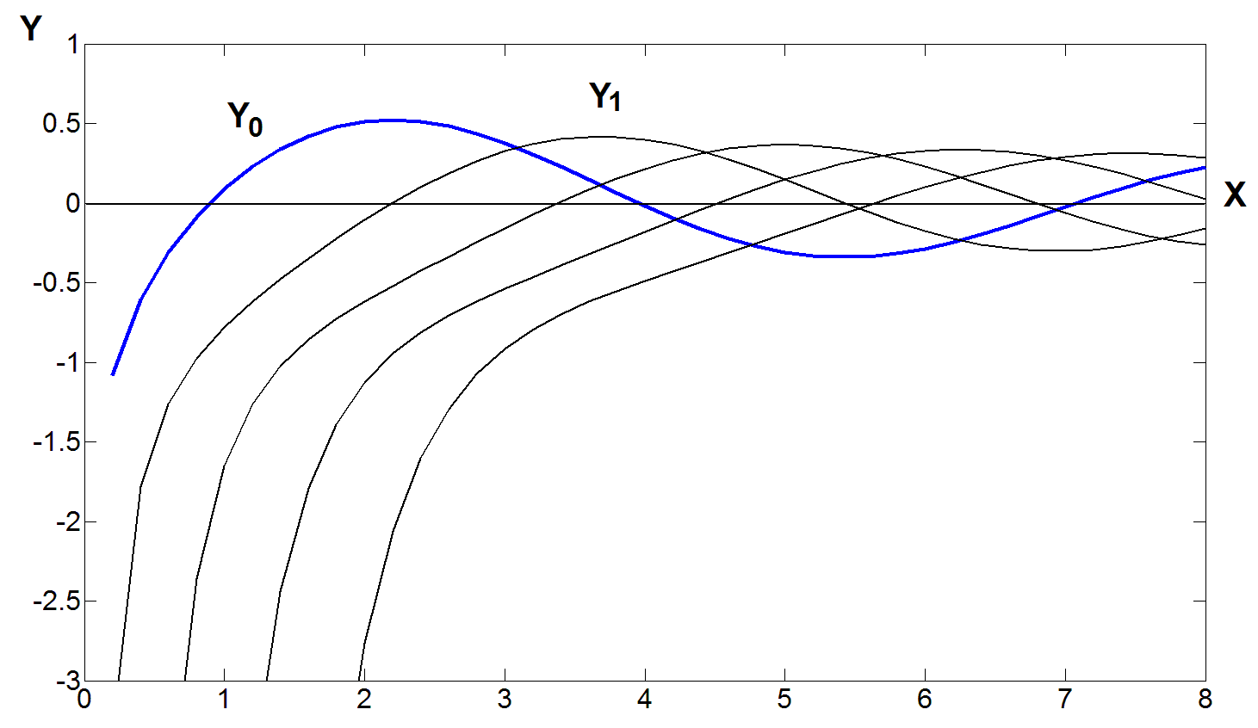
6.4.1.5 Bessel function of the 2nd kind (order m 為整數時)的性質
(1)
(2) Zero crossing 的位置，隨著 m 增加而越來越遠

Slide 61
6.4.1.6 Bessel’s equation 的變型
解：c₁J_{v}(x) + c₂Y_{v}(x)
(A)
解：c₁J_{v}(α x) + c₂Y_{v}(α x)
Proof: Set t = αx
Similarly,
原式 =
對 t 而言是 Bessel equation
y = c₁J_{v}(t) + c₂Y_{v}(t) = c₁J_{v}(α x) + c₂Y_{v}(α x)

Slide 62
(B) modified Bessel equation of order v
解：c₁I_{v}( x) + c₂K_{v}(x)
其中
稱作是 modified Bessel function of the first kind of order v
稱作是 modified Bessel function of the second kind of order v
當 v 為整數時，也是取 limit

Slide 63
(C)
解：
式子有點複雜，但可以用來解許多物理上的問題
Example 4 (text page 266)

Slide 64
6.4.2 Legendre’s Equation
6.4.2.1 Legendre’s Equation
代入，得出 (過程見text pages 270, 271)
Two linearly independent solutions are

Slide 65
(a) When n is not an integer, both the two solutions have infinite number of terms.
(b) When n is an even integer, y₁(x) has finite number of terms.
In y₁(x), the coefficient of x^{k} is zero when k > n.
(c) When n is an odd integer, y₂(x) has finite number of terms.
In y₂(x), the coefficient of x^{k} is zero when k > n.
y₁(x) when n is an even integer and y₂(x) when n is an odd integer are called the Legendre polynomials
(denoted by P_{n}(x)).

Slide 66
通常選
(讓 P_{n}(1) 一律等於 1)
When n is a non-negative integer, one of the solutions is the n^{th} order polynomial.
(Note 3)
由 y₁(x)
由 y₂(x)

Slide 67
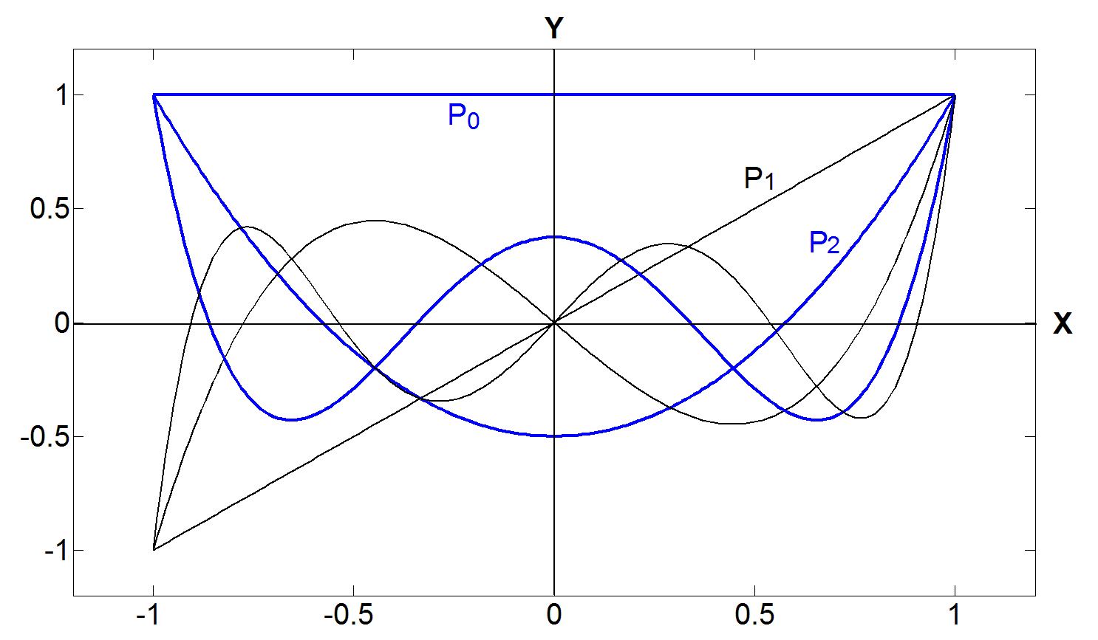
Legendre polynomials
Interval:
x ∈ [−1, 1]

Slide 68
6.4.2.2 Properties of Legendre Polynomials
(1)
even / odd symmetry
(2)
(3)
when n is odd
(4)
when n is even
(5)
recursive relation
(6)
Rodrigues’ formula

Slide 69
(7)
If m ≠ n
orthogonality property
(Note 4)
(8) 若任何在 x ∈ [−1, 1] 區間為 continuous 的函式 f(x)
皆可表示為
由於
根據 orthogonality property
所以
Orthogonality property 才是 Legendre polynomials 最重要的性質

Slide 70
Review of Chapter 6
解法適用範圍： Linear DE，且 coefficients 最好為 polynomials
• 當 P_{m}(x) 在 x = x₀ 時為 analytic
x₀ 為 ordinary point
代入求解
• 當 P_{m}(x) 在 x = x₀ 時不為 analytic
但是 (x − x₀ )^{n −m}P_{m}(x) 在 x = x₀ 時為 analytic
x₀ 為 regular singular point
代入求解
有時，另一個解為

Slide 71
Exercise for practice
Sec. 6-1: 4, 9, 12, 20, 22, 24, 30, 32, 34
Sec. 6-2: 2, 10, 13, 18, 20, 22, 24, 26, 27
Sec. 6-3: 4, 9, 13, 16, 22, 24, 26, 28, 29, 31, 33, 36
Review 6 6, 7, 10, 14, 19, 20

