Slide 1
工程數學特論
Selected Topics in Engineering Mathematics
授課者：丁建均，劉俊麟
教學網頁：https://djj.ee.ntu.edu.tw/EM.htm
(請上課前來這個網站將講義印好)
歡迎大家來修課！

Slide 2
授課者：丁建均，劉俊麟
丁建均
Office： 明達館723室, TEL： 33669652
Office hour： 週一下午，週三上午，週四下午，週五下午皆可以來找我
個人網頁：https://disp.ee.ntu.edu.tw/
E-mail: jjding@ntu.edu.tw
劉俊麟
Office： 明達館515室, TEL： 33669806
個人網頁：https://homepage.ntu.edu.tw/~chunlinliu/
E-mail: chunlinliu@ntu.edu.tw (用 E-mail 約 office hour 時間)
進階微分方程、傅立葉分析、進階機率與統計的部分由丁建均老師授課，進階線性代數的部分由劉俊麟老師授課

Slide 3
上課時間： 星期二 第 7, 8, 9 節 (PM 14:20~17:20)
上課方式
(1) 錄影 ，影片將藉由 NTU Cool 下載
(2) 現場 (明達館205室)
http://cool.ntu.edu.tw
教材： 講義
評分方式：五次作業 65%, 期末考 35%
用 NTU Cool 來繳交作業的電子檔 http://cool.ntu.edu.tw
(紙本用 PDF files 繳交，並且附程式碼)
考試：Open book，線上，限時240分鐘

Slide 4
參考教材：
[1] D. G. Zill and Michael R. Cullen, Differential Equations-with Boundary-Value Problem (metric version), 9th edition, Cengage Learning, 2017. [2] D. G. Zill, W. S. Wright, and J. J. Ding, Engineering Mathematics, Metric Edition, Cengage Learning, Taipei, Taiwan, 2019. [3] R. N. Bracewell, The Fourier Transform and Its Applications, 3rd ed., McGraw Hill, Boston, 2000. [4] R. D. Yates and D. J. Goodman, Probability and Stochastic Processes, 3rd Edition, John Wiley and Sons, 2015. [5] A. Papoulis and S.U. Pillai, Probability, Random Variables, and Stochastic Processes, 4th edition, Mcgraw-Hill, 2002. [6] R. A. Horn and C. R. Johnson, Matrix Analysis, 2nd ed., New York: Cambridge University Press, 2013. [7] G. H. Golub and C. F. Van Loan, Matrix Computations, 4th ed., Baltimore: The Johns Hopkins University Press, 2013.

Slide 5
上課日期
Week Number | Date (Tuesday) | Remark
1. | 2/20
2. | 2/27
3. | 3/5 | 出 HW1
4. | 3/12
5. | 3/19 | 交 HW1
6. | 3/26 | 出 HW2
7. | 4/2
8. | 4/9 | 交HW2
9. | 4/16 | 出 HW3
10. | 4/23
11. | 4/30 | 交HW3
12. | 5/7 | 出 HW4
13. | 5/14
14. | 5/21 | 交HW4
15. | 5/28 | 出 HW5
 | 6/4 | 期末考
 | 6/11 | 交HW5

Slide 6
注意事項：
請上課前，來這個網頁，將上課資料印好。
https://djj.ee.ntu.edu.tw/EM.htm
(2) 請各位同學踴躍出席 。
(3) 作業一次10題，作業不可以抄襲。作業若寫錯但有用心寫仍可以有40%~90% 的分數，但抄襲或借人抄襲不給分。
(4) 作業較難的題目都會給予充分的提示，但一定要自己寫
(5) 期末考採行 open book 的方式，考試時間為 240分鐘
出題範圍為講義有提到的部分 (除非特別註明只教不考)

Slide 7
注意事項：
(6) 只教不考的範圍是期末考不會考，但有可能作業會由當中出題
(7) 每三週一次作業，每次作業會有一個以上程式題
(8) 在解答公佈前作業皆可補交，但遲交將扣 15% 的分數
各次作業解答公佈時間為，
HW1: 4/28, HW2: 5/12, HW3: 5/26, HW4: 6/2, HW5: 6/16
(9) 不需記任何一個式子，不需磨練運算速度，但是要了解物理意義，培養實際上解決問題的能力

Slide 8
Matlab Program
Download: 請洽台大各系所
參考書目
洪維恩，Matlab 程式設計，旗標，台北市，2013 . (合適的入門書)
張智星，Matlab 程式設計入門篇，第四版，碁峰，2016.
預計看書學習所花時間： 3~5 天
Python Program
Download: https://www.python.org/
參考書目
葉難， Python程式設計入門，博碩，2015
黃健庭， Python程式設計：從入門到進階應用，全華，2020
The Python Tutorial https://docs.python.org/3/tutorial/index.html

Slide 9
課程大綱
(A) Differential Equation Part
(1) Numerical Methods and Nonlinear DEs (2W)
(2) Partial Differential Equations (3W)
(3) Function Approximation (1W)
(B) Fourier Analysis Part
(1) Fourier Analysis (2W)
(2) 2D FT and Discrete FT (1W)
(C) Probability and Statistics Part
Probability Model, Entropy, and KL Divergence (1W)
Random Process, Independent Component Analysis (1 W)
(D) Linear Algebra Part (4W)
Review, Advanced Operations, and Norms (1W)
Advanced Matrix Decompositions (1.5 W)
Least Squares Problems (1.5W)

Slide 10
課程定位
(1) Advanced Parts of (i) Differential Equations, (ii) Signals and Systems, (iii) Linear Algebra, and (iv) Probability and Statistics
(2) Connection between the Undergraduate Courses and the Mathematical Tools Required for Research
(3) Improving the Ability to Solve Practical Mathematical Problems

Slide 11
附錄一 Table of Integration
1/x | ln|x| + c
cos(x) | sin(x) + c
sin(x) | –cos(x) + c
tan(x) | –ln|cos(x)| + c
cot(x) | ln|sin(x)| + c
a^{x} | a^{x}/ln(a) + c
x e^{ax}
x² e^{ax}

Slide 12
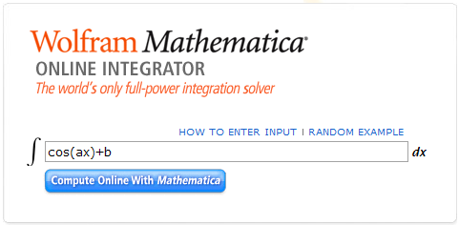
附錄二 微分方程查詢
https://integrals.wolfram.com/index.jsp
輸入數學式，就可以查到積分的結果
範例：
(a) 先到integrals.wolfram.com/index.jsp 這個網站
(b) 在右方的空格中輸入數學式，例如
數學式

Slide 13
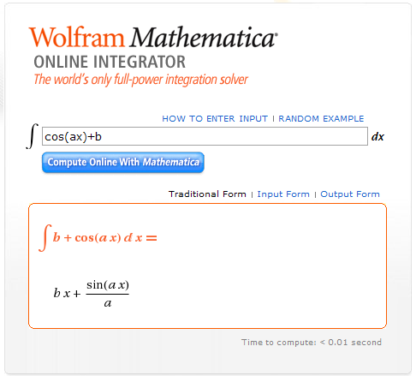
(c) 接著按 “Compute Online with Mathematica”
就可以算出積分的結果
按
結果

Slide 14
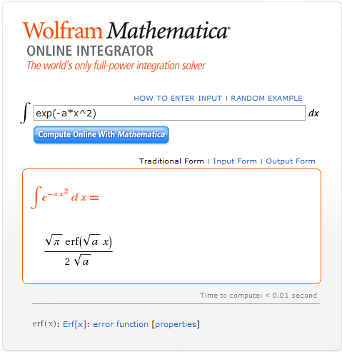
(d) 有時，對於一些較複雜的數學式，下方還有連結，點進去就可以看到相關的解說
連結

Slide 15
其他有用的網站
http://mathworld.wolfram.com/
對微分方程的定理和名詞作介紹的百科網站
http://www.sosmath.com/tables/tables.html
眾多數學式的 mathematical table (不限於微分方程)
http://www.seminaire-sherbrooke.qc.ca/math/Pierre/Tables.pdf
眾多數學式的 mathematical table，包括 convolution, Fourier transform, Laplace transform, Z transform
軟體當中， Maple, Mathematica, Matlab 皆有微積分結果查詢有功能

Slide 16
Part A: Differential Equations

Slide 17
1. Numerical Methods and Nonlinear Differential Equations
1.1 Review (只教不考)
1.2 Numerical Methods (只教不考)
1.3 Nonlinear Differential Equations
1.4 Applications of Nonlinear Differential Equations
[1] D. G. Zill and Michael R. Cullen, Differential Equations-with Boundary-Value Problem (metric version), 9th edition, Cengage Learning, 2017.
[2] http://djj.ee.ntu.edu.tw/DE.htm

Slide 18
1.1 Review
1.1.1 Definitions
(1) Differential Equation (DE): any equation containing derivation
x: independent variable 自變數
y(x): dependent variable 應變數

Slide 19
(2) Ordinary Differential Equation (ODE):
differentiation with respect to one independent variable
(3) Partial Differential Equation (PDE):
differentiation with respect to two or more independent variables

Slide 20
(4) Linear Differentiation Equation:
All of the coefficient terms a_{m}(x) m = 1, 2, …, n are independent of y.
(5) Non-Linear Differentiation Equation

Slide 21
1.1.2 First Order DE
Methods:
graphic method
direct integration
numerical method
separable variable
analytic method
method for linear equation
method for exact equation
homogeneous equation method
Bernoulli’s equation method
series solution
method for Ax + By + c
Laplace transform

Slide 22
Methods of Solving the 1st Order DE
(1) Direct computation
(2) Separable variable
(3) Linear DE
(4) Exact equation
破解法： 直接積分
條件：
破解法： x, y 各歸一邊後積分
條件：
破解法：算
條件：
破解法：double N method
先處理
再處理
條件：
(或反過來)

Slide 23
(4-1) Exact equation 變型
(4-2) Exact equation 變型
(5) Homogeneous equation
破解法：
條件：
is exact
independent of x
破解法：
條件：
is exact
independent of y
破解法：u = y/x, (y = xu)
再用 separable variable method
條件：

Slide 24
(6) Bernoulli’s Equation
(7) Ax + By + C
破解法： u = y^{1–n}
再用 linear DE 的方法
條件：
破解法： u = Ax + By + c
條件：

Slide 25
(2) Separable Variable Method
If , then
Step 1
where p(y) = 1/h(y)
Step 2
where
分離變數
個別積分
Extra Step: Initial conditions

Slide 26
[Example 1] (Zill, Page 48)
Step 1
Step 2

Slide 27
(3) Linear DE Method
(Step 1) Obtain the standard form and find P(x)
(Step 2) Calculate
(Step 3) The standard form of the linear 1st order DE can be rewritten as:
(Step 4) Further solve the equation.
(Extra Step) Initial conditions

Slide 28
[Example 2] (Zill, Page 58)
Step 1
Step 2
Step 3
Step 4

Slide 29
(6) Bernoulli’s Equation
【Definition】 Bernoulli’s equation:
We can set u = y^{1–n} , , and the method of solving
the 1st order linear DE to solve the Bernoulli’s equation.
so
(Chain rule)

Slide 30
[Example 3] (Zill, Page 74)
Previous Step: Conclude that it is a Bernoulli’s equation with n = 2.
Step 1: set u = y^{–1} (y = u^{–1})
(Chain rule)
Step 2: Convert into the 1st order linear DE (standard form)
原式
Step 3: Obtain the solution of the 1st order DE
Step 4: Substituted by u = y^{–1}

Slide 31
1.1.3 Linear Higher Order DE
Methods:
reduction of order
homogeneous part
auxiliary function
linear
Cauchy-Euler
power series
form rule (guess)
particular solution
annihilator
variation of parameters
Fourier series

Slide 32
Architecture for Solving Higher-Order Linear DEs
Nonhomogeneous linear DE
Part 1
Part 2
Associated homogeneous DE
particular solution
(any solution of the nonhomogeneous linear DE)
find n linearly independent solutions
general solution of the nonhomogeneous linear DE

Slide 33
(A) Linear DE Homogeneous Part 3 大解法
(1) Reduction of Order (Zill, Section 4-2)
適用情形： 2nd order, linear,
one non-trivial solution has been known.

Slide 34
(2) Auxiliary Function (Zill, Section 4-3)
適用情形：linear, constant coefficients
(i) If m₀ is a root of
then
is one of the solutions.
(ii) If m₀ is a repeated root and the multiplicity is k
then
are k of the solutions.
(iii) If there is a pair of complex roots
then
and
are two of the solutions.

Slide 35
(3) Cauchy-Euler Equation (Zill, Section 4-7)
適用情形：linear, Cauchy-Euler DE
(i) If m₀ is a root of the above equation
then
is one of the solutions.
(ii) If m₀ is a repeated root and the multiplicity is k
then
are k of the solutions.
(iii) If there is a pair of complex roots
then
and
are two of the solutions.

Slide 36
(4) Power Series (Zill, Chapter 6)
If x₀ is an ordinary point (not a singular point)
If x₀ is a regular singular point

Slide 37
[Example 4] (Zill page 137)
(a)
2m² − 5m − 3 = 0, m₁ = −1/2, m₂ = 3
(b)
m² − 10m + 25 = 0, m₁ = 5, m₂ = 5
(c)
m² + 4m + 7 = 0,

Slide 38
[Example 5] (Zill page 138)
Solve
m₁ = 1, m₂ = m₃ = −2
3 independent solutions:
general solution:
[Example 6] (Zill page 167)
2 independent solutions:
general solution:

Slide 39
[Example 7] (Zill page 246)
Set
Step 1
set k = n −2
set k = n + 1
Step 2 對齊
Step 3

Slide 40
Step 4
2c₂ = 0
c₂ = 0
或
recurrence relation
c₀, c₁ 給定之後
k = 1
k = 6
k = 2
k = 7
k = 3
k = 8
k = 4
k = 9
:
:
k = 5

Slide 41
group 1
group 2
group 3
Step 5
y₁
y₂

Slide 42
(B) Linear DE Particular solution 4 大解法
(1) Guess (Zill, Section 4-4)
要訣： y_{p} should be a linear combination of
g(x), g′(x), g′′(x), g′′′(x), g⁽⁴⁾(x), g⁽⁵⁾(x), …………….
form rule
遇到重覆，乘 x 或 lnx
適用情形：linear, constant coefficients, g^{(n)}(x) have finite terms

Slide 43
Trial Particular Solutions
(from Zill’s textbook, page 146)
g(x) | Form of y_{p}
1 (any constant) | A
5x + 7 | Ax + B
3x² – 2 | Ax² + Bx + C
x³ – x + 1 | Ax³ + Bx² + Cx + E
sin4x | Acos4x + Bsin4x
cos4x | Acos4x + Bsin4x
e^{5x} | Ae^{5x}
(9x – 2)e^{5x} | (Ax + B)e^{5x}
x²e^{5x} | (Ax² + Bx + C)e^{5x}
e^{3x}sin4x | Ae^{3x}cos4x + Be^{3x}sin4x
5x²sin4x | (Ax² + Bx + C)cos4x + (Ex² + Fx + G)sin4x
xe^{3x}cos4x | (Ax + B)e^{3x}cos4x + (Cx + E)e^{3x}sin4x
It comes from the “form rule”.

Slide 44
(2) Annihilator (Zill, Section 4-5)
若原本的 DE 為 L[y(x)] = g(x)
Annihilator: L₁[ g(x)] = 0
Particular solution 為 L₁{L[y(x)]} = 0 的解
(扣去和 L[y(x)] = 0 的解重複的部分)
適用情形：linear, constant coefficients, g^{(n)}(x) have finite terms

Slide 45
(3) Variation of parameters (Zill, Section 4-6)
W_{k} : replace the k^{th} column of W by
適用情形：linear

Slide 46
(4) Fourier series (Zill, Section 11-3)
Trying to express f(t) as
Then, suppose the particular solution is
適用情形：periodic, being able to transformed by the Fourier series

Slide 47
[Example 8] (Zill page 144)
Step 1: find the solution of the associated homogeneous equation
Guess
Step 2: particular solution
A = 6/73, B = −16/73
Step 3: General solution:

Slide 48
Until now, only a small part of DEs can be solved.

Slide 49
1-2 Numerical Methods
Even if it can be shown that a solution of a differential equation exists, we might not be able to exhibit it in an explicit or implicit form.
D. G. Zill and Michael R. Cullen, Differential Equations-with Boundary-Value Problem (metric version), 9th edition, Cengage Learning, 2017. (Sections 2-6, 9-1, 9-2)

Slide 50
1-2-1 Euler’s Method
independent variable x x₀, x₁, x₂, …………
Find the solution of
Since approximation
sampling(取樣)
前一點的值
取樣間格

Slide 51
$If y\left(x_{0}\right)$ is known
: : : :

Slide 52
y(x)
y(x_{n+1})
y(x_{n})
x
x_{n}
x_{n+1}
Problem: Can we modify the slope when determining y(x_{n+1})?

Slide 53
[Example 1] (Zill page 371)
In this case,
From the Taylor series
The local truncation error in y_{n+1} is
Global error:
Large h → Large error
(Their definitions can be seen from the next page)

Slide 54
The local truncation error: The error to compute the next interation.
Global error: The error at the same point.
The local truncation error
= the global error

Slide 55
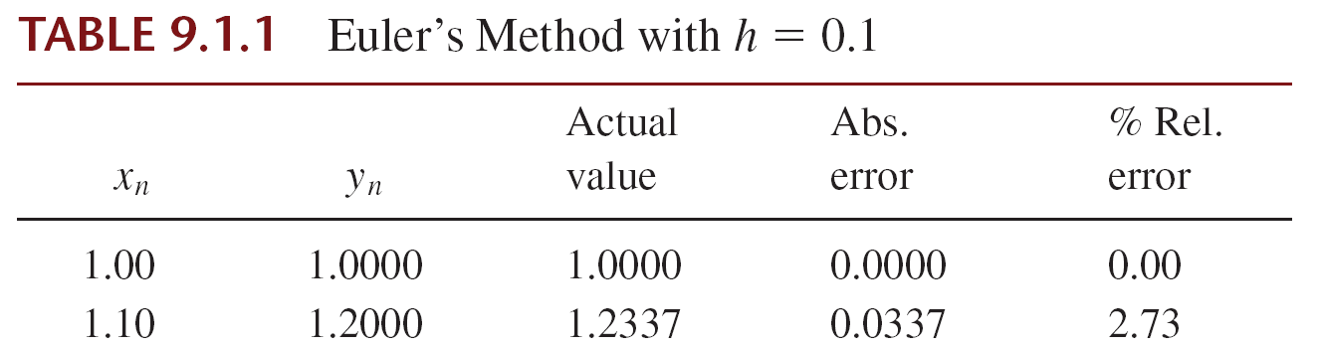
Zill
Zill
Large h → Large error

Slide 56
1-2-2 Improved Euler’s Method
n = n+1
where
is the first estimation for

Slide 57
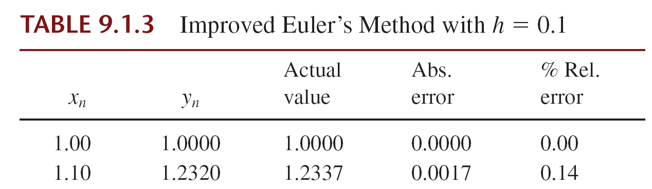
Zill
Zill
The errors are much less than those of Euler’s method.
Local truncation error for the improved Euler’s method is O(h³), the global truncation error is O(h²).

Slide 58
1-2-3 Runge-Kutta Methods
General form of the Runge-Kutta (RK) method.
k₂, …, k_{m}: the values of f(x, y) between (x_{n}, y_{n}) and (x_{n+1}, y_{n+1})
Euler’s method is said to be a first-order Runge-Kutta method (RK1).
Improved Euler’s method is said to be a second-order Runge-Kutta method (RK2).

Slide 59
A Fourth-Order Runge-Kutta Method
where
k₂: estimated slope at x_{n}+α₁h
k₃: estimated slope at x_{n}+α₂h
k₄: estimated slope at x_{n}+α₃h

Slide 60
RK4 method
It is also named as the fourth-order Runge-Kutta method (the RK4 method) or the classical Runge-Kutta method.
k₁ is determined at x_{n}
k₂, k₃ are estimated at x_{n} + h/2
k₄ is estimated at x_{n} + h
k₁
k₂, k₃
k₄
x_{n}
x_{n}+h/2
x_{n}+h

Slide 61
[Example 2] (Zill page 375) RK4 Method
Use the RK4 method with h = 0.1 to obtain an approximation to y(1.5) for the solution of
SOLUTION
For the sake of illustration, let us compute the case when n = 0.
Note:

Slide 62
And therefore,
The remaining calculations are summarized in Table 9.2.1, whose entries are rounded to four decimal places.

Slide 63
much more accurate

Slide 64
The local truncation error for this method is
or O(h⁵), and the global truncation error is thus O(h⁴).
[Detail of proof of the RK4 method]:
https://math.stackexchange.com/questions/2636121/prove-that-runge-kutta-method-rk4-is-of-order-4

Slide 65
1-3 Nonlinear Differential Equations
Method 1: Reduction of Order
Method 2: Taylor Series
Method 3: Numerical Approach
D. G. Zill and Michael R. Cullen, Differential Equations-with Boundary-Value Problem (metric version), 9th edition, Cengage Learning, 2017. (Section 4-10)

Slide 66
1-3-1 Method 1: Reduction of Order
精神：變成 1st order DE
再用 1st order DE 的方法求解
限制：The DE should have the form of
Case 1, pages 67-68
Case 2, pages 69-71
or
(Without the term y)
(Without the term x)

Slide 67
Case 1: The 2nd order DE has the form of
(Without the term y)
u
解法： (Step 1) Set
此時DE 變成 (對 u 而言，是 1st order DE)
(Step 2) 將 u 解出來 (用 1st Order DE 的方法)
(Step 3) 對 u 作積分，即解出 y

Slide 68
[Example 1] (Zill page 189)
(Step 1)
(Step 2)
(Step 3)

Slide 69
Case 2: The 2nd order DE has the form of
(Without the term x)
u
解法：(Step 1) Set
(Chain rule)
此時DE 變成
(對 u 而言，是1st order DE, independent variable 為 y)

Slide 70
(Step 2) 將 u 解出來 (用 1st Order DE 的方法)
得出的解, u 是 y 的函數
(Step 3)
用 separable variable 的方法即可將解得出

Slide 71
[Example 2] (Zill page 190)
(Step 1) Set
(Step 2)
(Step 3)

Slide 72
1-3-2 Method 2: Taylor Series
更一般化的型態
Step 1 算出
Step 2 代回 Taylor series

Slide 73
[Example 3] (Zill page 190)
:
代回 Taylor series

Slide 74
限制：(1) y(x) 在 x₀ 的地方必需為 analytic,
(x = x₀ 不為 singular point)
(2) 在解 n^{th} order DE 時，y(x₀)， y'(x₀)， y''(x₀)， …..
y^{(n−1)}(x₀) 的值必需皆為已知
(3) 得出的解只有在 x₀ 附近較為正確
問題：(1) Taylor series 應該取多少項？
(2) |x −x₀| 的範圍？

Slide 75
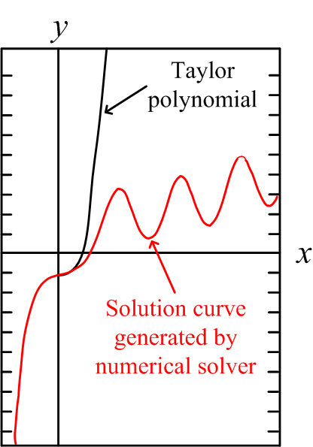
x₀ =0

Slide 76
1-3-3 Method 3: Numerical Method
複習
Numerical Method for the 1st Order DE

Slide 77
解法
subject to
使用 Euler’s Method

Slide 78
Recursive 的解法 (Euler’s Method)
Initial: n = 0
n = n + 1

Slide 79
Recursive 的解法 (Modified Euler’s Method)
Initial: n = 0
n = n + 1

Slide 80
Recursive 的解法 (RK4)
Initial: n = 0
n = n + 1

Slide 81
更一般化的情形
……………
改變為
subject to

Slide 82
Recursive 的解法 (Euler)
n = n + 1

Slide 83
Recursive 的解法 (Modified Euler Method)
n = n + 1

Slide 84
解法的限制：
(1) 當 為無窮大 (例如 singular point)
或者 雖然不是無窮大，但是值相當大
用以上的方法會產生問題
(2) 必需有 k 個在同一點的initial conditions

Slide 85
1-4 Applications of Nonlinear Differential Equations
火箭的例子 (1-4-1)
拿鏈子的例子 (1-4-2)
D. G. Zill and Michael R. Cullen, Differential Equations-with Boundary-Value Problem (metric version), 9th edition, Cengage Learning, 2017. (Section 5-3)

Slide 86
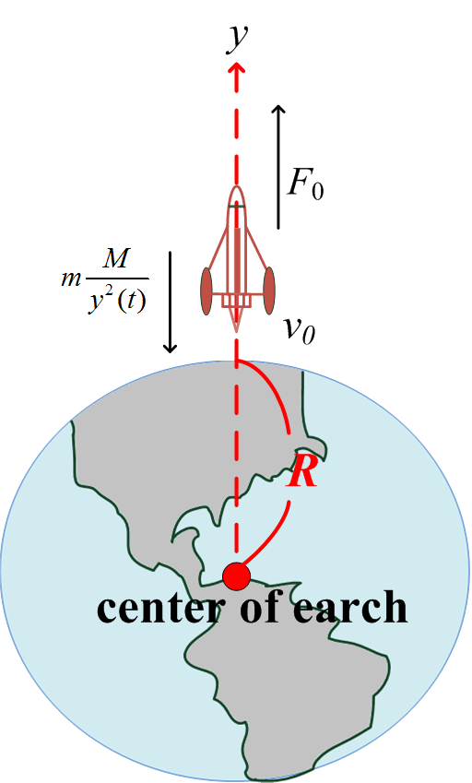
1-4-1 火箭的例子
F = ma
F 會隨著 y 而改變 (萬有引力定律)
萬有引力
M: 地球的質量
m: 火箭的質量
• 修正：
推進力

Slide 87
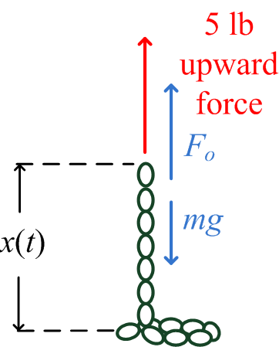
1-4-2 拿鏈子的例子
m: 質量, v: 速度, mv: 動量
20 N
m 會隨著 x 而改變 (拿鏈子的例子),
m = kx(t)
重量 (weight) = x(t)
質量 (mass) = x(t)/9.8

Slide 88
F₀: 施力, k: 每單位長的質量, x(t) 高度 (如前頁)
小常識：使用公制時， g = 9.8 metres per s²
使用英制時， g = 32 feet per s²

Slide 89
[Example 1] (Zill page 227)
k = 1/9.8
g = 9.8
F₀ = 20

