Slide 1
Facial Expression Recognition in Image Sequences Using 1D Transform and Gabor Wavelet Transform
Presenter: R12942007 羅偉倫

Slide 2
Ⅰ. Introduction
In recent years, wide spread utilization of Facial Expression Recognition (FER) have motivated scientific community to find out the optimal solutions for various factors such as facial alignments, occlusions, facial landmarks, illumination and intrinsic variations in FER. However, these factors are mainly highlighted in large set of facial expressions with slight differences, makes it difficult to recognize each facial expression correctly in the real-world scenarios. FER has become a fast growing research interest due to its utility in many disciplines. For example, security agencies for automated user authentication, monitoring human behaviors in the disciplines of psychology/medicine, noticing user responses in public areas and promoting e-learning. FER system can also be employed in business administration for monitoring staff performance; robotics and entertainment. All these disciplines need to perceive, monitor and observe intension/emotions performed by human communication as facial expression.

Slide 3
Ⅰ. Introduction
Different researchers have developed different techniques to extract facial features and classify facial expressions. N. Kauser and J. Sharma used Viola jones algorithm to detect facial components and local binary patterns (LBP) to train the Neural Network (NN).However, their approach performed well but ignored real environments. In [12], a combination of Active Appearance Model (AAM) and NN is presented by T. Li et al., which was unique in terms of image processing pipeline but lacked recognition accuracy. In [13], facial expression recognition system is proposed by considering general regression neural network and LBP features to improve recognition accuracy. F. Hsu et al. [14] designed an automatic FER technique for affective computing based on bag of distances features adopted by holistic/local distance cues. For classification, they used histogram based vectors to support Support Vector Machine (SVM) for FER. In [15], facial masks are combined from the whole face and individual facial components; which presented good results but did not cover image sequences of facial detection. D. Acevedo et al. [16] suggested failure of dynamic approach when movement is not vital in the image sequences and failure of static approach in case of subtle expressions; however the combination of both approaches yields better recognition accuracy.

Slide 4
Ⅰ. Introduction
In this work, we have proposed FER using radon transform and Gabor wavelet transform to classify sequential images of human facials into discrete expressions categories. The methodology is divided into 3 phases. At first, the image sequences are passed through a preprocessing phase where illumination effects, noise reduction, color contrast and face alignment are performed. Then, a face mask is generated for each detected face to identify the face region. These facial detected masks are used to extract optimal features using Principal Component Analysis (PCA), radon transform and Gabor transform. Finally, Self-Organizing Map (SOM) is used to align proper neurons values with specific class. In addition, neural network is used to evaluate weight of each class and recognize the facial expressions. We noticed the success of performance results over several datasets by adding multiple features transformations techniques with combination of fused- classification methods.

Slide 5
Ⅱ. System Methodology
facial detection and generating face mask to do face alignment
feature representation and extraction. Using PCA and other facial feature to do Radon transform and Gabor transform.
Treat features as vectors, and convert vector into symbol sequences. classification and recognition phase gives the predicted values of facial expression.

Slide 6
Ⅱ. System Methodology
Facial Alignment and Detection
The behavioral change in the facial points is observed by considering the vector movements which is controlled as:
noise removal from the facial sequences images
extracting the edges of facial features using a high pass filter. Next, we determine the oval parameters of each feature from the extracted edges using coded chain edge tracking algorithm. The algorithm aims to connect these edges to form an oval shape. To examine the formulation flow, sobel filter is used
Considering vector movements and feature vertices, a face mask is generated as:

Slide 7
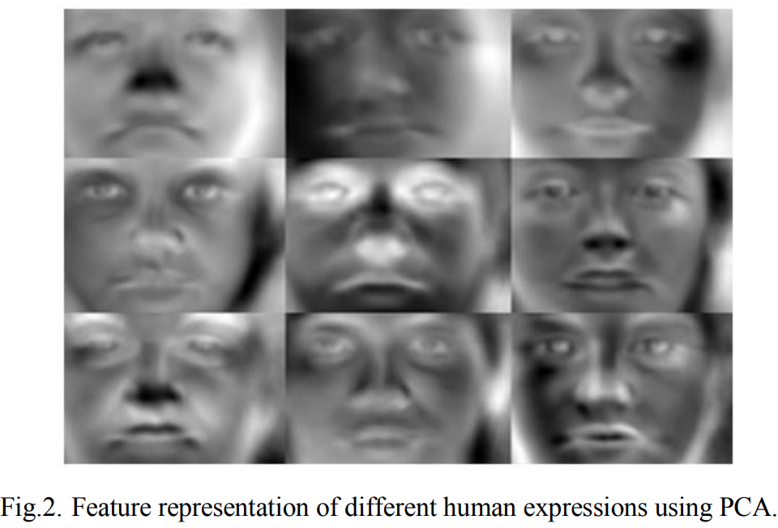
Ⅱ. System Methodology
Feature Reduction and Representation
PCA has been widely used to extract global features and convert the high dimensional data to low dimensional data. Due to large facial feature vertices, PCA is used to reduce the feature space, extracted features from the entire face and optimize the training time
All the facial masks can be reconstructed by storing a set of eigenfaces and their corresponding weights as:

Slide 8
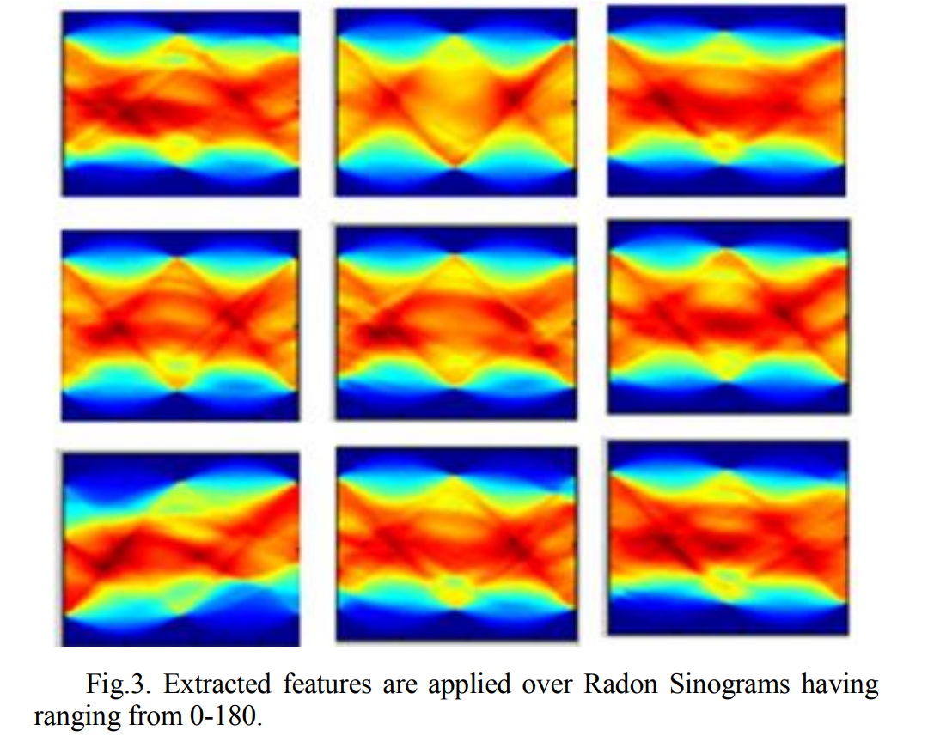
Ⅱ. System Methodology
Intensity based Feature Extraction
From the eigenfaces, we have extracted intensity based features using radon transform. The radon transform converts the image from Cartesian coordinates f(x , y) to polar coordinates g(p , θ), which is expressed as:

Slide 9
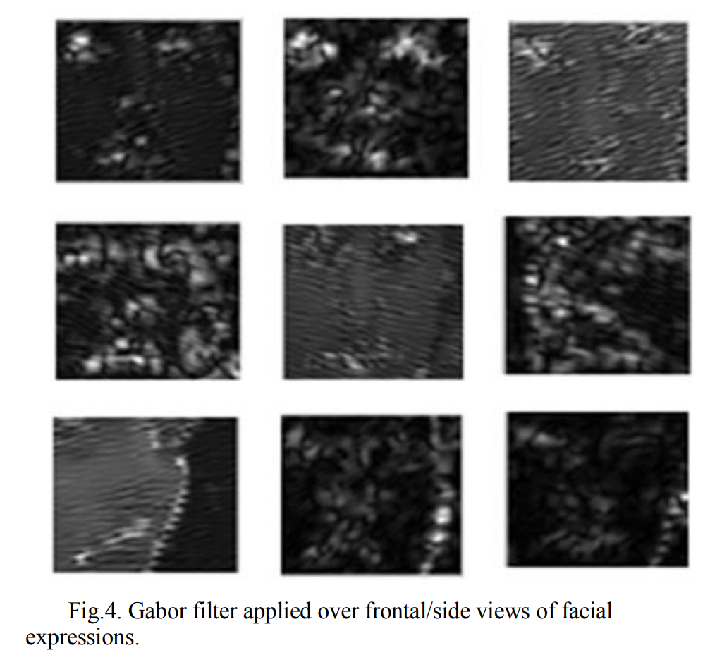
Ⅱ. System Methodology
Gabor Wavelet Transform Features
A Gabor filter is a band pass filter which allows extraction of specific frequencies at particular directions and is mathematically represented as :

Slide 10
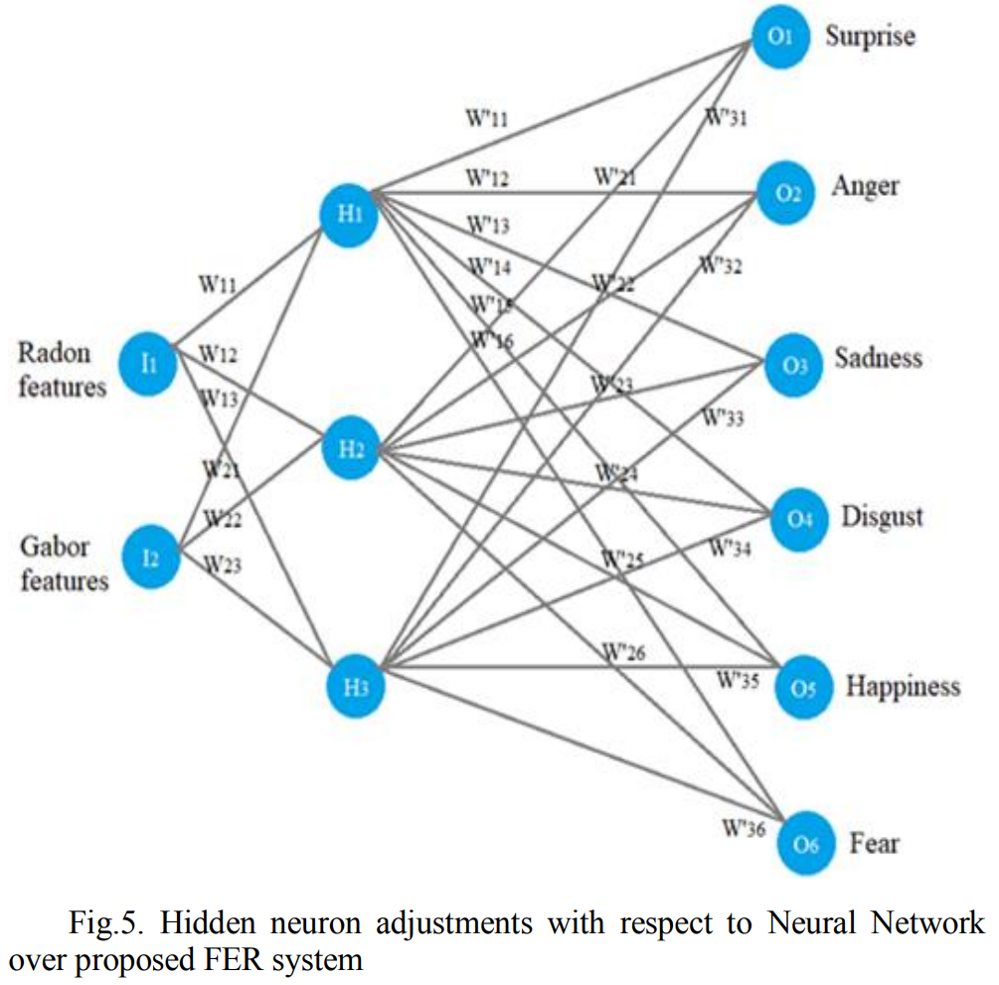
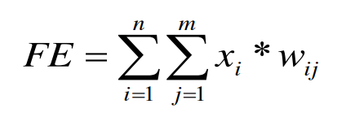
Ⅱ. System Methodology
Neuron mapping and weighted networks
Radon and Gabor features are provided at the input layer which is multiplied with corresponding weights to explore the hidden layer. Finally, facial expression is calculated by taking the sum of the product of neurons and their corresponding weights as :

Slide 11
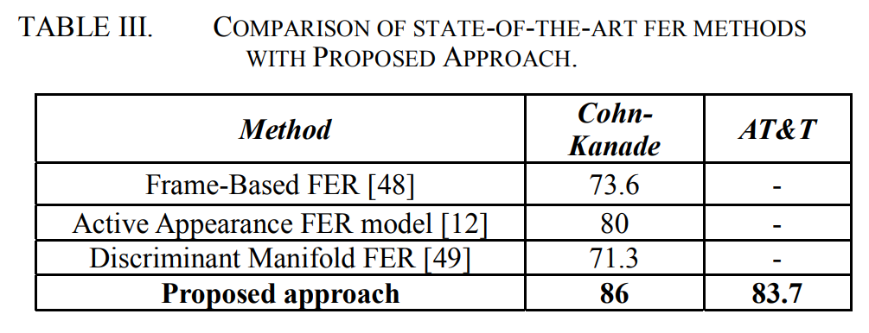
Ⅲ .Performance evaluation
Results

Slide 12
Ⅳ . Conclusion
In this paper, an effective approach for FER is proposed by combining two distinguished feature extractors i.e. radon transform and Gabor wavelet transform. For the classifier, we introduced fused-classifier approach is the form of Neural network over self-organized maps, which outperformed the recognition results. The proposed system has been validated over two publicly available datasets. In our future plan, we will step-forward our approach towards real-time scenarios, introduced robust segmentation techniques and applied features over different angles of facial frames to improve the accuracy of FER.

Slide 13
Reference
M. Mahmood, A. Jalal and H. A. Evans, "Facial Expression Recognition in Image Sequences Using 1D Transform and Gabor Wavelet Transform," 2018 International Conference on Applied and Engineering Mathematics (ICAEM), Taxila, Pakistan, 2018, pp. 1-6, doi: 10.1109/ICAEM.2018.8536280.

