Slide 1
Spectrogram-Based Frequency Hopping Signal Detection in a Complex Electromagnetic Environment
Presenter: Kuang Ping Pan
Student ID: D09942017
Date: 2023 / 12 / 21

Slide 2
Outline
Background and Objective
Frequency-Hopping in Fading Channel
Spectrogram-based FH detection scheme
Simulation and Discussion
Conclusion

Slide 3
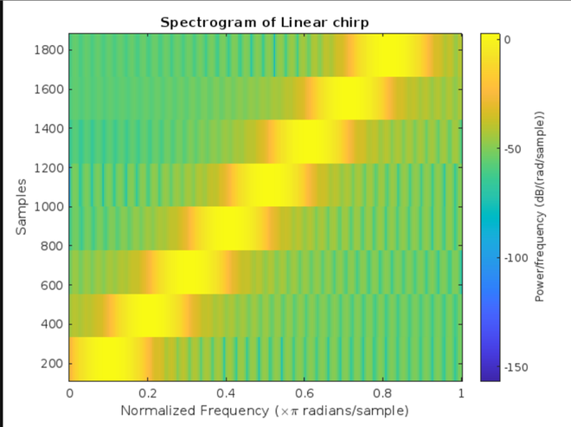
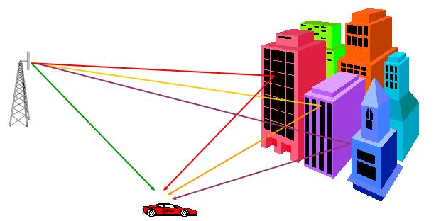
Background & Objective
The main objective of this topic
FH is a non-stationary signal.
Distinguish the signal and Noise.
Compared to traditional CFAR Method.
Use DeepLabv3 Net to do the segmentation
The Figure of Time-Frequency Spectrogram
The traditional method of FH Signal detection
Energy Detection ( CFAR Method for Radar )
Auto-Correlation method
Wavelet transform analysis
Fading Effect in the Communication World
Zhe Deng, Jing Lei* College of Electronic Science and Technology, National University of Defense Technology “Spectrogram-based Frequency Hopping Signal Detection in a Complex Electromagnetic Environment” from 2022 7th International Conference on Signal and Image Processing

Slide 4
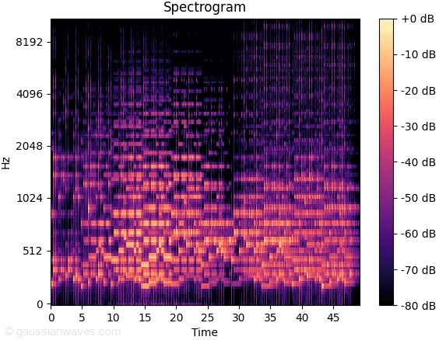
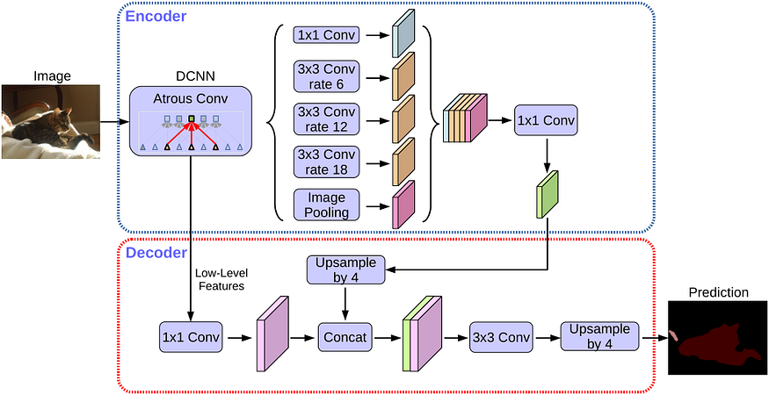
The Novel Detection Method
Use DeepLabv3+ Net platform to detect the spectrogram image pixels
Leverage the similarity of spectrogram and semantic segmentation.
Spatial pyramid pooling module. ( Full contextual information )
Encoder and decoder structure. ( Sharp boundary condition )
Zhe Deng, Jing Lei* College of Electronic Science and Technology, National University of Defense Technology “Spectrogram-based Frequency Hopping Signal Detection in a Complex Electromagnetic Environment” from 2022 7th International Conference on Signal and Image Processing

Slide 5
Outline
Background and Objective
Frequency-Hopping in Fading Channel
Spectrogram-based FH detection scheme
Simulation and Discussion
Conclusion

Slide 6
The Math Modeling of Fading Channel Effect
The 3 main factors compose the math formula in advance
Multipath Effect.
Doppler Effect.
Frequency signal interference.
White noise
White Noise
Time Varying Impulse Response
Interference
Multipath of Fading the i-th Channel
Zhe Deng, Jing Lei* College of Electronic Science and Technology, National University of Defense Technology “Spectrogram-based Frequency Hopping Signal Detection in a Complex Electromagnetic Environment” from 2022 7th International Conference on Signal and Image Processing

Slide 7
The Basic Math Representation of Signal
The MSK Modulation is usually used for FH signal
The k-th hopping duration
Initial Phase
Hopping Phase
Initial time
Non-Return to Zero Rectangular Pulse
Zhe Deng, Jing Lei* College of Electronic Science and Technology, National University of Defense Technology “Spectrogram-based Frequency Hopping Signal Detection in a Complex Electromagnetic Environment” from 2022 7th International Conference on Signal and Image Processing

Slide 8
The Observed Parameters
Power reference ratio represent the physical meaning within this architecture
Zhe Deng, Jing Lei* College of Electronic Science and Technology, National University of Defense Technology “Spectrogram-based Frequency Hopping Signal Detection in a Complex Electromagnetic Environment” from 2022 7th International Conference on Signal and Image Processing

Slide 9
Outline
Background and Objective
Frequency-Hopping in Fading Channel
Spectrogram-based FH detection scheme
Simulation and Discussion
Conclusion

Slide 10
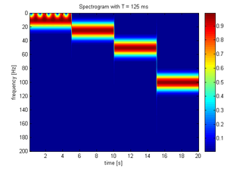
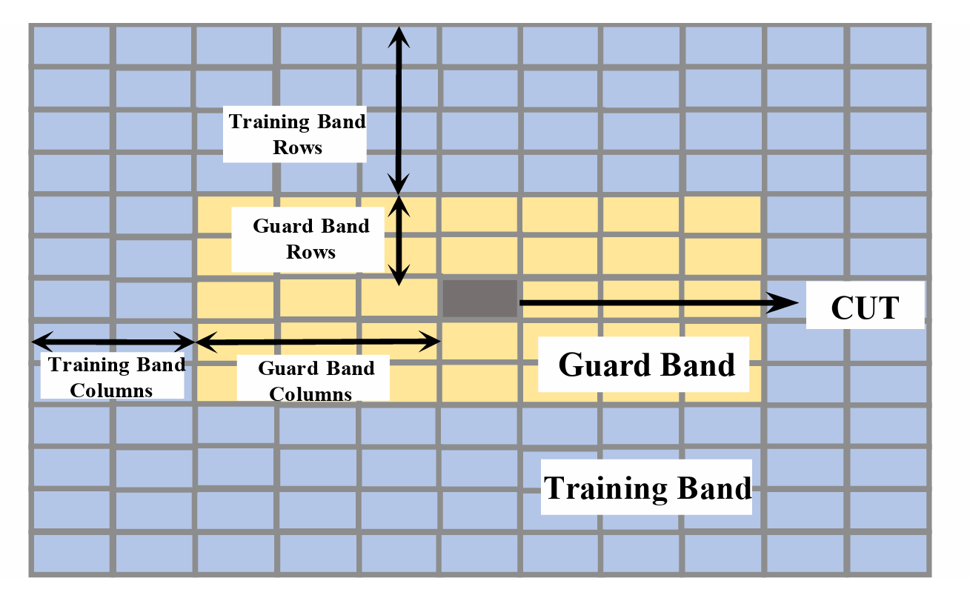
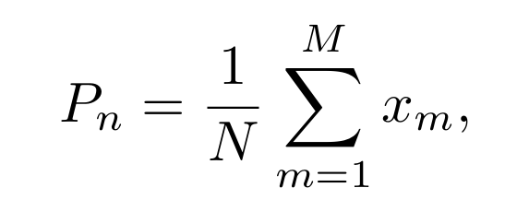
Initiative Time-Frequency Analysis
The basic form of spectrogram
Short Time Fourier Transform
Wavelet Transform Analysis
Wigner Distribution
Original Signal
The result of STFT
Noise Cells can be represented by Power
The Threshold of Detection
False Alarm Detection Rate
Detection by CFAR
Zhe Deng, Jing Lei* College of Electronic Science and Technology, National University of Defense Technology “Spectrogram-based Frequency Hopping Signal Detection in a Complex Electromagnetic Environment” from 2022 7th International Conference on Signal and Image Processing

Slide 11
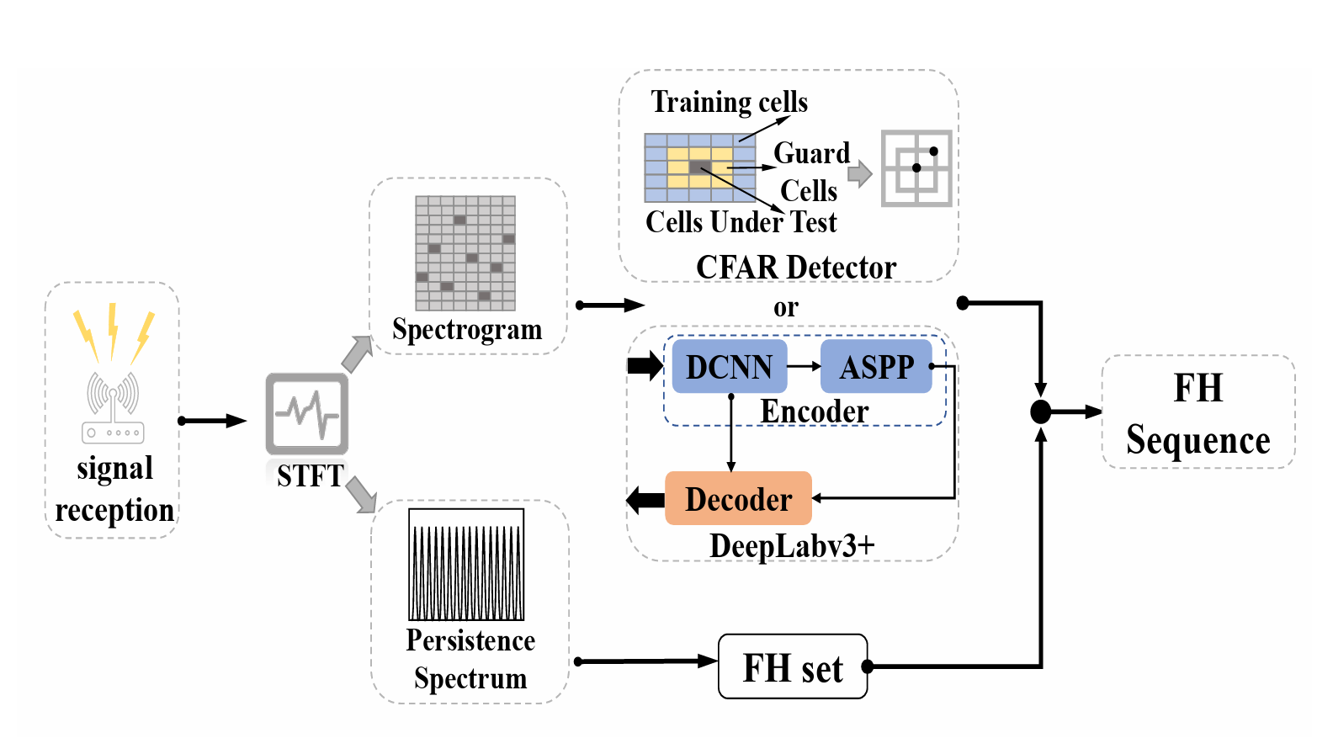
Detection Scheme
The logic flow chart of the detection scheme of hopping signal
Zhe Deng, Jing Lei* College of Electronic Science and Technology, National University of Defense Technology “Spectrogram-based Frequency Hopping Signal Detection in a Complex Electromagnetic Environment” from 2022 7th International Conference on Signal and Image Processing

Slide 12
Outline
Background and Objective
Frequency-Hopping in Fading Channel
Spectrogram-based FH detection scheme
Simulation and Discussion
Conclusion

Slide 13
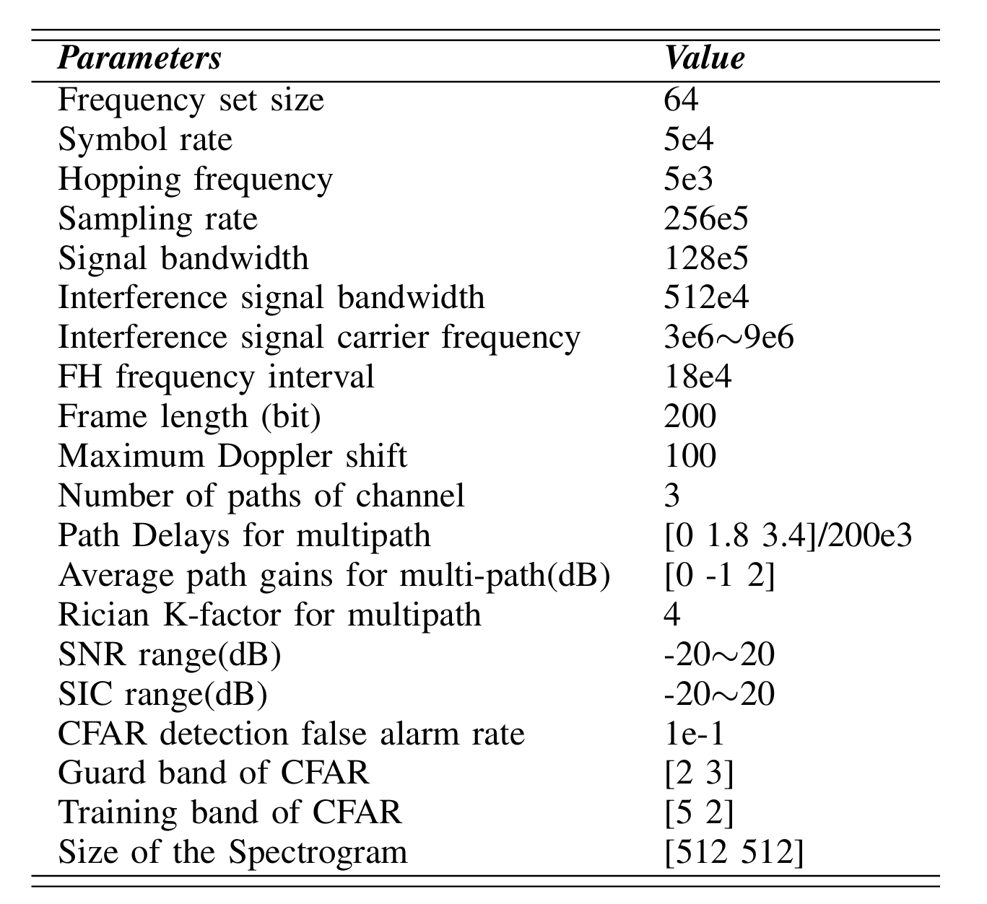
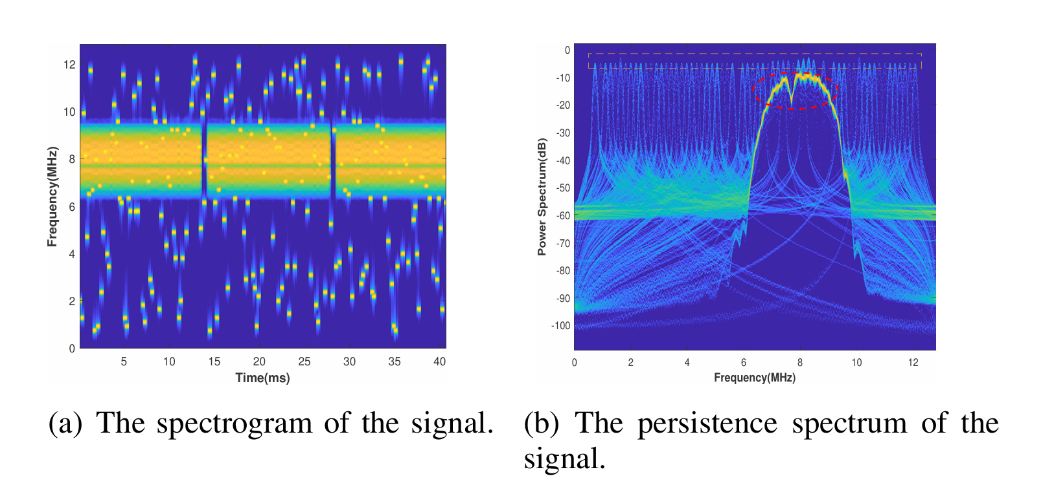
Simulation Condition Analysis
The real case simulation was applied by industrial WLAN standard
MSK Modulation
Rayleigh Fading Channel
WLAN Radio by 802.11 Specifications
Zhe Deng, Jing Lei* College of Electronic Science and Technology, National University of Defense Technology “Spectrogram-based Frequency Hopping Signal Detection in a Complex Electromagnetic Environment” from 2022 7th International Conference on Signal and Image Processing

Slide 14
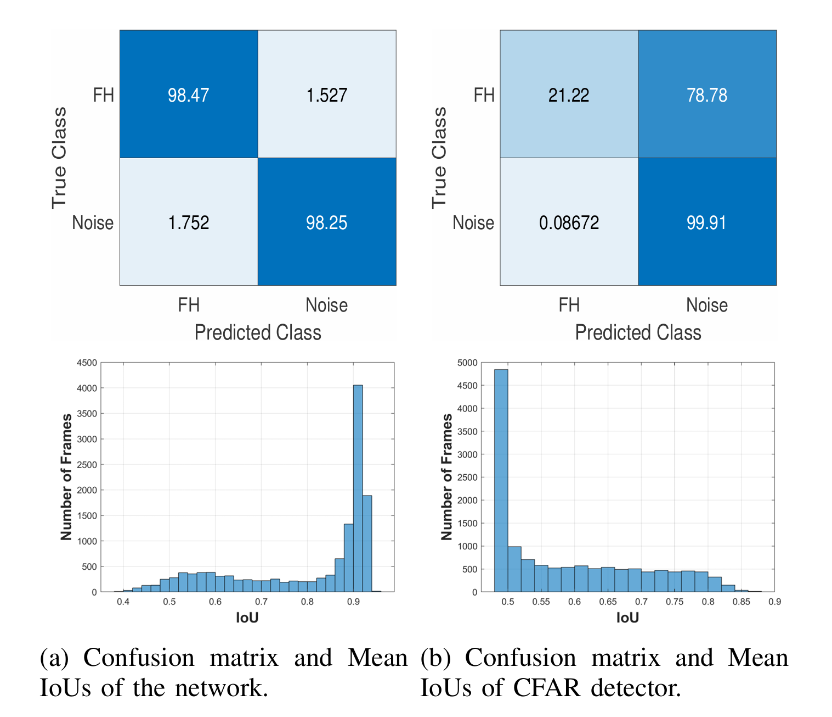
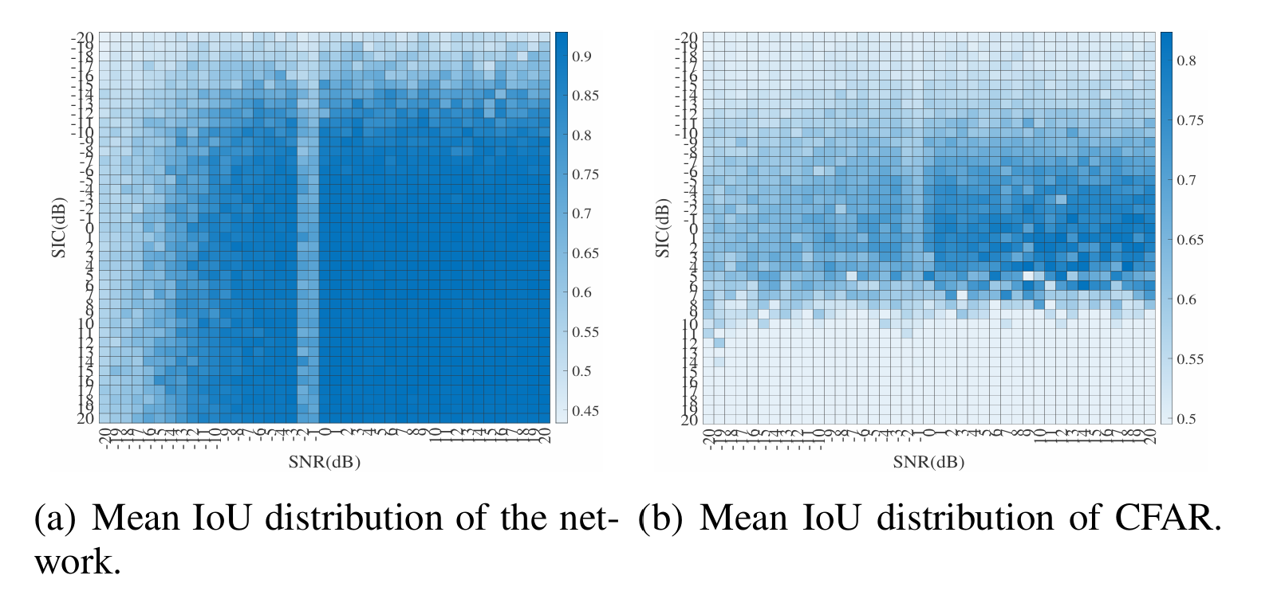
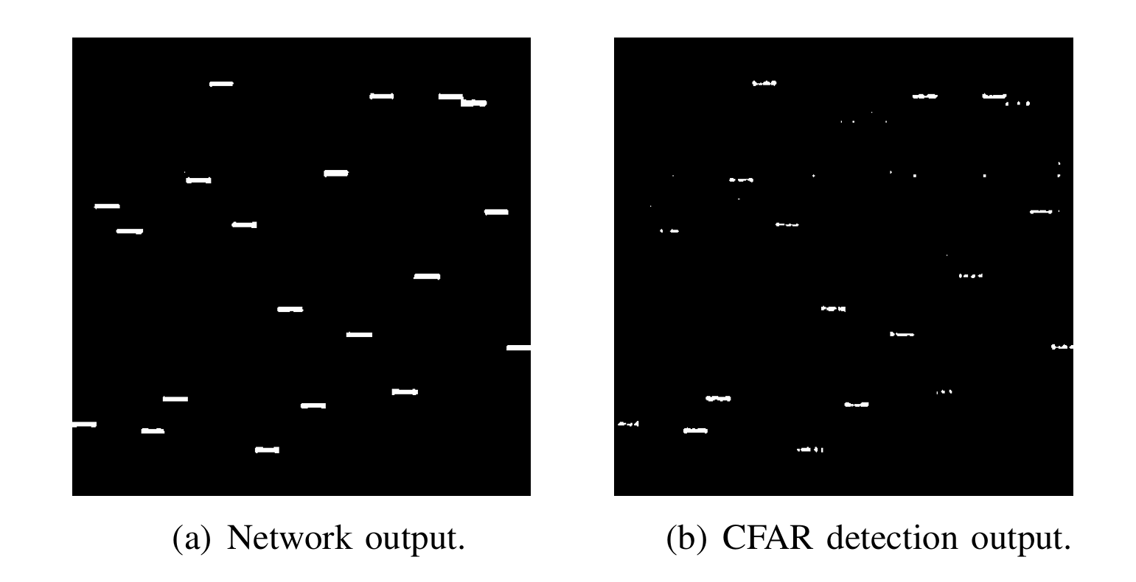
The Result Comparison
Comparison between the method of “Network” and “CFAR”
Zhe Deng, Jing Lei* College of Electronic Science and Technology, National University of Defense Technology “Spectrogram-based Frequency Hopping Signal Detection in a Complex Electromagnetic Environment” from 2022 7th International Conference on Signal and Image Processing

Slide 15
Outline
Background and Objective
Frequency-Hopping in Fading Channel
Spectrogram-based FH detection scheme
Simulation and Discussion
Conclusion

Slide 16
Conclusion
How to detect the FH signal under complex electromagnetic environment
The spectrogram-based algorithm was proposed to detect the FH signal.
The DeepLabv3+ platform can perform well under stronger signal and noise interference.
The Net-based detection method is much better than the CFAR-based one.
When SNR and SIR are lower, Net-based performance will be lower than CFAR-based.
Zhe Deng, Jing Lei* College of Electronic Science and Technology, National University of Defense Technology “Spectrogram-based Frequency Hopping Signal Detection in a Complex Electromagnetic Environment” from 2022 7th International Conference on Signal and Image Processing

Slide 17
Thank You

