Slide 1
Super-Resolution using Wavelet
CHIH-YUAN YEH
Paper Survey
Dec 3, 2020

Slide 2
Outline
Super-Resolution
Super-Resolution using Wavelet
Learning-based Super-Resolution
DWSR

Slide 3
Outline
Super-Resolution
Super-Resolution using Wavelet
Learning-based Super-Resolution
DWSR

Slide 4
Super-Resolution
Restore high-resolution image from one or more low-resolution observations of the same scene.
Single image super-resolution
Multi-image super-resolution

Slide 5
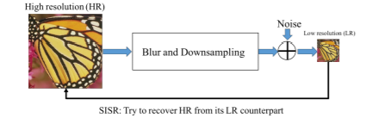
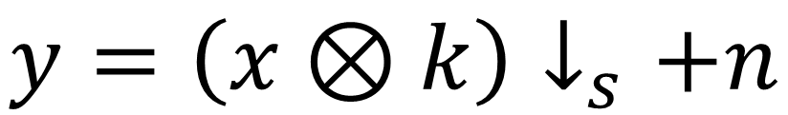
Data
$$y=\left(x⊗k\right)↓_{s}+n$$

Slide 6
Outline
Super-Resolution
Super-Resolution using Wavelet
Learning-based Super-Resolution
DWSR

Slide 7
Wavelet
L-points
g[m]
↓ 2
x_{1,L}[m, n]
along m
m 低頻, n 低頻
g[n]
↓ 2
v_{1,L}[m, n]
M ×N
along n
h[m]
↓ 2
x_{1,H1}[m, n]
x[m, n]
along m
m 高頻, n 低頻
L-points
g[m]
↓ 2
x_{1,H2}[m, n]
h[n]
↓ 2
v_{1,H}[m, n]
along m
m 低頻, n 高頻
along n
h[m]
↓ 2
x_{1,H3}[m, n]
along m
m 高頻, n 高頻
n
m
x[m, n]

Slide 8
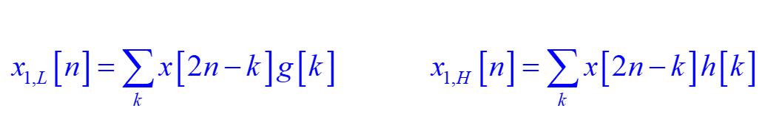
Wavelet
例子：2-point Haar wavelet
g[n] = 1/2 for n = −1, 0
g[n] = 0 otherwise
h[0] = 1/2, h[−1] = −1/2,
h[n] = 0 otherwise
½ ½
½
g[n]
h[n]
-3 -2 -1 0 1 2 3
n
-3 -2 -1 0 1 2 3
n
-½
then
(兩點平均)
(兩點之差)

Slide 9
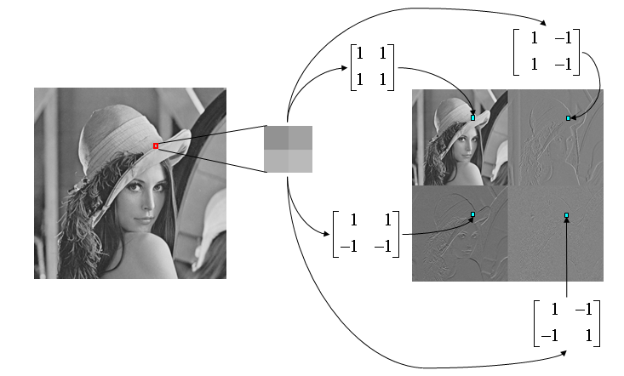
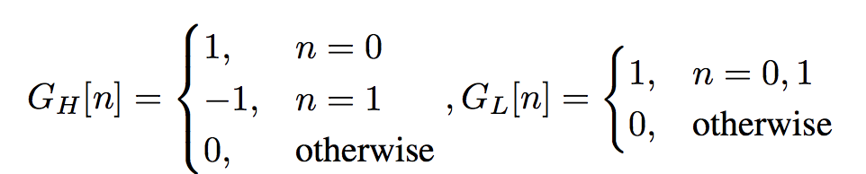
Wavelet

Slide 10
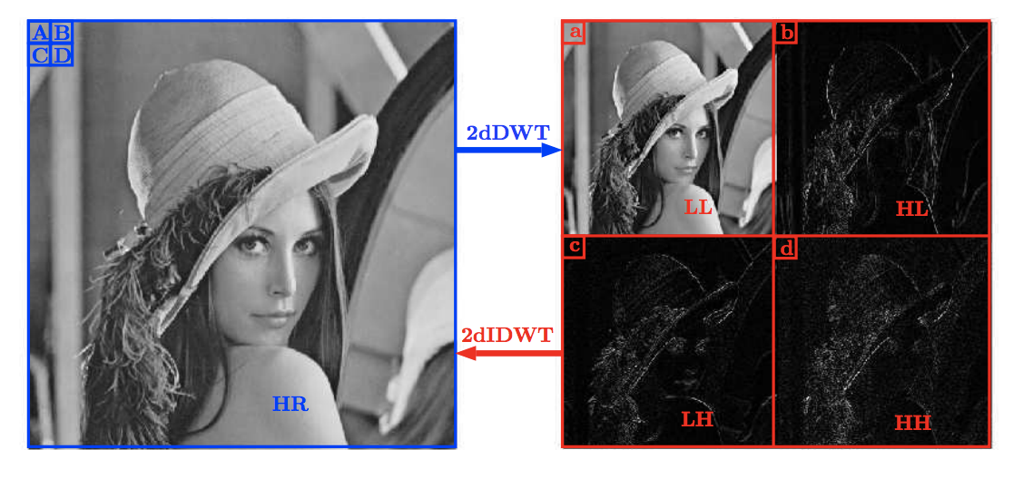
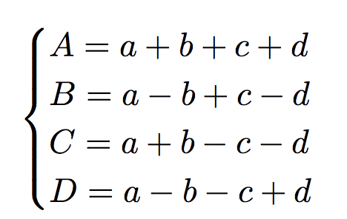
Wavelet

Slide 11
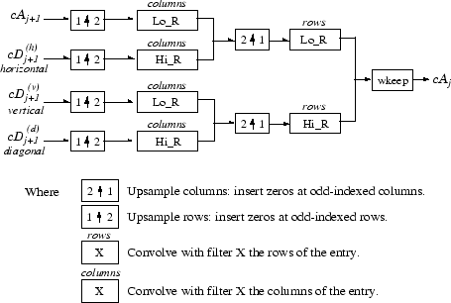
2D Inverse DWT

Slide 12
原影像
Pepper.bmp
x_{1,L}[m, n]
x_{1,H2}[m, n]
2-D DWT
的結果
x_{1,H1}[m, n]
x_{1,H3}[m, n]

Slide 13
Super-Resolution using Wavelet
N. Nguyen and P. Milanfar, “An efficient wavelet-based algorithm for image superresolution,” in Image Processing. IEEE International Conference on, vol. 2, pp. 351–354, 2000.
C. Jiji, M. V. Joshi, and S. Chaudhuri, “Single-frame image super-resolution using learned wavelet coefficients,” International journal of Imaging systems and Technology, vol. 14, no. 3, pp. 105–112, 2004.
G. Anbarjafari and H. Demirel, “Image super resolution based on interpolation of wavelet domain high frequency subbands and the spatial domain input image,” ETRI journal, vol. 32, no. 3, pp. 390–394, 2010.

Slide 14
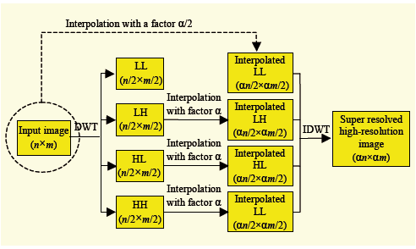
DASR
G. Anbarjafari and H. Demirel, “Image super resolution based on interpolation of wavelet domain high frequency subbands and the spatial domain input image,” ETRI journal, vol. 32, no. 3, pp. 390–394, 2010

Slide 15
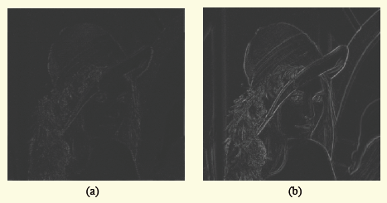
DASR

Slide 16
Outline
Super-Resolution
Super-Resolution using Wavelet
Learning-based Super-Resolution
DWSR

Slide 17
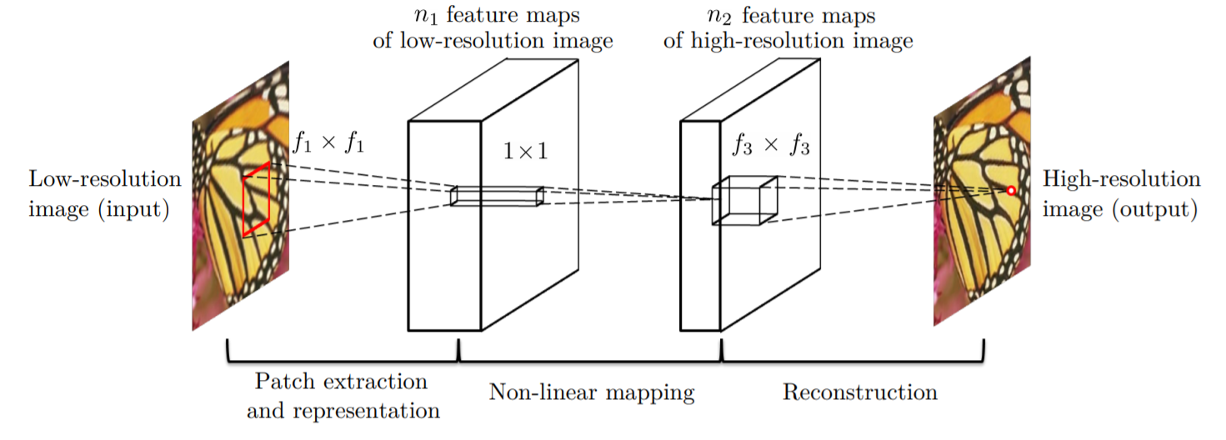
Learning-based Super-Resolution
SRCNN

Slide 18
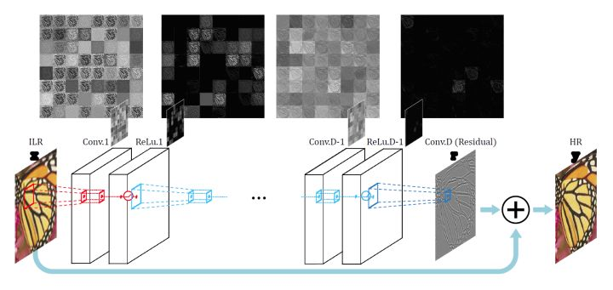
Learning-based Super-Resolution
VDSR

Slide 19
Outline
Super-Resolution
Super-Resolution using Wavelet
Learning-based Super-Resolution
DWSR

Slide 20
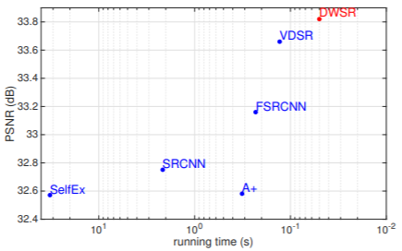
DWSR
Deep Wavelet Prediction for Image Super-resolution (2017 CVPR workshop Challenge on Single Image Super-Resolution)

Slide 21
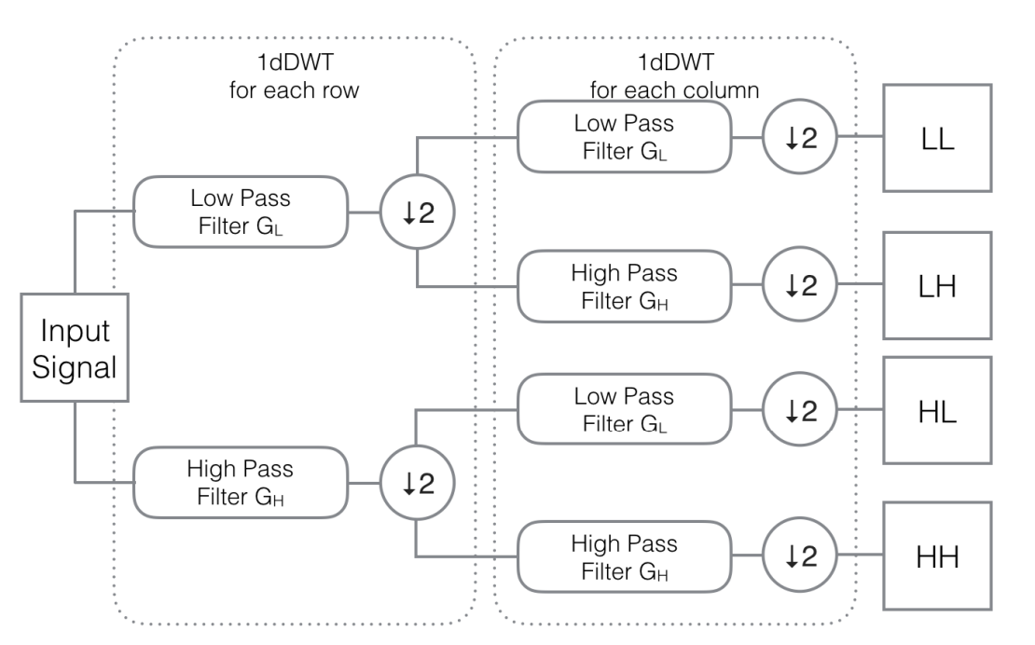
DWSR

Slide 22
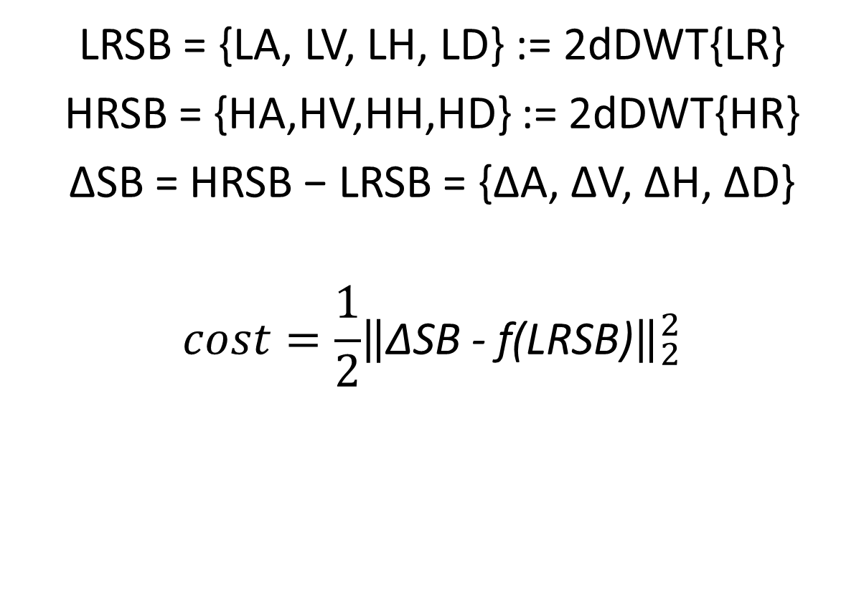
DWSR Training Procedure
LRSB = {LA, LV, LH, LD} := 2dDWT{LR}
HRSB = {HA,HV,HH,HD} := 2dDWT{HR}
∆SB = HRSB − LRSB = {∆A, ∆V, ∆H, ∆D}
$$cost=\frac{1}{2}{\left\|\text{∆}\text{SB} \text{−} \text{f}\text{(}\text{LRSB}\text{)}\right\|}_{2}^{2}$$

Slide 23
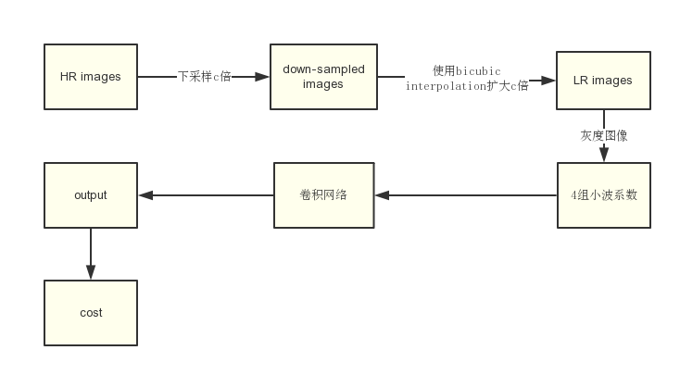
DWSR

Slide 24
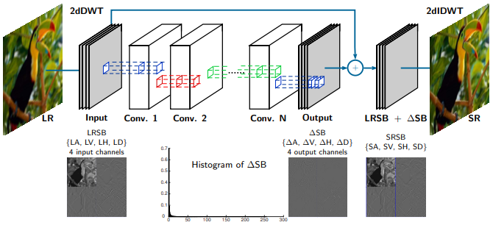
DWSR

Slide 25

 | VDSR | DWSR
First layer | 1 × 3 × 3 × 64 | 4 × 3 × 3 × 64
Middle layer | 64 × 3 × 3 × 64 | 64 × 3 × 3 × 64
Last layer | 64 × 3 × 3 × 1 | 64 × 3 × 3 × 4
Total layer | 20 | 12

Slide 26
Generating SR Results
LRSB = {LA, LV, LH, LD} := 2dDWT{LR}
SRSB = {SA, SV, SH, SD}
= {LA + ∆A, LV + ∆V, LH + ∆H, LD + ∆D}
SR = 2d Inverse DWT{SRSB}

Slide 27
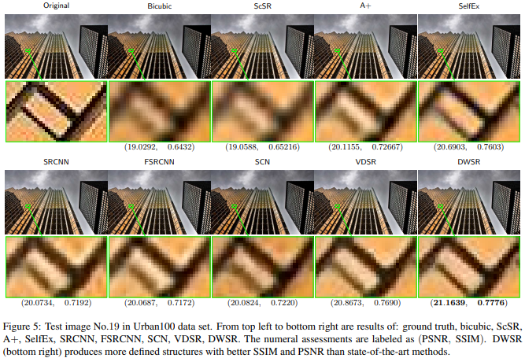
Results

Slide 28
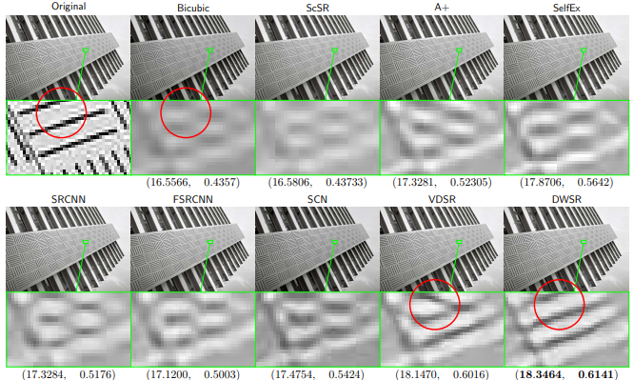
Artifacts Diagonal Edges

Slide 29
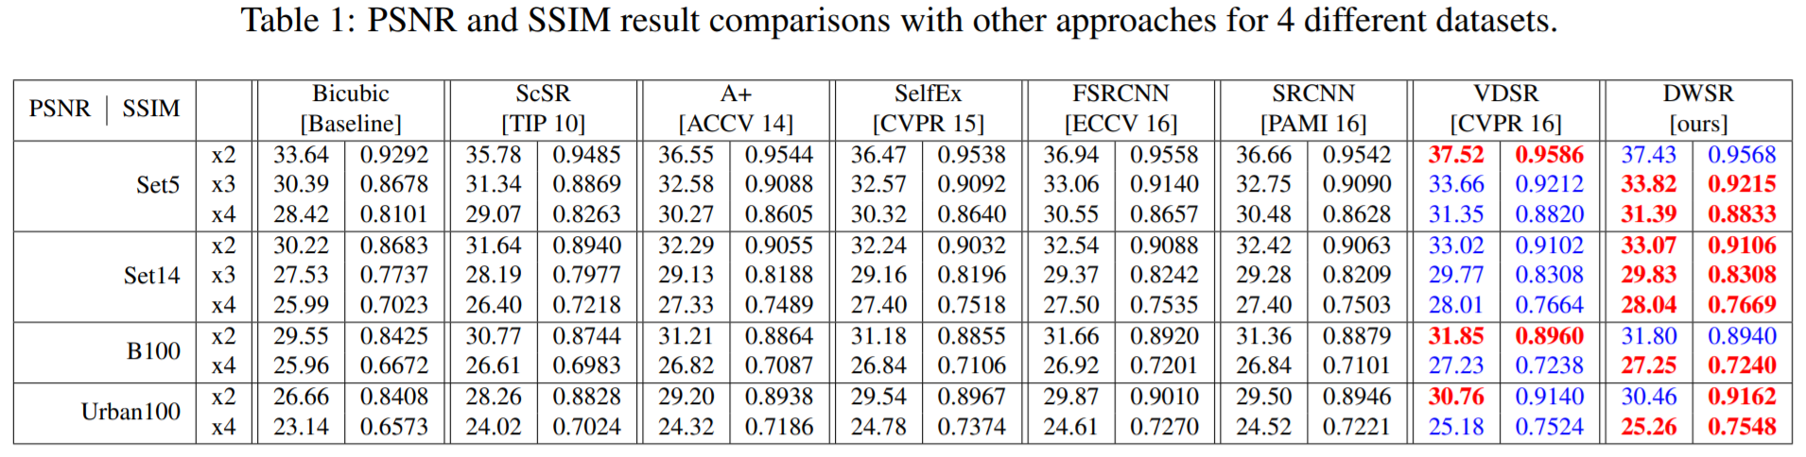
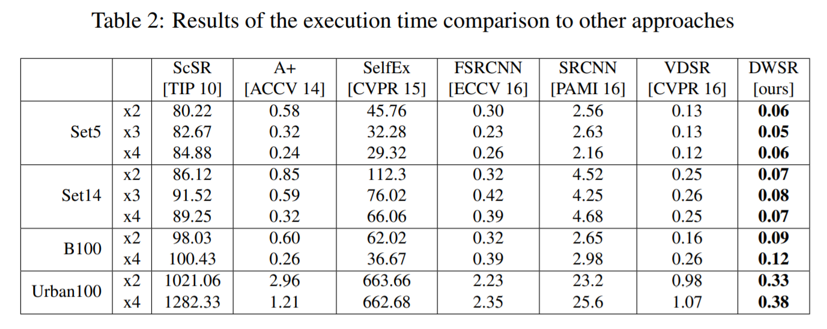
Results

Slide 30
Conclusion
Recovers the “missing details” by using (low-resolution) wavelet sub-bands as inputs.
DWSR is significantly economical in the number of parameters compared to most state-of-the-art methods and yet achieves competitive or better results

Slide 31
Thank you
Notes:
/*///

