Slide 1
Applications of Time-Frequency Analysis
for Filter Design
9-1 Signal Decomposition and Filter Design
Signal Decomposition: Decompose a signal into several components.
Filter: Remove the undesired component of a signal
(1) Decomposing in the time domain
component 1
component 2
t₀
t-axis
criterion

Slide 2
(2) Decomposing in the frequency domain
-5 -2 2 5
f-axis
• Sometimes, signal and noise are separable in the time domain →
(1) without any transform
• Sometimes, signal and noise are separable in the frequency domain →
(2) using the FT (conventional filter)
If signal and noise are not separable in both the time and the frequency domains →
(3) Using the fractional Fourier transform and time-frequency analysis

Slide 3
以時頻分析的觀點，criterion in the time domain 相當於 cutoff line perpendicular to t-axis
f-axis
cutoff line
t₀
=
t-axis
t₀
t-axis
以時頻分析的觀點，criterion in the frequency domain 相當於 cutoff line perpendicular to f-axis
f-axis
f₀
cutoff line
=
f₀
f-axis
t-axis

Slide 4

x(t) = triangular signal + chirp noise 0.3exp[j 0.5(t −4.4)²]
signal + noise
FT
reconstructed signal
FRFT
φ = -arccot(1/2π)

Slide 5
x(t) = triangular signal + chirp noise 0.3exp[j 0.5(t −4.4)²]
f-axis
t-axis

Slide 6
Decomposing in the time-frequency distribution
If x(t) = 0 for t < T₁ and t > T₂
for t < T₁ and t > T₂ (cutoff lines perpendicular to t-axis)
If X( f ) = FT[x(t)] = 0 for f < F₁ and f > F₂
for f < F₁ and f > F₂ (cutoff lines parallel to t-axis)
What are the cutoff lines with other directions?
with the aid of the FRFT, the LCT, or the Fresnel transform

Slide 7
• Filter designed by the fractional Fourier transform
比較：
means the fractional Fourier transform:
f-axis
φ
Signal
noise
noise
noise
Signal
Signal
FRFT_{φ}
FRFT_{−φ}
t-axis
cutoff line
cutoff line

Slide 8
If
If
S(u): Step function
0
(1) φ 由 cutoff line 和 f-axis 的夾角決定
(2) u₀ 等於 cutoff line 距離原點的距離
(注意正負號)

Slide 9
• Effect of the filter designed by the fractional Fourier transform (FRFT):
Placing a cutoff line in the direction of (−sinφ, cosφ)
φ = 0 φ = 0.15π φ = 0.35π φ = 0.5π
(time domain) (FT)

Slide 10
.
.
f-axis
(0, f₁)
desired part
cutoff line
undesired
part
(-t₀, 0)
(t₁, 0)
t-axis
undesired
part
cutoff line
(0, -f₀)
φ = ? u₀ = ?

Slide 11
  The Fourier transform is suitable to filter out the noise that is a combination of
  sinusoid functions exp(jn₁t).
• The fractional Fourier transform (FRFT) is suitable to filter out the noise that
  is a combination of higher order exponential functions
  exp[j(n_{k} t^{k} + n_{k-1} t^{k-1} + n_{k-2} t^{k-2} + ……. + n₂ t² + n₁ t)]
For example: chirp function exp(jn₂ t²)
• With the FRFT, many noises that cannot be removed by the FT will be
filtered out successfully.

Slide 12
Example (I)
(a) Signal s(t) (b) f(t) = s(t) + noise (c) WDF of s(t)

Slide 13
(d) WDF of f(t) (e) GT of s(t) (f) GT of f(t)
GT: Gabor transform,
WDF: Wigner distribution function
horizontal: t-axis, vertical: ω-axis

Slide 14
GWT: Gabor-Wigner transform
(g) GWT of f(t) (h) Cutoff lines on GT (i) Cutoff lines on GWT
根據斜率來決定 FrFT 的 order

Slide 15
(j) performing the FRFT
and calculate the GWT
(k) High pass filter (l) GWT after filter
(performing the FRFT)
(m) recovered signal (n) recovered signal (green)
and the original signal (blue)

Slide 16
Example (II)
Signal +
(a) Input signal (b) Signal + noise (c) WDF of (b)
(d) Gabor transform of (b) (e) GWT of (b) (f) Recovered signal

Slide 17
[Important Theory]:
Using the FT can only filter the noises that do not overlap with the signals in the frequency domain (1-D)
In contrast, using the FRFT can filter the noises that do not overlap with the signals on the time-frequency plane (2-D)

Slide 18
[思考]
Q1: 哪些 time-frequency distribution 比較適合處理 filter 或 signal decomposition 的問題？
Q2: Cutoff lines 有可能是非直線的嗎？

Slide 19
[Ref] Z. Zalevsky and D. Mendlovic, “Fractional Wiener filter,” Appl. Opt., vol. 35, no. 20, pp. 3930-3936, July 1996.
[Ref] M. A. Kutay, H. M. Ozaktas, O. Arikan, and L. Onural, “Optimal filter in fractional Fourier domains,” IEEE Trans. Signal Processing, vol. 45, no. 5, pp. 1129-1143, May 1997.
[Ref] B. Barshan, M. A. Kutay, H. M. Ozaktas, “Optimal filters with linear canonical transformations,” Opt. Commun., vol. 135, pp. 32-36, 1997.
[Ref] H. M. Ozaktas, Z. Zalevsky, and M. A. Kutay, The Fractional Fourier Transform with Applications in Optics and Signal Processing, New York, John Wiley & Sons, 2000.
[Ref] S. C. Pei and J. J. Ding, “Relations between Gabor transforms and fractional Fourier transforms and their applications for signal processing,” IEEE Trans. Signal Processing, vol. 55, no. 10, pp. 4839-4850, Oct. 2007.

Slide 20
9-2 TF analysis and Random Process
For a random process x(t), we cannot find the explicit value of x(t). The value of x(t) is expressed as a probability function.
• Auto-covariance function R_{x}(t,τ )
(alternative definition of the auto-covariance function:
• Power spectral density (PSD) S_{x}(t, f )
In usual, we suppose that
E[x(t)] = 0 for any t

Slide 21
Relation between the WDF and the random process
Relation between the ambiguity function and the random process

Slide 22
• Stationary random process:
the statistical properties do not change with t.
Auto-covariance function
for any t,
PSD:
White noise: where σ is some constant.

Slide 23
• When x(t) is stationary,
(invariant with t)
(nonzero only when η = 0)
a typical E[W_{x}(t, f)] for stationary random process
a typical E[A_{x}(η, τ)] for stationary random process
f
τ
t
η

Slide 24
• For white noise,
[Ref 1] W. Martin, “Time-frequency analysis of random signals”, ICASSP’82, pp. 1325-1328, 1982.
[Ref 2] W. Martin and P. Flandrin, “Wigner-Ville spectrum analysis of nonstationary processed”, IEEE Trans. ASSP, vol. 33, no. 6, pp. 1461-1470, Dec. 1983.
[Ref 3] P. Flandrin, “A time-frequency formulation of optimum detection” , IEEE Trans. ASSP, vol. 36, pp. 1377-1384, 1988.
[Ref 4] S. C. Pei and J. J. Ding, “Fractional Fourier transform, Wigner
distribution, and filter design for stationary and nonstationary
random processes,” IEEE Trans. Signal Processing, vol. 58, no.
8, pp. 4079-4092, Aug. 2010.

Slide 25
Filter Design for White noise
f-axis
conventional filter
by TF analysis
Signal
t-axis
white noise everywhere
E_{signal}: energy of the signal
A: area of the time frequency distribution of
the signal
The PSD of the white noise is S_{noise}(f) = σ

Slide 26
If varies with t and is nonzero when η ≠ 0,
then x(t) is a non-stationary random process.
If ①
② x_{n}(t)’s have zero mean for all t’s
③ x_{n}(t)’s are mutually independent for all t’s and τ’s
if m ≠ n, then
,

Slide 27
(1) Random process for the STFT
E[x(t)] ≠ 0 should be satisfied.
Otherwise,
for zero-mean random process, E[X(t, f )] = 0
(2) Decompose by the AF and the FRFT
Any non-stationary random process can be expressed as a summation of the fractional Fourier transform (or chirp multiplication) of stationary random process.

Slide 28
τ-axis
η-axis
An ambiguity function plane can be viewed as a combination of infinite number of radial lines.
Each radial line can be viewed as the fractional Fourier transform of a stationary random process.

Slide 29
信號處理小常識
white noise
α ≠ 0 color noise

Slide 30
X. Other Applications of Time-Frequency Analysis
Applications
(1) Finding Instantaneous Frequency
(2) Signal Decomposition
(3) Filter Design
(4) Sampling Theory
(5) Modulation and Multiplexing
(6) Electromagnetic Wave Propagation
(7) Optics
(8) Radar System Analysis
(9) Random Process Analysis
(10) Music Signal Analysis
(11) Biomedical Engineering
(12) Accelerometer Signal Analysis
(13) Acoustics
(14) Data Compression
(15) Spread Spectrum Analysis
(16) System Modeling
(17) Economic Data Analysis
(18) Signal Representation
(19) Seismology
(20) Geology
(21) Astronomy
(22) Oceanography
(23) Satellite Signal Analysis
(24) Image Processing??

Slide 31
10-1 Sampling Theory
Number of sampling points == Sum of areas of time frequency distributions
+ the number of extra parameters
How to make the area of time-frequency smaller?
(1) Divide into several components.
(2) Use chirp multiplications, chirp convolutions, fractional Fourier transforms, or linear canonical transforms to reduce the area.
[Ref] X. G. Xia, “On bandlimited signals with fractional Fourier transform,”
IEEE Signal Processing Letters, vol. 3, no. 3, pp. 72-74, March 1996.
[Ref] J. J. Ding, S. C. Pei, and T. Y. Ko, “Higher order modulation and the
efficient sampling algorithm for time variant signal,” European Signal
Processing Conference, pp. 2143-2147, Bucharest, Romania, Aug. 2012.

Slide 32
Analytic Signal Conversion
Shearing
shearing
Area

Slide 33
Step 1 Analytic Signal Conversion
Step 2 Separate the components
(a) (b)
+
Step 3 Use shearing or rotation to minimize the “area” to each component
Step 4 Use the conventional sampling theory to sample each components

Slide 34
傳統的取樣方式
重建：
新的取樣方式
Hilbert transform of x(t)
(1)
(2)
(3)
k = 1, 2, …, K
(4)
k = 1, 2, …, K

Slide 35
重建：
(1)
(2)
(3)
(4)

Slide 36
嚴格來說，沒有一個信號的 時頻分佈的「面積」是有限的。
Theorem:
If x(t) is time limited (x(t) = 0 for t < t₁ and t > t₂)
then it is impossible to be frequency limited
If x(t) is frequency limited (X(f) = 0 for f < f₁ and f > f₂)
then it is impossible to be time limited
但是我們可以選一個 “threshold” Δ
時頻分析 |X (t, f)| > Δ 或 的區域的面積是有限的
實際上，以「面積」來討論取樣點數，是犧牲了一些精確度。

Slide 37
只取 t ∈ [t₁, t₂] and f ∈ [f₁, f₂] 犧牲的能量所佔的比例
X₁(f) = FT[x₁(t)],
x₁(t) = x(t) for t ∈ [t₁, t₂] , x₁(t) = 0 otherwise
• For the Wigner distribution function (WDF)
= energy of x(t).

Slide 38
A
B
C
D
f-axis
D
A
f₂
B
t-axis
t₁
t₂
f₁
C

Slide 39
10-2 Modulation and Multiplexing
With the aid of
the Gabor transform (or the Gabor-Wigner transform)
horizontal and vertical shifting, dilation, shearing, generalized shearing, and rotation.
[Ref] C. Mendlovic and A. W. Lohmann, “Space-bandwidth product
adaptation and its application to superresolution: fundamentals,”
J. Opt. Soc. Am. A, vol. 14, pp. 558-562, Mar. 1997.
[Ref] S. C. Pei and J. J. Ding, “Relations between Gabor transforms and
fractional Fourier transforms and their applications for
signal processing,” vol. 55, issue 10, pp. 4839-4850, IEEE Trans.
Signal Processing, 2007.

Slide 40
Example
FT
We want to add f(t) into G(u)
(no empty band)

Slide 42
◎ Conventional Modulation Theory
The signals x₁(t), x₂(t), x₃(t), ……., x_{K}(t) can be transmitted successfully if
Allowed Bandwidth ≥
B_{k}: the bandwidth (including the negative frequency part) of x_{k}(t)
◎ Modulation Theory Based on Time-Frequency Analysis
The signals x₁(t), x₂(t), x₃(t), ……., x_{K}(t) can be transmitted successfully if
Allowed Time duration × Allowed Bandwidth ≥
The interference is inevitable.
How to estimate the interference?
A_{k}: the area of the time-frequency distribution of x_{k}(t)

Slide 43
10-3 Electromagnetic Wave Propagation
Time-Frequency analysis can be used for
Wireless Communication
Optical system analysis
Laser
Radar system analysis
Propagation through the free space (Fresnel transform): chirp convolution
Propagation through the lens or the radar disk: chirp multiplication

Slide 44
Fresnel Transform ：描述電磁波在空氣中的傳播 (See pages 267-271)
電磁波包括光波、雷達波、紅外線、紫外線………
Fresnel transform == LCT with parameters
思考： (1) STFT 或 WDF 哪一個比較適合用在電磁波傳播的分析？
(2) 為何波長越短的電磁波，在空氣中散射的情形越少？

Slide 45
(4) Spherical Disk
y-axis
x-axis
direction of wave
propagation
R
radius of the disk = R
plane
Disk 相當於 LCT
的情形

Slide 46
R_{A} R_{B}
disk A disk B
D
相當於 LCT
的情形

Slide 47
10-3 Accelerometer Signal Analysis
The 3-D Accelerometer (三軸加速規) can be used for identifying the activity of a person.
z-axis
y: 0
z: -9.8
z-axis
y-axis
y-axis
tilted by θ
x-axis
z-axis
y-axis
y: -9.8sinθ
z: -9.8cosθ

Slide 48
Using the 3D accelerometer + time-frequency analysis, one can analyze the activity of a person.
Walk, Run (Pedometer 計步器)
Healthcare for the person suffered from Parkinson’s disease

Slide 49
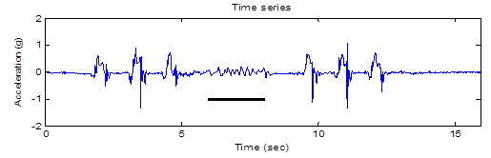
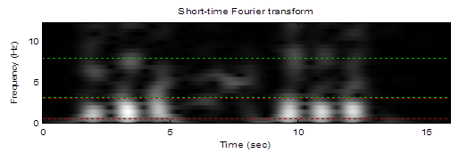
3D accelerometer signal for a person suffering from Parkinson’s disease
The result of the short-time Fourier transform
Y. F. Chang, J. J. Ding, H. Hu, Wen-Chieh Yang, and K. H. Lin, “A real-time detection algorithm for freezing of gait in Parkinson’s disease,” IEEE International Symposium on Circuits and Systems, Melbourne, Australia, pp. 1312-1315, May 2014

Slide 50
10-5 Music and Acoustic Signal Analysis
Music Signal Analysis
Acoustic
Voiceprint (Speaker) Recognition
Speech Signal ：
(1) 不同的人說話聲音頻譜不同 (聲紋 voiceprint)
(2) 同一個人但不同的字音，頻譜不一樣
(3) 語調 (第一、二、三、四聲和輕聲) 不同，則頻譜
變化的情形也不同
(4) 即使同一個字音，子音和母音的頻譜亦不相同
(5) 雙母音本身就會有頻譜的變化
• 王小川， “語音訊號處理”，第二章，全華出版，台北，民國94年。

Slide 51
large energy
middle energy
small energy
large energy
Typical relations between time and the instantaneous frequencies for (a) the 1st tone, (b) the 2nd tone, (c) the 3rd tone, and (d) the 4th tone in Chinese.
X. X. Chen, C. N. Cai, P. Guo, and Y. Sun, “A hidden Markov model applied to Chinese four-tone recognition,” ICASSP, vol. 12, pp. 797-800, 1987.

Slide 52
ㄚ1, ㄚ2, ㄚ3, ㄚ4

Slide 53
10-6 Other Applications
時頻分析適用於頻譜會隨著時間而改變的信號
Biomedical Engineering (心電圖 (ECG), 肌電圖 (EMG), 腦電圖, ……)
Communication and Spread Spectrum Analysis
Economic Data Analysis
Seismology
Geology
Astronomy
Oceanography
Satellite Signal

Slide 54
Short-time Fourier transform of the power signal from a satellite
福爾摩沙衛星三號
C. J. Fong, S. K. Yang, N. L. Yen, T. P. Lee, C. Y. Huang, H. F. Tsai, S. Wang, Y. Wang, and J. J. Ding, “Preliminary studies of the applications of HHT (Hilbert-Huang transform) on FORMOSAT-3/COSMIC GOX payload trending data,” 6th FORMOSAT-3/COSMIC Data Users' Workshop, Boulder, Colorado, USA, Oct. 2012

Slide 55
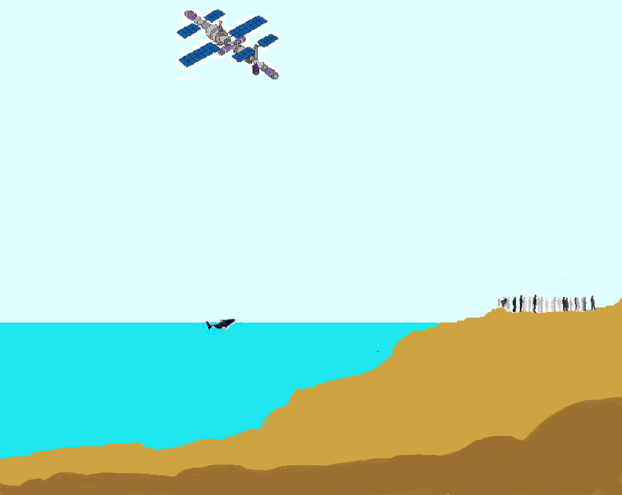
時頻分析的應用範圍
astronomy
satellite
over 700 km
communication
human life
vocal signal, ECG
vocal signal
oceanography
over 1000m
geology
ocean crust

Slide 56
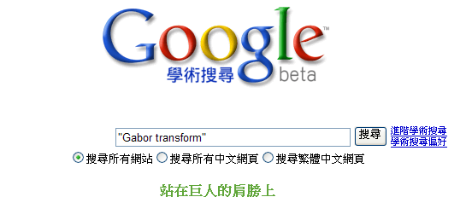
附錄十二：幾個常見的資料蒐尋方法
(1) Google 學術搜尋
http://scholar.google.com.tw/
(太重要了，不可以不知道) 只要任何的書籍或論文，在網路上有電子版，都可以用這個功能查得到
再按「搜尋」，就可找到想要的資料
輸入關鍵字，或期刊名，或作者

Slide 57
(2) 尋找 IEEE 的論文
http://ieeexplore.ieee.org/Xplore/guesthome.jsp
(3) Wikipedia
(4) Github (搜尋 code)
(5) ChatGPT (萬事通)
(6) 數學的百科網站
http://eqworld.ipmnet.ru/index.htm
有多個 tables，以及對數學定理的介紹
(7) 傳統方法：去圖書館找資料
台大圖書館首頁 http://www.lib.ntu.edu.tw/
或者去 http://www.lib.ntu.edu.tw/tulips

Slide 58
(8) 查詢其他圖書館有沒有我要找的書
「台大圖書館首頁」
「其他圖書館」
(9) 找尋電子書
「台大圖書館首頁」
「電子書」
或「免費電子書」
(10) 查詢一個期刊是否為 SCI
Step 1: 先去 http://scientific.thomson.com/mjl/
Step 2: 在 Search Terms 輸入期刊全名
Search Type 選擇 “Full Journal Title”，再按 “Search”
Step 3: 如果有找到這期刊，那就代表這個期刊的確被收錄在 SCI

Slide 59
(11) 想要對一個東西作入門但較深入的了解:
看 journal papers 會比看 conference papers 適宜
看書會比看 journal papers 適宜
(12) 如果實在沒有適合的書籍，可以看 “review”， “survey”，或
“tutorial” 性質的論文
有了相當基礎之後，再閱讀 journal papers
(以 Paper Title， Abstract， 以及其他 Papers 對這篇文章的描述，
來判斷這篇 journal papers 應該詳讀或大略了解即可)

Slide 60
附錄十三 Time-Frequency Analysis 理論發展年表
AD 1785 The Laplace transform was invented
AD 1812 The Fourier transform was invented
AD 1822 The work of the Fourier transform was published
AD 1898 Schuster proposed the periodogram.
AD 1910 The Haar Transform was proposed
AD 1927 Heisenberg discovered the uncertainty principle
AD 1929 The fractional Fourier transform was invented by Wiener
AD 1932 The Wigner distribution function was proposed
AD 1946 The short-time Fourier transform and the Gabor transform was
proposed.
In the same year, the computer was invented
註：沒列出發明者的，指的是 transform / distribution 的名稱和發明者的名字相同

Slide 61
AD 1961 Slepian and Pollak found the prolate spheroidal wave function
AD 1965 The Cooley-Tukey algorithm (FFT) was developed
AD 1966 Cohen’s class distribution was invented
AD 1970s VLSI was developed
AD 1971 Moshinsky and Quesne proposed the linear canonical transform
AD 1980 The fractional Fourier transform was re-invented by Namias
AD 1981 Morlet proposed the wavelet transform
AD 1982 The relations between the random process and the Wigner distribution
function was found by Martin and Flandrin
AD 1988 Mallat and Meyer proposed the multiresolution structure of the wavelet
transform;
In the same year, Daubechies proposed the compact support
orthogonal wavelet
註：沒列出發明者的，指的是 transform / distribution 的名稱和發明者的名字相同

Slide 62
AD 1989 The Choi-Williams distribution was proposed; In the same year, Mallat
proposed the fast wavelet transform
Kontis proposed the chromagram. (我所知最早的 chromagram 論文)
AD 1990 The cone-Shape distribution was proposed by Zhao, Atlas, and Marks
AD 1990s The discrete wavelet transform was widely used in image processing
AD 1992 The generalized wavelet transform was proposed by Wilson et. al.
AD 1993 Mallat and Zhang proposed the matching pursuit;
In the same year, the rotation relation between the WDF and the
fractional Fourier transform was found by Lohmann
AD 1994 The applications of the fractional Fourier transform in signal processing
were found by Almeida, Ozaktas, Wolf, Lohmann, and Pei;
Boashash and O’Shea developed polynomial Wigner-Ville distributions
AD 1995 Auger and Flandrin proposed time-frequency reassignment
L. J. Stankovic, S. Stankovic, and Fakultet proposed the pseudo
Wigner distribution

Slide 63
AD 1995 Katkovnik proposed the local polynomial Fourier transform and the
local polynomial time-frequency transform
AD 1996 Stockwell, Mansinha, and Lowe proposed the S transform
Daubechies and Maes proposed the synchrosqueezing transform
AD 1998 N. E. Huang proposed the Hilbert-Huang transform
Chen, Donoho, and Saunders proposed the basis pursuit
AD 1999 Bultan proposed the four-parameter atom (i.e., the chirplet)
Wakefield applied the chromagram in music signal processing.
AD 2000 The standard of JPEG 2000 was published by ISO
Another wavelet-based compression algorithm, SPIHT, was proposed
by Kim, Xiong, and Pearlman
The curvelet was developed by Donoho and Candes
AD 2000s The applications of the Hilbert Huang transform in signal processing,
climate analysis, geology, economics, and speech were developed

Slide 64
AD 2002 The bandlet was developed by Mallet and Peyre;
Stankovic proposed the time frequency distribution with complex
arguments
AD 2003 Pinnegar and Mansinha proposed the general form of the S transform
Liebling et al. proposed the Fresnelet.
AD 2005 The contourlet was developed by Do and Vetterli;
The shearlet was developed by Kutyniok and Labate
The generalized spectrogram was proposed by Boggiatto, et al.
AD 2006 Donoho proposed compressive sensing
AD 2006~ Accelerometer signal analysis becomes a new application.
AD 2007 The Gabor-Wigner transform was proposed by Pei and Ding
AD 2007 The multiscale STFT was proposed by Zhong and Zeng.
AD 2007~ Many theories about compressive sensing were developed by Donoho,
Candes, Tao, Zhang ….
AD 2010~ Many applications about compressive sensing are found.

Slide 65
AD 2012 The generalized synchrosqueezing transform was proposed by Li and
Liang
AD 2014 The variational mode decomposition was proposed by Dragomiretskiy
and Zosso
AD 2015~ Time-frequency analysis was widely combined with the deep
learning technique for signal identification
The second-order synchrosqueezing transform was proposed by
Oberlin, Meignen, and Perrier.
AD 2017 The wavelet convolutional neural network was proposed by Kang et al.
The higher order synchrosqueezing transform was proposed by Pham
and Meignen
AD 2018 Shen et al applied the Mel spectrogram in speech recognition.
AD 2018~ With the fast development of hardware and software, the time-
frequency distribution of a 10⁶-point data can be analyzed efficiently
within 0.1 Second
時頻分析理論與應用未來的發展，還看各位同學們大顯身手

