Slide 1
小波轉換期末報告 Time and frequency analysis for biomedical signals
林東毅

Slide 2
Outline
Introduction : Types and character of biomedical signal
Linear-type time–frequency analysis
Bilinear-type time–frequency analysis
Nonlinear-type time–frequency analysis (EMD, IF, SST)
Conclusion

Slide 3
Introduction
Biomedical signals : The signals which are measurable indicators of the physiological activities occurring within the human body or other living organisms.
Types of biomedical signals
EEG (Electroencephalogram):The electrical activity in the brain.
ECG (Electrocardiogram) : The electrical activity of the heart.
EMG(Electromyogram) : The electrical signals produced by muscles.
Respiration Signal : Measures the rate and depth of breathing.
Ta-mECG (transabdominal maternal electrocardiogram) : The signal of one maternal electrocardiogram (ECG) and one fetal ECG.

Slide 4
Introduction
Characteristic of biomedical signals
Contain multiple oscillatory components with time-varying features.
Easy to be contaminated by noise and artifacts (low SNR).
Sometimes it can be intermittent or nonstationary.
Reflect the physiological activities of human beings to detect the diseases.

Slide 5
Introduction
Challenge and goal of biomedical signals analysis
How to extract useful information?
How to decompose the signal?
How to quantify the dynamics?
How to visualize the results?
Figure 1

Slide 6
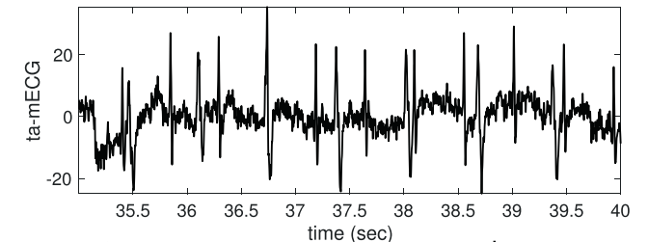
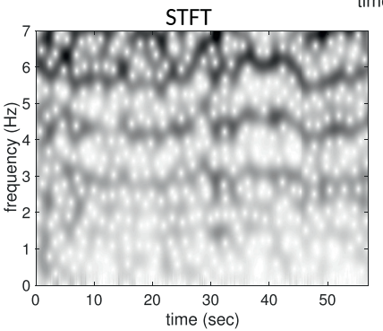
Linear-type time–frequency analysis
The main idea : Truncate the signal into pieces and apply a linear transform to each piece
Types : short-time Fourier transform (STFT), continuous wavelet transform (CWT)
Advantages: easy to implement, widely used, well-studied
Limitations: subject to the uncertainty principle, not adaptive to the signal, depend on the choice of atoms (e.g., window or wavelet)
Figure 2

Slide 7
Bilinear-type time–frequency analysis
Bilinear relation : f(x,y) = ax+ by +cxy
The main idea : The fourier transform of the auto-correlation function
Types : Wigner–Ville distribution, Cohen’s class
Advantages: higher clarity, Cohen’s class can smooth the TF result
Limitations: cross-term issue, the kernel smooth step might generate unwanted artifacts, difficult to decompose the signal

Slide 8
Nonlinear-type time–frequency analysis
The main idea:
Take more information from the signal.
Modify the linear-type or bilinear-type time–frequency analysis.
Achieve better signal decomposition, feature extraction, and visualization.
Example: Empirical mode decomposition (EMD), Iterative filtering (IF), Synchrosqueezing transform (SST)

Slide 9
Nonlinear-type time–frequency analysis
Advantages:
resolve the issues encountered in linear-type and bilinear-type time–frequency analysis
more robust to noise and artifacts
Limitations:
depend on the choice of model or parameters
may require more computational resources
may lack theoretical support or rigorous analysis

Slide 10
Models for nonlinear-type time–frequency analysis
The harmonic model : the signal is composed of finite sinusoidal functions with fixed amplitude and frequency.
The adaptive harmonic model (AHM): the signal is composed of intrinsic mode type functions with time-varying amplitude and frequency
The adaptive nonharmonic model : With the wave-shape function, the AHM is generalized to the adaptive nonharmonic model (ANHM)
$$Y\left(t\right)= \sum_{l=1}^{L}{A_{l}(t)\cos\left(∅_{l}(t)\right)}+Φ(t)$$

Slide 11
Nonlinear-type time–frequency analysis
Empirical mode decomposition
Decompose the signal into a set of intrinsic mode functions (IMFs)
Based on finding the upper and lower envelopes of the signal and removing the mean of the envelopes iteratively
Advantages: adapt to the local features of the signal, extract the oscillatory components
Limitations: mode mixing, lack of mathematical foundation, and sensitivity to noise

Slide 12
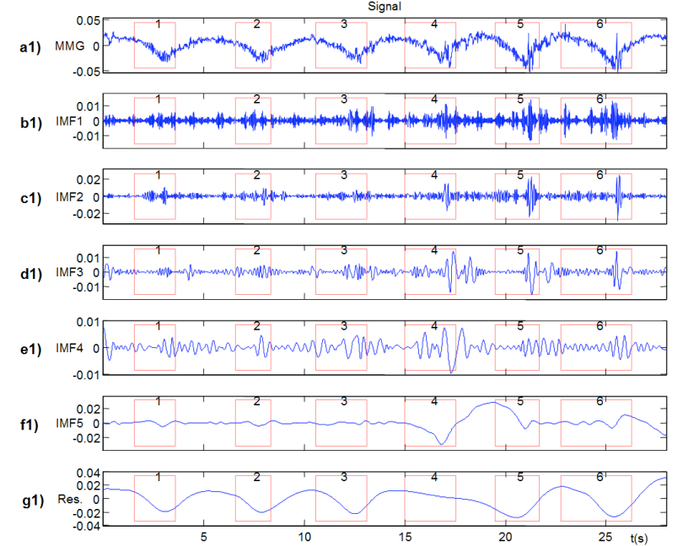
Example of Empirical mode decomposition (EMD)
The signals contain 6 respiratory cycles of a diaphragmatic MMG signal
The MMG signal was acquired with a Kistler 8302A capacitive accelerometer placed on the surface of the thoracic cage.
Low frequency: the respiratory movement
High frequency: the vibratory activity of the muscle
Figure 3

Slide 13
Nonlinear-type time–frequency analysis
h($τ$) can be LPF to extract the low frequency characteristic of signal g(t)
Iterative filtering
Main idea: Decompose the signal into a set of intrinsic mode functions (IMFs)
Based on designing a filter that preserves the highest frequency component and removes the lower frequency components iteratively
Step 1
captures the fluctuation part from g(t)
Step 2
Step 3
We get IMF1 from M1 The highest frequency component of g(t)
Step 4
Let the remainder to be calculated again from step 1 to step 3, and we get IMF2

Slide 14
Iterative filtering (IF)
Advantages:
IF is effective in analyzing signals with non-stationary and nonlinear components.
IF is a model-based method that allows for the incorporation of prior knowledge about the signal.
IF can be used as dynamic and adaptive analysis of the signal.
Limitations:
Computational complexity may be large.
The performance of IF may be sensitive to the choice of parameters and initial conditions. → May not user-friendly.

Slide 15
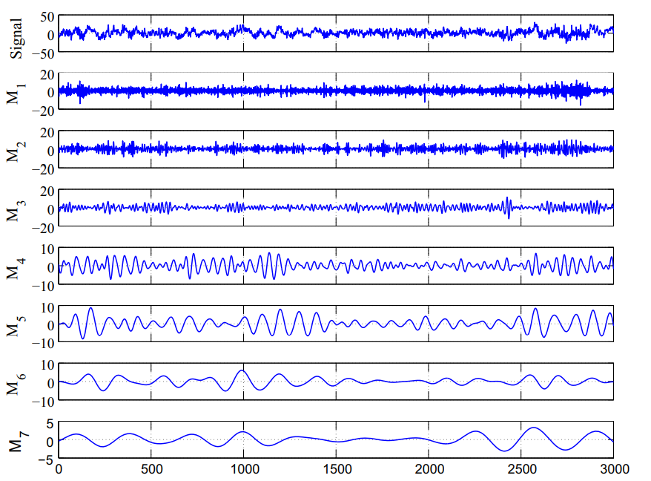
Example of Iterative filtering (IF)
Goal :
Present a method for automatic classification of sleep stages from EEG signals.
Study the features extracted from the amplitude envelope and instantaneous frequency functions of the modes obtained using iterative filtering method for classification of sleep stages.
Figure 4

Slide 16
Nonlinear-type time–frequency analysis
STFT-based synchrosqueezing transform
Synchrosqueezing transform
Main idea: A technique to sharpen and decompose the analysis result by reassigning the energy contributions along the frequency axis.
Based on the stationary phase approximation of the linear-type time–frequency analysis, such as CWT or STFT
Step 1
The local instantaneous frequency of the signal is extracted.
Step 2
Move any coefficient $V_{f}^{g}(t,ξ)$ with magnitude larger than γ to location (t, $\hat{ω_{f}(}t,ξ)$)

Slide 17
Nonlinear-type time–frequency analysis
Wavelet-based synchrosqueezing transform
Synchrosqueezing transform
Main idea: A technique to sharpen and decompose the analysis result by reassigning the energy contributions along the frequency axis.
Based on the stationary phase approximation of the linear-type time–frequency analysis, such as CWT or STFT
Step 1
The continuous wavelet transform of the signal.
The local instantaneous frequency of the signal is extracted.
Step 2
Step 3
Move any coefficient $W_{f}^{ψ}(t,a)$ with magnitude larger than γ to location (t, $\hat{ω_{f}(}t,a)$)

Slide 18
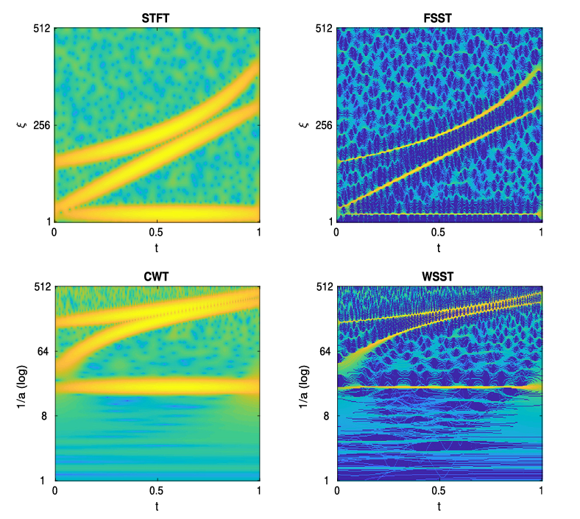
Nonlinear-type time–frequency analysis
Synchrosqueezing transform
Main idea: A technique to sharpen and decompose the analysis result by reassigning the energy contributions along the frequency axis.
Based on the stationary phase approximation of the linear-type time–frequency analysis, such as CWT or STFT
Figure 5

Slide 19
Synchrosqueezing transform (SST)
Advantages:
Accurately separate and retrieve the modes of a multicomponent signal.
Facilitate the detection and characterization of oscillatory components in biomedical signals, such as alpha and beta waves in EEG and ECG.
Robust to noise and can provide a more accurate representation of the signal's oscillatory components even in the presence of noise.
Limitations:
Computational complexity may be large.
The performance of SST may be sensitive to the choice of parameters. → May not user-friendly.

Slide 20
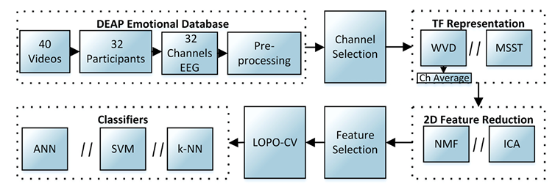
Example of Synchrosqueezing transform (SST)
Goal : Recognize emotion from the EEG signals with SST.
WDF
MSST (multivariate synchrosqueezing transform)
Figure 6
Figure 7

Slide 21
Example of Synchrosqueezing transform (SST)
Result : the accuracy
Emotional State | Classifier | MSST | WVD
High/low arousal | k-NN | 74.84 | 74.01
 | ANN(t-test) | 82.11 | 81.72
 | RBF-SVM(t-test) | 76.64 | 76.41
 | Linear-SVM(t-test) | 75.00 | 75.08
High/low valence | k-NN | 73.67 | 72.08
 | ANN(t-test) | 82.03 | 80.55
 | RBF-SVM(t-test) | 78.75 | 75.16
 | Linear-SVM(t-test) | 75.86 | 73.98
Emotion classification
Valence: represents the fear or happiness; it is the positivity or negativity of an emotion.
Arousal: represents the intensity of emotion elicited by a stimulus. Precisely, a high arousal is an anger status and a low arousal represent a sadness status.

Slide 22
Conclusion
Nonlinear-type time-frequency analysis techniques, such as the EMD, IF, SST, have been developed to address the challenges of analyzing non-stationary and nonlinear signals in biomedical engineering.
Advantage :
Improve time-frequency resolution, feature extraction capabilities, and robustness to noise.
Extract useful information from high-frequency biomedical signals, such as electroencephalogram (EEG), electrocardiogram (ECG).

Slide 23
Conclusion
Challenges:
Computational complexity.
Sensitivity to parameter selection.
The need for expertise in applying and interpreting the results.
The development of biomedical signal analysis keeps going, with the help of AI, it can be quite potential to bring humans a healthy daily lives.
NOT perfect enough to be commercialized, but keep developing !

Slide 24
Reference
Figure 1 : from paper1 , figure 1
Figure 2 : from paper 1 , figure 2
Figure 3 : from paper 2 , figure 2
Figure 4 : from paper 3, figure 3
Figure 5 : from paper 5, figure 1
Figure 6 : from paper 6, figure 3
Figure 7 : from paper 6, figure 4

Slide 25
Reference paper
Wu, H.-T. (2020). Current state of nonlinear-type time–frequency analysis and applications to high-frequency biomedical signals. Current Opinion in Systems Biology, 23, 8-21. https://doi.org/10.1016/j.coisb.2020.07.013
Torres, A., Fiz, J. A., Jane, R., Galdiz, J. B., Gea, J., & Morera, J. (2007). Application of the empirical mode decomposition method to the analysis of respiratory mechanomyographic signals. Annu Int Conf IEEE Eng Med Biol Soc, 2007, 1566-1569. https://doi.org/10.1109/IEMBS.2007.4352603
Sharma, R., Pachori, R. B., & Upadhyay, A. (2017). Automatic sleep stages classification based on iterative filtering of electroencephalogram signals. Neural Computing and Applications, 28(10), 2959-2978. https://doi.org/10.1007/s00521-017-2919-6
Cicone, A., Liu, J., & Zhou, H. (2016). Adaptive local iterative filtering for signal decomposition and instantaneous frequency analysis. Applied and Computational Harmonic Analysis, 41(2), 384-411. https://doi.org/10.1016/j.acha.2016.03.001
Meignen, S., Oberlin, T., & Pham, D.-H. (2019). Synchrosqueezing transforms: From low- to high-frequency modulations and perspectives. Comptes Rendus Physique, 20(5), 449-460. https://doi.org/10.1016/j.crhy.2019.07.001

Slide 26
Reference paper
Mert, A., & Akan, A. (2018). Emotion recognition based on time–frequency distribution of EEG signals using multivariate synchrosqueezing transform. Digital Signal Processing, 81, 106-115. https://doi.org/10.1016/j.dsp.2018.07.003

