Slide 1
The Application and Evolution of Wiener Filter
電信所一年級 黃重翰

Slide 2
Agenda
Introduction
Wiener Filter
New sights into the wiener filter
Conclusion
Reference

Slide 3
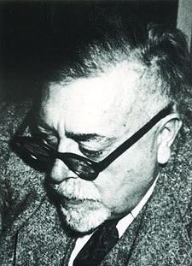
Introduction
Norbert Wiener is a prodigy.
11 years old : graduating from Ayer High School
14 years old : graduating from Tufts College
14 years old : study zoology at Harvard
15 years old : study philosophy at Cornell
16 years old : study philosophy at Harvard
18 years old : Ph. D. from Harvard
A dissertation on mathematical logic

Slide 4
Introduction
Wiener filter is proposed by Wiener in 1940 (46 years old)
Wiener–Khinchin theorem

Slide 5
Wiener Filter
若 X[n] 為 Original signal Y[n] 為 Received signal
為 Fourier Transform of crosscorrelation
between X[n] and Y[n]
為 Power spectrum of Received signal

Slide 6
Wiener Filter
Assume the signal and additive noise is stationary.
y(t) is received signal , h(t) is a LTI system, x(t) is original signal,
n(t) is additive noise
g(t) is wiener filter in order to minimize the MSE err(f)

Slide 7
Wiener Filter
For minimize the MSE err(f)
Then, we will get G(f) as following.
S(f) is power spectrum of original signal
N(f) is power spectrum of additive noise
H(f) is Fourier transform of LTI system

Slide 8
Wiener Filter
When the H(f)=1,
When the SNR is large enough, then wiener filter will nearly approach to 1
When the SNR is small, then wiener filter will reduce the noise

Slide 9
Wiener Filter
is inverse of SNR
When SNR is large,
we can easily find the wiener filter
also has a application of deconvolution

Slide 10
Wiener Filter
The input must be stationary, so it’s not an adaptive filter.
We don’t have to distinguish original signal from received signal.
It needs training data to optimize the filter coefficients.

Slide 11
New sights into the wiener filter
Although the wiener filter can minimize the MSE to approach the noise reduction, it also causes the speech distortion.
For example, speech distortion plays an important role on speech recognition.

Slide 12
New sights into the wiener filter
The impulse response of FIR wiener filter h_{o}: 設 FIR wiener filter length 為 L
:additive zero mean noise

Slide 13
New sights into the wiener filter

Slide 14
New sights into the wiener filter
is the estimation filter of noise
In order to reduce speech distortion
is choose between 0~1
For making a balance between noise reduction
and speech distortion

Slide 15
New sights into the wiener filter
The result :
:Speech-distortion index of suboptimal filter
:noise reduction index of suboptimal filter

Slide 16
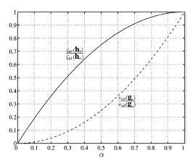
New sights into the wiener filter

Slide 17
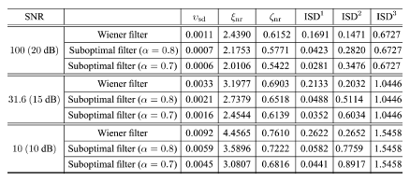
New sights into the wiener filter

Slide 18
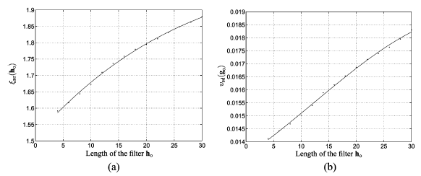
New sights into the wiener filter

Slide 19
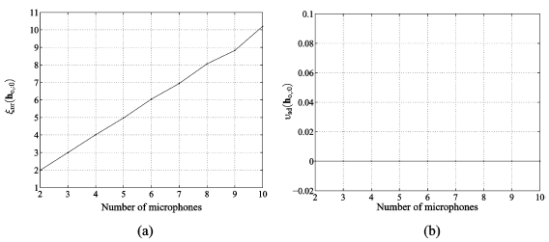
New sights into the wiener filter

Slide 20
New sights into the wiener filter
It’s a trade-off between speech-distortion and noise-reduction.
When number of microphone is more, then we can set alpha smaller to lower the speech-distortion.
The more length of wiener filter, the more speech-distortion and noise-reduction.

Slide 21
Conclusion
Wiener filter is used in many fields such as noise reduction in speech and image, linear prediction.
Adaptive Wiener Filter is a new idea recently.
Wiener filter can be used in many domain such as DCT domain, spatial domain…

Slide 22
Reference
“Dynamic wiener filters for small-target radiometric restoration” Russel P. Kauffman, James P. Helferty, Mark R. Blattner 2009
“New Insights into the noise reduction wiener filter” Jingdong Chen, Jacob Benesty, Yiteng Huang 2008
“Image enhancement via space-adaptive lifting scheme using spatial domain adaptive wiener filter” Hac Tasmaz, Ergun Ercelebi 2009
“Image deblocking using dual adaptive FIR wiener filter in the DCT transform domain” Renqi Zhang, Wanli Ouyang, Wai-Kuen Cham 2009
“Harmonic Enhancement with noise reduction of speech signal by comb filtering” Yu Cai, Jianping Yuan, Chaohuan Hou, Jun Yang, Bian Wu,2009
“Speech Enhancement using the Multistage Wiener filter” Michael Tinston and Yariv Ephraim 2009
“Optimized and Interative Wiener Filter for Image Restoration”Abdul Majeed A. Madmood 2009

