Slide 1
TFW Final 1. ViT Robustness Against Adversarial Attack 2. Using TFW Technique for Defense
Speaker: 羅元鈞 (r11943023)
Date: 2023/12/21

Slide 2
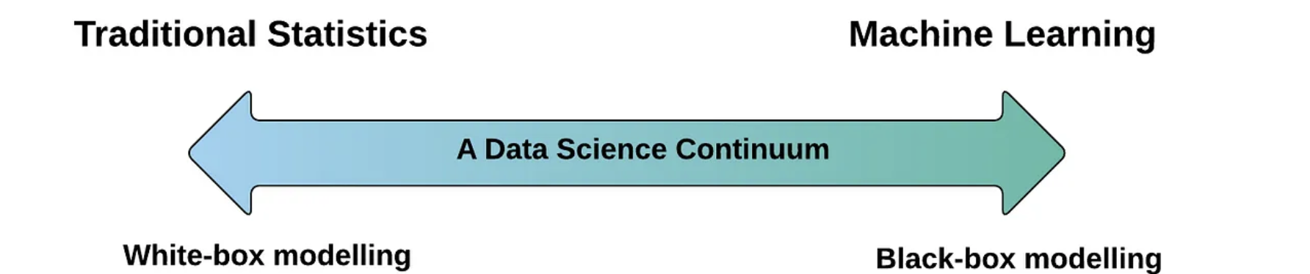
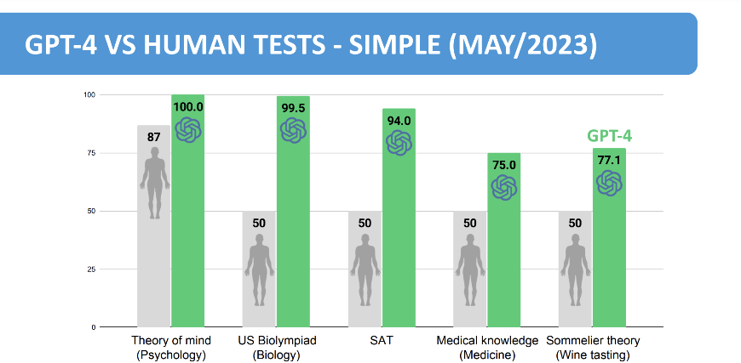
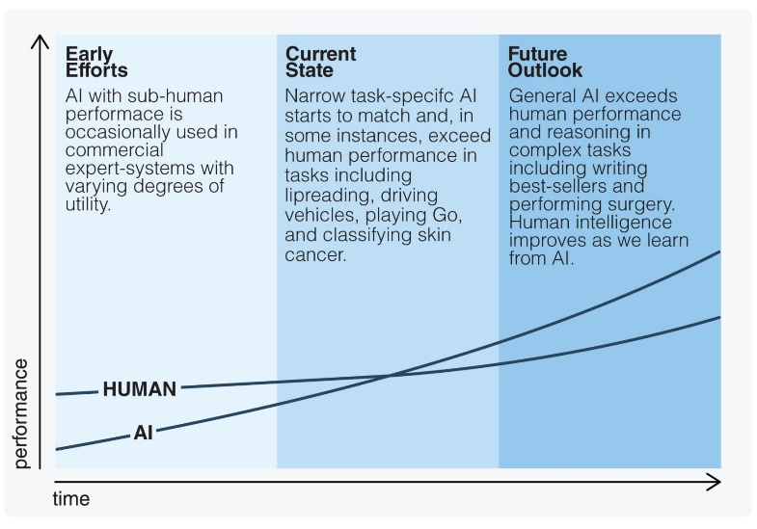
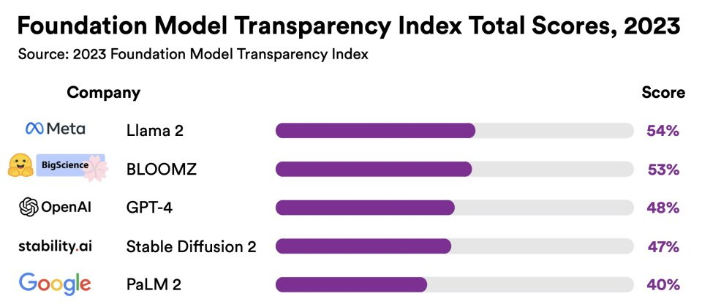
Motivation (1/2)
Highly complex Neural Network(NN) tend to lack of interpretability
Suggestion
Improvement
Collaboration
Interpretability (Transparency) Accuracy

Slide 3
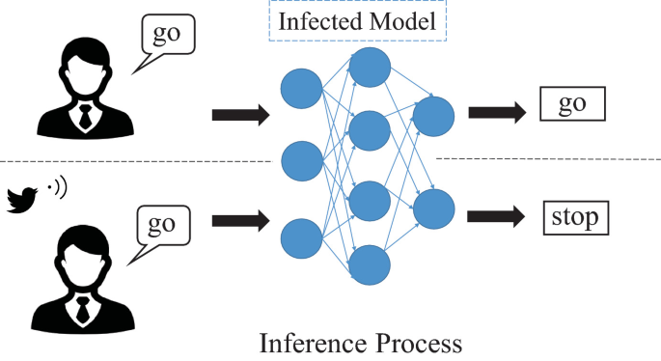
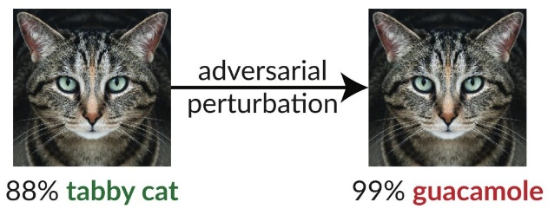
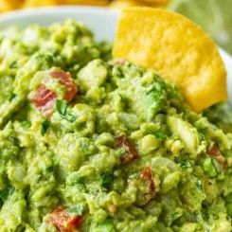
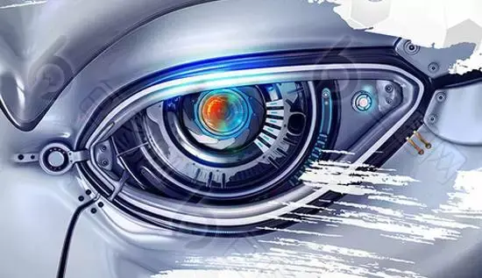
Motivation (2/2)
Lack of interpretability leads to insufficient trustworthiness
If attacked, model would turn into trash
Perturbation frequency ?
Adversarial Attack
No need for training !
Backdoor Attack
Characteristic | Adversarial Attack | Backdoor Attack
Attack Phase | Inference | Training
Nature of Attack | Perturbation | Trojan Insertion
Purpose | Misidentification | Trigger Abnormal
Trustworthiness Accuracy

Slide 4
Design Case: Vision Transformer(ViT)
Adversarial robustness in CNNs for CV has more research
Towards evaluating the robustness of neural networks [7]IEEE S&P’17
Boosting adversarial attacks with momentum [8]CVPR’18
Reliable evaluation of adversarial robustness with an ensemble of diverse parameter-free attacks [9]PMLR’20
Adversarial robustness in Transformers for NLP has more research
On the robustness of self-attentive models [3]ACL’19
Robustness verification for transformers [4]ICLR’20
Pretrained transformers improve out-of-distribution robustness [5]ACL’20
Interpreting information interactions inside transformer [6]arXiv’20
There is less research on adversarial robustness in ViT !

Slide 5
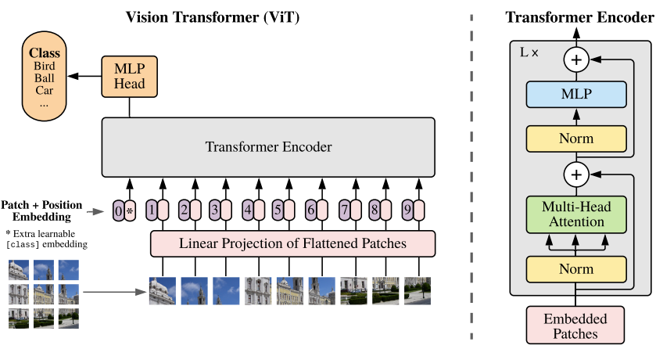
ViT Robustness Against Adversarial Attack
Do ViTs provide enhanced security compared to CNNs ?
On the robustness of vision transformers to adversarial examples [1]*156
On the adversarial robustness of vision transformers [2]*64

Slide 6
ViT Robustness to Adversarial Examples [1]
Adversarial attacks:
White-box: knowing the hyperparameters and parameters
FSGM, MIM, C&W, PGD, APGD….
Black-box: knowing the inputs and outputs
Query-based: querying the defense and adjusting the noise (RayS attack)
Transfer-based: querying and obtaining labels for training synthetic model
ViT provide improvement in security over CNNs under a white-box adversaries ? As vulnerable as CNNs to white-box adversaries !
Transformer
Big Transfer CNN
CNN
Classification accuracy (ImageNet) of different models under various attack techniques

Slide 7
ViT Robustness to Adversarial Examples [1]
How transferable are adversarial examples between ViT and other models ? Transferring adversarial examples between different models is challenging !
Can low transferability be used for white-box defense?
Ensemble: majority voting, absolute consensus, random selection
*SAGA successfully attacks under white-box
Transformer
Big Transfer CNN
CNN
Transformer
B-Trans
CNN
CNN
Transferability results (ASR) for ImageNet
*SAGA: Self-Attention Gradient Attack / BiT: Big transfer model

Slide 8
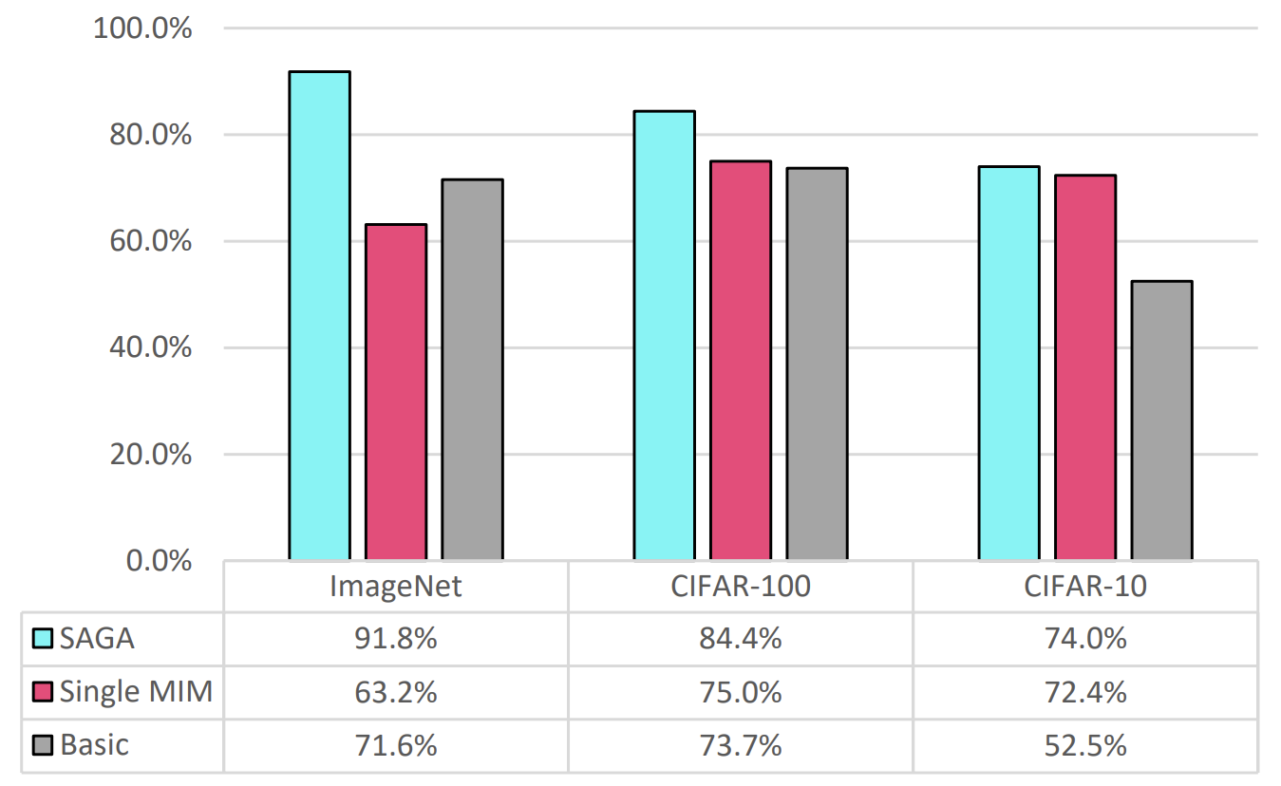
ViT Robustness to Adversarial Examples [1]
Self-Attention Gradient Attack(SAGA)
Generate adversarial examples that are misclassified simultaneously by both ViTs and CNNs
The hyperparameters of SAGA
[10] Attention Rollout
ASR of the SAGA, Single MIM and Basic attack on an ensemble of ViT-L-16 & BiT-M-R101x3 (BiT-M-R152x4 for ImageNet)
The mathematical description of SAGA

Slide 9
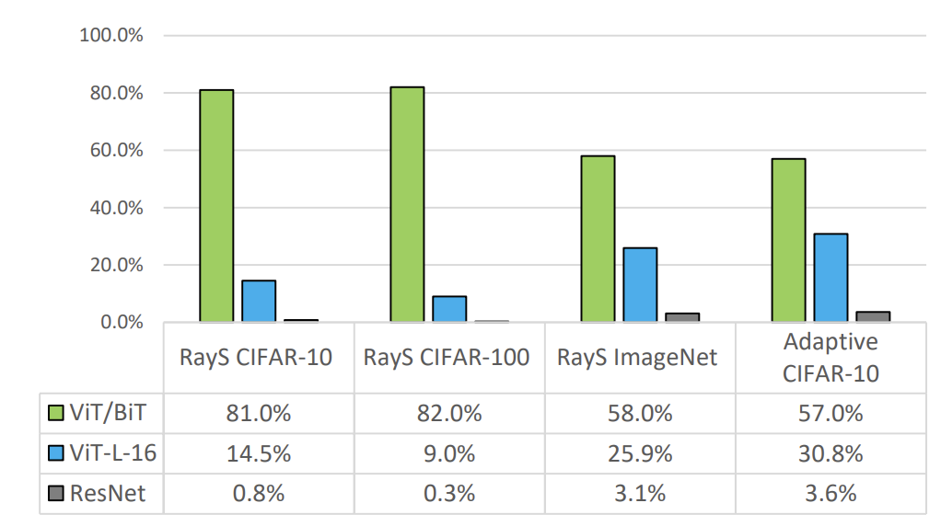
ViT Robustness to Adversarial Examples [1]
Black-box security and transferability ? Low transferability !
Attacker lacks access to individual model gradients => SAGA failed
Ensemble including a ViT and BiT models drastically improves security
Robust accuracy of different models under black-box attacks. Here ViT/BiT is an ensemble containing a ViT-L-16 and a BiT-M-101x3 for CIFAR-10/CIFAR-100 and Bit-MR152x4 for ImageNet

Slide 10
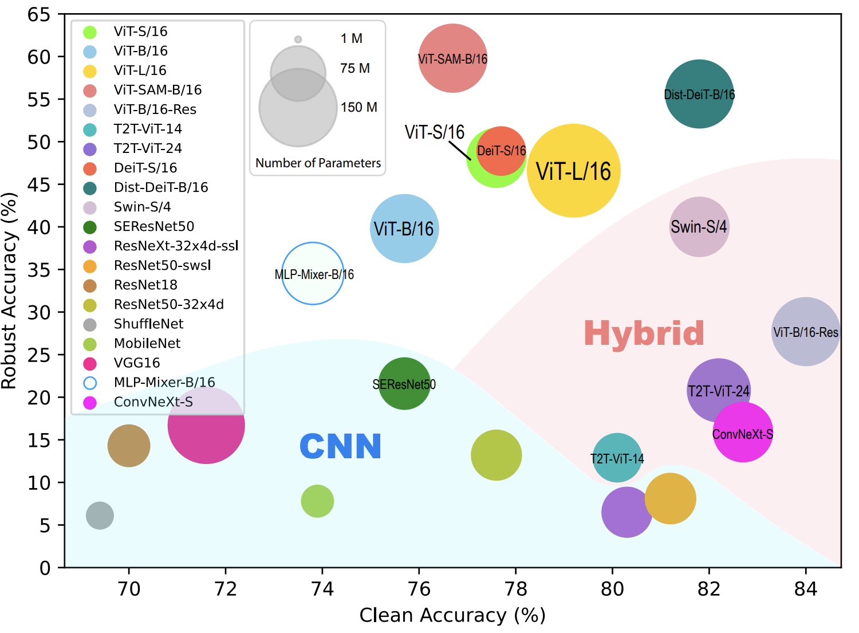
On the Adversarial Robustness of ViT [2]
ViTs learn features with fewer high-frequency details, enhancing adversarial robustness compared to CNNs
Denoised Randomized Smoothing for Certified Robustness Analysis [11]
Robust accuracy v.s. clean accuracy

Slide 11
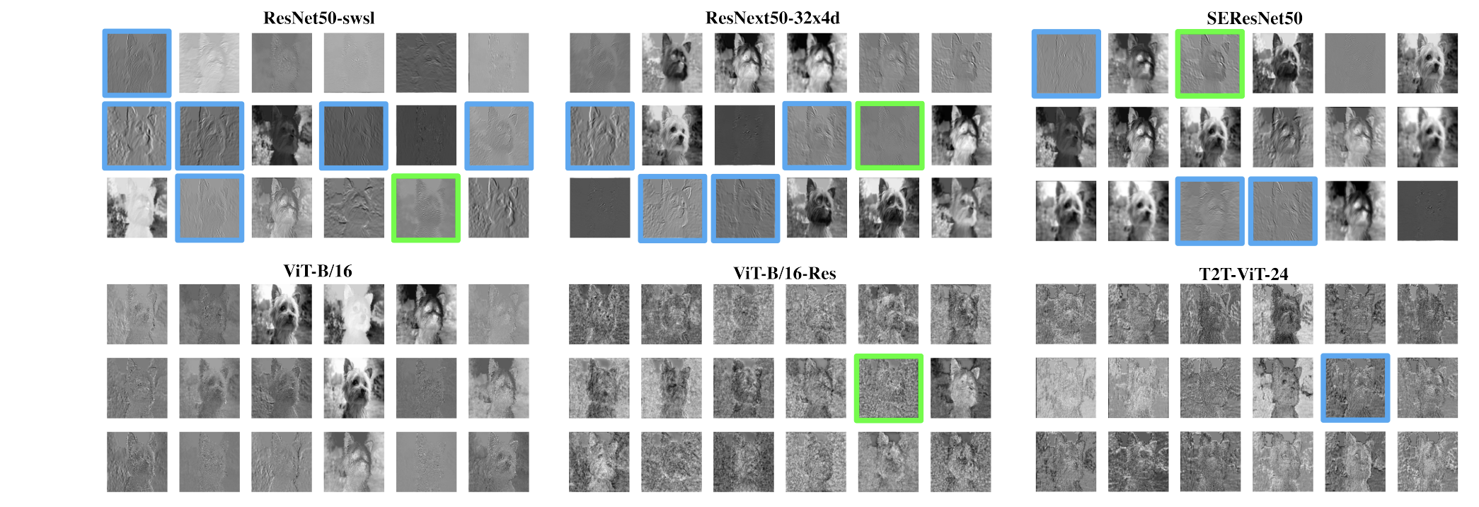
On the Adversarial Robustness of ViT [2]
SE: squeeze and excitation
*SEResNet: global information access and filter recalibration
CNN-ViT: replacing patches with features extracted from CNN
T2T-ViT: aggregates neighboring tokens into one token
Feature visualization
CNN learns more low-level (edges and lines) features than ViT !

Slide 12
On the Adversarial Robustness of ViT [2]
PGD: Projected Gradient Descent
Frequency-Filtered PGD:
CNN is more sensitive to high-frequency perturbations compared to ViT
CNN-ViT facilitate learning low-level features but has a negative effect on adversarial robustness
*Adversarial examples generated for ViT transfer more effectively to CNN
*Pre-training with clean images does not improve robustness
Transformer
13.1~32.8
Hybrid
58.0~72.9
RA (%) of the target models against frequency-filtered PGD attack in frequency study
CNN

Slide 13
On the Adversarial Robustness of ViT [2]
PGD: Projected Gradient Descent
Frequency-Filtered PGD:
CNN is more sensitive to high-frequency perturbations compared to ViT
CNN-ViT facilitate learning low-level features but has a negative effect on adversarial robustness
*Adversarial examples generated for ViT transfer more effectively to CNN
*Pre-training with clean images does not improve robustness
Transformer
Big Transfer CNN
CNN
Transformer
B-Trans
CNN
CNN
Transferability results (ASR) for ImageNet

Slide 14
Simulation Result

Slide 15
White-Box Adversarial Attacks
Fast Gradient Sign Method (FGSM): :
Causes targeted distortion in a single step to achieve a specific outcome
This noise is derived from the gradients of the model's loss function
Iterative Fast Gradient Sign Method (IFGSM):
Adds calculated noise iteratively to the input
This noise is derived from the gradients of the model's loss function

Slide 16
Defense Approach
Adversarial Training => Fair comparison is challenging
Augmenting training data with adversarial examples to improve the robustness
Robust Model Architectures => Comparing CNNs/ViTs/Hybrid models
Designing models that inherently resist adversarial manipulation
Input Preprocessing => PCA, JPEG, Wavelet, HOG, Rembg
Modifying input data to remove or reduce adversarial perturbations
Detection and Response Mechanisms => Need defensive measures
Implementing systems that can detect adversarial

Slide 17
Principal Components Analysis
Dimension Reduction
W/ inverse transform: (d, d) -> (d, k) -> (d, d)
W/o inverse transform: (d, d) -> (d, k)
d
d
Normalization
Extract matrix information
Projection
d
d
Recovery
d
k

Slide 18
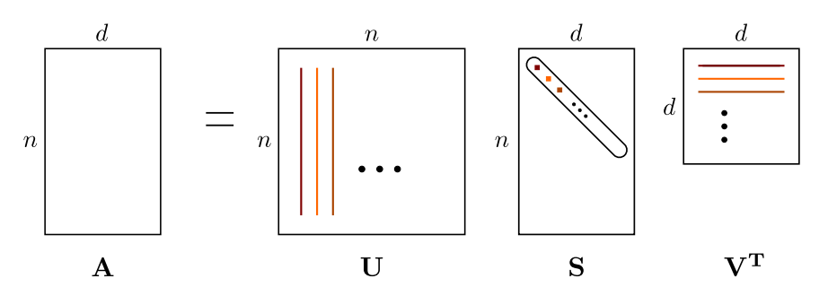
Low Rank Approximation (LRA)
Singular Value Decomposition (SVD)
$A=USV^{T} ➔$ $A=\sum_{i=0}^{min\{n,d\}}{s_{i}∙u_{i}v_{i}^{T}}$
Lossy Compression via Truncated Decompositions
Prune all but the “most important” terms: $A≈A_{r}= U_{r}S_{r}V_{r}^{T}$
Parms & FLOPs are reduced from $O\left(nd\right) to O\left(r(n+d)\right)$
Choose a sufficient small $r<\frac{nd}{n+d}=\frac{n}{2}, if d=n$
r
r
$$U_{r}$$
r
$$S_{r}$$
r
$$V_{r}$$

Slide 19
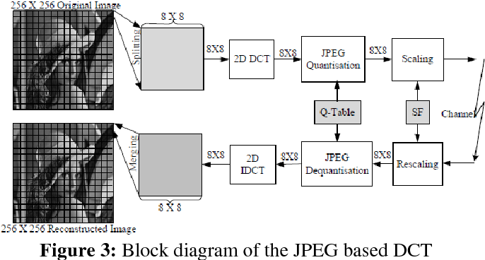
Joint Photographic Experts Group (JPEG)
Widely used image compression standard
Lossy compression technique that aims to reduce file sizes
Achieves this by leveraging a Discrete Cosine Transform (DCT) algorithm

Slide 20
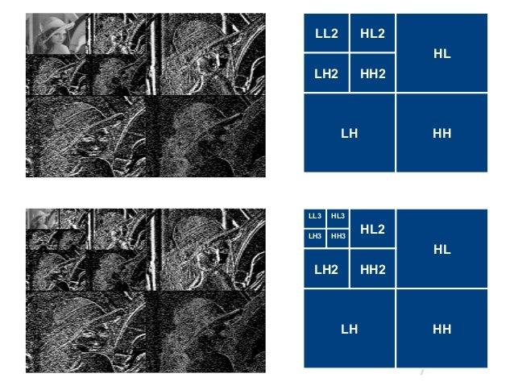
Wavelet Compression
Breaks down the signal into different frequency components

Slide 21
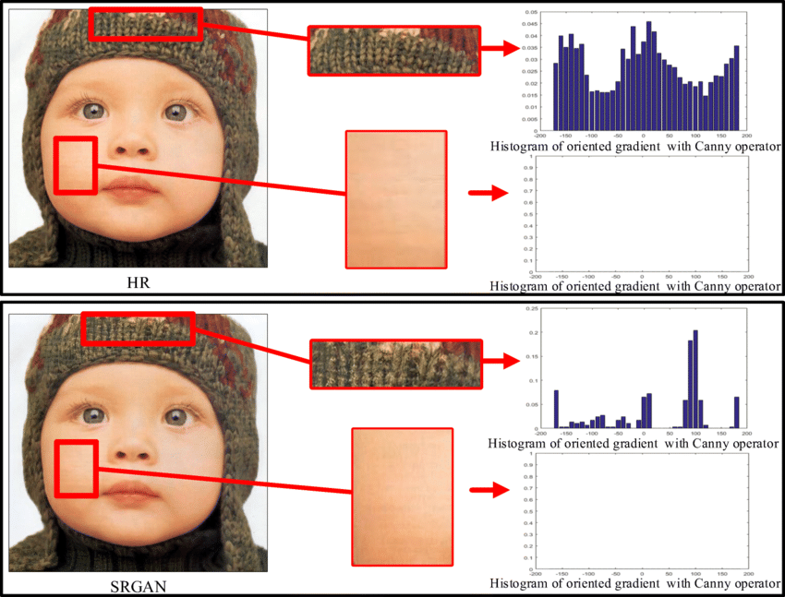
Histogram of Gradient (HoG)
Feature descriptor used in computer vision
Gradient Calculation
Histogram Binning

Slide 22
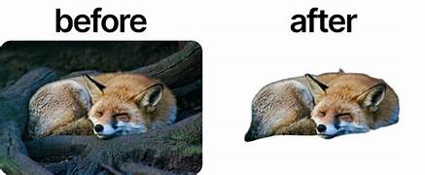
Background Removal (Rembg)
Utilizes neural networks to segment the foreground subject from its background in images

Slide 23
Others
Mean, min, and max filters
Distraction attack using a fabricated pattern
Quantization
Saturation Boost
Conversion to HSL/HSV Color Space

Slide 24
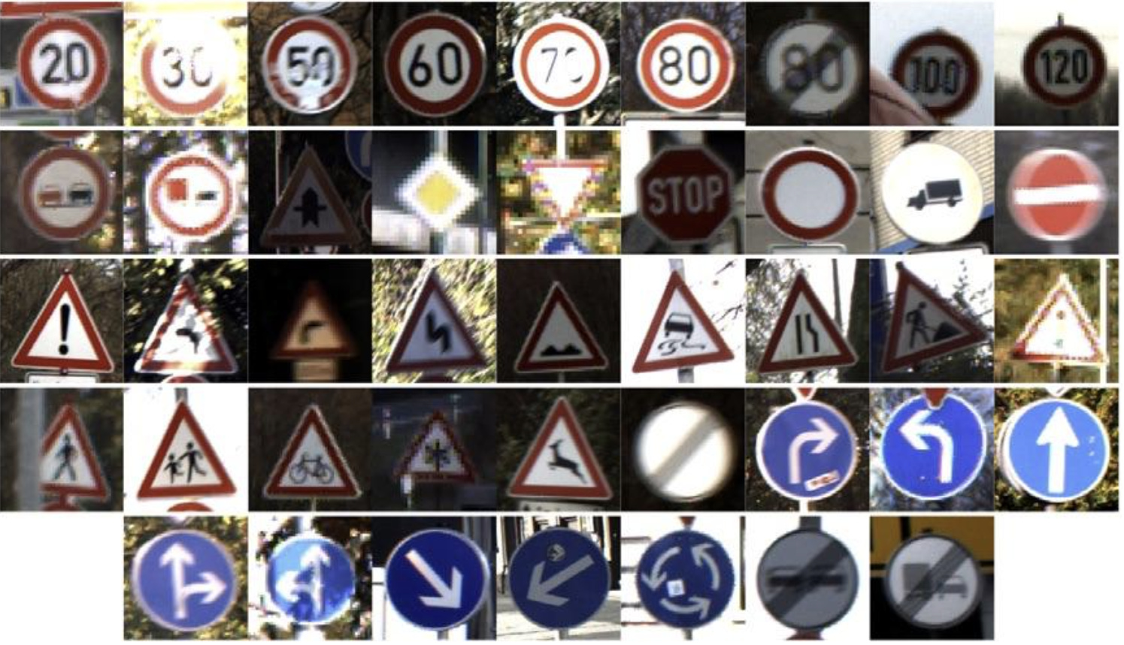
Models and Dataset
Models: Resnet18, Resnet50, ViT-t, ViT-s, Hybrid-s
Dataset: GTSRB
 | Resnet18 | Resnet50 | ViT-t | ViT-s | Hybrid-s
CA | 98.47 | 98.84 | 98.55 | 99.01 | 99.38
Parms (M) | 11.7 | 25.6 | 5.7 | 22 | 36
Flops (G) | 1.8 | 4.09 | 2.5 | 9.41 | 11

Slide 25
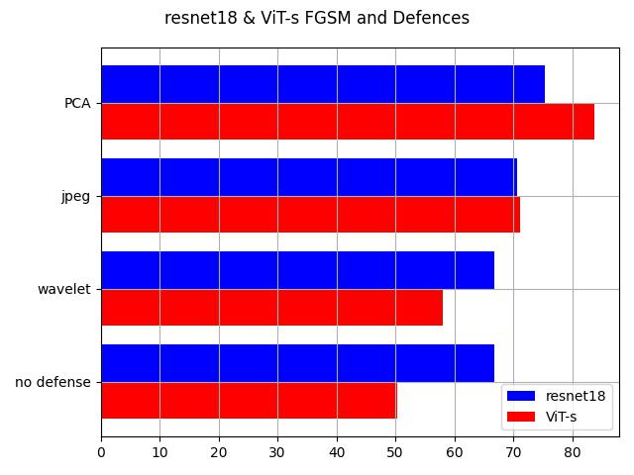
Experiment Results(1/3)

Slide 26
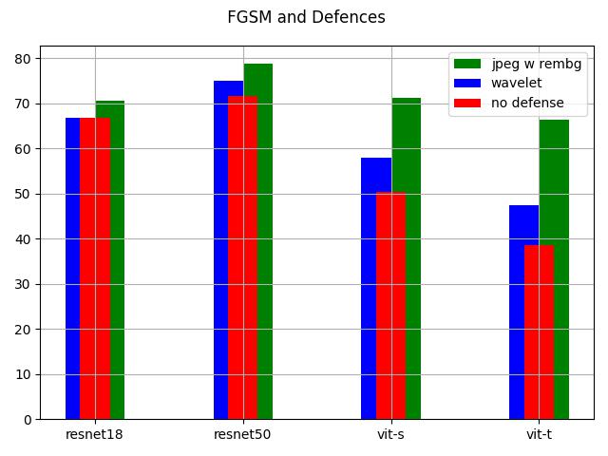
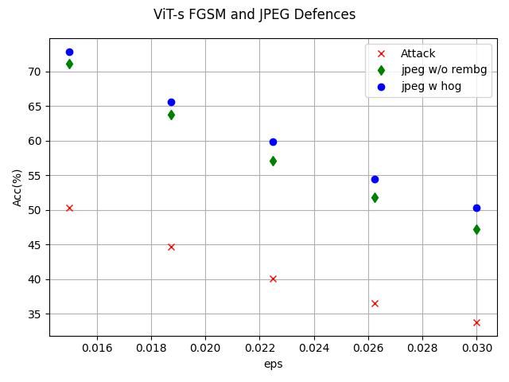
Experiment Results(2/3)

Slide 27
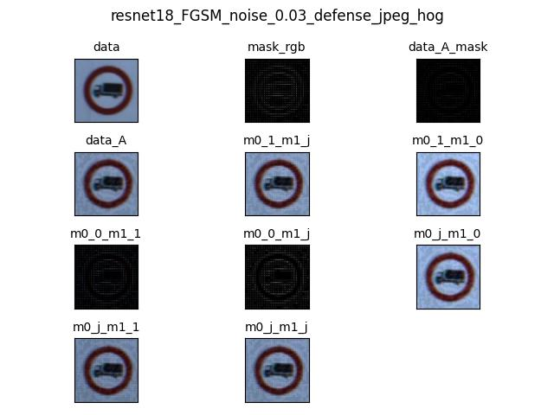
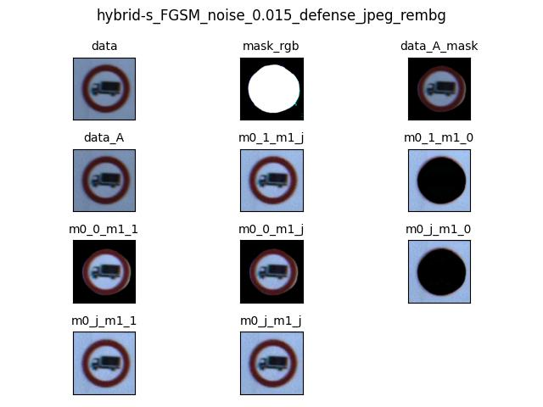
HOG & REMBG

Slide 28
Image Processing
PCA
Jpeg
Wavelet
Utilizing wavelet transformations multiple times may be beneficial !

Slide 29
Experiment Results(3/3)
 | No attack | FGSM |  | IFGSM
Model | ResNet18 | ResNet18 | ViT-S | ResNet18 | ViT-S
No defense | 98.87% | 66.82% | 50.38% | 39.07% | 1.72%
Wavelet | 98.81% | 66.84% | 57.97% | 39.94% | 17.01%
JPEG | 98.78% | 70.61% | 71.12% | 42.52% | 65.92%
PCA | 92.41% | 75.30% | 83.77% | 71.42% | 87.35%
Wavelet+hog | 98.80% | 67.28% | 60.39% | 43.52% | 39.38%
Wavelet+rembg | 98.81% | 68.88% | 62.18% | 42.76% | 62.19%
JPEG+rembg | 98.75% | 68.79% | 70.61% | 40.82% | 63.77%
PCA+hog | 98.70% | 75.07% | 84.19% | 69.98% | 87.51%

Slide 30
Reference
[1] Mahmood, Kaleel, Rigel Mahmood, and Marten Van Dijk, "On the robustness of vision transformers to adversarial examples." Proceedings of the IEEE/CVF International Conference on Computer Vision. 2021.
[2] Shao, Rulin, et al, "On the adversarial robustness of vision transformers." arXiv preprint arXiv:2103.15670 (2021).
[3] Yu-Lun Hsieh, Minhao Cheng, Da-Cheng Juan, Wei Wei, Wen-Lian Hsu, and Cho-Jui Hsieh. On the robustness of self-attentive models. In Proceedings of the 57th Annual Meeting of the Association for Computational Linguistics, pages 1520–1529, 2019.
[4] Zhouxing Shi, Huan Zhang, Kai-Wei Chang, Minlie Huang, and Cho-Jui Hsieh. Robustness verification for transformers. In ICLR, 2020.
[5] Dan Hendrycks, Xiaoyuan Liu, Eric Wallace, Adam Dziedzic, Rishabh Krishnan, and Dawn Song. Pretrained transformers improve out-of-distribution robustness. In Proceedings of the 58th Annual Meeting of the Association for Computational Linguistics, pages 2744–2751, July 2020.
[6] Yaru Hao, Li Dong, Furu Wei, and Ke Xu. Self-attention attribution: Interpreting information interactions inside transformer. arXiv preprint arXiv:2004.11207, 2020.
[7] Nicholas Carlini and David Wagner. Towards evaluating the robustness of neural networks. In 2017 ieee symposium on security and privacy (sp), pages 39–57. IEEE, 2017.
[8] Yinpeng Dong, Fangzhou Liao, Tianyu Pang, Hang Su, Jun Zhu, Xiaolin Hu, and Jianguo Li. Boosting adversarial attacks with momentum. In Proceedings of the IEEE conference on computer vision and pattern recognition (CVPR), pages 9185–9193, 2018.
[9] Francesco Croce and Matthias Hein. Reliable evaluation of adversarial robustness with an ensemble of diverse parameter-free attacks. In International Conference on Machine Learning, pages 2206–2216. PMLR, 2020.
[10] Abnar, Samira, and Willem Zuidema. "Quantifying attention flow in transformers." arXiv preprint arXiv:2005.00928 (2020).
[11] Hadi Salman, Mingjie Sun, Greg Yang, Ashish Kapoor, and J Zico Kolter. Denoised smoothing: A provable defense for pretrained classifiers. arXiv preprint arXiv:2003.01908, 2020.

