Slide 1
WAVESP-NET: LEARNABLE WAVELET-DOMAIN SPARSE PROMPT TUNING FOR SPEECH DEEPFAKE DETECTION
R12921119 Chih-Kai Yang

Slide 2
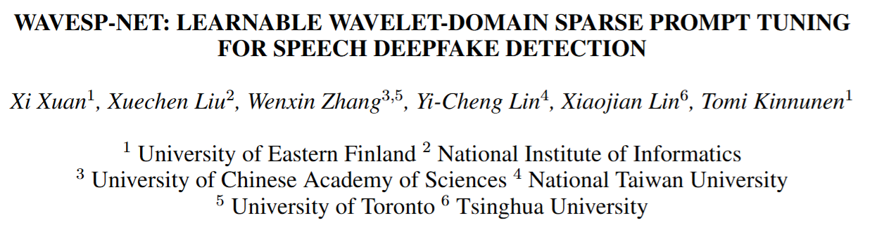
https://arxiv.org/abs/2510.05305

Slide 3
Disclaimer
I will not mention all the details of the paper
Please refer to the paper if you’re interested in.

Slide 4
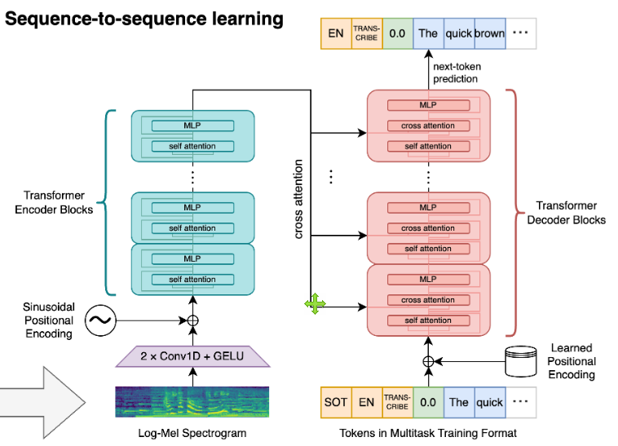
Motivation
I am working on speech processing
Wondering how what we learn in this course can be applied in the era of deep learning

Slide 5
Speech Deepfake Detection
Identifying artificially generated or manipulated speech
Generated via…
Text-to-speech
Voice cloning
Voice conversion

Slide 6


Common Methods
Features
Front End
Back End

Slide 7
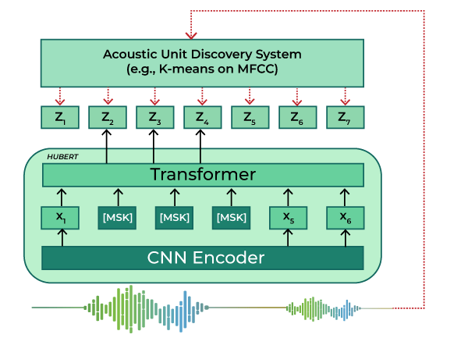
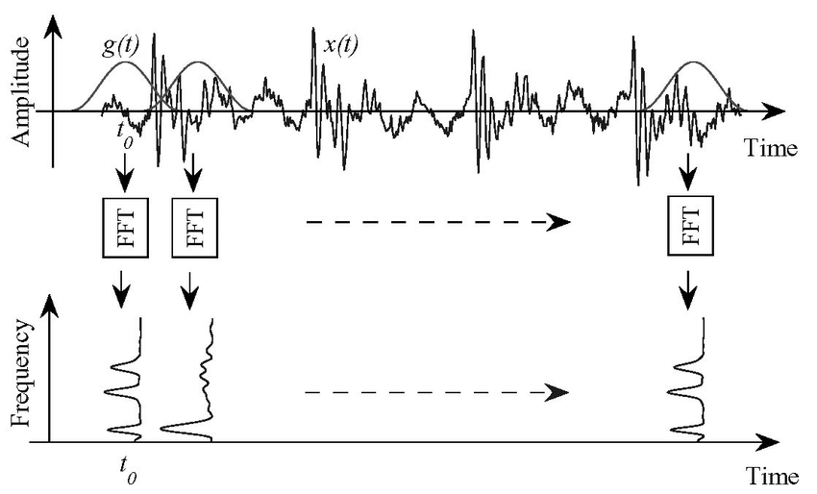
Common Methods
Features
Front End
Back End
SSL Models
Signal Processing

Slide 8
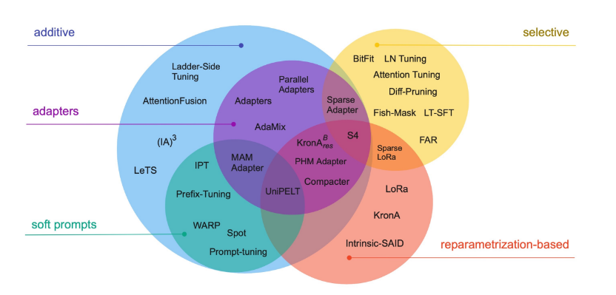
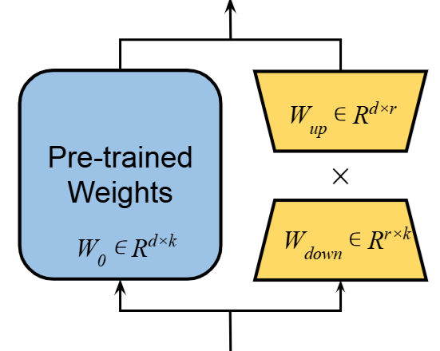
Parameter-efficient Fine-tuning (PEFT)
Adapting a foundation model to new domains
while keeping the number of parameters requiring updating small

Slide 9
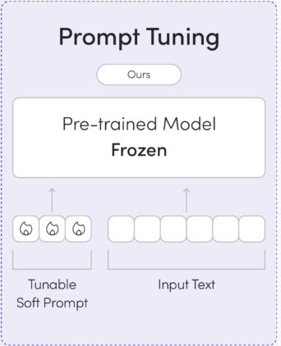
Parameter-efficient Fine-tuning (PEFT)
Prompt tuning
Soft prompts trained for new domains

Slide 10
Core Idea of This Paper
Enrich or constrain the structure of the prompt embeddings
With wavelet transform

Slide 11
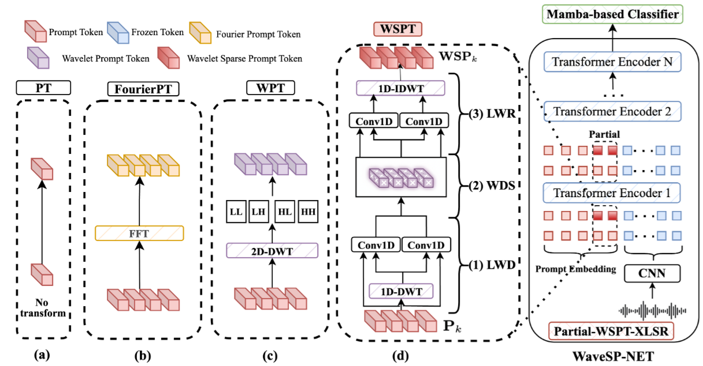
Overview

Slide 12
Dataset & Metrics
Benchmarks
Deepfake-Eval-2024
SpoofCeleb
Metrics
EER, AUC, F1, and accuracy (ACC)

Slide 13
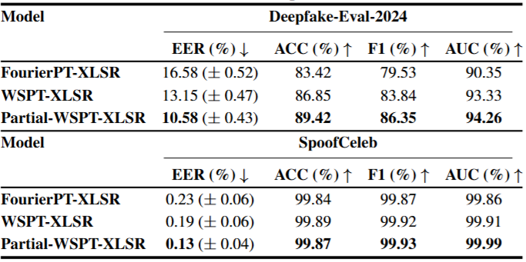
Results

Slide 14
Results
Wavelet features are more effective.

Slide 15
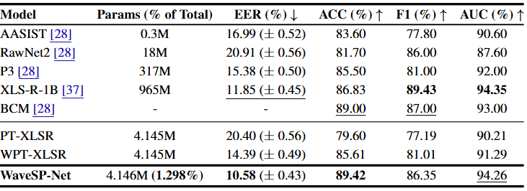
Results

Slide 16
Results
Leading performance with less params.

Slide 17
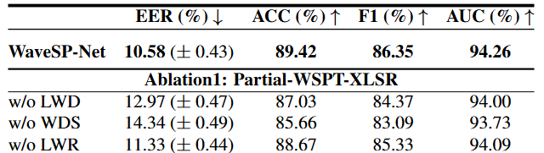
Results
WDS causing the most significant drop

Slide 18
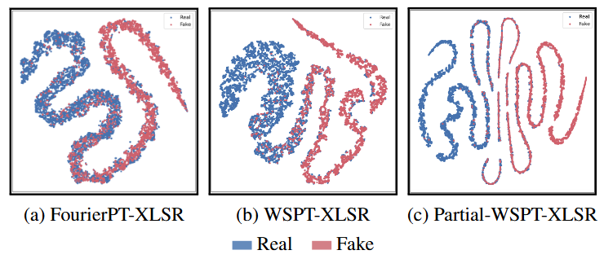
Results

Slide 19
Conclusion
Using learnable wavelet filters to enhance a sparse subset of prompt tokens

