Slide 1
V. Homomorphic Signal Processing
· 5-A Homomorphism
Homomorphism is a way of “carrying over” operations from one algebra system into another.
Ex. convulution multiplication addition
把複雜的運算，變成效能相同但較簡單的運算

Slide 2
182
· 5-B Cepstrum
For the process of cepstrum (denoted by D*[．] )
convolution
product
addition
addition
*
×
＋
＋
x[n]
FT[．]
Log[ ]
FT⁻¹[．]
X(F)
FT: discrete-time Fourier transform

Slide 3

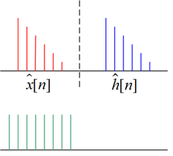
• 由 y[n]= x [n]*h[n] 重建 x[n]
y[n]= x [n]*h[n]
x[n]
*
D*[ ]
＋
＋
Lifter
＋
＋
D⁻¹*[ ]
*
cepstrum
inverse
cepstrum
For the inverse cepstrum D⁻¹*[．]
• 有趣的名詞
n
cepstrum
lifter
quefrency
n
lifter

Slide 4
· 5-C Methods for Computing the Cepstrum
• Method 1: Compute the inverse discrete time Fourier transform:
ambiguity for phase
Problems: (1)
(2)
Actually, the COMPLEX Cepstrum is REAL for real input

Slide 5
185
實際上計算cepstrum的方法
• Method 2 (From Poles and Zeros of the Z Transform)
time delay
where
a_{k}: zeros inside unit circle
c_{k}: poles inside unit circle
b_{k}⁻¹: zeros outside unit circle
d_{k}⁻¹: poles outside unit circle

Slide 6
186
Taylor series
Z⁻¹
(inverse Z transform)
?

Slide 7
187
Taylor series expansion
Z⁻¹
(Suppose that r = 0)
Poles & zeros inside unit circle, right-sided sequence
Poles & zeros outside unit circle, left-sided sequence
Note:
(1) always decays with |n|.
(2) 在 complex cepstrum domain
Minimum phase 及 maximum phase 之貢獻以 n = 0 為分界切開
(3) For FIR case, there is no c_{k} and d_{k}
(4) The complex cepstrum is unique and of infinite duration for both positive
& negative n, even though x[n] is causal & of finite durations

Slide 8
• Method 3
Z⁻¹

Slide 9
189
Suppose that x[n] is causal and has minimum phase, i.e. x[n] = = 0, n < 0
For a minimum phase sequence x[n]
recursive method
Determining
from

Slide 10
190
For anti-causal and maximum phase sequence, x[n] = = 0, n > 0
For maximum phase sequence,

Slide 11
· 5-D Properties
P.1 ) The complex cepstrum decays at least as fast as
P.2 ) If X(Z) has no poles and zeros outside the unit circle, i.e. x[n] is minimum phase, then
   
because of no b_{k}, d_{k}
P.3 ) If X(Z) has no poles and zeros inside the unit circle, i.e. x[n] is maximum phase, then
because of no a_{k}, c_{k}

Slide 12
192
P.4 ) If x[n] is of finite duration, then
has infinite duration

Slide 13
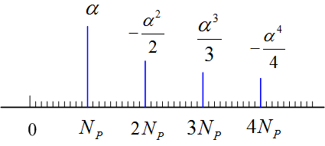
193
· 5-E Application of Homomorphic Deconvolution
(1) Equalization for Echo
x[n]
y[n]
delay N_{p}
Let p[n] be p[n] =δ[n] +αδ[n-N_{p}]
y[n] =x[n] +α x[n-N_{p}] =x[n] * p[n]
Z⁻¹
n

Slide 14
194
Filtering out the echo by the following “lifter”:
Q: For the case where N_{p} is unknown
(2) Representation of acoustic engineering
y[n] = x[n] * h[n]
l[n]
N_{p}
2N_{p}
3N_{p}
n
or
l[n]
N₀
n
Np > N₀
Synthesized music
music
building effect：e.g. 羅馬大教堂的impulse response

Slide 15
195
(3) Speech analysis
(4) Seismic Signals
(5) Multiple-path analysis for any wave-propagation problem
Speech
wave
Global wave shape
Pitch
Vocal tract impulse
They can be separated by filtering in the complex cepstrum domain

Slide 16
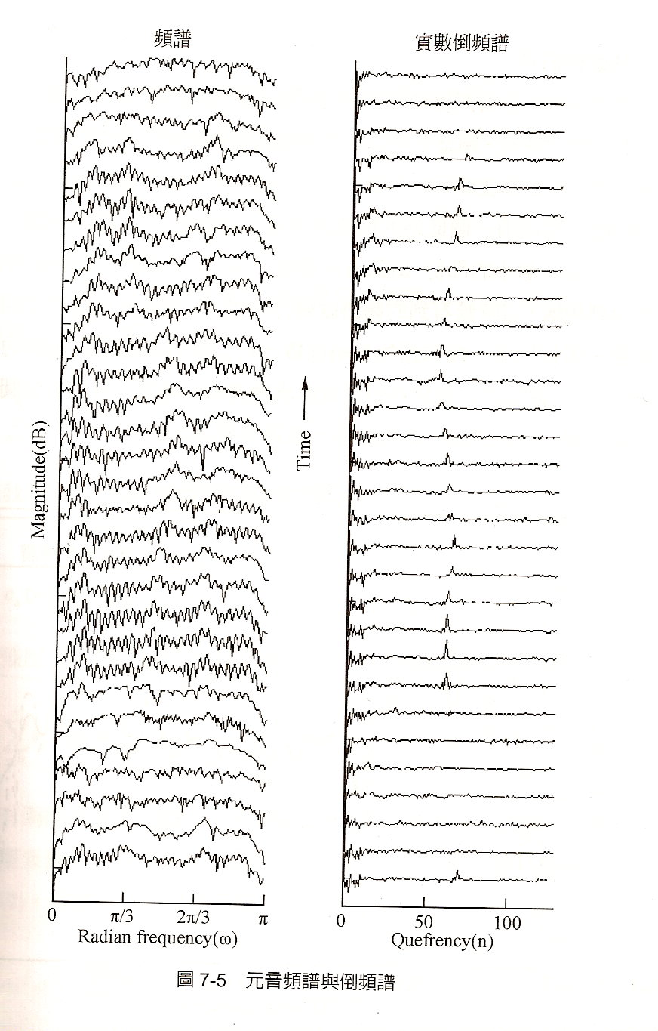
196
用 cepstrum 將 multipath的影響去除
From 王小川， “語音訊號處理”，全華出版，台北，民國94年。

Slide 17
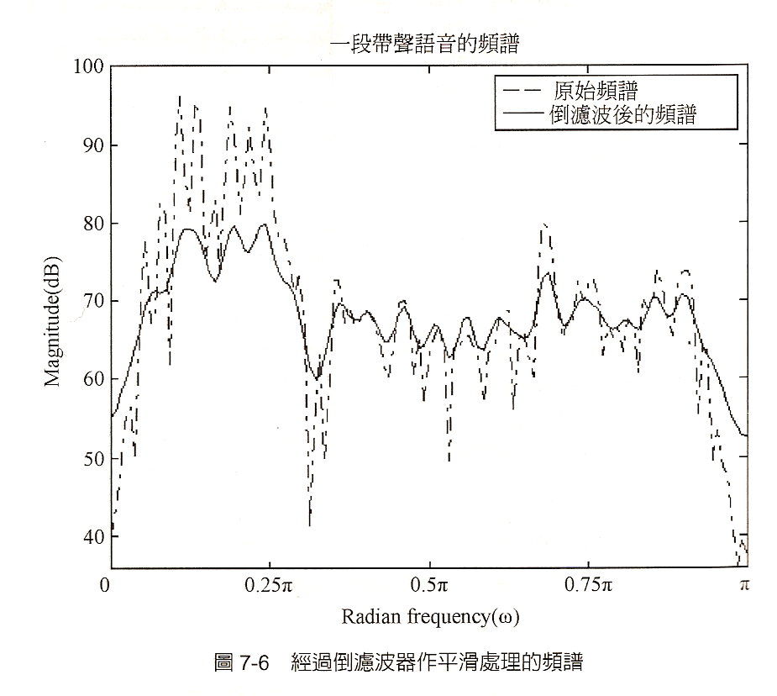
197
From 王小川， “語音訊號處理”，全華出版，台北，民國94年。

Slide 18
198
· 5-F Problems of Cepstrum
(1) | log(X(Z))|
(2) Phase
(3) Delay Z^{-k}
(4) Only suitable for the multiple-path-like problem

Slide 19
· 5-G Differential Cepstrum
或
inverse Z transform
Note:
If
Advantages: no phase ambiguity
able to deal with the delay problem

Slide 20
• Properties of Differential Cepstrum
(1) The differential Cepstrum is shift & scaling invariant
不只適用於 multi-path-like problem
也適用於 pattern recognition
If y[n] = A X[n - r]
(Proof):

Slide 21
(2) The complex cepstrum is closely related to its differential cepstrum and the signal original sequence x[n]
 
Complex cepstrum 做得到的事情, differential cepstrum 也做得到！

Slide 22
202
(3) If x[n] is minimum phase (no poles & zeros outside the unit circle), then
= 0 for n ≤ 0
(4) If x[n] is maximum phase (no poles & zeros inside the unit circle) , then
= 0 for n ≥ 2
delay
max phase
min phase
0
1
2
(5) If x(n) is of finite duration, has infinite duration
Complex cepstrum decay rate
Differential Cepstrum decay rate 變慢了,

Slide 23
203
· 5-H Mel-Frequency Cepstrum (梅爾頻率倒頻譜)
Take log in the frequency mask
B_{m}[k] = 0 for f < f_{m−1} and f > f_{m+1}
for f_{m−1} ≤ f ≤ f_{m}
for f_{m} ≤ f ≤ f_{m+1}
f = k f_{s} /N
gain
mask of Mel-frequency cepstrum
B_{m}[k]
f₁ , f₂ , f₃…… 以等比級數增加
frequency
f_{m-1}
f_{m}
f_{m+1}
f_{m+2}
f_{m+3}

Slide 24
204
Process of the Mel-Cepstrum
summation of the effect inside the m^{th} mask
x[n] X[k]
Q: What are the difference between the Mel-cepstrum and the original cepstrum?
Mel-frequency cepstrum 更接近人耳對語音的區別性
用 c_{x}[1], c_{x}[2], c_{x}[3], ……., c_{x}[13] 即足以描述語音特徵
FT
Advantages :

Slide 25
205
· 5-I References
• R. B. Randall and J. Hee, “Cepstrum analysis,” Wireless World, vol. 88, pp. 77-80. Feb. 1982
• 王小川， “語音訊號處理”，全華出版，台北，民國94年。
• A. V. Oppenheim and R. W. Schafer, Discrete-Time Signal Processing, London: Prentice-Hall, 3rd ed., 2010.
• S. C. Pei and S. T. Lu, “Design of minimum phase and FIR digital filters by differential cepstrum,” IEEE Trans. Circuits Syst. I, vol. 33, no. 5, pp. 570-576, May 1986.
• S. Imai, “Cepstrum analysis synthesis on the Mel-frequency scale,” ICASSP, vol. 8, pp. 93-96, Apr. 1983.

Slide 26
附錄六：聲音檔和影像檔的處理 (by Matlab)
206
A. 讀取聲音檔
電腦中，沒有經過壓縮的聲音檔都是 *.wav 的型態
有經過壓縮的聲音檔是*.mp3的型態
讀取： audioread
例： [x, fs] = audioread(C:\WINDOWS\Media\Alarm01.wav');
可以將 ringin.wav 以數字向量 x 來呈現。 fs: sampling frequency
這個例子當中 size(x) = 122868 2 fs = 22050
思考: 所以，取樣間隔多大?
這個聲音檔有多少秒？
註：2015版本以後的 Matlab，wavread 將改為 audioread
雙聲道 (Stereo，俗稱立體聲)

Slide 27
207
畫出聲音的波型
time = [0:size(x,1)-1]/fs; % x 是前頁用 audioread 所讀出的向量
subplot(2,1,1); plot(time, x(:,1)); xlim([time(1),time(end)])
subplot(2,1,2); plot(time, x(:,2)); xlim([time(1),time(end)])
注意： *.wav 檔中所讀取的資料，值都在 −1 和 +1 之間

Slide 28
B. 繪出頻譜 (詳細方法請參考附錄二)
X = fft(x(:,1)); % 只做這一步無法得出正確的頻譜
X=X.';
N=length(X); N1=round(N/2);
dt=1/fs;
X1=[X(N1+1:N),X(1:N1)]*dt; % shifting for spectrum
f=[[N1:N-1]-N,0:N1-1]/N*fs; % valid f
plot(f, abs(X1));

Slide 29
Alarm01.wav 的頻譜

Slide 30
Alarm01.wav 的頻譜
xlim([-2000,2000]) % 只看其中 -2000Hz ~ 2000Hz 的部分

Slide 31
211
C. 聲音的播放
(1) sound(x): 將 x 以 8192Hz 的頻率播放
(2) sound(x, fs): 將 x 以 fs Hz 的頻率播放
Note: (1)~(3) 中 x 必需是1 個column (或2個 columns)，且 x 的值應該 介於 −1 和 +1 之間
(3) soundsc(x, fs): 自動把 x 的值調到 −1 和 +1 之間 再播放
D. 用 Matlab 製作 *.wav 檔： audiowrite
audiowrite(filename, x, fs)
將數據 x 變成一個 *.wav 檔，取樣速率為 fs Hz
① x 必需是1 個column (或2個 columns) ② x 值應該 介於 −1 和 +1

Slide 32
212
E. 用 Matlab 錄音的方法
錄音之前，要先將電腦接上麥克風，且確定電腦有音效卡
(部分的 notebooks 不需裝麥克風即可錄音)
範例程式：
Sec = 3;
Fs = 8000;
recorder = audiorecorder(Fs, 16, 1);
recordblocking(recorder, Sec);
audioarray = getaudiodata(recorder);
執行以上的程式，即可錄音。
錄音的時間為三秒，sampling frequency 為 8000 Hz
錄音結果為 audioarray，是一個 column vector (如果是雙聲道，則是兩個 column vectors)

Slide 33
213
範例程式 (續)：
sound(audioarray, Fs); % 播放錄音的結果
t = [0:length(audioarray)-1]./Fs;
plot (t, audioarray‘); % 將錄音的結果用圖畫出來
xlabel('sec','FontSize',16);
audiowrite(‘test.wav’, audioarray, Fs) % 將錄音的結果存成 *.wav 檔

Slide 34
214
指令說明：
recorder = audiorecorder(Fs, nb, nch);
(提供錄音相關的參數)
Fs: sampling frequency,
nb: using nb bits to record each data
nch: number of channels (1 or 2)
recordblocking(recorder, Sec);
(錄音的指令)
recorder: the parameters obtained by the command “audiorecorder”
Sec: the time length for recording
audioarray = getaudiodata(recorder);
(將錄音的結果，變成 audioarray 這個 column vector，如果是雙聲道，則 audioarray 是兩個 column vectors)
以上這三個指令，要並用，才可以錄音

Slide 35
215
F：影像檔的處理
Image 檔讀取: imread
Image 檔顯示: imshow, image, imagesc
Image 檔製作: imwrite
基本概念：灰階影像在 Matlab 當中是一個矩陣
彩色影像在 Matlab 當中是三個矩陣，分別代表 Red,
Green, Blue
*.bmp: 沒有經過任何壓縮處理的圖檔
*.jpg: 有經過 JPEG 壓縮的圖檔
Video 檔讀取: aviread

Slide 36
範例一： (黑白影像)
216
im=double(imread('C:\Program Files\MATLAB\pic\Pepper.bmp'));
(注意，如果 Pepper.bmp 是個灰階圖，im 將是一個矩陣)
size(im)
ans =
256 256
(用 size 這個指令來看 im 這個矩陣的大小)
image(im);
colormap(gray(256))
範例二：(彩色影像)
im2=double(imread('C:\Program Files\MATLAB\pic\Pepper512c.bmp'));
size(im2)
ans =
512 512 3
(注意，由於這個圖檔是個彩色的，所以 im2 將由三個矩陣複合而成)
imshow(im);
or
image(im/255);

Slide 37
217
注意：要對影像做運算時，要先變成 double 的格式
否則電腦會預設影像為 integer 的格式，在做浮點運算時會產生誤差
例如，若要對影像做 2D Discrete Fourier transform
im=imread('C:\Program Files\MATLAB\pic\Pepper.bmp');
im=double(im);
Imf=fft2(im);

Slide 38
附錄七 聲音檔和影像檔的處理 (by Python)
可以先安裝幾個模組
pip install numpy
pip install scipy
pip install matplotlib # plot
pip install pipwin
pipwin install simpleaudio # vocal files
pipwin install pyaudio
PS: 謝謝2021年擔任助教的蔡昌廷同學協助製作

Slide 39
A. 讀音訊檔
要先import 相關模組 : import scipy.io.wavfile as wavfile
讀取音檔 :
fs, wave_data = wavfile.read('C:/WINDOWS/Media/Alarm01.wav’)
# fs: sampling frequency
# If the audio file has one channel, then wave_data is a column vector
# If the audio file has two channels, then wave_data has two column
vectors
num_frame = len(wave_data) # 音訊長度:
n_channel = int(wave_data.size/ num_frame) # channels 數量
>>> fs
22050
>>> num_frame, n_channel
(1150416, 2)

Slide 40
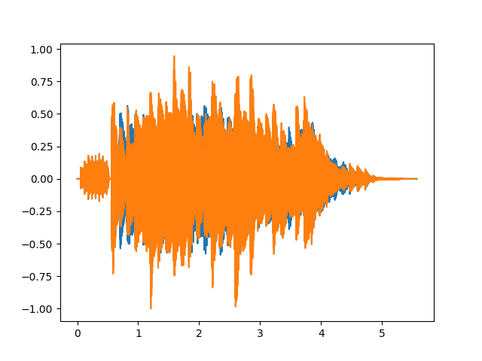
畫出音訊波形圖
要先import 相關模組 : import matplotlib.pyplot as plt
time = np.arange(0, num_frame)*1/fs
plt.plot(time, wave_data)
plt.show()

Slide 41
B. 畫出頻譜
要先import 相關模組 : from scipy.fftpack import fft
fft_data = abs(fft(wave_data[:,1]))/fs # only choose the 1st channel
# 注意要乘上 1/fs
n0=int(np.ceil(num_frame/2))
fft_data1=np.concatenate([fft_data[n0:num_frame],fft_data[0:n0]])
# 將頻譜後面一半移到前面
freq=np.concatenate([range(n0-num_frame,0),range(0,n0)])*fs/num_frame
# 頻率軸跟著調整
plt.plot(freq,fft_data1)
plt.xlim(-1000,1000) # 限制頻率的顯示範圍
plt.show() # 如後圖

Slide 42
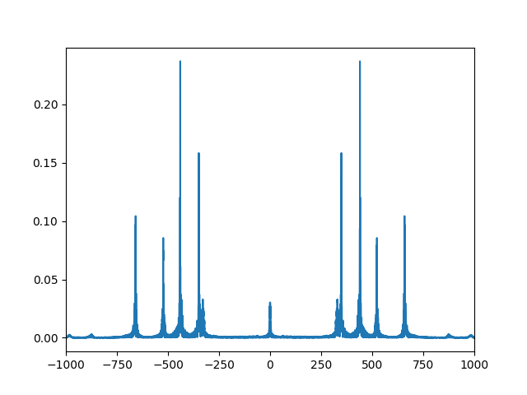

Slide 43
C. 播放聲音
要先import 相關模組 : import simpleaudio as sa
n_bytes =2 # using two bytes to record a data
wave_data = (2**15-1)* wave_data
# change the range to -2¹⁵ ~ 2¹⁵
wave_data = wave_data.astype(np.int16)
play_obj = sa.play_buffer(wave_data, n_channel, n_bytes, fs)
play_obj.wait_done()

Slide 44
D. 製作音檔
wavfile.write(file name, fs, data)
# fs means the sampling frequency
# data should be a one-column or two column array
Example:
wavfile.write('Alarm01_test.wav’, 22050, wave_data)

Slide 45
E. 錄音
要先import 相關模組 : import pyaudio
範例程式
import pyaudio
pa=pyaudio.PyAudio()
fs = 44100
chunk = 1024
stream = pa.open(format=pyaudio.paInt16, channels=1, rate=fs, input=True, frames_per_buffer=chunk)
vocal=[]
count=0

Slide 46
while count<200: #控制錄音時間
audio = stream.read(chunk) #一次性錄音取樣位元組大小
vocal.append(audio)
count +=1
save_wave_file('testrecord.wav',vocal)
stream.close()
參考 https://codertw.com/%E7%A8%8B%E5%BC%8F%E8%AA%9E%E8%A8%80/491427/

Slide 47
F. 影像檔的處理
可以先安裝幾個模組
pip install numpy
pip install matplotlib
1. 讀取影像檔
import cv2
image = cv2.imread('D:/Pic/peppers.bmp’)
或
import matplotlib.pyplot as plt
image = plt.imread(‘D:/Pic/peppers.bmp’)

Slide 48
注意
(1)寫入圖片若為彩色圖片，需要注意 cv2.imread 預設channels 順序為BGR,
image[:, :, 0] => B, image[:, :, 1] => G, image[:, :, 2] => R
(2) 若使用 plt.imread, 則 3 個 channels 的順序仍為 RGB
image[:, :, 0] => R, image[:, :, 1] => G, image[:, :, 2] => B
(3) 若讀檔讀不出來，有時要將路徑的 \ 改為 /
(4) image.shape 可以看出影像之大小
>>> image.shape
(512, 512, 3)
(5) 可讀 jpg, bmp, png 檔，但不能讀 gif 檔

Slide 49
2. 顯示影像
Case 1: 圖的值格式為 int
以下的指令要配合使用 (彩色，灰階皆可)
cv2.imshow('test', image) # 以 test 為顯示的圖的名稱
cv2.waitKey(0)
cv2.destroyAllWindows()
亦可用以下之指令
import matplotlib.pyplot as plt
plt.imshow(image)
plt.show()
若一開始用 cv.imread 讀圖但要用 plt.imshow來顯示彩色圖，要先將 BGR 的順序轉回 RGB，將第二行改為
plt.imshow(image[:,:,[2,1,0]])

Slide 50
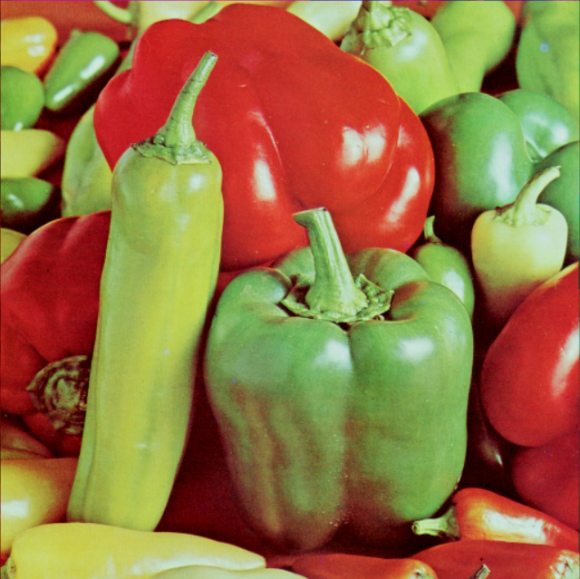

Case 2: 圖的值格式為 double (非整數)
此時，無論用 cv2.imshow或是 plt.imshow，皆要先除以255，再將圖顯示出來
Example 1:
image = cv2.imread('D:/Pic/peppers.bmp’)
Image1 = image*0.5 + 127.5 # lighten the image
cv2.imshow(‘test’, image) # int 不用除255
cv2.waitKey(0)
cv2.destroyAllWindows()
cv2.imshow(‘test’, image1/255) # 非整數要除255
cv2.waitKey(0)
cv2.destroyAllWindows()

Slide 51
Example 2:
import matplotlib.pyplot as plt
image = plt.imread('D:/Pic/peppers.bmp’)
image1 = image*0.5 + 127.5 # lighten the image
plt.imshow(image) # int 不用除255
plt.show()
plt.imshow(image1/255) # 非整數要除255
plt.show()

Slide 52
3. 寫入圖片檔
cv2.imwrite('D:/Pic/jpg', image)
或
plt.imsave('D:/Pic/jpg', image)
注意
(1) 寫入圖片若為彩色圖片，在使用 cv2.imwrite 時需要注意
image[:, :, 0] => B, image[:, :, 1] => G, image[:, :, 2] => R
若用 plt.imsave 則
image[:, :, 0] => R, image[:, :, 1] => G, image[:, :, 2] => B
(2) 若用 cv2.imwrite(‘D:\Pic\jpg’, image) 可能無法存檔，要將 \ 改為 /
(3) 若是使用 plt.imshow 和 plot.show() 來顯示，可以用右下角的 “save the figure” 來存檔

