Slide 1
Overlapped Context Modeling Using Feature Mapping Functions in the Adaptive Arithmetic Coding Process for Lossless Encoding
Authors: Jian-Jiun Ding, Tzu-Jung Tseng
Graduate Institute of Communication Engineering, National Taiwan University, Taipei, Taiwan
Speaker: M11302223 葉丞峰

Slide 2
Outline
• Abstract
• Introduction
• Overall Process
• Experiments
• Conclusion
• References

Slide 3
Abstract
Context modeling plays a critical role in the adaptive arithmetic coding process.
However, the feature value around the border of the ranges of two adjacent contexts, its corresponding probability model can not be estimated accurately.
More than one contexts will be assigned for each input data by making the contexts overlapping.
High coding efficiency can be achieved.

Slide 4
Introduction
Adaptive arithmetic coding (AAC) is one of the advanced data compression algorithms.
The context modeling-based AAC (CAAC) is to assign the context according to the neighboring casual part and use different frequency tables, which reflect the probability distributions.
Coding efficiency can be achieved better.

Slide 5
Introduction
However, CAAC apply hard criterions to classify the casual part into several classes.
And problem will happen if the casual part has the feature value near to the boundary between two contexts.
Increasing the number of contexts can not solve the problem by leading to fewer training data for each class.
e.g. Data -> Contexts -> Class
Data / Context -> Class
1000/10 -> 100
1000/100 -> 10

Slide 6
Introduction
In this paper, contexts are overlapped with one more.
1 to 1 -> 1 to more
They assign data to be encoded into more than one contexts.
The probability model is constructed from the weighted combination of the frequency table of these overlapped contexts.
The weights is according to the distance.
Larger distance means smaller weights.

Slide 7
Overall Process
A. Prediction of the current pixel values by LOCO-I.
LOCO-I (Low Complexity lossless compression for images)
Input image A
Current pixel $A_{P}$

Slide 8
Overall Process
B. Features of the Surrounding Casual Part (Construct the context).
1. A$[i,j]$ is the true pixel value and $A_{P}[i,j]$ is the predicted pixel value.
res$[i,j]$ is the prediction residue.
2. Feature1 is
Weights 2 means they are closer to the current pixel.

Slide 9
Overall Process
B. Features of the Surrounding Casual Part (Construct the context).
3. $g_{h}[i,j]$ is the horizontal gradients and $g_{v}[i,j]$ is the vertical gradients.
2. Feature2 is
This is related to the smoothness of surrounding casual pixels.

Slide 10
Overall Process
B. Features of the Surrounding Casual Part (Construct the context).
Feature value of the surrounding casual part is determined from
K$[i,j]$ is near to 0 means predict precisely.
K$[i,j]$ is large means the probability distribution of the prediction error will spread widely..

Slide 11
Overall Process
C. Overlapped-range Context Assignment Method
They assign the input more than one contexts.
1.T is the number of contexts
2. ovp is the allowed number of overlapped contexts.
3. The context value mapping function is
$σ$ is some constant

Slide 12
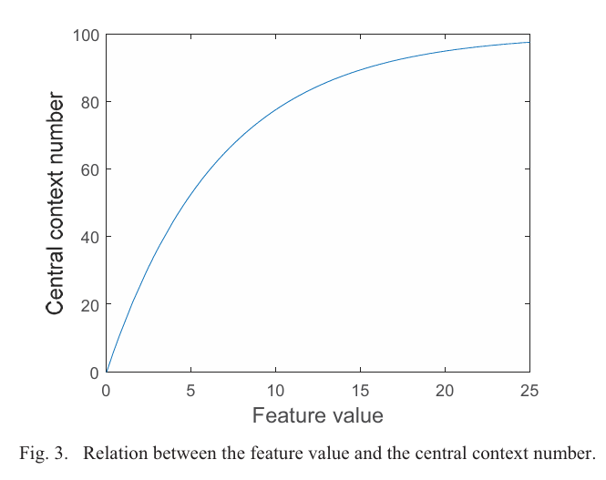
Overall Process
C. Overlapped-range Context Assignment Method
T is 100
ovp is 20
$σ$ is 0.15

Slide 13
Overall Process
C. Overlapped-range Context Assignment Method
The range of number of Contexts is
From (8) and (9) , we can see that
The range of the Feature value is

Slide 14
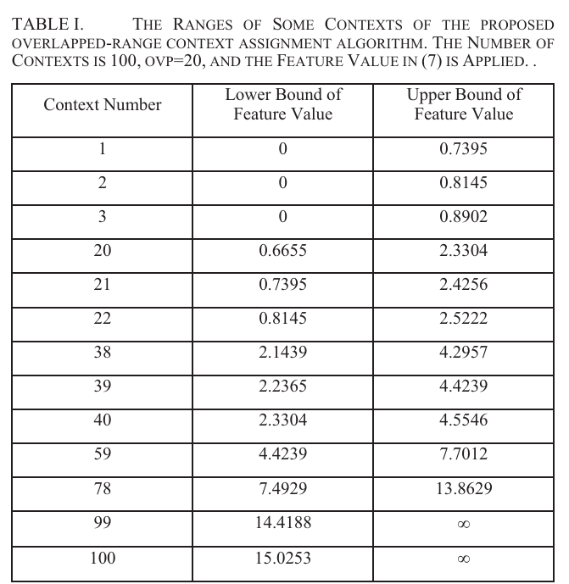
Overall Process
C. Overlapped-range Context Assignment Method

Slide 15
Overall Process
D. Probability Model Construction and Frequency Table Adjustment by Weight Functions
Probability model from single frequency table.
Probability model from a weight function to perform weighted linear combination on the frequency tables of multiple contexts.
1. The weight functions for the Context is

Slide 16
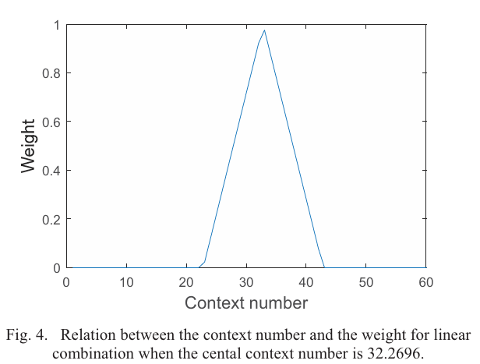
Overall Process
D. Probability Model Construction and Frequency Table Adjustment by Weight Functions

Slide 17
Overall Process
D. Probability Model Construction and Frequency Table Adjustment by Weight Functions
2. Frequency model is
$F_{C}$[n] is the frequency table corresponding to the $C^{th}$ context.
3. Applying the frequency model to adjust the coding range [L, H]:

Slide 18
Overall Process
D. Probability Model Construction and Frequency Table Adjustment by Weight Functions
After adjusting the coding length, they adjust the frequency table whose range is overlapped
where

Slide 19
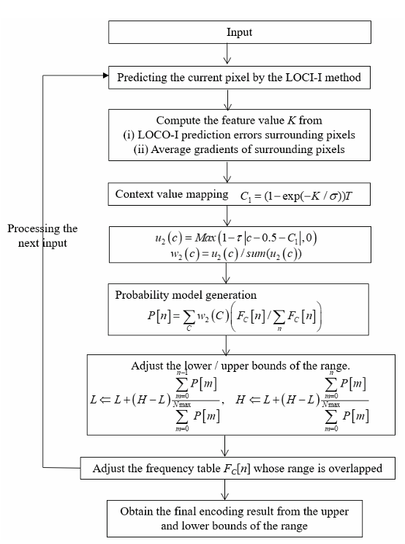
Overall Process

Slide 20
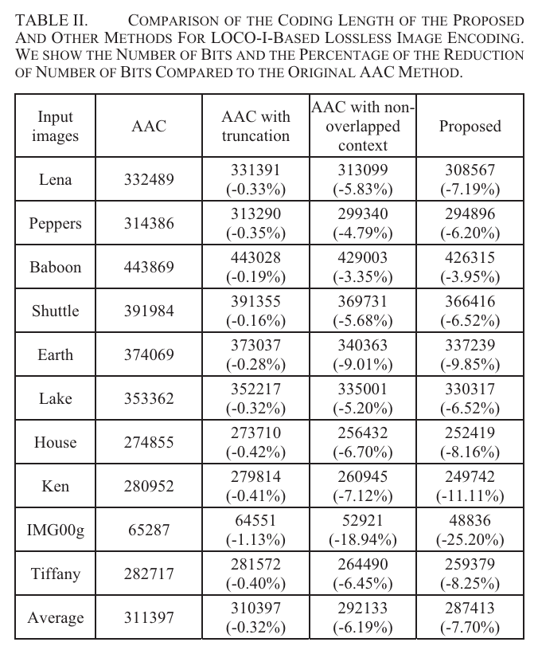
Experiments
Even they apply much advanced way for lossless image compression, the encoding time Is only 1.09 second when using Matlab and executed on a notebook.

Slide 21
Conclusion
An advanced algorithm for context assignment in the CAAC process for LOCO-I is proposed in this paper.
They assign the input into more than one contexts and the ranges of the contexts overlap with one another.
A proper mapping function is designed to convert the characteristics of the casual part into a qualified feature value.
The coding efficiency of losses image encoding can be further improved and the proposed algorithm is beneficial for losses image compression.

Slide 22
References
[1]
J. -J. Ding and T. -J. Tseng, "Overlapped Context Modeling Using Feature Mapping Functions in the Adaptive Arithmetic Coding Process for Lossless Encoding," 2023 Sixth International Symposium on Computer, Consumer and Control (IS3C), Taichung, Taiwan, 2023, pp. 314-317, doi: 10.1109/IS3C57901.2023.00091. keywords: {Training;Adaptation models;Image coding;Computational modeling;Feature extraction;Data models;Frequency estimation;data compression;adaptive arithmetic coding;context modeling;probability model;lossless compression},

