Slide 1

ADVANCED DIGITAL SIGNAL PROCESSING
Machine Learning-Enabled Non-Contact Blood Pressure Estimation Using a 24 GHz FMCW Radar Sensor
Student
Course:
Pham Tuan Phong
Advanced Digital Signal Processing
June 2026

Slide 2
Outline
1. FMCW Radar Signal Model
2. Range FFT Processing
3. Phase Extraction & Unwrapping
4. Band-Pass Filter Design
5. Multi-Rate Signal Processing (Resampling)
6. R-Peak Detection & Beat Segmentation
Pham Tuan Phong
24 GHz FMCW Radar – BP Estimation
2

Slide 3
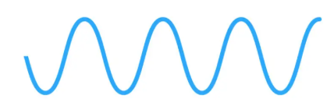
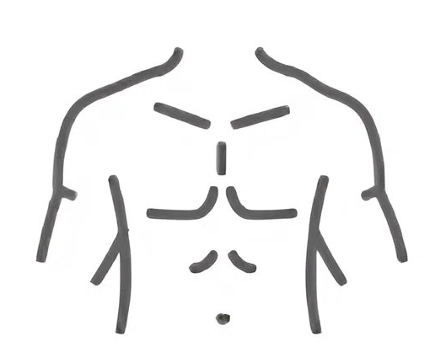
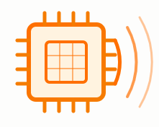
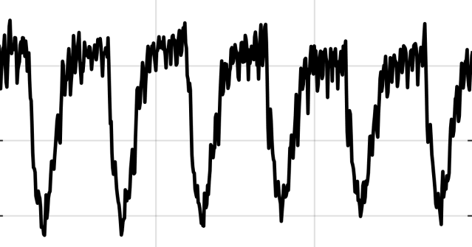
1. FMCW Radar Signal Model
FMCW: Frequency-modulated continuous-wave
System Block Diagram
TX Antenna
(24 GHz Chirp)
Target Chest
(Distance R)
Chip and antenna
Human chest
RX Antenna
(Reflected)
Mixer → Beat Signal
Digital Signal Processing
AI Regression
Signal processing
Pham Tuan Phong
24 GHz FMCW Radar – BP Estimation
3

Slide 4
1. DSP Pipeline Overview — Signal Flow
1
2
3
4
5
6
7
8
Displacement
Δx(t)
Band-Pass
Filtering
Raw IQ Data
(24 GHz FMCW)
Range FFT
Range Profile
Phase Extraction
Phase
Unwrapping
Resampling → 250 Hz
R-Peak Detection
ADSP Topics Covered in This Pipeline
ADSP Topic
Description
Range FFT
FFT of the beat signal along the fast-time axis produces a range profile. The bin with the highest magnitude identifies the chest position; its complex slow-time sequence z[n] is extracted for further processing.
Phase Processing
The phase of z[n] is extracted and unwrapped to remove 2π discontinuities, then converted to physical chest displacement: Δx(t) = $\frac{λ}{4π}{ φ}_{uw\left(t\right)}$
Filter Design
Two band-pass filters are applied to Δx(t) in parallel — 0.1–0.4 Hz for respiration and 0.8–2.0 Hz for cardiac motion — to separate the two physiological components.
Multirate DSP
The radar-derived signals are resampled to 250 Hz to match the ECG and BP sampling rate, enabling synchronization across all channels.
Nonlinear DSP
R-peaks are detected from the ECG and used as physiological anchors, ensuring each segmentation window starts at a consistent point in the cardiac cycle.
Segmentation
A 256-sample window (~1.02 s) is extracted at each R-peak across all three channels, forming a 256×3 input tensor for the 1D U-Net.
Pham Tuan Phong
24 GHz FMCW Radar – BP Estimation
4

Slide 5
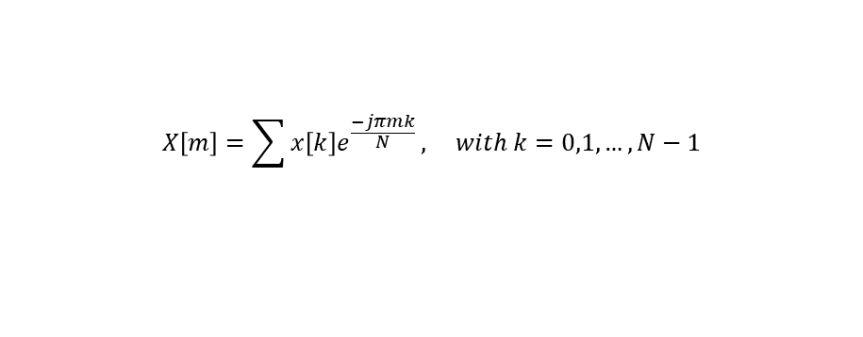
2. Range FFT Processing
FFT Algorithm
Application in This Paper
DFT Definition:
①
Beat signal construction
$$X\left[m\right]=\sum{x\left[k\right]e^{\frac{−jπmk}{N}}}, with k=0,1,…,N−1$$
Each radar frame: N=32 fast-time samples (IQ complex). The IQ matrix has shape [32 × T_frames], where T_frames spans the entire recording session.
• Maps N time-domain samples → N frequency-domain bins
• Each bin m corresponds to frequency f_m = m · Fs / N
• Complexity: O(N²) for DFT → O(N log N) for FFT (Cooley-Tukey)
②
FFT along fast-time axis
Windowing before FFT
S[n,m] = FFT{ s[n,k] } along k (dim 1)
Result: [32 × T_frames] complex range profiles
Range resolution: Δr = c/(2B) = 0.75 m
The finite-length beat signal is implicitly multiplied by a rectangular window → abrupt edges cause spectral leakage. A Hann window is suitable to taper the signal smoothly to zero at both ends, concentrating energy at the true frequency bin and making the chest-bin peak sharper and easier to detect.
③
Select chest bin m*
Take magnitude |S[n,m]| and average across all frames. Find the peak within the expected chest range [~0.5–1.0 m]. This bin is stable because the chest is the dominant reflector.
Dominant Bin Selection (Code)
m* = argmax |S[n, m]|
Bin m* corresponds to the patient's chest at distance:
R = m* · c / (2B) = m* × 0.75 m (B = 200 MHz)
④
Extract slow-time sequence
z[n] = S[n, m*] → shape: [1 × T_frames]
This 1D complex signal tracks how the chest bin evolves over time — its phase encodes all chest wall motion (respiration + heartbeat).
Wynn Pham
24 GHz FMCW Radar – BP Estimation
5

Slide 6
3. Phase Extraction & Unwrapping
Since the amplitude |z[n]| depends on radar cross-section (how reflective the chest is) — amplitude only gives distance but not displacement of the object. Therefore, we can use phase to retrieve chest displacement.
Phase angle(z[n]) — Encodes chest displacement
The phase of z[n] directly encodes the round-trip path length 2R(t). As the chest moves, R(t) changes by fractions of a mm — causing the phase to shift proportionally:
φ(t) = 4π $\frac{\text{R}\text{(}\text{t}\text{)}}{\text{λ}}\text{Δx}\text{(}\text{t}\text{)}$
IQ Signal Model & Phase Extraction
Complex Baseband Signal Model
z[n] = I[n] + j.Q[n] = A.cos(φ[n]) + j.A.sin(φ[n])
where A = |z[n]| (amplitude, nearly constant)
and φ[n] = $\frac{\text{4}\text{πR}\text{(}\text{n}\text{)}}{\text{λ}}$ (phase, encodes displacement)
At 24 GHz: λ = c/f₀ = 3×10⁸ / 24×10⁹ ≈ 12.5 mm
1 radian of phase change corresponds to: Δx = λ/4π ≈ 0.995 mm of chest displacement
Pham Tuan Phong
24 GHz FMCW Radar – BP Estimation
6

Slide 7
3. Phase Extraction & Unwrapping
If we apply Δx = $\frac{λ}{4π}$ $ϕ$ directly, the displacement signal will contain fake jumps of ± $\frac{λ}{2}$ ≈ ± 6.25 mm at every 2π boundary. These are not real chest movements — they are mathematical artifacts that corrupt the respiratory and cardiac signals extracted in the next step.
The Wrapped Phase Problem
Convert to Physical Displacement
# np.unwrap applies exactly the algorithm above
Once $ϕ_{uw}[n]$is continuous, apply the radar phase model:
True phase $φ_{true}\left(t\right)$ continuous, reflects actual chest motion:
Δx(t) = $\frac{λ}{4π}{ φ}_{uw\left(t\right)}$
Result: continuous chest displacement signal containing both respiration and heartbeat.
φ_true: ramps up continuously (chest moving)
Unwrapping Algorithm
Measured phase $φ_{wrapped}\left(t\right)$ clipped to (−π, +π]:
Core idea: detect jumps > π between consecutive samples and compensate with ± 2π
diff[n] = φ[n] − φ[n−1]
if diff[n] > +π → diff[n] -= 2π (jumped up: subtract)
if diff[n] < −π → diff[n] += 2π (jumped down: add)
φuw[n] = φw[n−1] + diff[n]
φ_wrapped: jumps ±2π each time true phase crosses ±π boundary
Wynn Pham
24 GHz FMCW Radar – BP Estimation
7

Slide 8
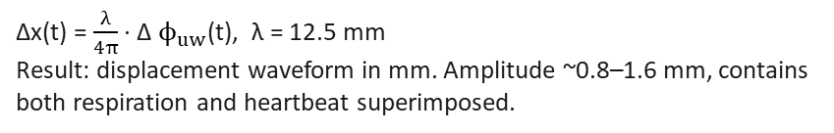
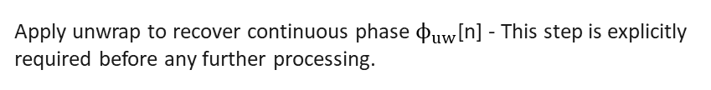
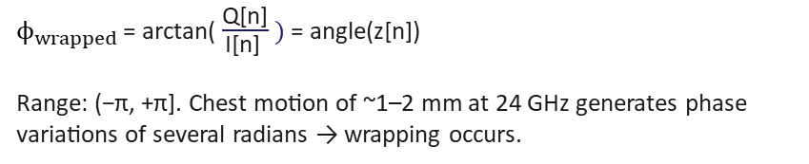
3. Phase Processing and Signal Displacement
In This Paper
Key Equations from Paper
Z
①
Extract slow-time sequence
Radar phase model:
z[n] = S[n, m*] — complex signal at dominant chest bin across T frames. Each sample z[n] = I[n] + jQ[n] captures the reflected chirp from the chest at frame n.
φ(t) = 4π · R(t) / λ
Wavelength at 24 GHz:
λ = c / f₀ = 12.5 mm
②
Extract wrapped phase
Displacement formula:
$ϕ_{wrapped}$ = arctan( $\frac{\text{Q}\text{[}\text{n}\text{]}}{\text{I}\text{[}\text{n}\text{]} } )$ = angle(z[n])
Range: (−π, +π]. Chest motion of ~1–2 mm at 24 GHz generates phase variations of several radians → wrapping occurs.
Δx(t) = λ /(4π) · Δφ_uw(t)
Sensitivity:
1 rad ≈ 0.995 mm of motion
③
Phase unwrapping
Apply unwrap to recover continuous phase $ϕ_{uw}$[n] - This step is explicitly required before any further processing.
Output: Displacement Signal Δx(t)
Properties of Δx(t) of the paper:
• Amplitude: ~0.8 – 1.6 mm (dominated by respiration)
④
Displacement recovery
• Contains slow oscillation (~0.25 Hz) = breathing
Δx(t) = $\frac{λ}{4π}$ · Δ $ϕ_{uw}$(t), λ = 12.5 mm
Result: displacement waveform in mm. Amplitude ~0.8–1.6 mm, contains both respiration and heartbeat superimposed.
• Contains fast ripple (~1.2 Hz) = heartbeat
• Both components superimposed → need BPF to separate
• Ready for Band-Pass Filtering (next step)
Pham Tuan Phong
24 GHz FMCW Radar – BP Estimation
8

Slide 9
4. Band-Pass Filter Design
Δx(t) contains both respiration and heartbeat superimposed in one signal. The two components occupy different frequency ranges with no overlap → a band-pass filter can cleanly separate them without distorting either signal.
BPF₁ — Respiratory Band
BPF₂ — Cardiac Band
0.1 – 0.4 Hz
0.8 – 2.0 Hz
Rationale (from paper):
Rationale (from paper):
Normal breathing rate: 12–24 breaths/min = 0.2–0.4 Hz. The lower bound 0.1 Hz provides margin for slow breathing.
Normal heart rate: 48–120 bpm = 0.8–2.0 Hz. A clear frequency gap of 0.4 Hz exists between the two bands (0.4–0.8 Hz is empty), ensuring no overlap.
Signal characteristics:
Signal characteristics:
Large amplitude (~0.2 mm) — diaphragm moves significantly during breathing. Smooth, near-sinusoidal shape.
Small amplitude (~0.05 mm) — 4× smaller than respiration. Complex shape as it reflects the mechanical dynamics of the heart.
Frequency gap between the two bands: 0.4 – 0.8 Hz (0.4 Hz wide) — ensures the two filters do not interfere with each other. Signals in this gap are discarded, which is acceptable since no known physiological process produces chest motion in this range at rest.
Pham Tuan Phong
24 GHz FMCW Radar – BP Estimation
9

Slide 10
4. Band-Pass Filter Design – Method could be used
Filtfilt filter — forward + backward pass → zero phase shift
Filtfilt filter applies the filter twice: once forward in time, then backward on the result. The two-phase shifts cancel exactly → net phase shift = 0. Every frequency component arrives at its true time position. Cardiac peaks in the output align precisely with actual heartbeat timing.
The filtered cardiac signal must be temporally aligned with the ECG and A-line BP for synchronization. If there is any phase delay in the cardiac band signal, the 256-sample windows will contain misaligned events across the three channels → the U-Net receives inconsistent training data.
Filter Properties
cardiac = filtfilt(b2, a2, displacement)
Filter type
Band-pass IIR (Butterworth-type)
Order
4th order — paper does not specify (standard choice)
BPF₁ cutoffs
0.1 Hz – 0.4 Hz (Respiratory)
BPF₂ cutoffs
0.8 Hz – 2.0 Hz (Cardiac)
Application
Filtfilt — zero-phase, applied to Δx(t)
Applied to
Same input Δx(t) — parallel, independent
Output
Two signals ready for resampling to 250 Hz
Pham Tuan Phong
24 GHz FMCW Radar – BP Estimation
10

Slide 11
5. Resampling and Multirate DSP
The radar's slow-time sampling rate depends on frame rate (e.g., ~20–100 Hz depending on config). ECG and cuff BP reference signals are recorded at 250 Hz. Resampling to 250 Hz synchronizes all channels so the U-Net input tensor has consistent time alignment across all 3 channels.
Nyquist Criterion
Cardiac signal bandwidth: f_max ≤ 2.0 Hz
→ Minimum fs required = 2 × 2.0 = 4 Hz
Chosen fs = 250 Hz ≫ 4 Hz ✓
→ No aliasing. Fine time resolution preserved for U-Net waveform regression.
Rational Resampling L/M
To go from fs_in → fs_out:
1. Upsample by L (insert L−1 zeros between samples)
2. Low-pass filter (anti-imaging + anti-aliasing)
Cutoff = min(fs_in, fs_out) / 2
3. Downsample by M (keep every M-th sample)
Application in This Paper
The radar-derived signals are resampled to 250 Hz to match the sampling rate of the simultaneously recorded ECG and blood pressure signals.
Pham Tuan Phong
24 GHz FMCW Radar – BP Estimation
11

Slide 12
6. R-Peak Detection — Physiological Anchor for Segmentation
In each cardiac cycle, the ECG shows P wave → QRS complex → T wave. The R-peak is the tallest, sharpest spike in the QRS complex, occurring when the ventricles contract (systole begins). It is the most reliably detectable event in the ECG signal.
Consistent phase
①
Band-pass filter ECG (5–15 Hz)
Isolates QRS energy. Removes baseline wander (<0.5 Hz) and high-frequency noise (>40 Hz). Leaves the sharp R-peak intact.
Every cardiac cycle starts at a well-defined physiological event (ventricular contraction) → systolic upstroke in BP always follows R-peak by a fixed delay.
②
Differentiate
d[n] = x[n] − x[n−2]. The steep rising/falling edges of the R-peak produce large values. Flat P and T waves produce near zero.
Handles HR variability
③
Square d[n]²
Heart rate fluctuates over time. R-peak anchoring ensures each 256-sample window contains exactly one complete cardiac cycle regardless of heart rate at that moment.
Makes all values positive and amplifies large slopes (QRS) much more than small ones (noise), increasing the signal-to-noise ratio non-linearly.
④
Moving Window Integration (150 ms)
Cross-channel alignment
MWI[n] = (1/W)·Σ d²[k]. Smooths the squared signal into broad peaks around each QRS. Window = 150 ms ≈ typical QRS duration.
ECG, radar cardiac, and BP all show corresponding events at the same relative time within each R-peak window → U-Net learns consistent mappings.
⑤
Threshold + findpeaks
Adaptive threshold ≈ 0.5·max(MWI). Min distance between peaks = 0.5 s (refractory period — heart cannot beat faster than 120 bpm).
Pham Tuan Phong
24 GHz FMCW Radar – BP Estimation
12

Slide 13
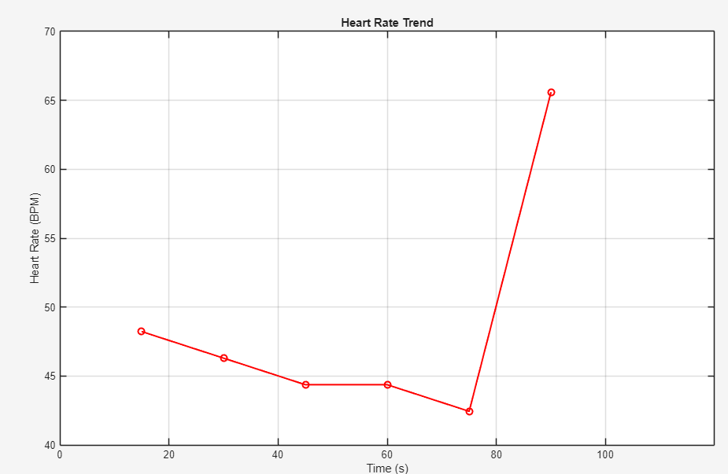
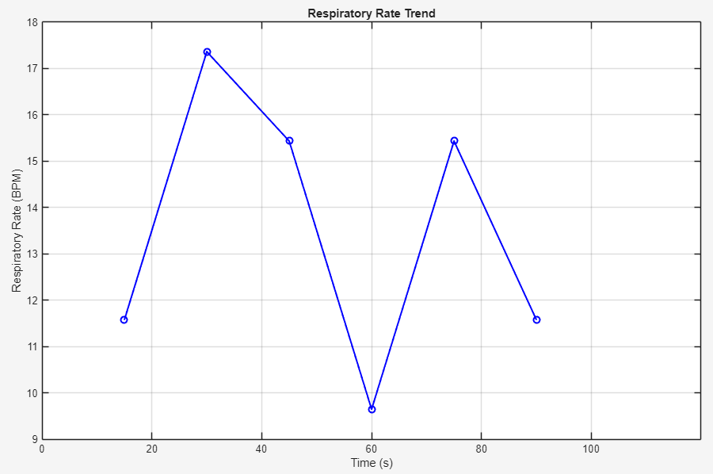
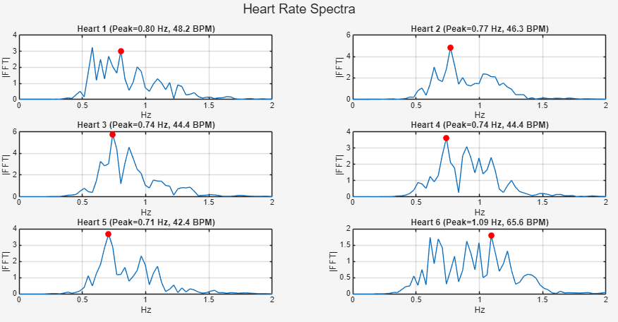
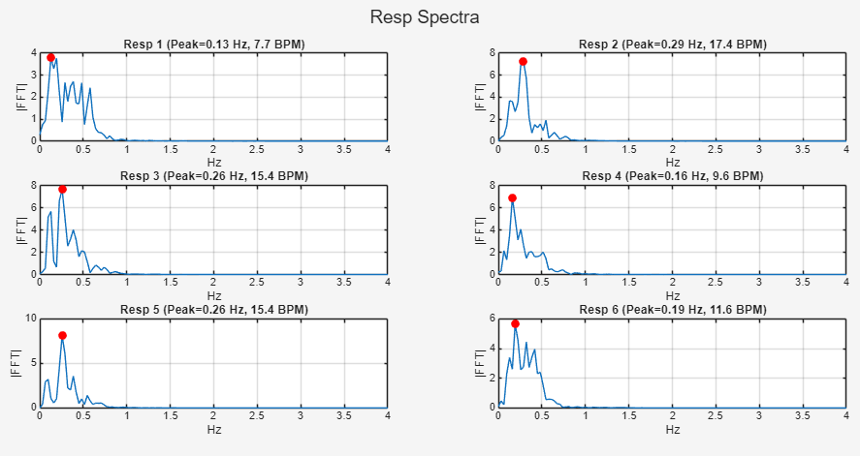
6. Matlab code
Link github: https://github.com/TuanFong/ADSP-HW/tree/main
Pham Tuan Phong
24 GHz FMCW Radar – BP Estimation
13

Slide 14
Reference
Machine Learning-Enabled Non-Contact Blood Pressure Estimation Using a 24 GHz FMCW Radar Sensor
Pham Tuan Phong
24 GHz FMCW Radar – BP Estimation
14

Slide 15
THANK YOU FOR LISTENING
Pham Tuan Phong
24 GHz FMCW Radar – BP Estimation
15

