Slide 1
De-aliasing based on
Multi Sample-rate Algorithm
2026/06/05
Advisor: 李百祺
R14945040 曾柏凱
Notes:
Good afternoon,

Slide 2
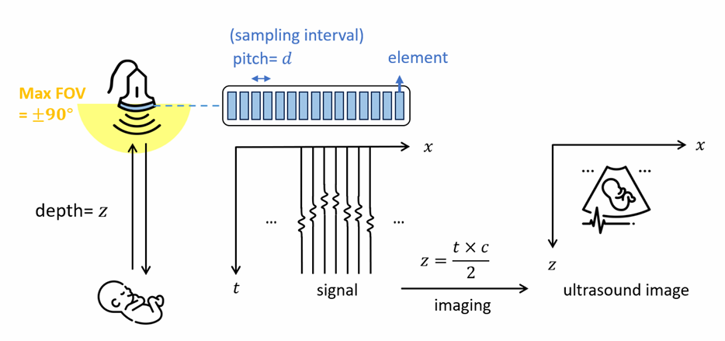
What is Ultrasound?
Notes:
超音波架構解說圖
Ultrasound is one of the most widely used medical diagnostic systems. This picture simply illustrates how ultrasound works. Firstly, probes convert electricity into acoustic pulses through transducers, which are made of piezoelectric materials. After a pulse is transmitted, it travels into the patient's body. Since there is acoustic impedance or mismatch formed by our tissues, vessels, or cells, the pulse will be reflected. The probes receive the echo pulses and convert them back into electrical signals. In the final stage, after going through a series of signal processing, the result is shown on a monitor, allowing us to visualize the internal structures of the body.

Slide 3
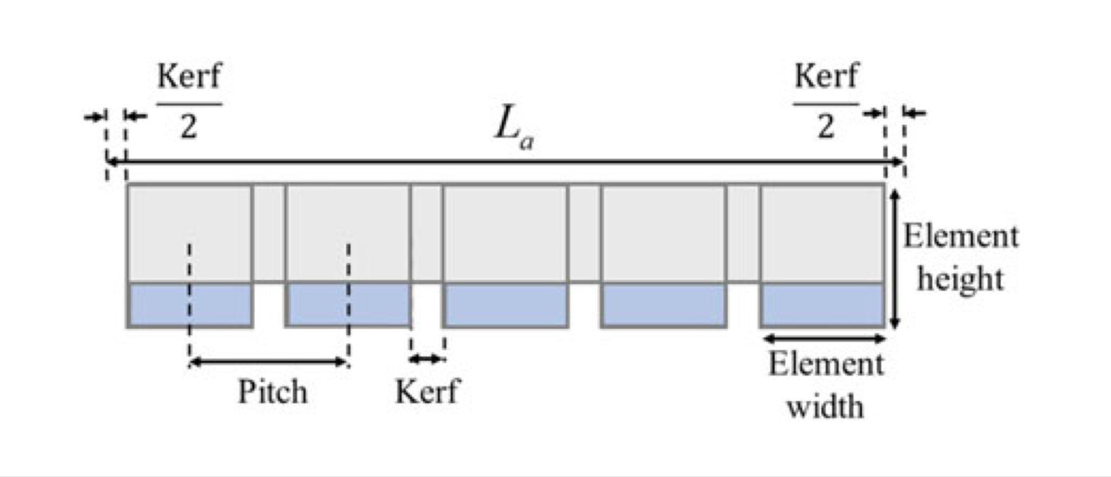
Schematic of a Linear Transducer
Kerf:
The space between every two consecutive elements
Pitch:
The distance between the center of two consecutive elements
Notes:
Transducer 的架構圖
This is a simple schematic of a linear transducer, in which there are some important parameters relevant to our topic. Kerf refers to the space between every two consecutive elements, while Pitch refers to the distance between the centers of two consecutive elements.

Slide 4
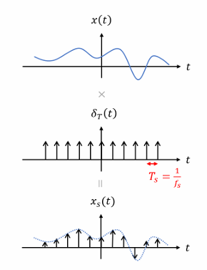
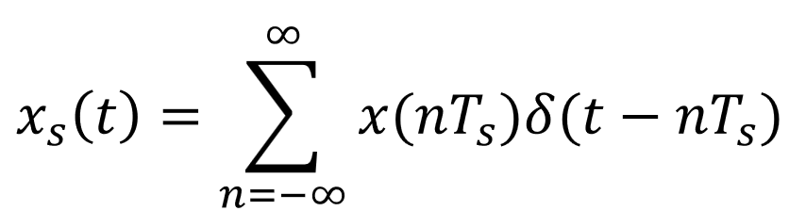
Sampling
Notes:
取樣原理與 Pitch 的關係
While signals existing in nature are continuous, our computers and processors can only process digital signals, which are discrete. Therefore, we must perform sampling before we start to process the signals.

Slide 5
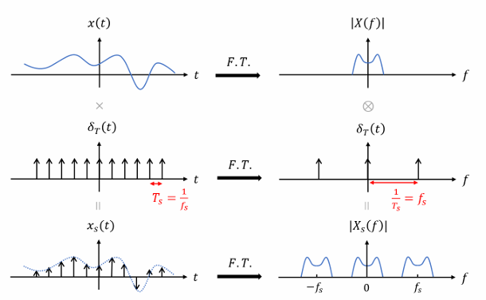

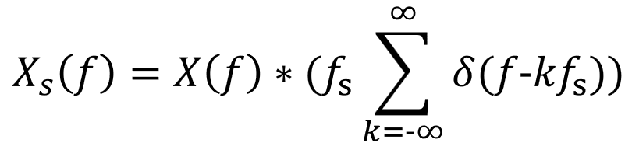
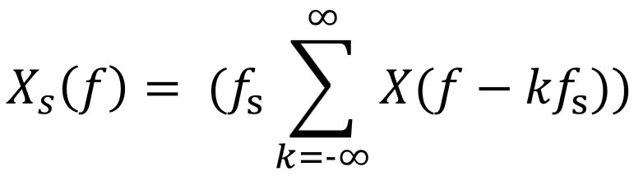
Notes:
取樣原理與 Pitch 的關係
By applying a Fourier transform to the signals, we can observe them shifting from the time domain to the frequency domain. The Ts (sampling interval) I mentioned in the previous slide determines the sampling frequency (fs). This means the signal's spectrum will be replicated every fs in the frequency domain, and this relationship can be expressed by the formula shown on the right.

Slide 6
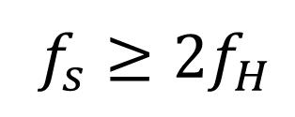
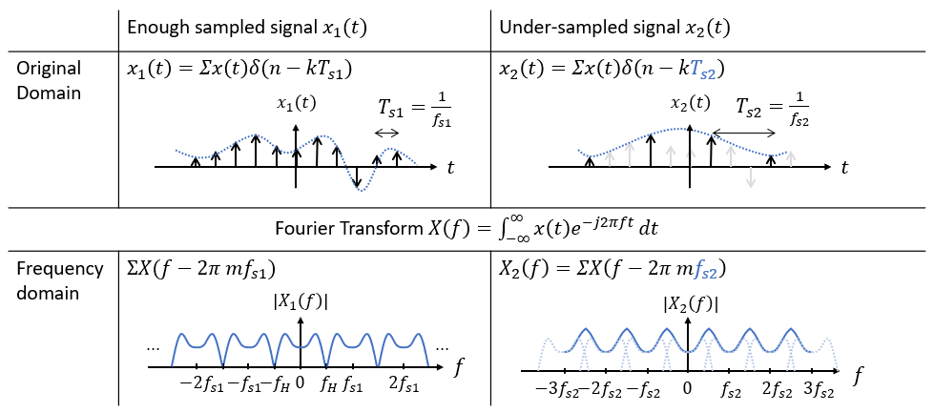
Nyquist Theorem
Aliasing
Notes:
Nyquist 定理與取樣不足
Having acknowledged the sampling theorem, a question arises: What is the optimal sampling rate? To answer this, I will explain the Nyquist Theorem. After sampling and performing a Fourier transform, the signal's spectrum is replicated along the frequency axis. Once the sampling frequency becomes smaller than twice the highest frequency of the signals (fs < 2fH), these spectral samples begin to overlap. When this happens, high-frequency information 'bleeds' into the lower frequencies, making it mathematically impossible to distinguish the original signal components. This phenomenon is what we call 'Aliasing'.

Slide 7
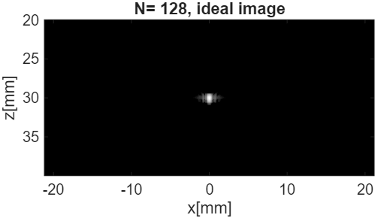
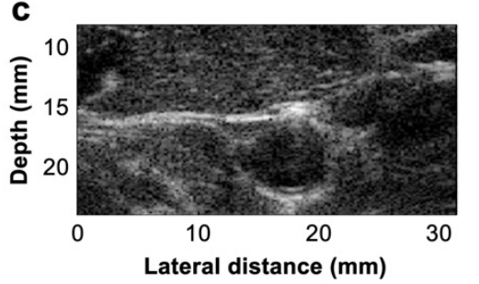

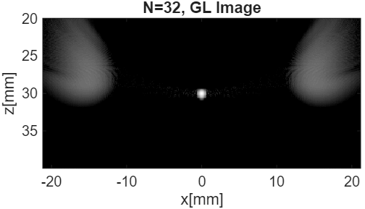
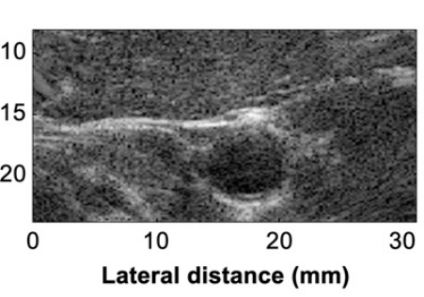


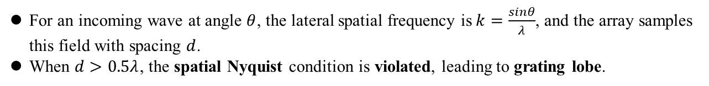

Spatial Sampling and Grating Lobe
Introduction
Method
Result
Discussion
Conclusion
Future work
For an incoming wave at angle $θ$, the lateral spatial frequency is$k=\frac{sinθ}{λ}$, and the array samples this field with spacing $d$.
When $d>0.5λ$, the spatial Nyquist condition is violated, leading to grating lobe.
pitch= $d$
element
$$x$$
grating lobe
…
…
$$t$$
signal
Notes:
In ultrasound imaging, the array elements sample the incoming acoustic field along the lateral direction. The sampling interval is the element pitch, $d$.
For a wave arriving from angle $θ$, the lateral spatial frequency is related to $\sin{θ}/λ$, where $λ$is the wavelength. Therefore, a larger observation angle corresponds to a higher lateral spatial frequency.
To avoid spatial aliasing, the array pitch must be small enough to sample this lateral wave field. The common criterion is that the pitch should be smaller than or equal to half a wavelength.
When the pitch becomes larger than this limit, the spatial Nyquist condition is violated. The acoustic field is under-sampled in space, and the copied spatial spectra may appear inside the field of view.
In ultrasound images, this spatial aliasing appears as grating lobes. These artifacts can generate false structures or strong off-axis responses, which may degrade image quality and affect interpretation.

Slide 8
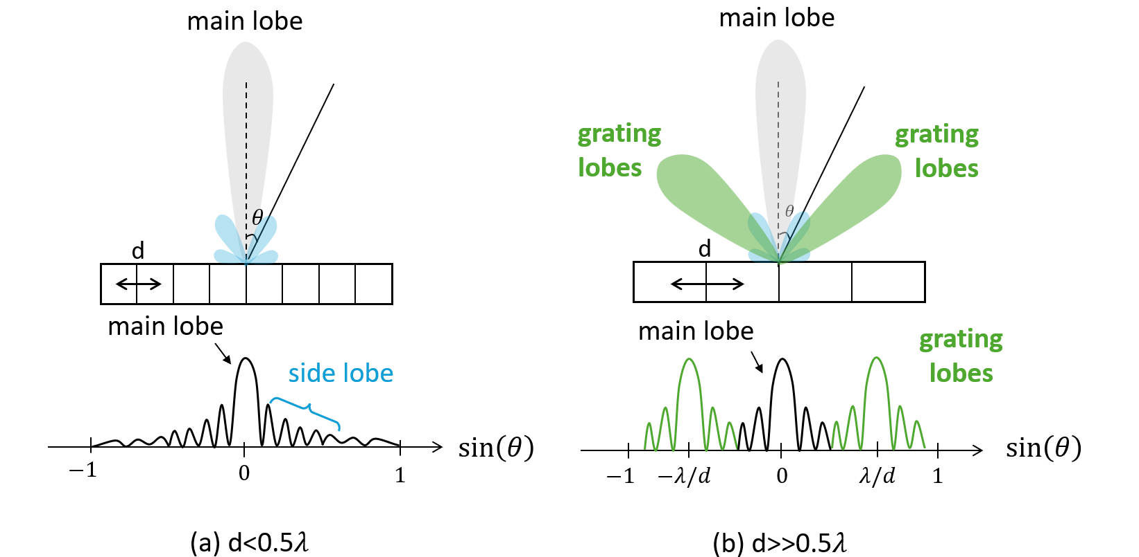
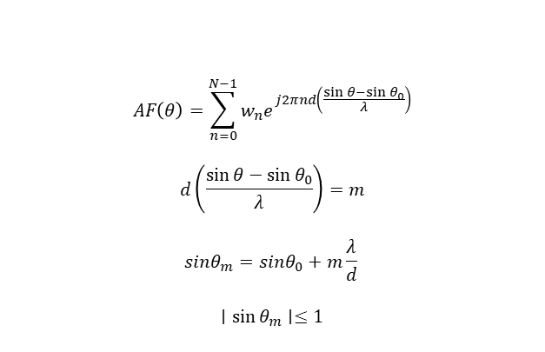
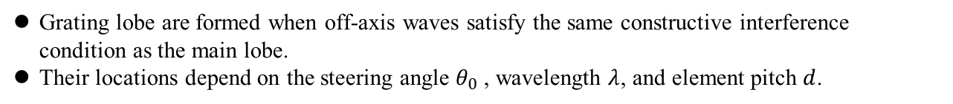
Grating Lobe Formation
Introduction
Method
Result
Discussion
Conclusion
Future work
Grating lobe are formed when off-axis waves satisfy the same constructive interference condition as the main lobe.
Their locations depend on the steering angle $θ_{0}$​, wavelength $λ$, and element pitch $d$.
$$AF\left(θ\right)=\sum_{n=0}^{N−1}{w_{n}e^{j2πnd\left(\frac{\sin{θ}−\sin{θ_{0}}}{λ}\right)}}$$
$$d\left(\frac{\sin{θ}−\sin{θ_{0}}}{λ}\right)=m$$
$$sinθ_{m}​=sinθ_{0}​+m\frac{λ}{d}​$$
$$∣\sin{θ_{m}}∣≤1$$
Notes:
Grating lobes can be understood from the constructive interference condition of an array.
For the desired imaging direction, the signals received by different elements are aligned by beamforming. After the delay correction, the waves add constructively and form the main lobe.
When the element pitch is too large, there can be additional off-axis directions that satisfy a similar phase-matching condition. Signals from these directions can also add constructively after beamforming.
As a result, the beam pattern does not contain only the main lobe. It also contains strong additional lobes at off-axis positions. These are the grating lobes.
Their locations are determined by the steering angle, wavelength, and element pitch. This is important because it means grating lobes are not random noise. They are predictable artifacts caused by spatial sampling.
This predictability is useful later, because if the artifact location changes with steering angle, then angle design may become a possible way to control grating-lobe behavior.

Slide 9
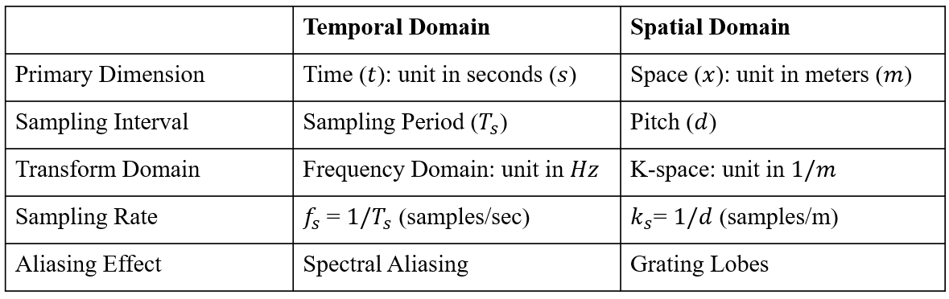
Why Pitch Matters to Sampling?
Notes:
取樣原理與 Pitch 的關係
K空間 : K 空間就是影像的『空間頻譜』，它是將物理空間進行傅立葉轉換後的結果，用來描述波前的傳播方向與相位變化率。
"Remember that I just mentioned there are two important parameters for ultrasound transducers: Kerf and Pitch. Now, I am going to explain why Pitch matters so much when we are performing sampling.
To understand this, let’s look at the comparison table on this slide. In the Time Domain, we have a sampling period (T_s) that represents how much time passes between samples. Similarly, in the Spatial Domain, the Pitch (d) represents the distance between two sampling points—our transducer elements. Just as fs gives us the temporal sampling frequency, ks defines our spatial sampling frequency (k_s).
Just as we use the Fourier Transform to convert a time-domain signal into the Frequency Domain, we apply it to physical space to get K-space. Simply put, K-space is the spatial frequency spectrum of an image. In this domain, the k_x doesn't represent time; it represents the rate of phase change, which physically maps to the steering angle of the ultrasound wave. K-space will be related to the prior work that I will bring it up later.

Slide 10

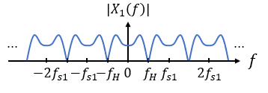
Prior Work 1 - Pitch Matching ( )
Notes:
The first de-aliasing technique is quite straightforward and represents a more 'direct' way to solve the aliasing problem.
Since we all know that pitch can directly effect the sampling rate in spatial domain, Pitch should be less than half the wavelength. If we can keep pitch under this constraint, we can avoid the alasing effect.
But how long should it be in reality.

Slide 11
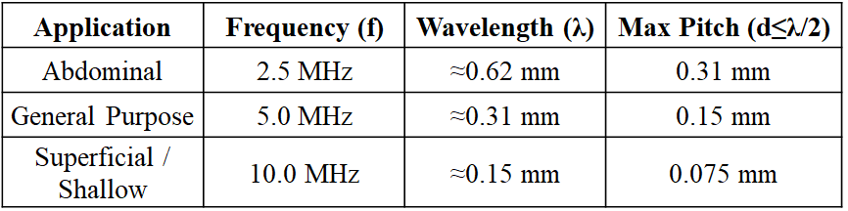
Prior Work 1 - Pitch Matching ( )
(Assumed Speed of Sound in Tissue c = 1540 m/s)
Notes:
Here is a simple comparison table showing the relationship between imaging frequency and the maximum allowable pitch. Depending on the clinical application, we use different frequencies to balance penetration and image quality.
As you can see, for Abdominal imaging at 2.5 MHz, the wavelength is about 0.6 mm, which gives us a maximum pitch of 0.31 mm. This is relatively manageable. However, as we move toward General Purpose or Superficial imaging—using 5 to 10 MHz—the frequencies become much higher, meaning the wavelengths become significantly smaller.
According to the Nyquist theorem, to avoid grating lobes, our consecutive elements must be placed closer and closer together. At 10 MHz, for example, the required pitch is only 0.075 mm, which is roughly the thickness of a single human hair.
This creates a massive challenge in transducer fabrication. Fitting hundreds of individual piezoelectric elements and their electrical connections into such a tiny space is not only expensive but also reaches the physical limits of current dicing technology.
This leads us to the first de-aliasing method I want to discuss, which is the Sub-dicing method. This approach attempts to solve the problem directly by physically or virtually cutting the elements into even smaller pieces to satisfy this strict $\lambda/2$ requirement.

Slide 12
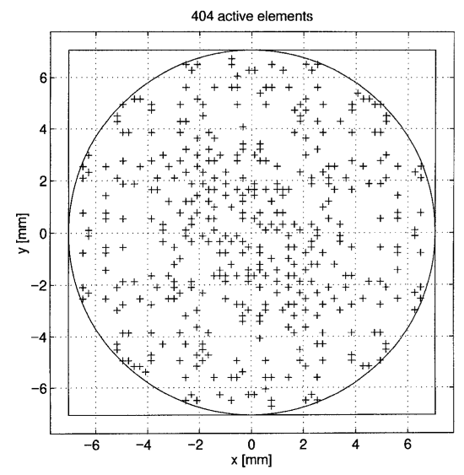
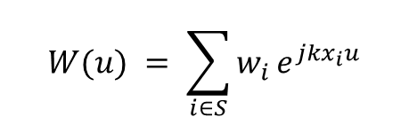
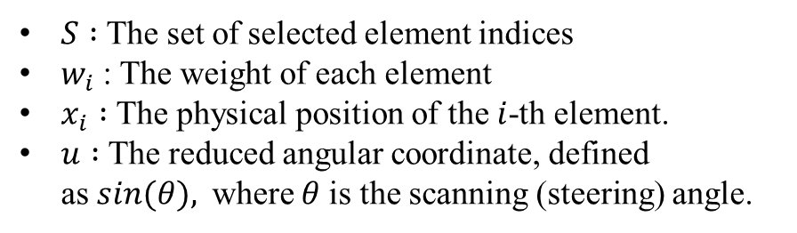
Prior Work 2 - Sparse Array
Adopted Sparse Arrays to achieve high resolution with limited active elements.
Broken the periodicity of elements to suppress Grating Lobes by scattering their energy into the sidelobe region.
Employed Linear Programming to optimize weights, minimizing the Peak Sidelobe Level (PSL) to below the theoretical 1/N limit.
S. Holm, B. Elgetun and G. Dahl, "Properties of the beampattern of weight- and layout-optimized sparse arrays"
Notes:
The second method is Sparse Array,

Slide 13

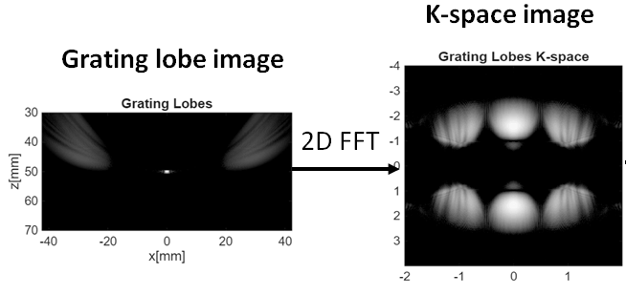
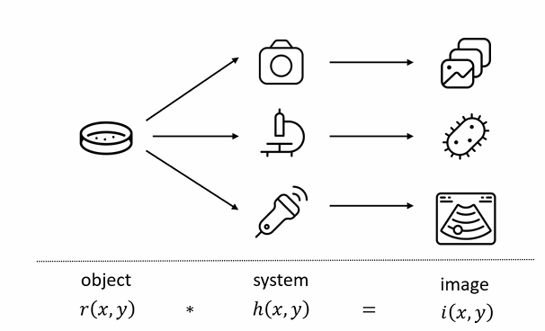
Prior Work 3 - K-Space Filter
Notes:
To demonstrate how the K-space filter works, let’s start with the most basic case: a single point target. In physical space, a point target is just one dot. However, in K-space, it reveals its true spectral signature."
"As you can see here, because our Pitch is larger than lambda/2, the spectrum is not just a single peak. Instead, we see multiple periodic 'replicas' along the $k_x$ axis. The center one is our 'Main Lobe'—the true signal—while the ones on the sides are the 'Grating Lobes'. The key takeaway here is that in K-space, these artifacts are at predictable, discrete locations

Slide 14
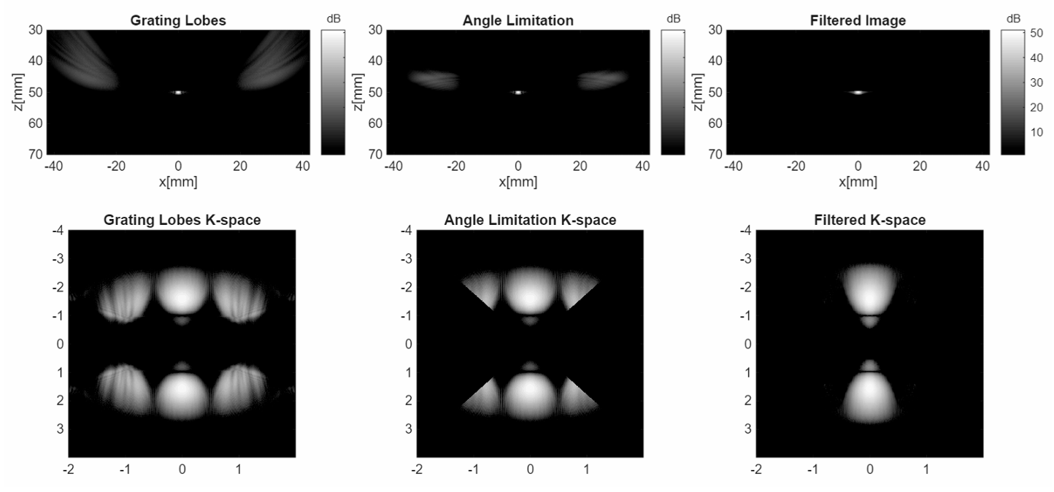
Prior Work 3 - K-Space Filter

Slide 15
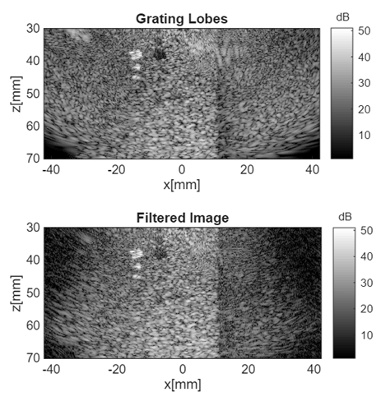
Prior Work 3 - K-Space Filter
Limitation :
Because the k-space spectrum of a real phantom is more dispersed, tissue structural information is mixed within the processing domain of k-space.
Critical signal components might be removed while trying to suppress the grating lobes.
Notes:
真實仿體在K空間上的頻率散布比較廣，所以重要資訊可能會和grating lobes一起被濾除

Slide 16
Summary of Previous Methods
Mitigation Strategy | Approach | Key Advantage | Main Limitation
Pitch Reduction | Hardware | Eliminates aliasing at the source (d < λ/2). | High manufacturing cost; limited for high-frequency/2D arrays.
Sparse / Random Array | Hardware | Large aperture with fewer elements; scatters energy. | High background noise (sidelobes); reduced image contrast.
K-space Filtering | Signal | No hardware modification required. | Limited by phase sensitivity and overlap of aliased replicas.

Slide 17

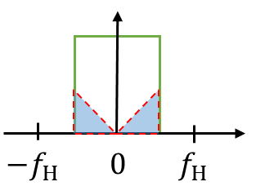
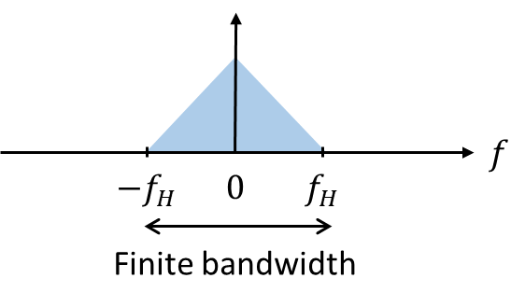
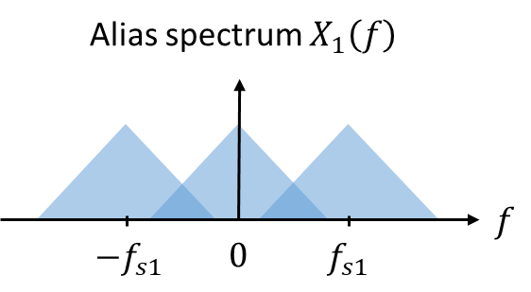


Multi Sample-rate De-aliasing Algorithm
Notes:
Building on what we just discussed about the limitations of traditional methods, I’m excited to introduce our core approach: the Multi Sample-rate De-aliasing Algorithm. Let's direct our attention to the spectrum diagram on this slide. What you see here is an alias spectrum, denoted as X1(f), which inherently has a finite bandwidth. The fundamental philosophy behind our algorithm is to take advantage of this finite bandwidth. Instead of trying to fix the hardware, we use signal processing to separate and extract the overlapping, aliased artifact energy directly in the frequency domain. In the next few slides, I will show you exactly how we achieve this.
在我們剛剛討論了傳統方法的限制之後，我很高興向大家介紹我們的核心方法：多取樣率去混疊演算法（Multi Sample-rate De-aliasing Algorithm）。
請把注意力放在這張投影片上的頻譜圖。你現在看到的是一個混疊頻譜，記為 X1(f)，它本質上具有有限的頻寬。我們這個演算法的核心理念，就是善用這個「有限頻寬」的特性。與其試圖修正硬體，我們改用訊號處理的方法，在頻域中直接將重疊的混疊失真能量分離並提取出來。
接下來的幾張投影片，我會向各位詳細說明我們是如何做到這一點的。

Slide 18
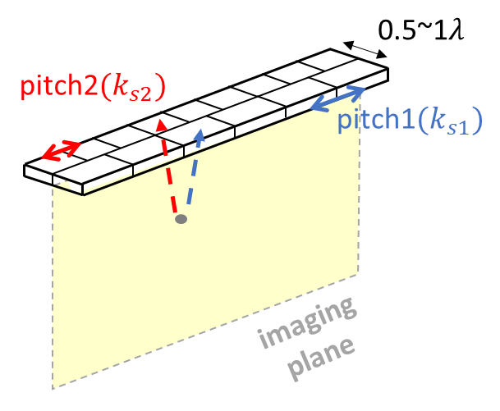
Structure of Aperture
Use two arrays with different element number to generate two different sample rates.
Ex:
Nnyquist = 64
N1 = 32
N2 = 48
Notes:
To make this multi-sample-rate algorithm work, we first need to look at the physical hardware structure of our aperture. As illustrated here, we place two distinct arrays on the exact same imaging plane. The crucial difference is that they have a different number of active elements. For example, we configure nyquist element number is 64, array one with 32 elements, while array two is configured with 48 elements. Because they occupy the same overall aperture size—which is strictly constrained to roughly 0.5 to 1 wavelength—this difference in element count naturally creates two different physical pitches. Consequently, this provides us with two independent spatial sample rates, ks1 and ks2. This dual-rate sampling is the physical foundation that makes our downstream processing possible.
為了讓這個多取樣率演算法能夠運作，我們首先需要檢視我們孔徑的實體硬體結構。如圖所示，我們在同一個成像平面上放置了兩組不同的陣列。關鍵的差異在於，它們具有不同數量的有效元素。
舉例來說，我們將奈奎斯特元件數設定為 64，其中第一個陣列配置為 32 個元素，而第二個陣列則配置為 48 個元素。由於它們佔據的是相同的整體孔徑尺寸——且這個尺寸被嚴格限制在約 0.5 到 1 個波長之間——這樣的元素數量差異自然會產生兩種不同的實體間距（pitch）。
因此，我們便能獲得兩個獨立的空間取樣率，ks1 和 ks2。這種雙取樣率的設計，正是使後續訊號處理成為可能的物理基礎。

Slide 19
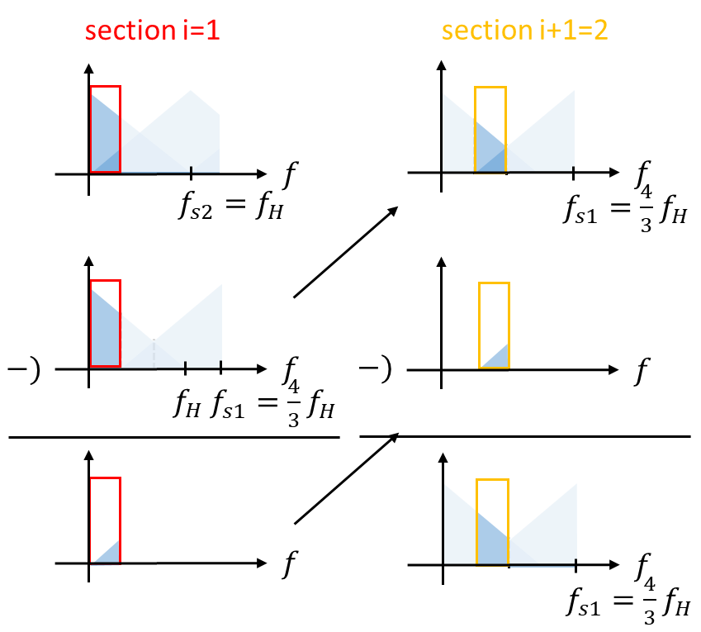
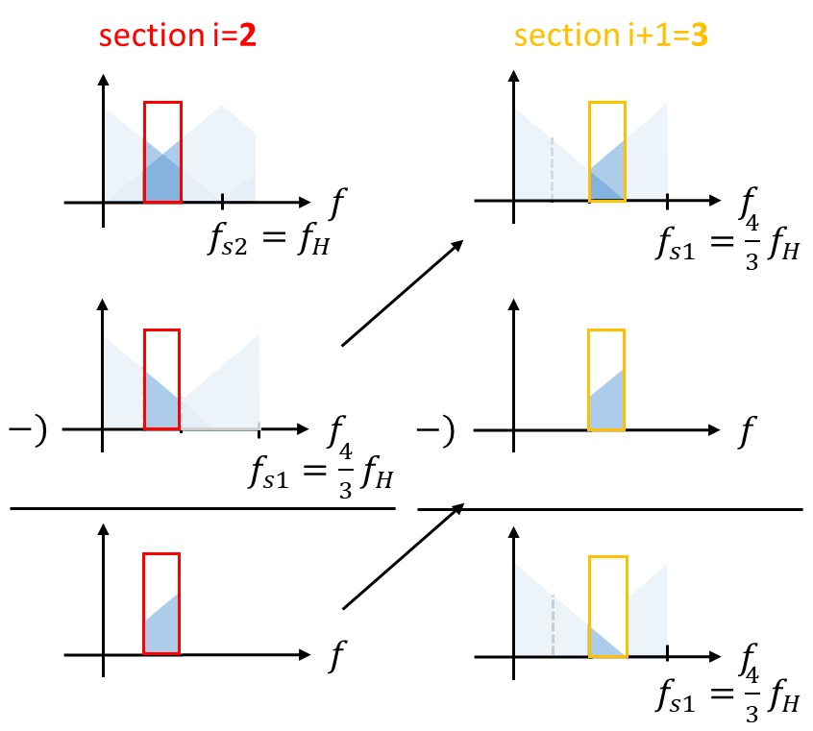
De-aliasing Algorithm
Notes:
Now, let’s break down the mathematical magic: how do we actually perform the de-aliasing? We process the received spectrum in distinct sections. Let’s start with section i=1. Because our two arrays have different sampling rates—say, fs2 = fH and fs1 equals 4/3 fH—their aliasing periods don't match. This mismatch creates a 'clean', unaliased region at the outer edges of the spectrum, highlighted by the red box. We extract this clean data and use it to subtract the overlapping artifacts from the adjacent section. Then, as shown in section i=2 and i=3, we use this newly cleaned segment to iteratively calculate and peel away the aliased energy closer to the center. It’s a layer-by-layer subtraction until the true spectrum is fully restored.
現在，讓我們來拆解這個數學上的關鍵：我們究竟是如何實現去混疊（de-aliasing）的？
我們會將接收到的頻譜分成數個區段來處理。先從第 i = 1 個區段開始說明。由於兩個陣列具有不同的取樣率——例如 fs2 = fH，而 fs1 = (4/3) fH——它們的混疊週期並不相同。正是這種「不匹配」的特性，使得在頻譜外側邊緣形成了一個「乾淨」、沒有混疊的區域（圖中以紅框標示）。
我們會先擷取這段乾淨的資料，並利用它來消除鄰近區段中的重疊混疊成分。接著，如同在 i = 2 和 i = 3 區段所示，我們再利用這段已經被清理過的訊號，逐步向頻譜中心推進，迭代地計算並剝離更多混疊能量。
整個過程就像一層一層地剝除干擾，直到最終完整還原出原始的真實頻譜。

Slide 20
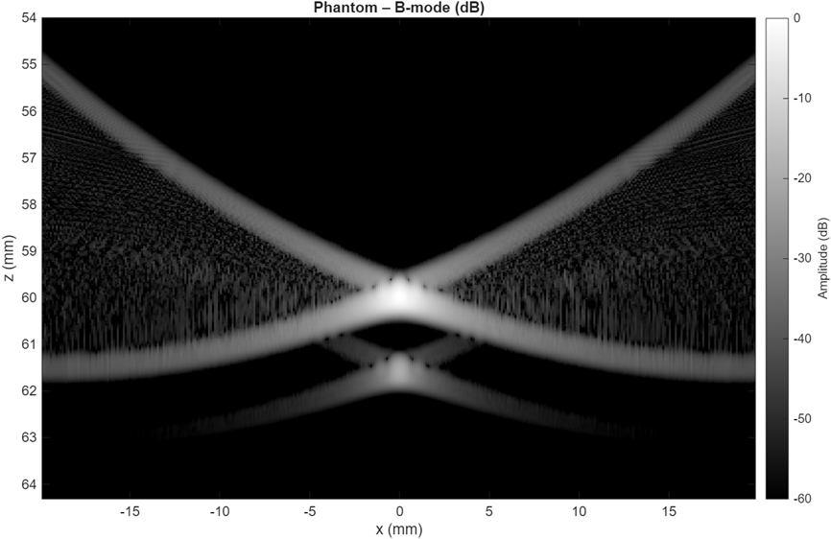
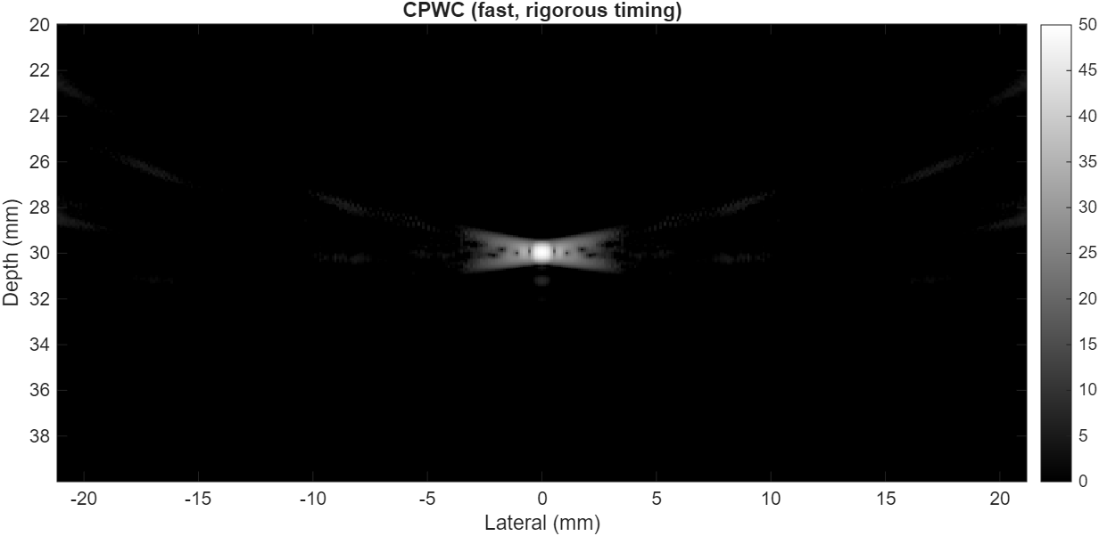
Results

Slide 21
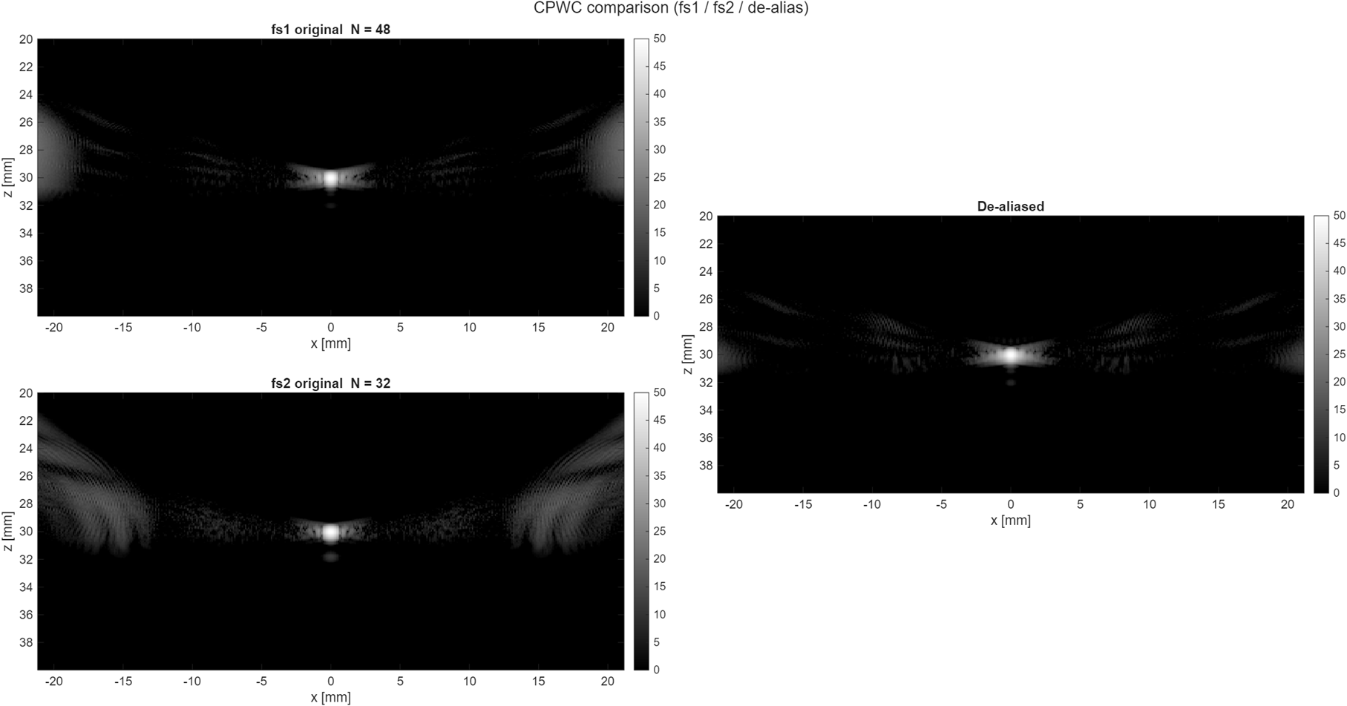
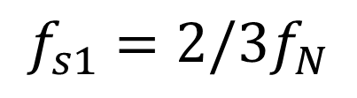
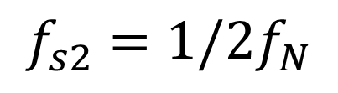
Results
Notes:
Next, we examine the raw, independent images produced by our two different element configurations before applying any de-aliasing. On the left side, we have the image from the 48-element array, which operates at a sample rate of 2/3 fN. On the right side, we see the image from the 32-element array, operating at 1/2 fN. Notice the critical difference between these two images: the main target remains in the exact same central position, but the grating lobes—the aliasing artifacts—appear at completely different spatial angles and locations. This happens because the aliasing angle is mathematically dependent on the element pitch. This spatial shift is exactly the distinct feature our algorithm targets for extraction and elimination.
接下來，我們來觀察在尚未進行任何去混疊處理之前，由兩種不同元素配置所產生的原始、獨立影像。
在左側，是來自 48 元件陣列的影像，其運作取樣率為 (2/3 f_N)。在右側，則是來自 32 元件陣列的影像，其取樣率為 (1/2 f_N)。
請注意這兩張影像之間的一個關鍵差異：主要目標（main target）仍然位於完全相同的中心位置，但光柵瓣（grating lobes，也就是混疊造成的假影）卻出現在完全不同的空間角度與位置上。
這是因為混疊角度在數學上取決於元素間距（element pitch）。也正因如此，這些混疊假影在不同取樣配置下會產生空間位移。
而這種「位置上的差異」，正是我們演算法用來辨識、提取並消除混疊成分的關鍵特徵。

Slide 22
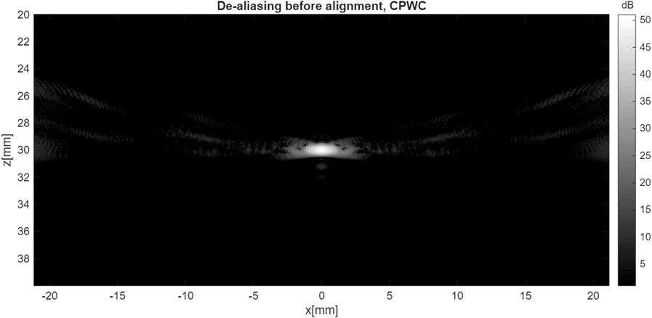
Results
Aliased image
De-aliasing image
Notes:
Here is the ultimate payoff of our multi-sample-rate approach. We apply our frequency-domain subtraction algorithm to the data we just saw. At the left is the original, artifact-heavy aliased image for reference. The right image shows our completed, de-aliased result. The visual improvement is striking. By leveraging the shifted artifacts from the dual-pitch arrays, we have successfully canceled out the aliased energy. The severe grating lobes on the sides are almost entirely eliminated, leaving a beautifully clean background and a highly contrasted main target. This confirms that our algorithm works exceptionally well in practice.
這裡就是我們多取樣率方法的最終成果展示。
我們將剛剛看到的資料套用頻域相減（frequency-domain subtraction）的演算法。左方是原始的 混疊 影像（作為參考），其中充滿了明顯的假影（artifact）。右方的影像就是我們完成去混疊後的最終成果。
視覺上的改善非常顯著。我們利用雙間距陣列所產生的假影位移特性，成功地將混疊能量相互抵消。原本在影像兩側嚴重的光柵瓣幾乎被完全消除，背景變得非常乾淨，而主要目標則呈現出高度對比、更加清晰。
這清楚地證明了，我們的演算法在實際應用中具有相當優異的效果。

Slide 23
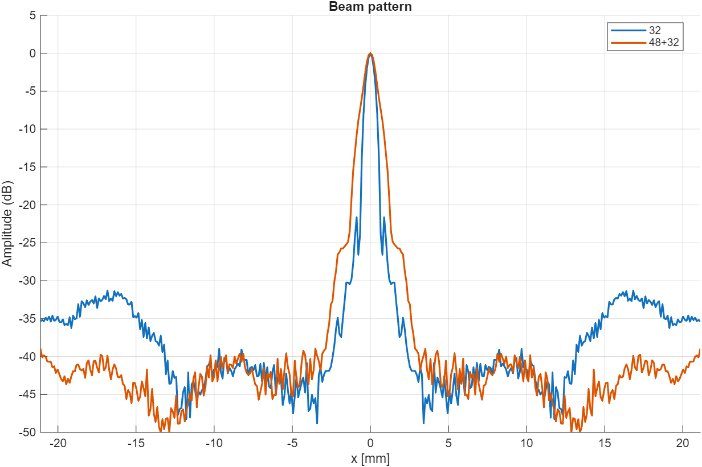
Beam Pattern
Notes:
While visual images are great, we also need strict quantitative data to validate our results. This graph displays the beam pattern, plotting amplitude in decibels against the lateral position. The blue line represents the 32 elements image, and you can clearly see the high energy spikes corresponding to the grating lobes between 15 to 20mm. The orange line represents our proposed algorithm, combining both the 48 and 32 element arrays. Look at the off-axis regions—our algorithm drives the amplitude down significantly, smoothing out those artifact spikes. We achieve a deep suppression of the grating lobe energy while maintaining the integrity and sharpness of the main beam at zero degrees. This mathematical proof solidifies the effectiveness of our de-aliasing technique.
雖然視覺影像的結果很直觀，但我們仍然需要嚴謹的量化數據來驗證效果。
這張圖顯示的是波束圖（beam pattern），橫軸為橫向角度（lateral angle），縱軸為振幅（以分貝表示）。藍色曲線代表 32 元件的影像，可以清楚看到對應光柵瓣的高能量尖峰。橘色曲線則代表我們提出的演算法，結合了 48 元件與 32 元件陣列的結果。
請特別觀察離軸區域（off-axis regions）——我們的演算法顯著降低了振幅，將那些由假影造成的尖峰有效地平滑與抑制。換句話說，我們成功大幅壓低了光柵瓣的能量，同時仍然維持主波束在 0 度方向的完整性與銳利度。
這樣的數學與量化結果，進一步強化並證明了我們去混疊技術的有效性。

Slide 24
Summary of Methods
 | Pitch Matching | Sparse Array | K-space Filter | Multi Sample-rate
Cost | High (Hardware) | Low (Fewer elements) | Low (Software) | Medium
Time Complexity | Low | High (Optimization) | Medium | Medium
Advantage | Eliminates aliasing at the source | Large aperture with fewer elements | No hardware modification required | High contrast; effectively suppresses grating lobes
Disadvantage | High manufacturing cost / Heating | High background noise (sidelobes) | Fails if aliased replicas overlap | Impractical hardware setup / requires centered phantom
Notes:
Now, let’s summarize and compare our method against the traditional strategies we discussed earlier. When we look at the cost, our Multi Sample-rate method avoids the extreme hardware expenses of shrinking pitch sizes. In terms of time complexity, while it requires more advanced signal processing than a simple filter, modern computing easily handles it. The major advantage here is the near-perfect elimination of grating lobes without sacrificing the main lobe resolution or suffering from the high background noise typical of sparse arrays. It strikes an excellent balance between hardware feasibility and overall imaging performance.However, as noted in the table, we acknowledge that our current method has physical constraints—specifically, an impractical hardware setup and the requirement of a centered phantom, which are challenges we aim to address in our future work.
現在，讓我們來做一個總結，並將我們的方法與先前討論的傳統策略進行比較。
在成本方面，我們的多取樣率方法不需要像縮小元素間距（pitch）那樣付出極高的硬體成本。
在時間複雜度方面，雖然我們的方法比單純的濾波器需要更進階的訊號處理，但以現代運算能力來說，這樣的負擔是完全可接受的。
而最關鍵的優勢在於：我們幾乎可以完全消除光柵瓣，同時不會犧牲主波束的解析度，也不會像稀疏陣列那樣引入較高的背景雜訊。
整體而言，這個方法在硬體可行性與影像品質之間取得了非常出色的平衡。
然而，如同表格下方所述，我們也清楚目前的方法仍有物理上的限制——主要是實務上難以實現的硬體設置，以及需要將目標物放置於正中央，這些挑戰將是我們未來研究要解決的重點。

Slide 25
Limitations
Simultaneous spatial sampling using two physically distinct pitch arrays is impractical
Phantom must place at middle of the aparture
CANNOT manufacture a aparture with different pitch
Notes:
As with any academic research, we must acknowledge the current limitations of our approach. We have identified three primary challenges. First, conducting simultaneous spatial sampling using two physically distinct pitch arrays on the exact same aperture is currently impractical in a real-world setting. Second, our mathematical derivation presently assumes and requires that the target phantom is placed exactly in the middle of the aperture. Finally, from a manufacturing perspective, fabricating a single ultrasound transducer that features interlaced, non-uniform pitches presents a massive engineering hurdle. These are the physical boundaries we are currently facing.
如同所有學術研究一樣，我們也必須誠實面對目前方法的限制。我們歸納出三個主要挑戰：
首先，在同一個孔徑上同時進行兩種不同間距（pitch）陣列的空間取樣，在現實硬體上目前仍然不可行。
其次，我們目前的數學推導假設並要求目標體（phantom）必須精確地位於孔徑的正中央，這在實際應用中具有一定限制。
最後，從製造角度來看，要製作一個具有交錯排列且非均勻間距的單一超音波換能器，仍然是一項極具挑戰性的工程問題。
這些就是我們目前所面臨的實體與實作上的主要限制。

Slide 26
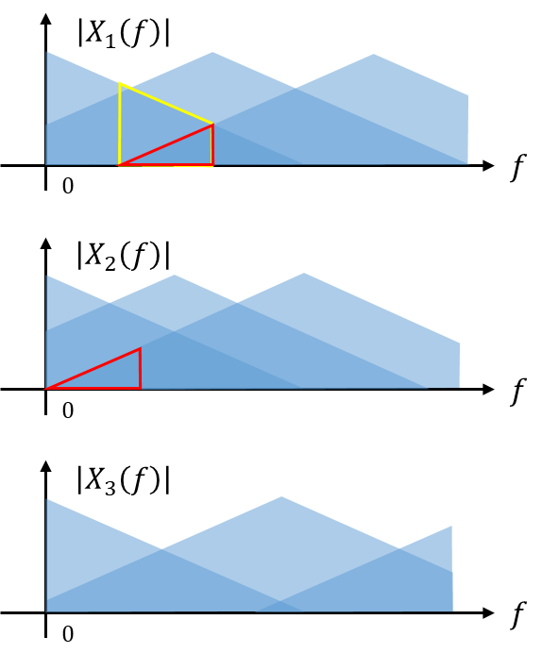
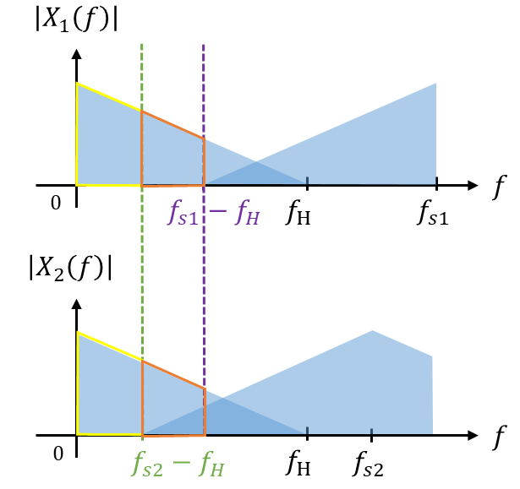
Future Work
Higher order de-aliasing algorithm
Notes:
To overcome these current limitations, our future work will pivot towards developing a higher-order de-aliasing algorithm. Right now, our method relies on just two sampling rates, X1 and X2. Moving forward, we plan to introduce a third sample rate, represented here as X3, or perhaps even more. By expanding to a multi-dimensional intersection and utilizing higher-order spectral subtraction, we aim to increase the robustness of the algorithm. This would allow us to handle much broader bandwidths, process off-center targets, and potentially adapt the algorithm to work with more manufacturable hardware designs.
為了克服目前的這些限制，我們未來的研究方向將轉向發展更高階的去混疊演算法。
目前的方法僅依賴兩個取樣率，X1 和 X2。接下來，我們計畫引入第三個取樣率，例如 X3，甚至可能擴展到更多取樣率。透過建立多維度的交集關係，並結合更高階的頻譜相減技術，我們希望能大幅提升演算法的穩健性。
這樣的改進將使我們有能力處理更寬的頻寬、應對非中心位置的目標，同時也有潛力讓整體方法更容易適配於實際可製造的硬體設計。

Slide 27
Reference
S. Holm, B. Elgetun and G. Dahl, "Properties of the beampattern of weight- and layout-optimized sparse arrays," in IEEE Transactions on Ultrasonics, Ferroelectrics, and Frequency Control, vol. 44, no. 5, pp. 983-991, Sept. 1997, doi: 10.1109/58.655623.
Ponnle, A., Hasegawa, H., & Kanai, H. (2013). Suppression of grating lobe artifacts in ultrasound images formed from diverging transmitting beams by modulation of receiving beams. Ultrasound in medicine & biology, 39(4), 681-691.
Yen, J. T., & Lou, Y. (2022). Ultrasound imaging using the coherence of estimated channel data. IEEE Transactions on Ultrasonics, Ferroelectrics, and Frequency Control, 69(7), 2293-2302.
Lou, Y., & Yen, J. T. (2020, September). A K-space-based Approach to Coherence Estimation. In 2020 IEEE International Ultrasonics Symposium (IUS) (pp. 1-4). IEEE.
Notes:
That brings us to the conclusion of our presentation. If there is one crucial take-home message we want you to remember from our research today, it is this: Grating lobes, which are fundamentally caused by spatial aliasing, do not always require impossible hardware solutions to fix. They can be effectively and elegantly reduced using spatial spectrum-based de-aliasing methods. Specifically, our dual-row, dual-pitch approach successfully suppresses these artifacts, proving that smart signal processing can overcome strict physical hardware limitations.
These is our presentation. Thank you all very much for your time and attention.
最後，這也帶我們來到本次簡報的結論。
如果今天的研究有一個最重要的重點希望大家記住，那就是：由空間混疊所造成的光柵瓣問題，並不一定需要依賴幾乎不可行的硬體解決方案。我們可以透過基於空間頻譜的去混疊方法，有效且優雅地降低這些影像假影。
特別是，我們提出的雙列、雙間距（dual-row, dual-pitch）方法，成功地抑制了這些光柵瓣，證明了只要運用聰明的訊號處理技術，就能突破嚴格的硬體限制。
以上是我們的報告，非常感謝各位的時間與聆聽。

