Slide 1
2.7 Polar Coordinates
Sections 2.7, 2.8, 2.9 are extended from Sec. 2.1, but the polar, cylindrical, and spherical coordinates are adopted.
2D
Polar Coordinate (Sec. 2.7)
Cylindrical Coordinate (Sec. 2.8)
3D
Spherical Coordinate (Sec. 2.9)
D. G. Zill and Michael R. Cullen, Differential Equations-with Boundary-Value Problem (metric version), 9th edition, Cengage Learning, 2017, Section 13.1

Slide 2
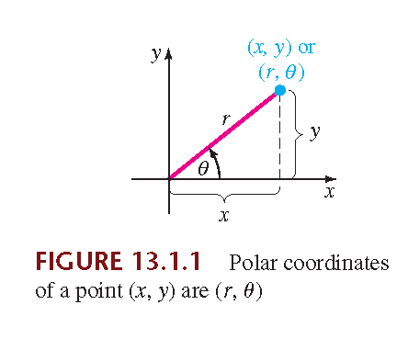
From D. G. Zill and Michael R. Cullen, Differential Equations-with Boundary-Value Problem (metric version), 9th edition, Cengage Learning, 2017, Section 13.1.
Fig. 2.7.1
(x, y)
(r, θ)
original coordinate
polar coordinate

Slide 3
the Laplacian of u in x-y coordinates
the Laplacian of u in polar coordinates
In this section we focus only on boundary-value problems involving Laplace’s equation in polar coordinates:
The key points of this section.

Slide 4
(Proof): Since
we have
from

Slide 7
The proof is completed.

Slide 8
In this section, we focus on the Laplace’s equation with steady temperature, i.e.,

Slide 9
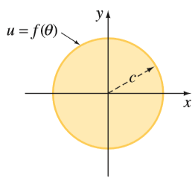
[Example 1] Steady Temperatures in a Circular Plate
Solve Laplace’s equation
subject to
SOLUTION
Fig. 2.8.2
(Step 1)
Suppose that
From D. G. Zill and Michael R. Cullen, Differential Equations-with Boundary-Value Problem (metric version), 9th edition, Cengage Learning, 2017, Section 13.2.

Slide 10
(Step 2)
There is no zero boundary condition.
But note that Θ(θ) should be periodic:
(Step 3) Then, we try to solve
Case 1: λ = 0,
from
Case 2: λ < 0, set
(trivial)

Slide 11
Case 3: λ > 0, set
From
where n is a positive integer,
where n is a positive integer,
Combine the results of Cases 1 and 3
where n is a nonnegative integer

Slide 12
(Step 4)
This is an important application of the Cauchy-Euler equation on page 35
Since
Cauchy-Euler
Auxiliary:
the solutions are
Since
but R(0) should not be infinite
c₄ = c₆ = 0 should be satisfied

Slide 13
where n is a nonnegative integer
(Step 5)
(Step 6)
(Step 7)
By applying the boundary condition
Next, solve the unknowns from the formula of the Fourier series

Slide 14
From the formula of the Fourier series
Since

Slide 15
EXAMPLE 2 Steady Temperatures in a Semicircular Plate
Find the steady-state temperature u(r, θ) in
From D. G. Zill and Michael R. Cullen, Differential Equations-with Boundary-Value Problem (metric version), 9th edition, Cengage Learning, 2017, Section 13.2.
Fig. 2.8.3

Slide 16
SOLUTION
The problem can be formulated as
(Step 1)
Suppose that
(Step 2)

Slide 17
(Step 3)
From
We then try to solve
Case 1:
Case 2:
$$⇒Θ(θ)=c_{3}coshθ+c_{4}sinhθ$$

Slide 18
Case 3:
n = 1, 2, 3, ….
The only nontrivial solution for Θ(θ) is
n = 1, 2, 3, ….
In this case,
(Step 4) To solve R(r)
To be bounded at r = 0, c₈ must be 0
n = 1, 2, 3, ….

Slide 19
(Step 5)
(Step 6)
(Step 7) From
Using Fourier sine series
Solution:

Slide 20
2.8 CYLINDRICAL COORDINATES
z
y
x
D. G. Zill and Michael R. Cullen, Differential Equations-with Boundary-Value Problem (metric version), 9th edition, Cengage Learning, 2017, Section 13.2

Slide 21
2.8.1 Review for Special Functions
• Bessel’s equation of order v
Solution:
: 1st kind Bessel function
: 2nd kind Bessel function
where
(gamma function)

Slide 22
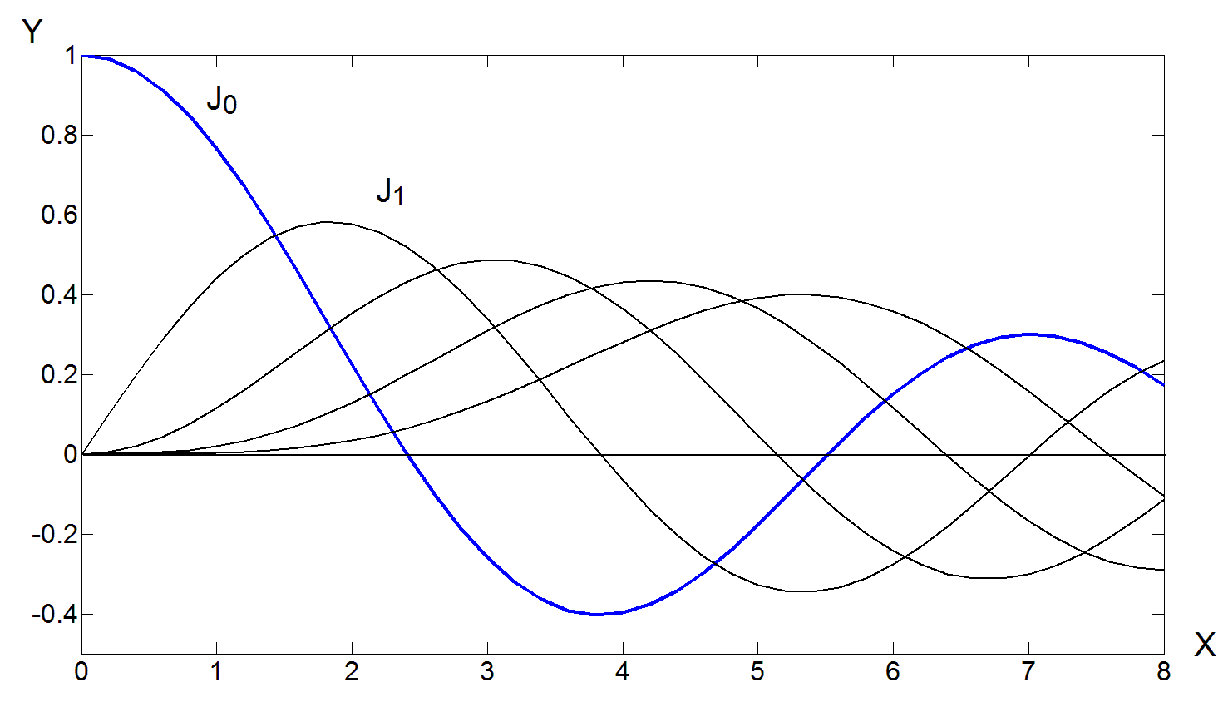
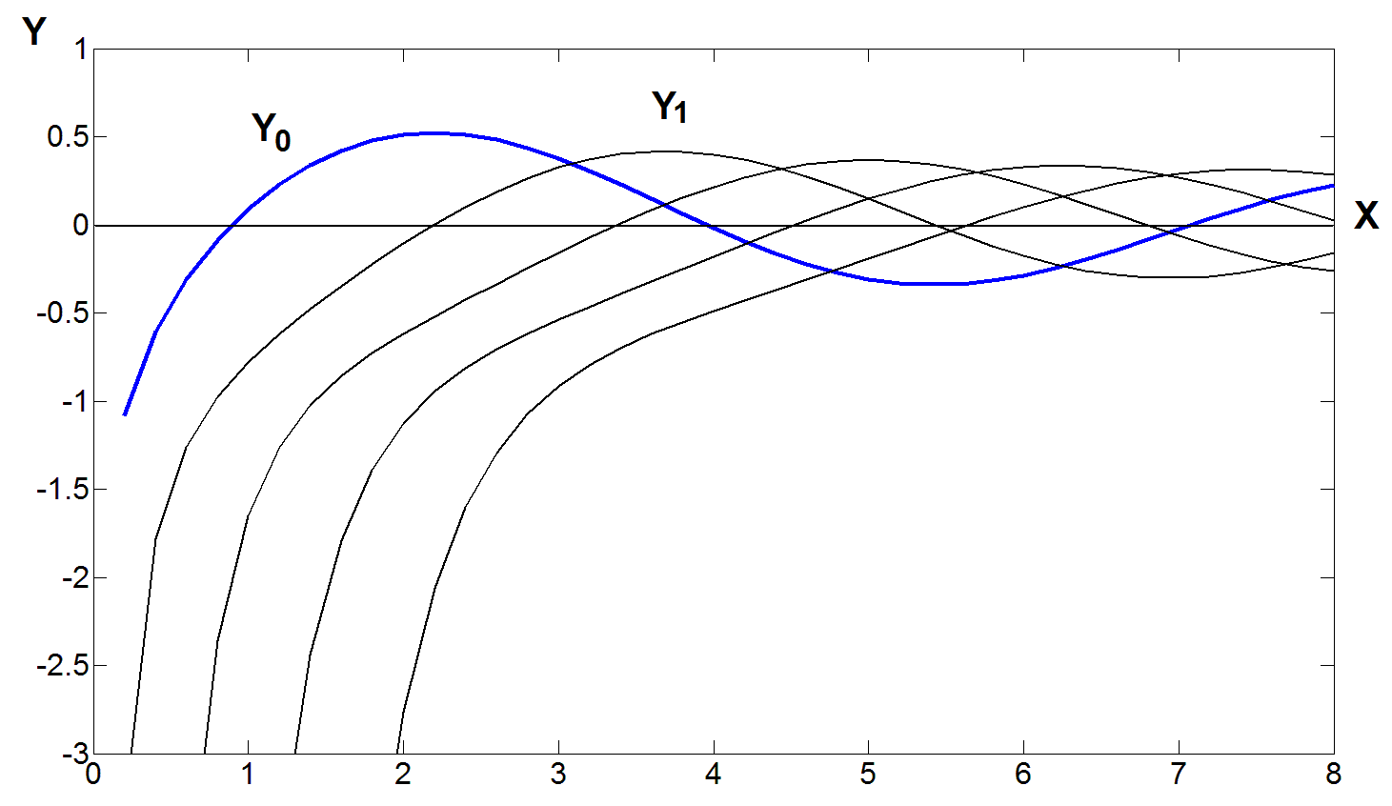
1st kind Bessel function
2nd kind Bessel function
From D. G. Zill and Michael R. Cullen, Differential Equations-with Boundary-Value Problem (metric version), 9th edition, Cengage Learning, 2017, Section 6.4.

Slide 23
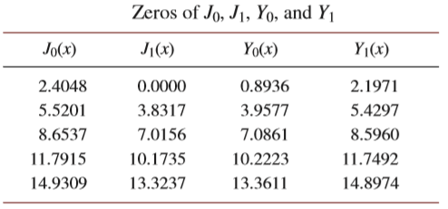
x₁
x₂
x₃
x₄
x₅
From D. G. Zill and Michael R. Cullen, Differential Equations-with Boundary-Value Problem (metric version), 9th edition, Cengage Learning, 2017, Section 6.4.

Slide 24
• Generalization of Bessel’s equation of order v
解：c₁J_{v}(x) + c₂Y_{v}(x)
解：c₁J_{v}(α x) + c₂Y_{v}(α x)
Proof: Set t = αx
Similarly,
原式 =
對 t 而言是 Bessel equation
y = c₁J_{v}(t) + c₂Y_{v}(t) = c₁J_{v}(α x) + c₂Y_{v}(α x)

Slide 25
• Modified Bessel’s equation of order v
解：c₁I_{v}( x) + c₂K_{v}(x)
解：c₁I_{v}(α x) + c₂K_{v}(α x)
其中
稱作是 modified Bessel function of the first kind of order v
稱作是 modified Bessel function of the second kind of order v
當 v 為整數時，也是取 limit

Slide 26
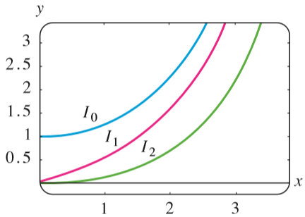
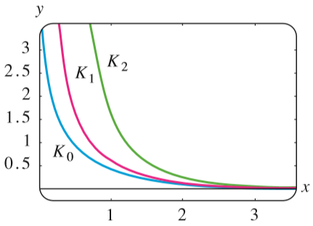
Modiﬁed Bessel functions of the ﬁrst kind for n = 0, 1, 2
Modiﬁed Bessel functions of the second kind for n = 0, 1, 2
From D. G. Zill and Michael R. Cullen, Differential Equations-with Boundary-Value Problem (metric version), 9th edition, Cengage Learning, 2017, Section 6.4.

Slide 27
• Legendre’s equation of order n
One of the solution: Legendre polynomials P_{n}(x)

Slide 28
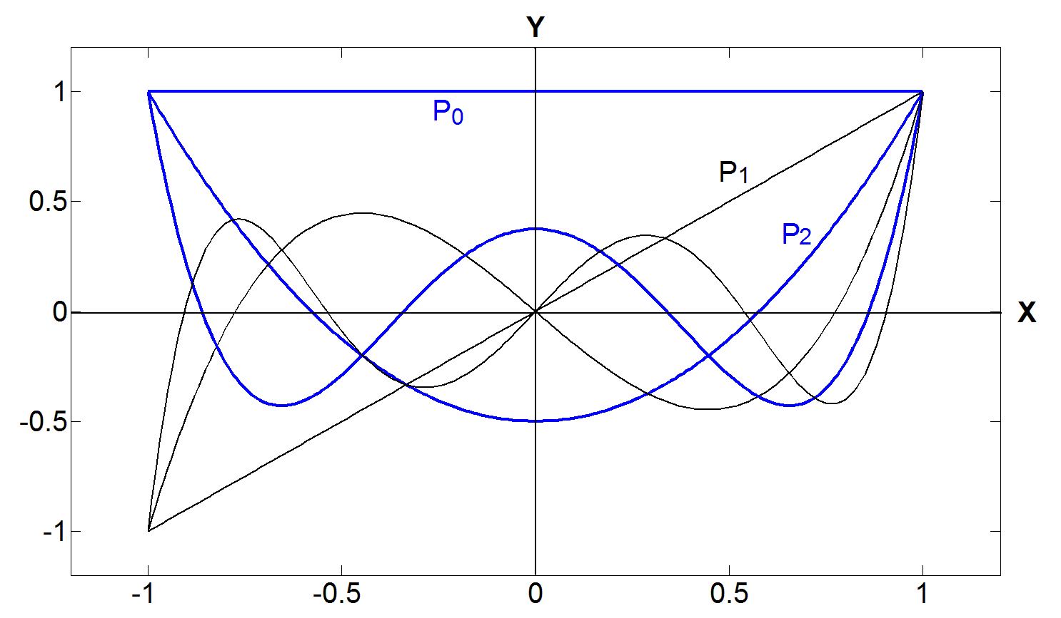
Legendre polynomials
Interval:
x ∈ [−1, 1]
From D. G. Zill and Michael R. Cullen, Differential Equations-with Boundary-Value Problem (metric version), 9th edition, Cengage Learning, 2017, Section 6.4.

Slide 29
2.8.2 PDE for Cylindrical Coordinates
Laplacian in Cylindrical Coordinates
For the case of radial symmetry

Slide 30
[Example 1] Steady Temperatures in a Circular Cylinder
From D. G. Zill and Michael R. Cullen, Differential Equations-with Boundary-Value Problem (metric version), 9th edition, Cengage Learning, 2017, Section 13.2.

Slide 31
It is a problem of the 2D heat equation
steady temperatures
radial symmetry
(since u = 0 when r = 2)

Slide 32
(Step 1)
(Step 2)
From

Slide 33
(Step 3)
Case 1: λ = 0
auxiliary: m(m-1) + m = 0, m = 0, 0
Since
, c₂ = 0
Since
(trivial)

Slide 34
Case 2: λ = −α² < 0
compared to modified Bessel function
(page 201)
solution：c₁I_{v}( x) + c₂K_{v}(x)
solution：c₁I_{v}(αx) + c₂K_{v}(α x)
I_{v}(x): modified Bessel function of the 1st kind
K_{v}(x): modified Bessel function of the 2nd kind
The solution of
is
R(r) = c₁I₀(αr) + c₂K₀(αr)
(page 202)
Since K₀(0) → ∞, c₂ = 0
R(r) = 0
Since
c₁I₀(2α) = 0
(trivial)
(page 202)
From I₀(x) ≠ 0 for all x ≠ 0 → c₁ = 0

Slide 35
Case 3: λ = α² > 0
compared to the Bessel function on page 200
solution：c₁J_{v}(αx) + c₂Y_{v}(α x)
(page 198)
Since Y₀(0) → -∞, c₂ = 0
Since
Therefore,
where
x_{n} are the zeros of J₀(x), i.e.,
(defined on page 199)

Slide 36
(Step 4) Try to solve
Since
From
(Step 5)
(Step 6)
where

Slide 37
(Step 7) From
From Eq. (9) in Section 11.5 of
D. G. Zill and Michael R. Cullen, Differential Equations-with Boundary-Value Problem (metric version), 9th edition, Cengage Learning, 2017

Slide 38
(Solution):
where

Slide 39
[Example 2] Steady Temperatures in a Circular Cylinder
(Solution):
(Step 1)
(Step 2)
From

Slide 40
(Step 3): Solve
There is no non-trivial solution for λ = 0 and λ > 0
When λ < 0, set λ = −α²,
From
where
(Step 4): Solve

Slide 41
Since
solution：c₁I_{v}(αx) + c₂K_{v}(α x)
the solution of
is
R(r) = c₃I₀(nπr) + c₄K₀(nπ r)
(page 201)
I_{v}(x): modified Bessel function of the 1st kind
K_{v}(x): modified Bessel function of the 2nd kind
Since K₀(0) → ∞
R(r) = c₃I₀(nπr)
(Step 5):
(Step 6):

Slide 42
(Step 7): From
From the Fourier sine series
we have

Slide 43
2.9 SPHERICAL COORDINATES
Spherical Coordinates
From D. G. Zill and Michael R. Cullen, Differential Equations-with Boundary-Value Problem (metric version), 9th edition, Cengage Learning, 2017, Section 13.3.
D. G. Zill and Michael R. Cullen, Differential Equations-with Boundary-Value Problem (metric version), 9th edition, Cengage Learning, 2017, Section 13.3

Slide 44
Laplacian in Spherical Coordinates
The 3D Laplacian is
Suppose that u is independent of φ.

Slide 45
[Example 1] Steady Temperatures in a Sphere
Find the steady-state temperature u(r, θ) within the sphere shown in Figure 13.3.2.
From D. G. Zill and Michael R. Cullen, Differential Equations-with Boundary-Value Problem (metric version), 9th edition, Cengage Learning, 2017, Section 13.3.

Slide 46
SOLUTION
Steady Temperatures
Analogous to page 180-184
With
(Step 1):

Slide 47
(Step 2):
(Step 3): Try to solve
0 ≤ θ ≤ π
Set x = cos(θ)
-1 ≤ x ≤ 1

Slide 48
x = cos(θ)
-1 ≤ x ≤ 1
page 203
When λ = n(n+1), it becomes Legendre’s equation of order n
This is one of the applications of the Legendre equation
The solution is
P_{n}(x): the Legendre polynomial of order n
n = 0, 1, 2, ….
Note: The other linearly independent solution may not have finite derivatives at x = ±1.

Slide 49
(Step 4): Try to solve
Since λ = n(n+1),
Auxiliary:
Since
c₂ = 0
(Step 5):
n = 0, 1, 2, ….
(Step 6):

Slide 50
(Step 7): From
We have known that
Set x = cos(θ)
(orthogonal with the weight function sinθ)

Slide 52
Another Method for Solving PDEs: Method of Characteristics
(只教不考)
Method of Characteristics
The method is suitable for the 1st Order PDE.
Suppose that there is a 1st Order PDE as follows:

Slide 53
Method of Characteristics
We set a variable s and suppose that
Then, the original equation can be expressed as

Slide 54
Then, we apply the process as follows to solve u:
(1) Solve the relation between x₁, x₂, …, x_{k} and s from each of the following ODEs:
:
:
(2) Try to find the general equation b such that
where c_{b} is a constant

Slide 55
(3) Solve the following ODE
The solution has the form of
where c_{g} is some unknown constant.
(Specially, for case where g = 0, u = c_{g})
(4) Replace c_{g} by
where f is any function, then the solution is
Here, we express s as a function of x₁.
(Specially, for case where g = 0, u = f(c_{b}))

Slide 56
[Example 1] Solve
(Solution):
(1)
(2)
(3)
where f is any function.

Slide 57
[Example 2] Solve
(Solution):
(1)
(2) Note that
and
can all generate a constant. Although x-z can also generate a constant,
it is dependent on x+y and y+z. Therefore, a general way to obtain a constant is
where f is any function with two independent variables.

Slide 58
(3)
Since
Here we set

Slide 59
附錄五 Review for Laplace Transforms
Laplace transform (1-sided form)
Differentiation Property for the Laplace transform

Slide 60
f(t) | F(s)
1
t ^{n}
exp(at)
sin(kt)
cos(kt)
sinh(kt)
cosh(kt)

Slide 61
Seven Important Properties of the Laplace Transform
input | Laplace transform
(1) Differentiation
(2) Multiplication by t
(3) Integration
(續)

Slide 62
input | Laplace transform
(4) Multiplication by exp
(5.1) Translation
(5.2) Translation
(6) Convolution
(7) Periodic Input f(t) = f(t + T)
u(t): unit step

Slide 63
239
2.10 Solving PDEs by Laplace Transforms
(只教不考)
In this section, we see that a linear PDE with constant coefficients is transformed into an ODE using the 1-sided Laplace transform.
D. G. Zill and Michael R. Cullen, Differential Equations-with Boundary-Value Problem (metric version), 9th edition, Cengage Learning, 2017, Section 14.2

Slide 64
240
Transform of a Function of Two Variables
To avoid confusing, we denote it as
Transform of Partial Derivatives
where
Because we are transforming with respect to t,
(not to x)
Be careful

Slide 65
241
[Example 1] Laplace Transform of a PDE
Find the Laplace transform of the wave equation
(respect to t)
SOLUTION
where

Slide 66
242
The process for solving the BVP or IVP of a partial differential equation (PDE) by the Laplace transform
The range of the independent variable should be [0, ∞)
(Step 1) Apply the Laplace transform for one independent variable to change the PDE into an ordinary differential equation (ODE) with another independent variable.
(Step 2) Solve the ODE obtain in Step 1.
(Step 3) Solution in Step 2 contains some constants. Find these constants by transforming the initial conditions.
(Step 4) Inverse transform.

Slide 67
243
[Example 2] Using the Laplace Transform to Solve a BVP
SOLUTION
(Step 1)
From Example 1 and the given initial conditions,
where

Slide 68
244
(Step 2)
Particular Solution
Complementary Function

Slide 69
245
(Step 3) From
We have c₁ = 0 and c₂ = 0.
(Step 4)

Slide 70
246
[Example 3] The Wave Equation with Gravity
Solution:
(Step 1)

Slide 71
247
(Step 2)
Complementary Function
Particular Solution

Slide 72
248
(Step 3) From initial conditions
Note:

Slide 73
249
(Step 4)
where
is the unit step function
We have applied the translation property:

Slide 74
附錄六 Review for Fourier Transforms
Fourier transform
代表 Fourier transform
inverse Fourier transform

Slide 75
文獻上其他 Fourier transform 的定義
或者
或者

Slide 76
When g(x) is even (g(x) = g(-x))
Fourier transform Fourier cosine transform
Remember that if k(x) is even
If k(x) is odd

Slide 77
When g(x) is odd (g(x) = –g(-x))
Fourier transform Fourier sine transform

Slide 78
Fourier, Fourier Cosine / Sine Transforms 的微分性質
(1) Fourier transform 的微分性質
微分性質做了一些假設： g(x) = 0 when x → ∞ and x → −∞
以此類推
比較：對 Laplace transform
對 Fourier transform
s → j2πf, without initial conditions

Slide 79
(2) Fourier cosine transform 的微分性質
(3) Fourier sine transform 的微分性質
注意： (1) Fourier sine, cosine transforms 互換
(2) α 正負號不同
(3) Fourier cosine transform 要考慮 initial condition

Slide 81
2.11 Solving PDEs by Fourier Transforms
(只教不考)
Differentiation
Multiplication
D. G. Zill and Michael R. Cullen, Differential Equations-with Boundary-Value Problem (metric version), 9th edition, Cengage Learning, 2017, Section 14.4

Slide 82
Method
(Condition 1) interval 為 −∞ < v < ∞ 時:
用 Fourier transform
(Condition 2) interval 為 0 < v < ∞，
有 “u(v, …..) = 0 or a constant when v = 0” 的 boundary condition 時:
用 Fourier sine transform
(Condition 3) interval 為 0 < v < ∞，
有 “ or a constant when v = 0” 的 boundary condition 時:
用 Fourier cosine transform

Slide 83
使用 Fourier transform, Fourier cosine transform, Fourier sine transform 來解 partial differential equation (PDE) 的 BVP 或IVP 的解法流程
(Step 1) 以 page 258 的規則，來決定要針對 哪一個 independent variable ，做什麼 transform (Fourier, Fourier cosine, 或Fourier sine transform)
(Step 2) 對 PDE 做 Step 1 所決定的 transform, 則原本的 PDE 變成針對另外一個 independent variable 的 ordinary differential equation (ODE)
(Step 3) 將 Step 2 所得出的 ODE 的解算出來
(Step 4) Step 3 所得出來的解會有一些 constants，可以對 initial conditions (或 boundary conditions) 做 transform 將 constants 解出
(※ 和 Step 1 所做的 transform 一樣，只是 transform 的對象變成是 initial 或 boundary conditions，見 pages 261, 264 的例子)
(Step 5) 最後，別忘了做 inverse transform (畫龍點睛）

Slide 84
[Example 1]
heat equation:
subject to
where
Step 1 決定針對 x 做 Fourier transform
Step 2
原本對 x, t 兩個變數做偏微分
經過 Fourier transform 之後， 只剩下對 t 做偏微分

Slide 85
對於 t 而言，是 1st order ODE
Step 3
這邊的 c 值，對 t 而言是 constant ，
但是可能會 dependent on f (特別注意)
Step 4
根據 u(x, 0) = g(x) 將 c 解出
和 Step 1 一樣，也是針對 x 做 Fourier transform
只是對象改成 initial condition
因為

Slide 86
比較係數
解出
Step 5
未完待續，別忘了最後要做 inverse Fourier transform
不易化簡，課本僅依據 對 f 而言是 even
function 將 u(x, t) 化簡為

Slide 87
[Example 2]
Laplace’s equation
Step 1 決定針對 y 做 Fourier cosine transform
Step 2
from
對於 x 的 2nd order ODE

Slide 88
Step 3
Step 4 由 來解 c₁, c₂ (may be dependent on f)
和 Step 1 一樣，也是針對 y 做 Fourier cosine transform
只是對象改成 boundary conditions
(1)
(2)
(可以用Laplace transform 的「取巧法」)

Slide 89
分別代入
Step 5 inverse cosine transform
(算到這裡即可，難以繼續化簡)

Slide 90
本節需要注意的地方
(1) 微分公式當中，Fourier cosine transform 和 Fourier sine transform 會有互換的情形。(See page 255)
(2) 在解 boundary value problem 時，要了解
何時用 Fourier transform，
何時用Fourier cosine transform,
何時用 Fourier sine transform (see page 258)
(3) 在解 partial differential equation 時，往往只針對一個 independent variable 做 Fourier transform, 另一個 independent variable 不受影響，如 Examples 1 and 2 的例子
計算過程中，自己要清楚是對哪一個 independent variable 做Fourier transform
※ 本講義中習慣用下標做記號

