Slide 1
3. Function Approximation
Section 3.1 Review for Orthogonal Basis Expansion
Section 3.2 Polynomial Approximation Using Legendre Polynomials
Section 3.3 Generalization for Function Set Approximation
Section 3.4 Other Orthogonal Polynomials (只教不考)
[1] D. G. Zill and Michael R. Cullen, Differential Equations-with Boundary-Value Problem (metric version), 9th edition, Cengage Learning, 2017.
[2] R. Beals, Special Functions and Orthogonal Polynomials, Cambridge Studies in Advanced Mathematics, vol. 153, Cambridge University Press, 2016.

Slide 2
Function Approximation
Theorems for Orthogonal Basis (Sec. 3.1)
Legendre Polynomials (Sec. 3.2)
by Polynomials
Function Approximation
Other Polynomials (Sec. 3.4，只教不考)
by Other Function Set (Sec. 3.3)

Slide 3
Sec. 3.1 Review for Orthogonal Basis Expansion
(1) inner product on an interval [a, b]
(f₁, f₂ 為 real 時)
or
(more standard definition)
(2) orthogonal on an interval [a, b]
(f₁, f₂ 為 real 時)
(more standard definition)
D. G. Zill and Michael R. Cullen, Differential Equations-with Boundary-Value Problem (metric version), 9th edition, Cengage Learning, 2017, Sections 11-1~11-3.

Slide 4
注意：任何 even function 和任何 odd function 在 [-b, b] 之間必為
orthogonal, (a = -b)
even
odd
(3) orthogonal set
For a set of functions φ₀(x), φ₁(x), φ₂(x), φ₃(x), ………., if
for any m ≠ n
then φ₀(x), φ₁(x), φ₂(x), φ₃(x), ……….. is an orthogonal set on the interval [a, b]

Slide 5
(4) square norm
(5) norm
(6) orthonormal set
對一個 orthogonal set, 若更進一步的滿足
for all n
則被稱為 orthonormal set
(7) normalize
normalize
將 norm 變為 1
ψ(x)

Slide 6
[Example 1] Suppose that [a, b] = [-1, 1]. Then
forms an orthonormal set.
(Proof):
If m ≠ n,
If m = n,

Slide 7
(8) complete
若在 interval [a, b] 之間，任何一個 function f(x) 都可以表示成 φ₀(x), φ₁(x), φ₂(x), φ₃(x), ………..的 linear combination
則 φ₀(x), φ₁(x), φ₂(x), φ₃(x), ……….. 被稱作 complete
(9) orthogonal series expansion
where
Specially, if φ₀(x), φ₁(x), φ₂(x), φ₃(x), ……….. are orthonormal

Slide 8
(10) weight
inner product with weight function
w(x) is called the weight function
With the weight function
(10-1) orthogonal 的定義改成
for m ≠ n
(10-2) square norm 的定義改成
(10-3) norm 的定義改成

Slide 9
(10-4) orthonormal 的定義改成
for m ≠ n
(10-5) normalize 的算法改成
(10-6) orthogonal series expansion of f(x) 的算法改成
orthonormal case:

Slide 10
trigonometric functions
form a complete and orthogonal set on the interval of [−p , p]
週期：
頻率：
Fourier Series (expanded by trigonometric functions)

Slide 11
Q:
Why should we use the orthogonal basis?
(1) The expansion coefficients are easier to determined,
(2) No Interference
(3) More basis functions → Less error

Slide 12
e₁ and e₂ are orthogonal
v = (2,2)
e₂ = (0,1)
e₁ = (1,0)
e₃ and e₄ are not orthogonal
v = (2,2)
e₄ = (0,1)

Slide 13
Section 3-2 Polynomial Approximation Using Legendre Polynomials
• Legendre’s equation of order n
One of the solution: Legendre polynomials
n =0
n =1
n =2
n =3
n =4
n =5
D. G. Zill and Michael R. Cullen, Differential Equations-with Boundary-Value Problem (metric version), 9th edition, Cengage Learning, 2017, Sections 6-4, 11-5.

Slide 14
3.2.1 Legendre Polynomial
Legendre’s Equation
代入，得出
Two linearly independent solutions are

Slide 15
(a) When n is not an integer, both the two solutions have infinite number of terms.
(b) When n is an even integer, y₁(x) has finite number of terms.
In y₁(x), the coefficient of x^{k} is zero when k > n.
(c) When n is an odd integer, y₂(x) has finite number of terms.
In y₂(x), the coefficient of x^{k} is zero when k > n.
y₁(x) when n is an even integer and y₂(x) when n is an odd integer are called the Legendre polynomials
(denoted by P_{n}(x)).

Slide 16
通常選
(讓 P_{n}(1) 一律等於 1)
由 y₁(x)
由 y₂(x)
In general,
Rodrigues’ formula

Slide 17
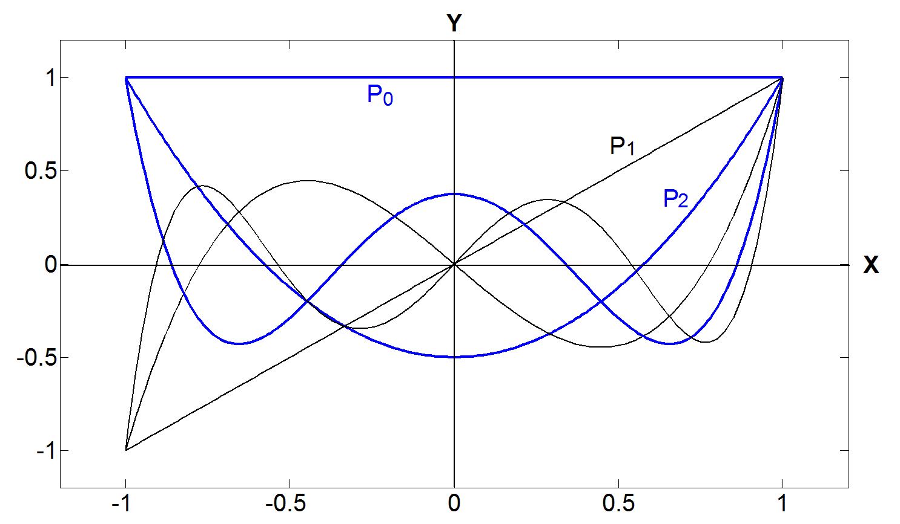

Legendre polynomials
Interval:
x ∈ [−1, 1]
P₃
P₄
P₅

Slide 18
(1)
even / odd symmetry
(2)
(3)
when n is odd
(4)
when n is even
(5)
recursive relation
(6)
(7)
If m ≠ n
orthogonality property
Orthogonality property 才是 Legendre polynomials 最重要的性質

Slide 19
3.2.2 Expansion by Legendre Polynomials
若任何在 x ∈ [−1, 1] 區間為 continuous 的函式 f(x)
皆可表示為
由於
根據 orthogonality property
所以

Slide 20
Q: How do we use the N^{th} order polynomial to approximate a function f(x) for x ∈ [−1, 1]?
note
Answer:
where
The detail of proof can be seen from Section 3.3.

Slide 21
[Example 2] Suppose that
when -1 ≤ x ≤ 1.
Try to approximate f(x) by a 2nd order polynomial
to minimize
(Solution):
Note that 1, x, x² are not a orthonormal set with x ∈ [-1, 1].
Therefore, instead, we may adopt the Legendre polynomials.

Slide 22
Then
where

Slide 23
red line: f(x)
blue line: f₂(x)
Approximation error is
Comparison: When using the Taylor series,

Slide 24
290
[Example 3] (Zill page 456)
SOLUTION
Using

Slide 25
291
If we want to approximate f(x) by the 1st order polynomial,
If we want to approximate f(x) by the 2nd order polynomial,
If we want to approximate f(x) by the 3rd order polynomial,

Slide 26
3.2.3 Generalization for the Interval
Problem :
How do we expand f(x) where the range of x is [a, b] and a ≠ -1, b ≠ 1?
(1)
Note: The range of x is changed into
[-1, 1]
(2) Expand g(x) by Legendre polynomials
where
(3)

Slide 27
Section 3.3 Generalization for Function Set Approximation
Suppose that φ₀(x), φ₁(x), φ₂(x), ……… φ_{N}(x) are a set of independent functions where x ∈ [a, b] and the weight function is w(x).
Problem :
How do we expand f(x) by φ₀(x), φ₁(x), φ₂(x) …. φ_{N}(x)
norm of f(x) – f_{N}(x)
where
is minimized.

Slide 28
Complete (Case 1)
Orthogonal
Incomplete
Orthonormal (Case 2)
Orthogonal (Case 3)
Complete, Incomplete (Case 4)
Non-Orthogonal
Over-Complete (Compressive Sensing)
(Case 1): The function set is complete and orthogonal / orthonormal
(orthonormal case)
(orthogonal case)

Slide 29
(Case 2): The function set is incomplete and orthonormal
(Case 3): The function set is incomplete and orthogonal
(Case 4): The function set is not orthogonal
Using the Gram-Schmidt method to convert it into an orthonormal set.
(page 303)

Slide 30
3.3.1 Orthonormal / Orthogonal Function Set Expansion
(Case 1)
[Theorem 3.3.1]
Parseval’s Theorem (Energy Preservation Theorem)
Suppose that φ₀(x), φ₁(x), φ₂(x), φ₃(x), ……….. are a complete and orthonormal function set for x ∈ [a, b] and
where
Then

Slide 31
(Proof):
Since
if n ≠ m

Slide 32
(Case 2)
[Theorem 3.3.2] Error When Expanded by an Incomplete Orthonormal Set
Suppose that φ₀(x), φ₁(x), φ₂(x), ……….., φ_{N}(x) are an incomplete and orthonormal function set for x ∈ [a, b]. Now, we want to approximate f(x) by a linear combination of φ₀(x), φ₁(x), φ₂(x), ……….., φ_{N}(x):
To minimize the approximation error, d_{n} should be calculated from
Then, the approximation error is:

Slide 33
(Proof):
Suppose that φ₀(x), φ₁(x), φ₂(x), ……….., φ_{N}(x) is a subset of the
complete and orthonormal function set φ₀(x), φ₁(x), φ₂(x), ……...,
φ_{N}(x), φ_{N+1}(x), ……....….. Then, f(x) can be expressed as
where
Therefore,
Then, from Theorem 3.3.1,
To minimize
, we should set
for n = 0, 1, …, N

Slide 34
Note that, when d_{n} = c_{n}, then
from
Theorem 3.3.2 is hence proved.

Slide 35
(Case 3)
[Theorem 3.3.3] Error When Expanded by an Incomplete Orthogonal Set
Suppose that φ₀(x), φ₁(x), φ₂(x), ……….., φ_{N}(x) are an incomplete and orthogonal function set for x ∈ [a, b]. Now, we want to approximate f(x) by a linear combination of φ₀(x), φ₁(x), φ₂(x), ……….., φ_{N}(x):
To minimize the approximation error, d_{n} should be calculated from
Then, the approximation error is:

Slide 36
(Proof): The formula of d_{n} is directly from page 273.
If
then ψ₀(x), ψ₁(x), ψ₂(x), ……….., ψ_{N}(x) form an orthonormal set.
From (Case 2),
where
Since

Slide 37
3.3.2 Non-Orthogonal Function Set Expansion
(Case 4)
How do we generate an orthonormal function set {φ₀(x), φ₁(x), φ₂(x), φ₃(x) , ……….} if the input {p₀(x), p₁(x), p₂(x), p₃(x) , ……….} is independent but not an orthogonal function set?
Gram-Schmidt process
n = 0
n = n+1

Slide 38
Proof for orthogonality of the function set generated from the Gram-Schmidt process
Suppose that we have known that φ₀(x), φ₁(x), φ₂(x), ……….., φ_{n-1}(x) are orthonormal.
If k < n,

Slide 39
[Example 4]
Derive φ₀(x), φ₁(x), φ₂(x), ……….. such that
u(x): unit step function
and
0
when m ≠ n
0
2
orthonormalization
1
3
2
4
3
5

Slide 40
Answer:
Set

Slide 41
………………
………………

Slide 42
附錄七 Compressive Sensing
The problems that compressive sensing deals with:
Suppose that b₀(t), b₁(t), b₂(t), b₃(t) ………….. form an over-complete and non-orthogonal spanning set.
(Problem 1) We want to minimize ||c||₀ (|| ||₀ 是 zero-order norm， ||c||₀ 意指c_{m} 的值不為 0 的個數） such that
(Problem 2) We want to minimize ||c||₀ such that
(Problem 3) When ||c||₀ is limited to M, we want to minimize

Slide 43
Examples for the spanning set used for compressive sensing
(Since they are not linearly independent, they are not basis).
3-atom form
4-atom form
Problems: over-complete, non-orthogonal, too many functions in the sets

Slide 44
Section 3.4 Other Orthogonal Polynomials
(只教不考)
In addition to Legendre Polynomials, there are many other orthogonal polynomials. However, their weight functions and intervals are different.
[1] R. Beals, Special Functions and Orthogonal Polynomials, Cambridge Studies in Advanced Mathematics, vol. 153, Cambridge University Press, 2016.
[2] M. R. Spiegel, Mathematical Handbook, Schaum, 1990.

Slide 45
Summary of Weights and Supports of Orthogonal Polynomials
Name | Weight Function w(x) | Support
Legendre | 1 | x ∈ [-1, 1]
Jacobi | (1+x)^{n}(1–x)^{m} | x ∈ [-1, 1]
Associated Legendre (Ultraspherical, Gegenbauer) | (1–x²)^{m} | x ∈ [-1, 1]
Chebyshev (1st Kind) | (1–x²)^{–1/2} | x ∈ [-1, 1]
Chebyshev (2st Kind) | (1–x²) ^{1/2} | x ∈ [-1, 1]
Laguerre |  | x ∈ [0, ∞)
Associated Laguerre |  | x ∈ [0, ∞)
Hermite |  | x ∈ (-∞, ∞)

Slide 46
• Associated Legendre Functions
P_{n}(x): the Legendre polynomial of order n, in fact,
They are orthogonal for x ∈ [-1, 1],
if n ≠ k
Ex: When m = 1,

Slide 47
• Chebychev polynomials
電子學和 filter design 常用
They are orthogonal for
x ∈ [-1, 1]
if n ≠ k
They are the solutions of

Slide 48
• Laguerre polynomials
They are orthogonal for
x ∈ [0, ∞)
if n ≠ k
They are the solutions of

Slide 49
• Associated Laguerre polynomials
where P_{n}(x) is the n^{th} order Laguarre polynomial
They are orthogonal for
x ∈ [0, ∞)
if n ≠ k
They are the solutions of

Slide 50
• Hermite polynomials
電磁波、光學、頻譜分析常用
They are orthogonal for
x ∈ (-∞, ∞)
if n ≠ k
They are the solutions of

