Slide 1
4. Fourier Analysis
Section 4.1 Definition of the Fourier Transform
Section 4.2 Dirac Delta Function
Section 4.3 Properties
Section 4.4 Uncertainty Principle
Section 4.5 Convolution and Correlation
Section 4.6 2D Fourier Transforms
Section 4.7 The Operations Related to Fourier Transforms (只教不考)
[1] R. N. Bracewell, The Fourier Transform and Its Applications, 3rd ed., McGraw Hill, Boston, 2000.
[2] D. G. Zill and Michael R. Cullen, Differential Equations-with Boundary-Value Problem (metric version), 9th edition, Cengage Learning, 2017.
[3] D. G. Zill, W. S. Wright, and J. J. Ding, Engineering Mathematics, Metric Edition, Cengage Learning, Taipei, Taiwan, 2019, Chapter 15.

Slide 2
Fourier Transform
Definition (Sec. 4-1)
Basic
Properties (Sec. 4-3)
Uncertainty (Sec. 4-4)
Transform Pair (Sec. 4-1)
Special Functions
Sinc (Sec. 4-1)
Fourier Transform
Dirac Delta (Sec. 4-2)
Hermite-Gaussian (Sec. 4-4)
Jinc (Sec. 4-6)
Convolution (Sec. 4-5)
Correlation (Sec. 4-5)
2D FT (Sec. 4-6)
Hankel Transform (Sec. 4-6)
Related Transforms
Hilbert Transform (Sec. 4-7)
Laplace Transform (Sec. 4-7)
Mellin Transform (Sec. 4-7)

Slide 3
4.1 Definition of the Fourier Transform
Fourier transform
代表 Fourier transform
inverse Fourier transform
[1] R. N. Bracewell, The Fourier Transform and Its Applications, 3rd ed., McGraw Hill, Boston, 2000.
[2] D. G. Zill, W. S. Wright, and J. J. Ding, Engineering Mathematics, Metric Edition, Cengage Learning, Taipei, Taiwan, 2019, Sections 15-2.

Slide 4
Review: Fourier Series of the Complex Form
n = …, -1, 0, 1, 2, 3, ….
form a complete and orthogonal set within

Slide 5
Review: Fourier Series of the Complex Form
(Compared to pages 273, 276)
If g(x) = g(x+T), then
where

Slide 6
4.1.1 Derivation and Physical Meaning
Fourier transform can be viewed as the Fourier series where
Note that, if we set g_{n} = c_{n}T
Then we set
where
If T →∞,

Slide 7
Physical Meaning of the Fourier Transform:
expanding a signal as a combination of
period: 1/f, frequency: f
G(f): the expansion coefficient for

Slide 8
When will the Fourier transform exist?
Sufficient Conditions:
(1)
(2) g(x) is of bounded variations (It means that g(x) can be represented by a curve of finite length in any finite interval of x).

Slide 9
4.1.2 Transform Pair
Find the Fourier transform of
[Example 1]
(Solution):

Slide 10
[Example 2]
Find the Fourier transform of the rectangular function Π(x) where
for -1/2 < x < 1/2,
otherwise.
-1/2
1/2
(Solution):

Slide 11
[Example 3]
Find the Fourier transform of the Dirac delta function δ(x)
(Solution): From the sifting property of δ(x):
(see page 342)
we have
height = 1/2b
area = 1
x₀−b
x₀+b
x-axis

Slide 12
Note:
More generally,

Slide 13
Linearity Property of the Fourier Transform
If
then

Slide 14
Duality Property of the Fourier Transform
If
then
(Proof): Since
Q: How do we compute the Fourier transforms of sinc(x) and 1?

Slide 15
[Example 4]
Find the Fourier transform of sinc(x) where
(Solution): Since
from the duality property, we have

Slide 16
[Example 5] Find the Fourier transform of exp(j2π k x)
(Solution): Since
from the duality property, we have
(Here we apply the fact that δ(x) = δ(-x)).
Specially,
(Note): Although 1 does not satisfy the sufficient condition on page 324, its Fourier transform exists.

Slide 17
[Example 6] Find the Fourier transform of cos(2π k x)
(Solution):

Slide 18
Some basic Fourier transform pairs
g(x)
(1) δ(x) | 1
(2) 1 | δ(f)
(3) δ(x−k) | exp(−j2πkf)
(4) exp(j2πkx) | δ(f − k)
(5) cos(2πkx)
(6) sin(2πkx)
(7) ∏(x) | sinc(f)
(8) sinc(x) | ∏(f)
(9) exp(-kx)U(x) (k > 0)
(10) exp(-k|x|) (k > 0)

Slide 19
Some basic Fourier transform pairs
δ(x)
1
1
δ(f)
cos(2πx)
sin(2πx)
∏(x)
sinc(f)
sinc(t)
∏(f)

Slide 20
附錄八 Summary of Popular Special Functions
(1) Sinc Function
Applications: sampling theorem; ideal filters

Slide 21
(2) Rectangular Function
(3) Triangular Function

Slide 22
(4) Step Function

Slide 23
4.2 Dirac Delta Functions
The Dirac delta function does not have a fixed definition. It is in fact the limitation of a distribution.
(1)
height = 1/2b
area = 1
−b
b
x-axis

Slide 24
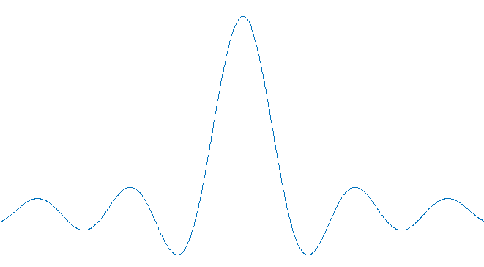
(2)
height = 1/b
area = 1
−b
b
x-axis
(3)
height = 1/b
−b
b

Slide 25
Definition of the Dirac delta function:
(1)
(2)
if x ≠ 0
(3)

Slide 26
Properties of the Dirac delta function:
(1)
U(x): unit step function
(2) Sifting property
(Proof):
1/(2b)
g(x)
k-b
k+b

Slide 27
(3) Sifting property (without integral)
(4) Scaling property
(to balance the integral)
for a > 0
for a < 0
(5) Convolution property
Specially,

Slide 28
(6) Integral for exponential functions
It is directly from the fact that
(7) Generalization of the integral for exponential functions
How do we define it?

Slide 29
(8) δ(g(x))
If g(x) = 0 only at x = x₀, then
(Proof):
when
In general, if g(x) = 0 only at x = x₁, x₂, …, x_{N}, then

Slide 30
(9) Derivative of δ(x)
(Proof):
(from the sifting property)

Slide 31
(10) Properties related to derivative of δ(x)
(i)
(ii)
(iii)
(Proof): Since

Slide 32
(11) Higher order derivative of δ(x)
when n > 0
when x ≠ 0

Slide 33
4.3 Properties of the Fourier Transform
4.3.1 List of Properties
(1) Recovery (inverse Fourier transform)
(2) Integration (DC property)
(3) Modulation
(4) Time Shifting
(5) Scaling
(6) Time Reverse

Slide 34
(7) Real / Imaginary Input | If g(x) is real, then G(f) = G*(−f); If g(x) is pure imaginary, then G(f) = −G*(−f)
(8) Even / Odd Input | If g(x) = g(−x), then G(f) = G(−f); If g(x) = −g(−x), then G(f) = −G(−f);
(9) Conjugation
(10) Differentiation
(11) Multiplication by x
(12) Division by x
(13) Parseval’s Theorem (Energy Preservation)
(14) Generalized Parseval’s Theorem

Slide 35
(15) Linearity
(16) Convolution | If then
(17) Multiplication | If , then
(18) Correlation | If then
(19) Two Times of Fourier Transforms
(20) Four Times of Fourier Transforms

Slide 36
(Proof of (2) Integration Property)
(Proof of (5) Scaling Property)
Property (6) is a special case of Property (5) where a = -1.

Slide 37
(Proof of (7) and (9))
((9) is proven)
If g(x) is real, then
(Proof of (10) Differentiation Property)

Slide 38
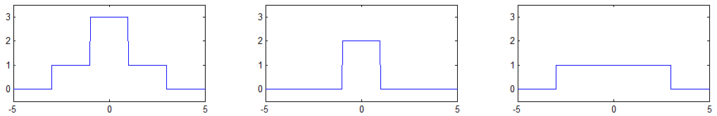
[Example 1] Determine the Fourier transform of the following signal.
for |x| < 1,
for 1< |x| < 3,
for |x| > 3
(Solution): Note that
=
+
Therefore,

Slide 39
[Example 2] Determine the Fourier transform of the following signal.
(Solution): From page 334, we have
Then, from the differentiation property

Slide 40
[Example 3] Determine the Fourier transform of the following signal.
(Solution): Since
time shifting property
modulation property

Slide 41
[Example 4] Determine the Fourier transform of the following signal.
for 0 < x < 8,
otherwise
(Solution): Note that
Since
(scaling)
(time shifting)

Slide 42
(modulation)
Therefore,

Slide 43
4.3.2 Real, Imaginary, Even, and Odd Parts
Moreover, from Properties (7), (8), (9), we can conclude that
(i)
(ii)
(Practice to prove them)

Slide 44
Also, any function can be decomposed into
(1)
where
(2)
where

Slide 45
One can prove that
where
note

Slide 47
4.3.3 Parseval’s Theorem
Parseval’s theorem is also called the energy preservation property, Rayleigh’s Theorem, or Plancheral’s Theorem.
(Proof):
(from page 344)
(from the sifting property)

Slide 48
Generalized Parseval’s Theorem
It also called the power theorem.

Slide 49
[Example 5] Determine the following integral:
[Example 6] Determine the following integral:
(Solution): Since

Slide 50
4.4 Uncertainty Principles
4.4.1 Uncertainty Principles from Different Views
(1) From the Point of View of the Scaling Property
wide in the time domain → narrow in the frequency domain
narrow in the time domain → wide in the frequency domain

Slide 51
(2) From the Point of View of Equivalent Width
Equivalent Width in the Time Domain:
from the integration property
Equivalent Width in the Frequency Domain:
Product of the Two Equivalent Widths:

Slide 52
(3) Heisenberg’s Uncertainty Principle
For a signal g(x), if when |x| ∞, then
σ_{x} σ_{f} ≥ 1/4π
where ,

Slide 53
(Proof of Henseinberg’s uncertainty principle):
For simplification, we consider the case where μ_{x} = μ_{f} = 0
Then, use Parseval’s theorem
Here, we apply the fact that

Slide 54
From Schwarz’s inequality
(using |a+b|² + |a–b|² ≥ 2|a|² )

Slide 55
4.4.2 Gaussian and Hermite-Gaussian Functions
Gaussian function:
The Gaussian function is an eigenfunction of the Fourier transform with eigenvalue = 1:

Slide 56
(Proof): From the fact that
M. R. Spiegel, Mathematical Handbook of Formulas and Tables, McGraw-Hill, 3rd Ed., 2009.
we have
The Gaussian function is not the only eigenfunction of the Fourier transform.

Slide 57
The Gaussian function satisfies the lower bound of Heisenberg’s uncertainty principle.
use
use

Slide 58
Since G(f) = g(f),
Therefore,
if
Note: Other Hermite Gaussian functions do not satisfy the lower bound of Heisenberg’s uncertainty principle.

Slide 59
H_{n}(x): The Hermite polynomial of order n (see page 316).

Slide 60
附錄八 Convolution
Convolution:
Specially, if g(x) = 0 for x < 0 and h(x) = 0 for x < 0, then
Convolution (causal form):
Physical meaning: The effect of the input on the output is determined by their time difference.
output
input
effect of g(τ) on y(x)

Slide 61
output
input
effect of g(τ) on y(x)
Any linear time-invariant system can be expressed as the convolution form.

Slide 62
[Support Theorem]:
If the support of g(x) is x ∈ [x₁, x₂]
(i.e., g(x) = 0 for x < x₁ and x > x₂)
and the support of h(x) is x ∈ [x₃, x₄],
then the support of z(x) is
x ∈ [x₁ + x₃, x₂ + x₄]
(Proof):
when x – τ ∈ [x₃, x₄],
x ∈ [x₃+ min(τ), x₄ + max(τ)] = [x₁ + x₃, x₂ + x₄]

Slide 63
附錄九 Change of Independent Variables for Integrals
where
For the definite integral case

Slide 64
4.5 Convolution and Correlation
4.5.1 Convolution Property
If
then
convolution
multiplication

Slide 65
(Proof): If
Therefore,

Slide 66
[Example 1] Determine the Fourier transform of
We call it the triangular function.
(Solution):
Note that
When x – 1/2 >1/2 or x +1/2 < -1/2, i.e., x > 1 or x < -1,
When -1 < x < 0
When 0 < x < 1

Slide 67
Therefore,

Slide 68
[Example 2] Determine the inverse Fourier transform of
(Solution): Note that
From page 334

Slide 69
When x ≤ 0,
When x > 0,

Slide 70
[Example 3] Determine
[Example 4] Determine
[Example 5] Determine
[Example 6] Determine

Slide 71
[Theorem 4.5.1]
Specially,
(Proof):
(from the time-shifting property)

Slide 72
4.5.2 Multiplication Property
If
then
multiplication
convolution

Slide 73
(Proof):
Therefore,

Slide 74
[Example 7] Determine the Fourier transform of
(Solution):
Therefore,

Slide 75
4.5.3 Correlation
Correlation
Auto-Correlation
Applications: Matched filter, communication, pattern recognition, signal detection ……

Slide 76
[Theorem 4.5.2] In fact, correlation is equivalent to convolution with the conjugate + time reverse of a signal.
(Proof):
where

Slide 77
Since
we have
Specially, if a_{g}(x) is the auto-correlation of g(x):
then

Slide 78
4.6 Two-Dimensional Fourier Transform
4.6.1 Rectangular Coordinate
Two Dimensional Fourier Transform
Two Dimensional Inverse Fourier Transform
Possible Applications: Image processing, optics, electromagnet wave propagation analysis, ….
[1] R. N. Bracewell, The Fourier Transform and Its Applications, 3rd ed., McGraw Hill, Boston, 2000.

Slide 79
Physical meaning: Express a signal by a linear combination of
f is the number of periods per unit of x
h is the number of periods per unit of y

Slide 80
real part of
Bright colors mean higher values and dark colors mean lower values.
(a) f = h = 0
(b) f = 2, h = 0
(c) f = 0, h = 3
(d) f = 2, h = 3

Slide 81
[Example 1] Find the 2D Fourier transform of
(Solution):

Slide 82
[Example 2] Find the 2D Fourier transform of
(Solution):
[Example 3] Find the 2D Fourier transform of

Slide 83
4.6.2 Circular Coordinate Conversion
where
(page 379)

Slide 84
Specially, if g(r, θ) is independent of θ
From the fact that
Bessel function of the 1st kind of zero order, see page 197
(cosϕ has a period of 2π)
We have
(Note that it is independent of φ)

Slide 85
Hankel Transform
It is in fact the 2D Fourier transform for a rotationally symmetric signal.
Inverse Hankel Transform
It has the same form as the forward transform.

Slide 86
Several Hankel Transform Pairs
y
(i) If
r₀
then
x
Note that
(from page 342(2))

Slide 87
(ii) If
y
1
x
then
Bessel function of the 1st kind of 1st order,
See page 197.

Slide 88
Jinc function (also called the Besinc function).
If
It plays a similar role as the sinc function.

Slide 89
Hankel transform

Slide 90
4.7 The Operations Closely Related to the Fourier Transform
(只教不考)
(1) Two-Sided Laplace Transform
Note that when
it is reduced to the Fourier transform. When
it is equivalent to the Fourier transform of exp(−σt)f(t).

Slide 91
(2) One-Sided Laplace Transform
When
it is equivalent to the Fourier transform of exp(−σt)f(t)U(t).
U(t): unit step function
It has less physical meaning, but the probability that the transform exists is higher. It is suitable for solving the initial value problem.

Slide 92
FT
inverse FT
(3) Fourier Cosine Transform
When g(x) is even, the FT is reduced to the Fourier cosine transform.
(4) Fourier Sine Transform
When g(x) is odd, the FT is reduced to the Fourier sine transform.

Slide 93
(5) Hartley Transform
where cas(x) = cos(x) + sin(x)
real input → real output

Slide 94
(6) Mellin Transform
If we set x = exp(-t),
, then
It is the two-sided Laplace transform of
It is suitable to deal with the fractal (碎形), since if
then

Slide 95
(7) Hilbert Transform
where
Note that

Slide 96
h(x)
Therefore,
h(x)

Slide 97
Hilbert
k ≠ 0
Hilbert
k ≠ 0
(Proof): If
then

Slide 98
(8) Analytic Signal
reconstruction:
Since
if g(x) is real
we have
(It is called the ‘single sided band signal’)
(halve the bandwidth)

Slide 99
(9) Fractional Fourier Transform
When φ = 0.5π, the FRFT becomes the FT.
φ = 0.5aπ
Physical meaning: Performing the FT a times,
[Ref] L. B. Almeida, “The fractional Fourier transform and time-frequency
representations,” IEEE Trans. Signal Processing, vol. 42, no. 11, pp. 3084-
3091, Nov. 1994.
[Ref] H. M. Ozaktas, Z. Zalevsky, and M. A. Kutay, The Fractional Fourier
Transform with Applications in Optics and Signal Processing, New York,
John Wiley & Sons, 2000.
[Ref] V. Namias, “The fractional order Fourier transform and its application to
quantum mechanics,” J. Inst. Maths. Applics., vol. 25, pp. 241-265, 1980.

Slide 100
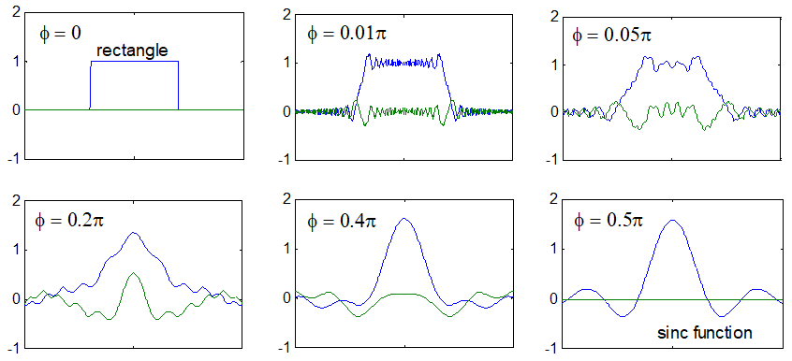
Fractional Fourier transforms for a rectangular function
blue lines: real parts; green lines: imaginary part

Slide 101
(10) Linear Canonical Transform
where ad − bc = 1
when
Fourier transform
when
fractional Fourier transform
[Ref] K. B. Wolf, “Integral Transforms in Science and Engineering,” Ch. 9:
Canonical transforms, New York, Plenum Press, 1979.

Slide 102
Summary of Transforms
Fourier Transform
2D Fourier Transform
Hankel Transform
Two-Sided Laplace Transform
One-Sided Laplace Transform
Fourier Cosine Transform
Fourier Sine Transform

Slide 103
Hartley Transform
Mellin Transform
Hilbert Transform
Analytic Signal
Fractional Fourier Transform
Linear Canonical Transform

