Slide 1
5. Sampling and Discrete Fourier Transform
Section 5.1 Sampling and Reconstruction
Section 5.2 Discrete Fourier Transform
[1] R. N. Bracewell, The Fourier Transform and Its Applications, 3rd ed., McGraw Hill, Boston, 2000.
[2] A. V. Oppenheim and R. W. Schafer, Discrete-Time Signal Processing, London: Prentice-Hall, 3rd ed., 2010.

Slide 2
Sampling and Discrete Fourier Transform
Sampling (Sec. 5-1-2)
Varying the Sampling Rate
(Sec. 5-1-4)
Reconstruction (Sec. 5-1-3)
Sampling and Discrete
Fourier Transform
Implementing the Continuous FT (Sec. 5-2-2)
Discrete Fourier
Transform (Sec. 5-2-1)
Properties (Sec. 5-2-3)
Complexity (Sec. 5-2-4)
2D Version (Sec. 5-2-5)

Slide 3
5.1 Sampling
5.1.1 Impulse Train
Impulse Train
It is also called the comb function.
……….....
………..........
x=-2
x=-1
x=0
x=1
x=2

Slide 4
Signal sampling can be express in terms of the impulse train
where
Since
the sampled signal g_{s}(x) can be expressed in terms of

Slide 5
[Theorem 5.1.1] The impulse train is also an eigenfunction of the Fourier transform, i.e.,
(Proof): Note that the impulse train is a periodic function
Therefore, it can be expanded by the Fourier series (page 321) of the complex form with T = 1
where
(page 342(2))

Slide 6
Therefore,
……
………
……
………
-1 0 1 2
-1 0 1 2

Slide 7
Varying the interval of the impulse train
(page 349(5))
……
………
…
………

Slide 8
5.1.2 Sampling Theory
[Theorem 5.1.2] Suppose that we perform sampling for a continuous signal with sampling interval Δ_{x}
where
then
(Proof): Since
(page 387)

Slide 9
If we set
(f_{s} is call the sampling frequency)
then
f-axis
f=0
sampling
-f_{s}
f=0
f_{s}
2f_{s}
f-axis

Slide 10
[Sampling Theory]
The sampling frequency
should be larger than twice of the
bandwidth of the original continuous function:
(Nyquist criterion)
where
when f > B.
Otherwise, the original function cannot be reconstructed and the aliasing effect is led.
-f_{s}
B
f_{s}−B
f_{s}
f_{s}+B
2f_{s}
−B
f=0
f-axis

Slide 11
Q: What will happen if
Even component with frequency f = ±B → preserved
Odd component with frequency f = ±B → destroyed

Slide 12
5.1.3 Reconstruction (Digital to Analogous)
When the Nyquist criterion is satisfied, one can apply the lowpass filter to reconstruct the original signal.
Frequency Domain
f-axis
-f_{s}
f=0
B
f_{s}−B
f_{s}
f-axis
-f_{s}
f=0
B
f_{s}−B
f_{s}
where B < f_{c} < f_{s}–B
-f_{c}
f_{c}

Slide 13
Time Domain
Frequency Domain
sampling
reconstruction
where B < f_{c} < f_{s}–B

Slide 14
Specially, when
Signal Reconstruction Formula:
where
constraint:

Slide 15
[Example 1] Suppose that
otherwise
for f ≥ 1
Try to reconstruct g(x).
(Solution):
Δ_{x} = 1/2

Slide 16
(Note):
do not interfere with one another at x = n/2.

Slide 17
5.1.4 Varying the Sampling Rate
(i) D/A conversion
(ii) Re-sampling
Note: When
and k is an integer

Slide 18
From the view point of the spectrum, if
then
where
-f_{s}
f=0
B
f_{s}−B
f_{s}
f-axis
-f_{new}
f=0
B
f_{new}−B
f_{new}
f-axis

Slide 19
5.2 Discrete Fourier Transform
5.2.1 Derivation and Definitions of the Discrete Fourier Transform
To process discrete functions, the continuous Fourier transform should be converted into the discrete version.
Continuous Fourier transform:
If we set
then

Slide 20
Specially, if
then

Slide 21
Discrete Fourier Transform (DFT)
m, n = 0, 1, 2, …, N-1
Inverse Discrete Fourier Transform (IDFT)
Note that the output of g[n] is periodic
Also note that, on page 439,

Slide 22
The DFT and the IDFT form a transform pair since
Because
if a ≠ 0,
if a = 0,
unit impulse function
(discrete Dirac delta function)

Slide 23
Unit Impulse Function (discrete Dirac delta function)
1
-3 -2 -1 0 1 2 3
n
The unit impulse function has an explicit form. It does not a limitation of a distribution.
Compared to page 341,

Slide 24
Other possible definitions of the DFT
DFT
IDFT
DFT
IDFT

Slide 25
5.2.2 Implementing Continuous FT by the DFT
Suppose that we want to calculate the continuous FT of g(x) digitally and
for x ∉ [x₁, x₁+T]
(i) Shifting
Note:
for x ∉ [0, T]
(ii) Sampling
(iii) DFT

Slide 26
(iv) Mapping to the true frequency
(from pages 439 and 440)
Since
Therefore,
if 0 ≤ m ≤ N/2,
if N/2 ≤ m ≤ N-1
(v) Using the modulation property

Slide 27
[Example 1]：Suppose that
g(x) = (1-|x|)² for -1 ≤ x ≤ 1
g(x) = 0 otherwise
Sampling interval： Δ_{x} = 0.1
How do we obtain the FT of g(x) by the DFT?
(Solution):
(i)
x

Slide 28
(ii)
n
(iii)
blue: real part; red: imaginary part
move to left
m

Slide 29
(iv) Mapping
blue: real part; red: imaginary part
f
change m to f
if 0 ≤ m ≤ N/2,
if N/2 ≤ m ≤ N-1

Slide 30
(v)
blue: real part; red: imaginary part
f

Slide 31
5.2.3 Transform Pairs and Properties
[Duality Property]
If
then
((a))_{N} : a modulo N
the remainder of a after divided by N

Slide 32
If
then
(Proof):
Since
(proved on the next page)

Slide 33
((a))_{N} : the remainder of a after
divided by N
When a ≠ bN where b is some integer
When a = bN where b is some integer (i.e., ((a))_{N} = 0)

Slide 34
[Determine the IDFT by the DFT]
Note:
(i) Computation loading of the IDFT = Computation loading of the DFT
(ii) In industry, only the chip of the DFT is required.

Slide 35
[Transform Pair]
g[n] | G[m]
(1) δ_{d}[n] (see page 442) | 1
(2) 1
(3) δ_{d}[n−k] | exp[−j2πkm/N]
(4) exp[j2πkn/N]
(5) cos[2πkn/N]
(6) sin[2πkn/N]
(7) g[n] = 1 for 0 ≤ n≤ W g[n] = 0 otherwise
(8) exp[-kn], k ≠ 0

Slide 36
[Discrete Impulse Train]
c is a factor of N

Slide 37
[Example 2] Determine the DFT of p_{c}[n]
c is a factor of N
n = ck
if m is not a multiple of N/c
if m is a multiple of N/c
Therefore,

Slide 38
DFT
DFT

Slide 39
Properties
(1) Linear | DFT{ax[n] + by[n]} = aX[m] + bY[m]
(2) DC Values
(3) Shifting | where ((n))_{N} = n if 0 ≤ n ≤ N-1 ((n))_{N} = n+N if -N ≤ n ≤ -1 ((n))_{N} = n−N if N ≤ n ≤ 2N-1
(4) Modulation
(5) Time Reverse
(6) Even /Odd Input | If g[n] = g[((-n))_{N}], then G[m] = G[((-m))_{N}]; If g[n] = -g[((-n))_{N}], then G[m] = -G[((-m))_{N}];

Slide 40
(7) Conjugate | DFT{g*[n]} = G*[((-m))_{N}]
(8) Real/Imaginary Input | If g[n] is real, then G[m] = G*[((-m))_{N}]; If g[n] is pure imaginary, then G[m] = −G*[((-m))_{N}];
(9) Circular Convolution | If then
(10) Circular Correlation | If then
(11) Parseval’s Theorem (Energy Preservation)
(12) Generalized Parseval’s Theorem

Slide 41
5.2.4 Discrete Circular Convolution
[Discrete Circular Convolution]
(Proof of the convolution property)
Here we apply
((a))_{N} : the remainder of a
after divided by N

Slide 42
[Discrete Circular Convolution and Discrete Linear Convolution]
A discrete linear time-invariant (LTI) system can always be expressed a discrete linear convolution:
However, the convolution implemented by the DFT is the discrete circular convolution:
If
then
((a))_{N} : the remainder of a
after divided by N

Slide 43
linear convolution:
circular convolution:
For example,
The condition where the circular convolution is equal to the linear convolution:
(i)
(ii)
(iii)

Slide 44
The condition where the circular convolution is equal to the linear convolution:
(i)
(ii)
(iii)
(Proof):
(Since N+n+1-L ≥ N+1-L ≥ M)

Slide 45
5.2.5 Complexity
Direct implementation: Complexity = O(N²)
With the fast algorithm: Complexity = O(Nlog₂N)

Slide 46
465
2-point DFT
g[0]
g[1]
G[0]
G[1]
-1

Slide 47
466
When N = 2^{k}
twiddle factors
g₁[n] = g[2n], g₂[n] = g[2n+1]
Therefore,
one N-point DFT = two (N/2)-point DFT + twiddle factors

Slide 48
8-point DFT
467
g[0]
g[2]
g[4]
g[6]
4-point DFT
G[0]
G[1]
G[2]
G[3]
G[4]
G[5]
G[6]
G[7]
1
w
w²
w³
g[1]
g[3]
g[5]
g[7]
4-point DFT
-1
-1
-1
-1
When N = 8

Slide 49
8-point DFT
468
g[0]
g[4]
g[2]
g[6]
g[1]
g[5]
g[3]
g[7]
G[0]
G[1]
G[2]
G[3]
G[4]
G[5]
G[6]
G[7]
-1
1
w²
-1
-1
-1
1
w
w²
w³
-1
-1
-1
1
w²
-1
-1
-1
-1
-1

Slide 50
469
complexity:
N/2 twiddle factors are required between two stages
Number of stages
• J. W. Cooley and J. W. Tukey, “An algorithm for the machine computation of complex Fourier series,” Mathematics of Computation, vol. 19, pp. 297-301, Apr. 1965. (Cooley-Tukey)
• C. S. Burrus, “Index Mappings for multidimensional formulation of the DFT and convolution,” IEEE Trans. Acoustics, Speech, and Signal Processing, vol. 25, pp. 1239-242, June 1977. (Prime factor)

Slide 51
5.2.6 2D DFTs
2-D Discrete Fourier Transform (2-D DFT)
2-D Inverse Discrete Fourier Transform (2-D IDFT)

Slide 52

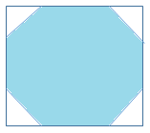
Low Frequency Part → Mild Variation → Plane
High Frequency Part → Large Variation → Edge and Noise
low frequency part
high frequency part
f_{x}
f_{x}
f_{y}
f_{y}

Slide 53
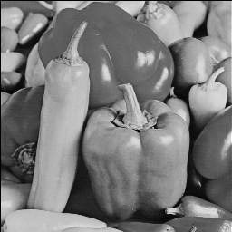
2D
DFT
Using the gray level to show the intensity
image(…….)
colormap(gray(256))

Slide 54
Low Frequency Part (similar to the blurred version of the input image)
Passband: |f_{x}| + |f_{y}| ≤ N/30
Passband: |f_{x}| + |f_{y}| ≤ N/10

Slide 55
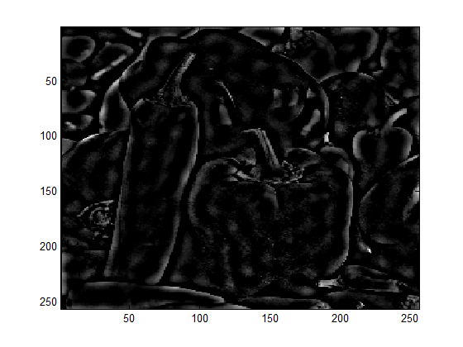
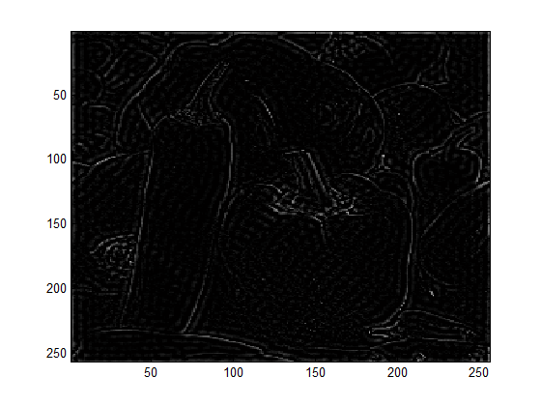
High Frequency Part (similar to the edges)
Passband: |f_{x}| + |f_{y}| > N/30
Passband: |f_{x}| + |f_{y}| > N/10

