Slide 1
Gray Image Compression
Speaker: Kuan-Ting Tu
Date:2024/03/02

Slide 2
Outline
Image Compress
Why Compress
Lossy vs. Lossless
JPEG vs. JPEG2000
Algorithm (KT Gray Image Compression)
Encoder Architecture
2D Discrete Wavelet Transform
Symmetric Extension & Quantization
Difference
Data Compression
Encoder System Architecture
Result
Reference

Slide 3
Outline
Image Compress
Why Compress
Lossy vs. Lossless
JPEG vs. JPEG2000
Algorithm (KT Gray Image Compression)
Encoder Architecture
2D Discrete Wavelet Transform
Symmetric Extension & Quantization
Difference
Data Compression
Encoder System Architecture
Result
Reference

Slide 4
Image Compress - Why Compress
Reduced File Size
Faster Loading Times
Bandwidth Conservation
Saving Storage Space
Improved SEO
Notes:
改善SEO：由於壓縮圖片導致的更快加載時間可能會提高網站的搜索引擎優化（SEO）性能。像Google這樣的搜索引擎將頁面速度視為排名因素，因此更快加載的頁面可能在搜索結果中排名更高。(By ChatGPT)

Slide 5
Image Compress - Lossy vs. Lossless
Lossy Compression
Higher Compression Ratio
Lower File Size
Fast Compression/Decompression
Simplified Processing
Loss of Quality
Irreversibility
Distortion
Notes:
Irreversibility不可逆性
JPEG、JPEG2000、HEIF(H.265 or HEIC)

Slide 6
Image Compress - Lossy vs. Lossless
Lossless Compression
Preservation of Quality
Reversibility
Distortionless
Limited Compression Ratio
Larger File Sizes
Slower Compression/Decompression
Notes:
BMP、PNG、SVG、JPEG2000

Slide 7
Image Compress - JPEG vs. JPEG2000
JPEG
Discrete Cosine Transform
Huffman Coding & Run-Length Coding
JPEG2000
Discrete Wavelet Transform
Dead-Zone Scalar Quantization
Arithmetic Coding & Run-Length Coding
Notes:
JPEG have Mosaic Distortion(馬賽克失真)
JPEG2000 需要更多的運算資源
本專題實現於硬體上=>簡化複雜度

Slide 8
Outline
Image Compress
Why Compress
Lossy vs. Lossless
JPEG vs. JPEG2000
Algorithm (KT Gray Image Compression)
Encoder Architecture
2D Discrete Wavelet Transform
Symmetric Extension & Quantization
Difference
Data Compression
Encoder System Architecture
Result
Reference

Slide 9
Algorithm - Encoder Architecture
Gray Image
Lossless
compress
Discrete Wavelet Transform
(DWT)
Data Compression
(Huffman Coding)
Lossy
compress
Quantization
(Dead-Zone Scalar Quantization)
Difference
u_image.ktic
Figure1 Encoder Architecture

Slide 10
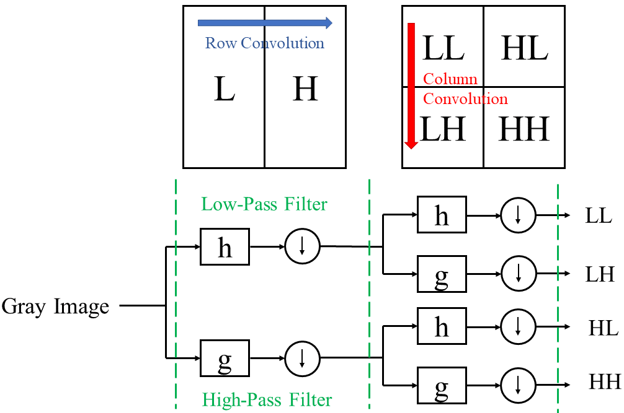
Algorithm - 2D Discrete Wavelet Transform
$$s_{j}\left(n\right)= \sum_{k=0}^{L}{s_{j−1}\left(k\right)h(2n−k)}$$
$$s_{j}\left(n\right)= \sum_{k=0}^{L}{s_{j−1}\left(k\right)g(2n−k)}$$
Figure2 Discrete Wavelet Transform
Notes:
DWT Processing down sampling factor 為 2

Slide 11
Algorithm - Symmetric Extension & Quantization
Figure3 Symmetric Extension Scheme for Boundary Pixels
Figure4 Dead-Zone Scalar Quantization

Slide 12
Algorithm - Difference
Figure5 Difference

Slide 13
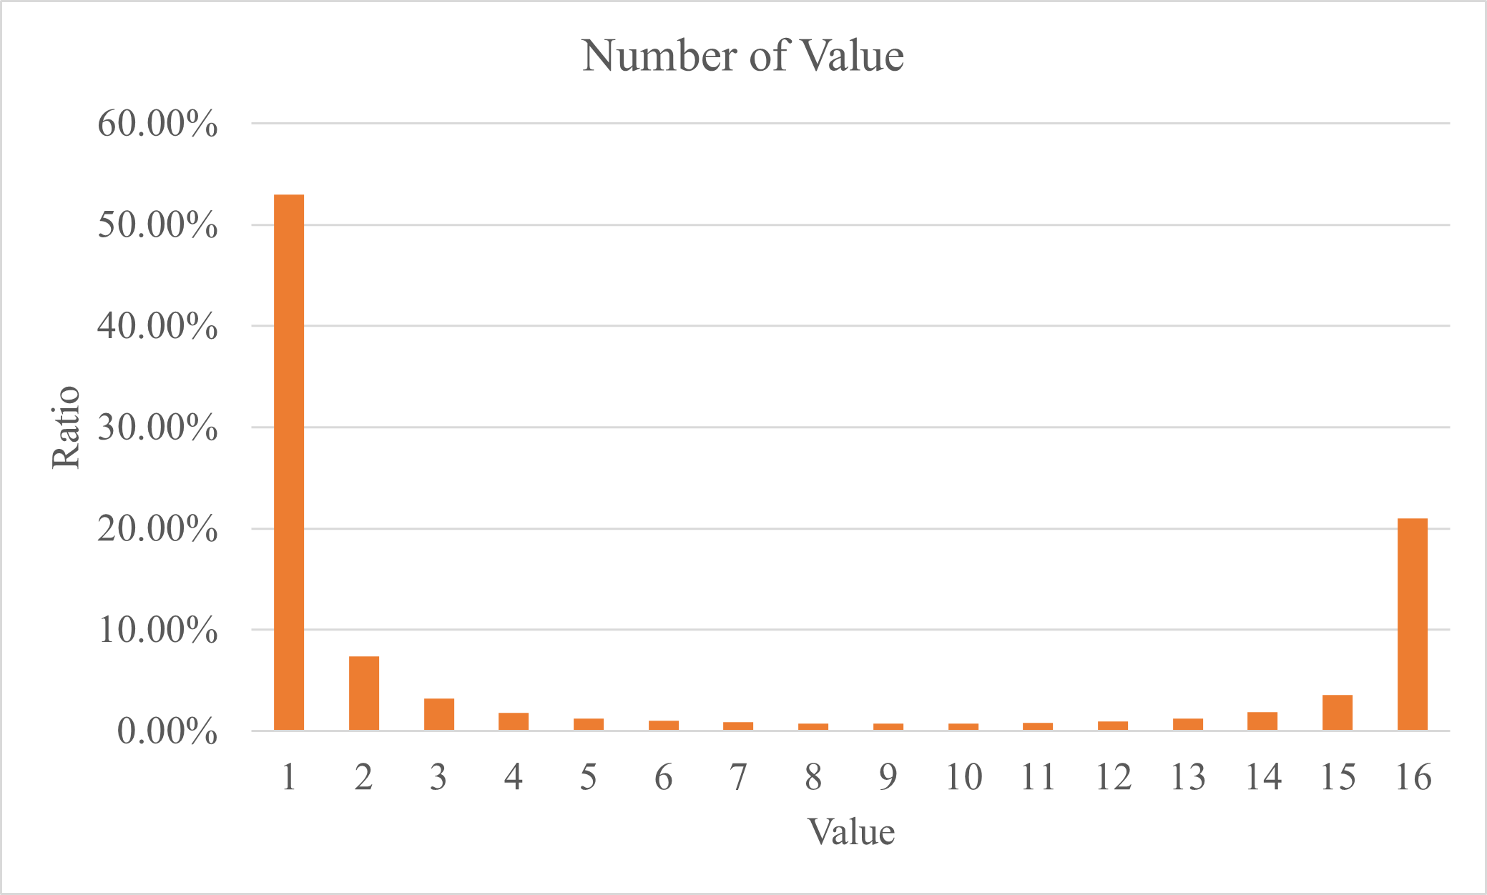
Algorithm - Data Compress
Table1 Huffman Table
Value | Huffman Code | Value | Huffman Code
0000 | 0 | 1000 | 111111111111111
0001 | 110 | 1001 | 111111111111110
0010 | 11110 | 1010 | 1111111111110
0011 | 1111110 | 1011 | 11111111110
0100 | 11111110 | 1100 | 111111110
0101 | 1111111110 | 1101 | 111110
0110 | 111111111110 | 1110 | 1110
0111 | 11111111111110 | 1111 | 10
Figure6 Number of Value

Slide 14
Outline
Image Compress
Why Compress
Lossy vs. Lossless
JPEG vs. JPEG2000
Algorithm (KT Gray Image Compression)
Encoder Architecture
2D Discrete Wavelet Transform
Symmetric Extension & Quantization
Difference
Data Compression
Encoder System Architecture
Result
Reference

Slide 15
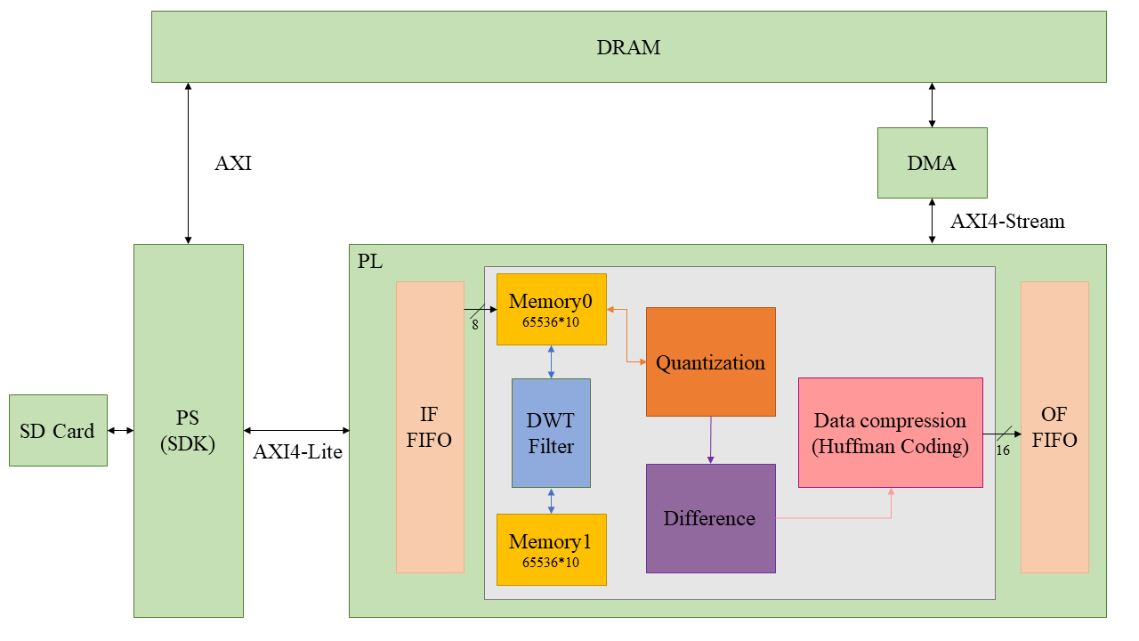
Encoder System Architecture
Figure8 System Architecture

Slide 16
Outline
Image Compress
Why Compress
Lossy vs. Lossless
JPEG vs. JPEG2000
Algorithm (KT Gray Image Compression)
Encoder Architecture
2D Discrete Wavelet Transform
Symmetric Extension & Quantization
Difference
Data Compression
Encoder System Architecture
Result
Reference

Slide 17
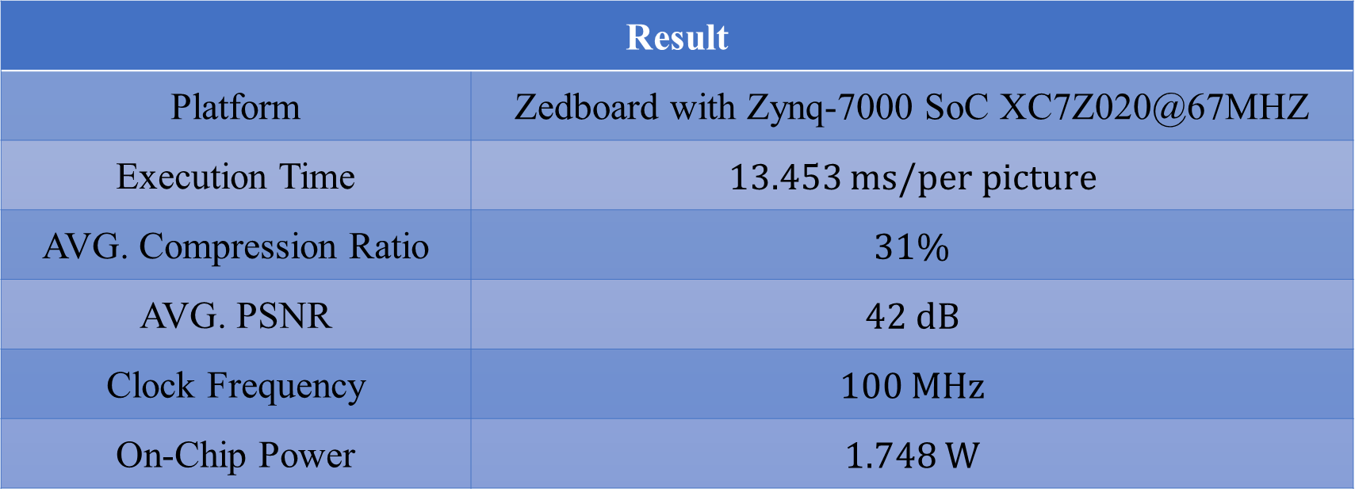
Result
Table2 Result
Result
Platform | Zedboard with Zynq-7000 SoC XC7Z020@67MHZ
Execution Time | 13.453 $ms/per picture$
AVG. Compression Ratio | 31%
AVG. PSNR | 42 dB
Clock Frequency | 100 MHz
On-Chip Power | 1.748 W

Slide 18
Outline
Image Compress
Why Compress
Lossy vs. Lossless
JPEG vs. JPEG2000
Algorithm (KT Gray Image Compression)
Encoder Architecture
2D Discrete Wavelet Transform
Symmetric Extension & Quantization
Difference
Data Compression
Encoder System Architecture
Result
Reference

Slide 19
Reference
[1] Po-Wei Liu, “The Implementation of Image Compression JPEG2000,” M.S. thesis, Dept. Elect. Eng., DYU, Changhua, Taiwan, 2014.
[2] M.Puttaraju, and Dr.A.R.Aswatha “FPGA Implementation of 5/3 Integer DWT for Image Compression” International Journal of Advanced Computer Science and Applications, Vol. 3, No. 10, 2012
[3] G. K. Khan and A. G. Sawant, "Spartan 6 FPGA implementation of 2D-discrete wavelet transform in Verilog HDL," 2016 IEEE International Conference on Advances in Electronics, Communication and Computer Technology (ICAECCT), 2016, pp. 139-143, doi: 10.1109/ICAECCT.2016.7942570
[4] Hardware Design of the Discrete Wavelet Transform: an Analysis of Complexity, Accuracy and Operating Frequency Dora M. Ballesteros L. 1, Diego Renza 2 and Luis Fernando Pedraza 3 Received: 28-04-2016 | Accepted: 21-10-2016 | Online: 18-11-2016 PACS: 84.40.Ua; 07.50.Qx doi:10.17230/ingciencia.12.24.6
[5] https://www.cnblogs.com/chengqi521/p/6732999.html
[6] https://www.cnblogs.com/amxiang/p/16543664.html
[7] https://zhuanlan.zhihu.com/p/608277782
[8] https://blog.csdn.net/weixin_38071135/article/details/118581250

