Slide 1
TFW 2024 Oral Report
Learnable Time-Frequency Analysis
Heng-Cheng Kuo, R11946023
2024/12/19

Slide 2
Outline
Introduction
SincNet
Methods
Experiments
LEAF
Methods
Experiments
Conclusion
References

Slide 3
Outline
Introduction
SincNet
Methods
Experiments
LEAF
Methods
Experiments
Conclusion
References

Slide 4
Introduction: Learnable Time-Frequency Analysis
Recap Mel-spectrogram
Perform the Short-Time Fourier Transform (STFT) on the input signal.
Take the square of the STFT output to obtain the spectrogram.
Apply the Mel-filterbank to compress the spectrogram into Mel-scale frequency bands.
Apply logarithmic compression to the Mel-scale energy.
Lack of Flexibility
Convolutional Neural Network?

Slide 5
Introduction: Learnable Time-Frequency Analysis
Overfitting risks in unconstrained learnable filters
Lack of interpretability and stability in learned representations

Slide 6
Outline
Introduction
SincNet
Methods
Experiments
LEAF
Methods
Experiments
Conclusion
References

Slide 8
Contributions
Learnable Parametric Filter Design
Efficiency and Interpretability
Focus on Speech-Specific Features

Slide 9
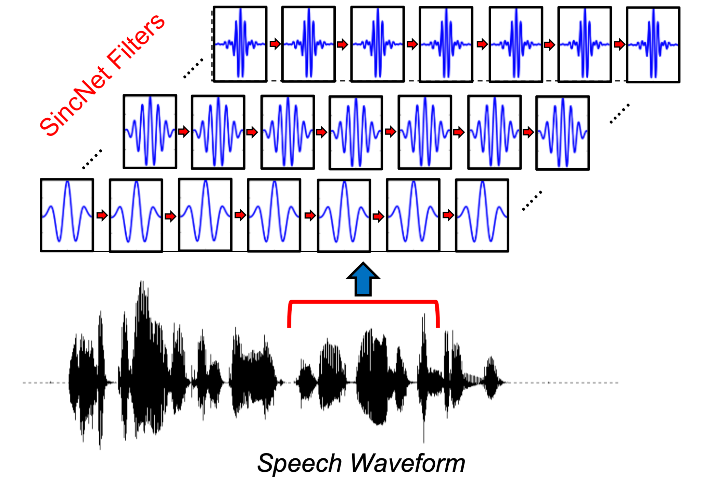
Methods

Slide 10
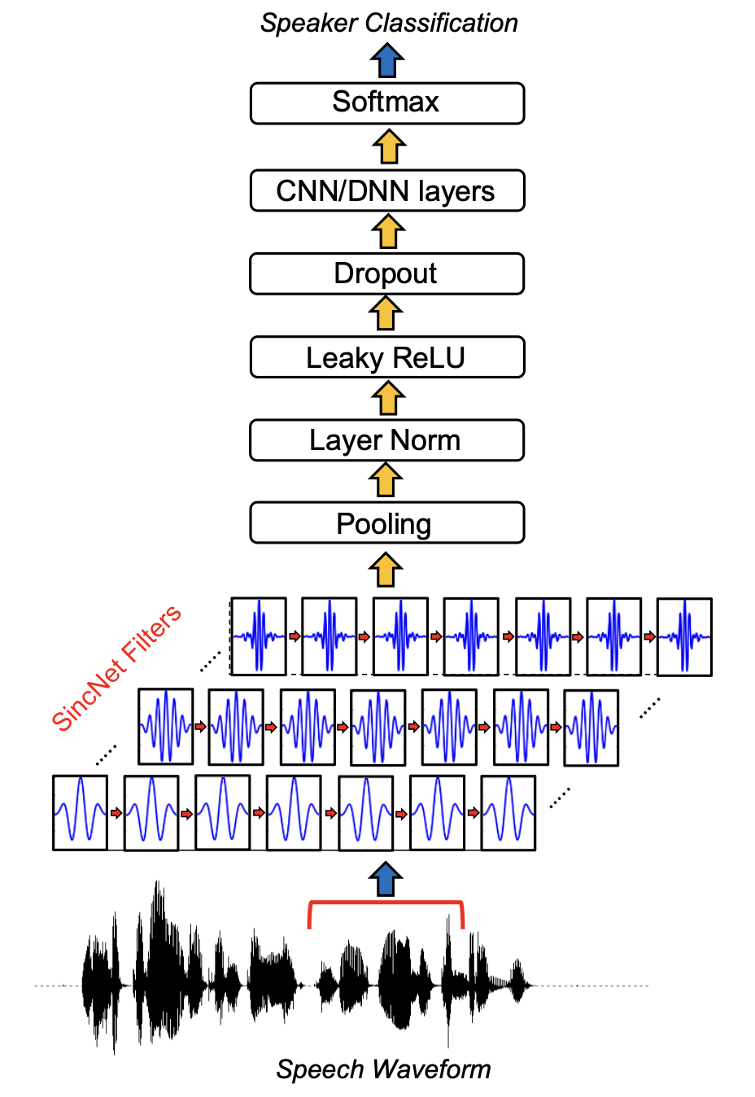
Methods

Slide 11
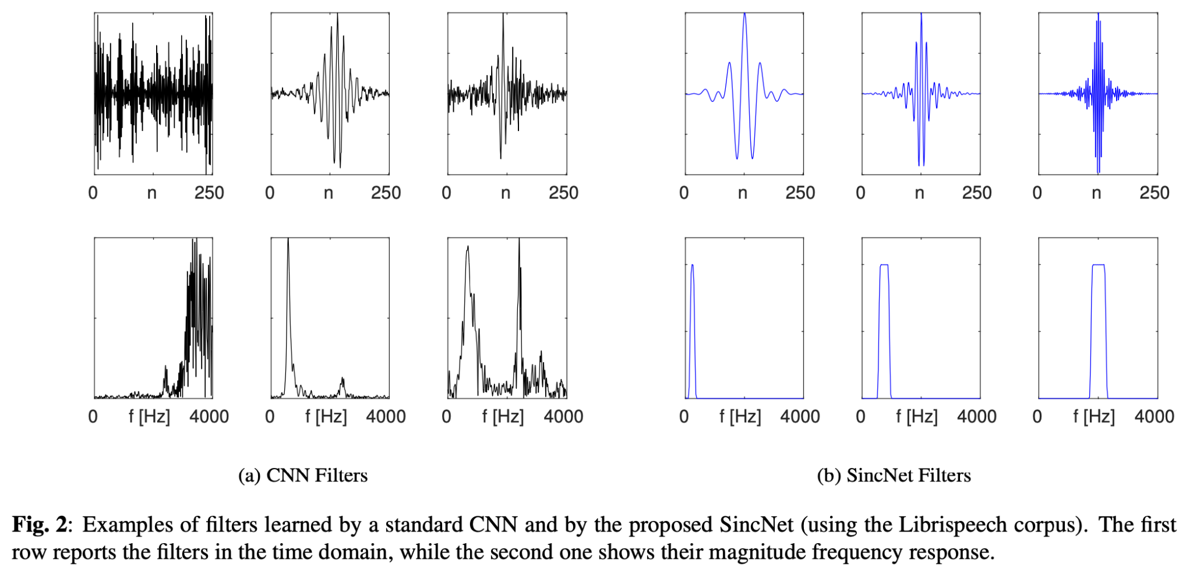
Compare with Standard CNN

Slide 12
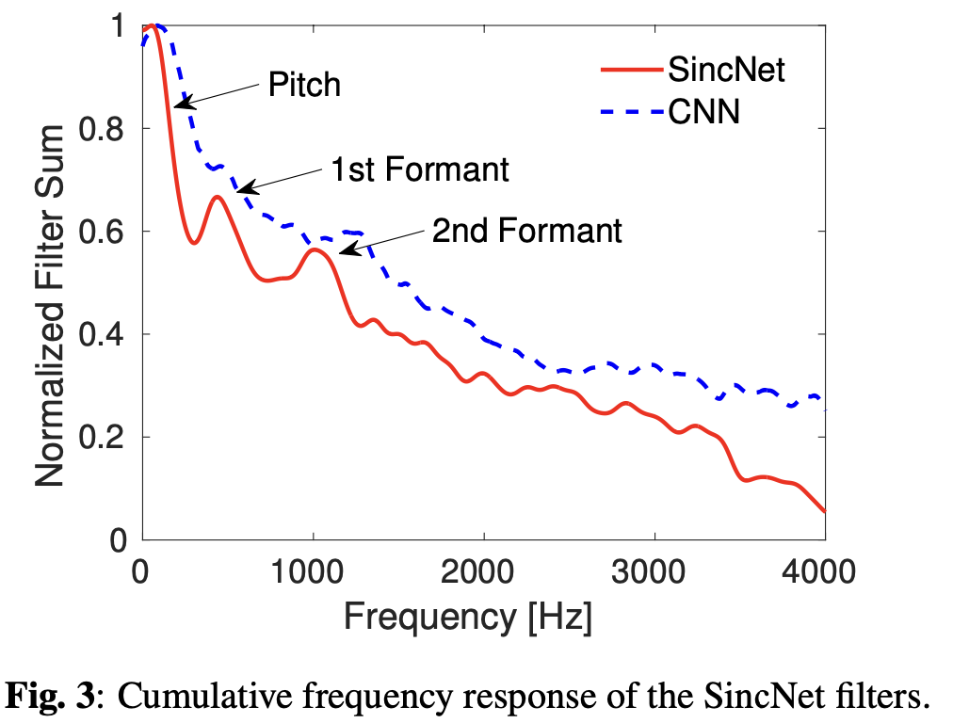
Compare with Standard CNN

Slide 13
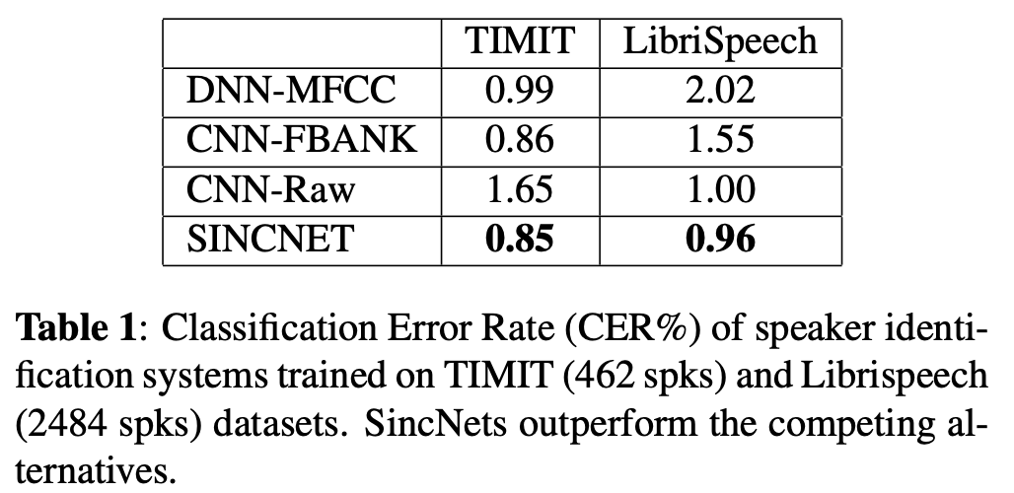
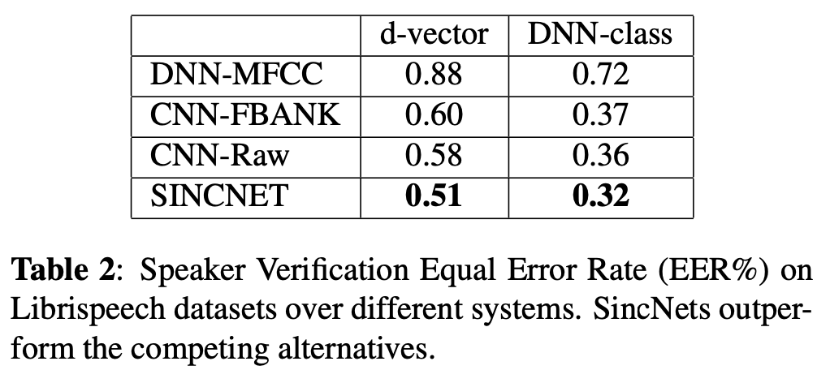
Results

Slide 14
Outline
Introduction
SincNet
Methods
Experiments
LEAF
Methods
Experiments
Conclusion
References

Slide 16
Contributions
Initialization with Gabor Filters
Gaussian Lowpass Pooling
Learnable PCEN Compression
Robustness to Noise

Slide 17
Methods

Slide 18
Methods

Slide 19
Methods

Slide 20
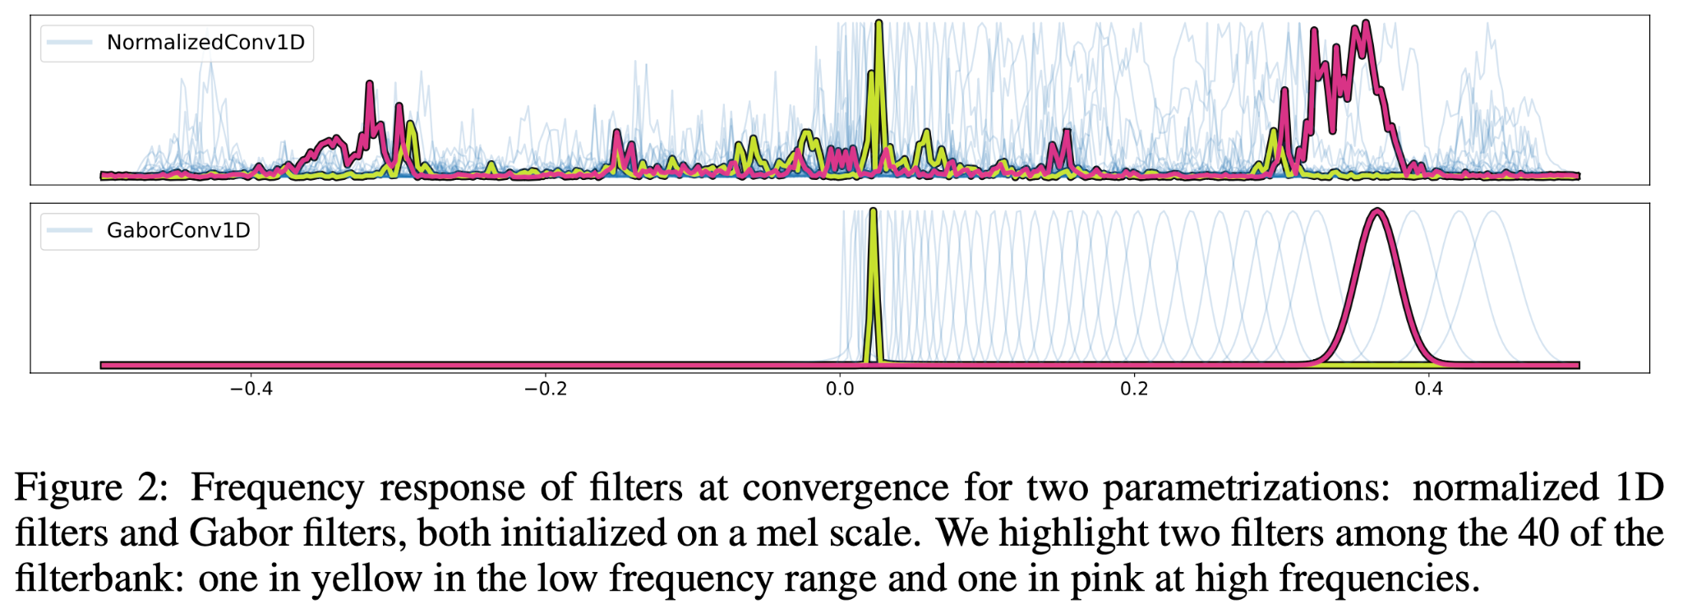
Compare with Standard CNN

Slide 21
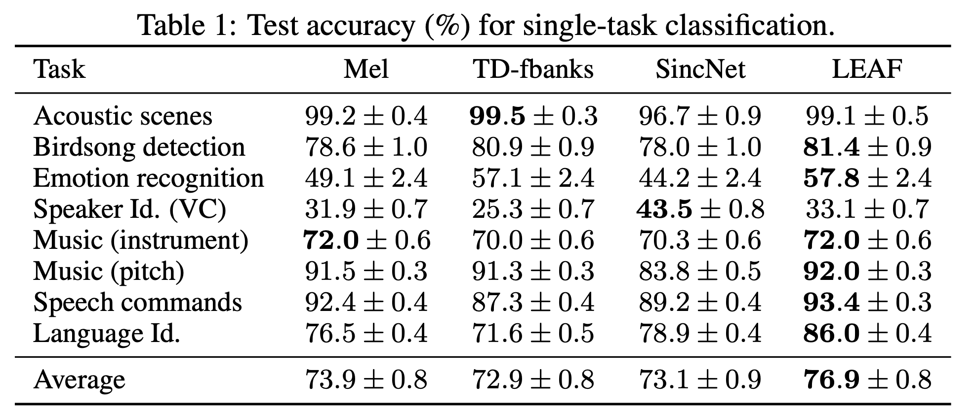
Results

Slide 22
Results

Slide 23
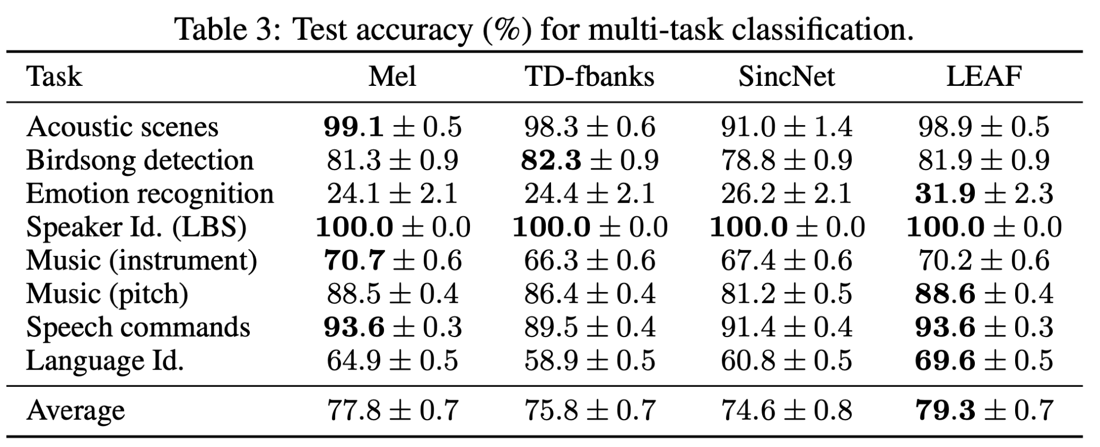
Results

Slide 24
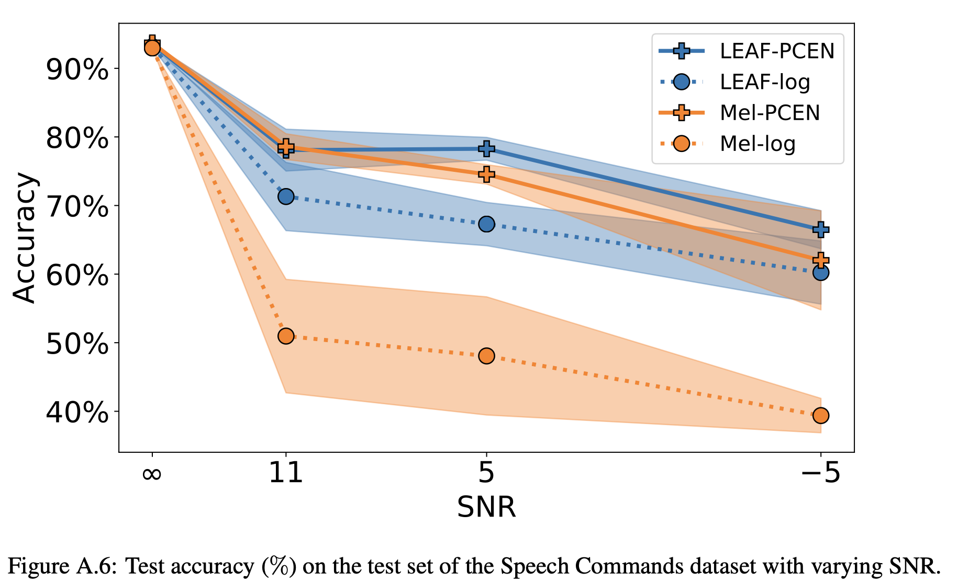
Results

Slide 25
Outline
Introduction
SincNet
Methods
Experiments
LEAF
Methods
Experiments
Conclusion
References

Slide 26
Conclusion
Generalizability
Computational Efficiency
Stride Setting

Slide 27
Outline
Introduction
SincNet
Methods
Experiments
LEAF
Methods
Experiments
Conclusion
References

Slide 28
References
[1] https://arxiv.org/abs/1808.00158
[2] https://arxiv.org/abs/2101.08596

