Slide 1
Personalization
R12942105 廖宇謙

Slide 2
Outline
Personalization
Quick introduction
Diffusion model
Object Personalization
Textual Inversion
DreamBooth
Concept Personalization
LEGO
Summary

Slide 3
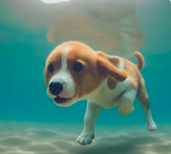
Personalization

Slide 4
Personalization
Diffusion Model
我家的可愛小狗在水裡游泳

Slide 5
Personalization
你家小狗是誰？？
隨便生…
Diffusion Model
我家的可愛小狗在水裡游泳

Slide 6
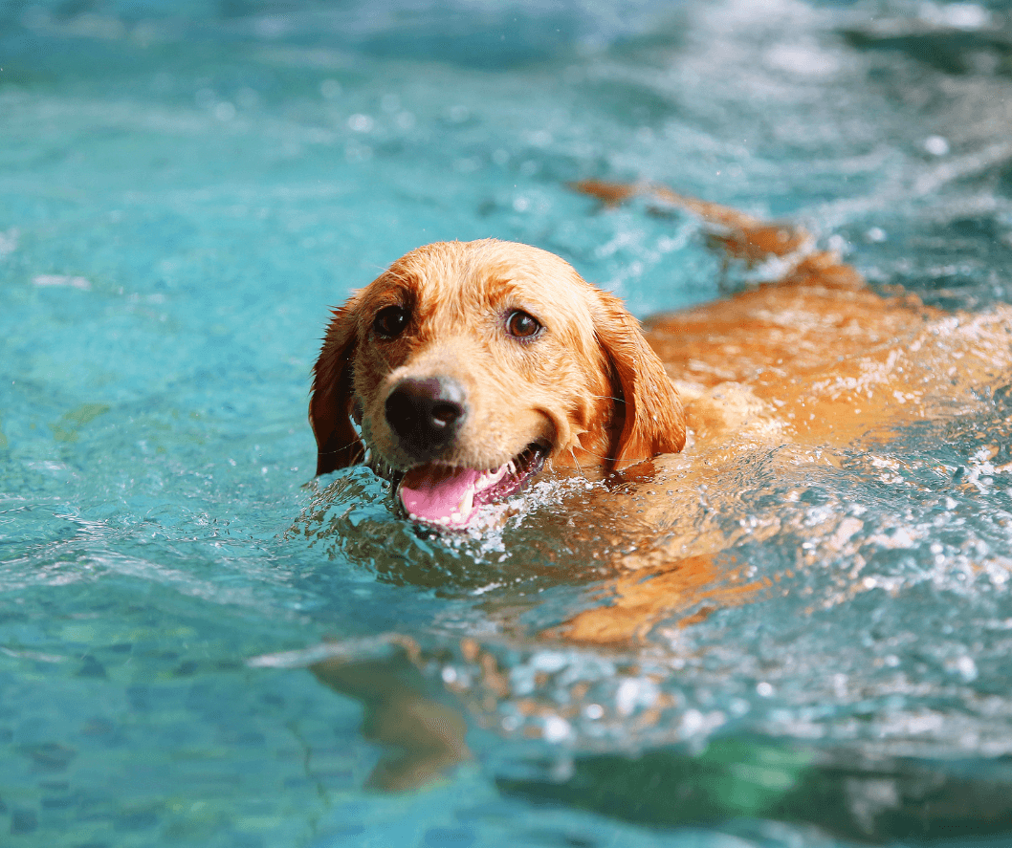
Personalization
你家小狗是誰？？
隨便生…
Diffusion Model
我家的可愛小狗在水裡游泳

Slide 7
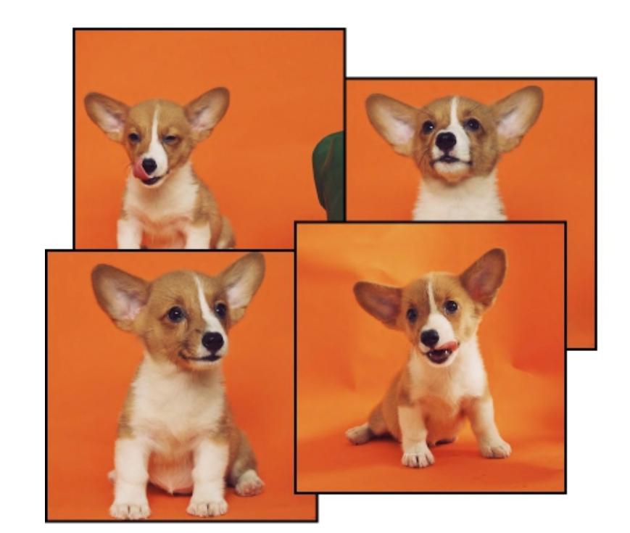
Personalization
我知道你家小狗長怎樣了！
先給你看幾張我家小狗的照片
Diffusion Model

Slide 8
Personalization
我知道你家小狗長怎樣了！
先給你看幾張我家小狗的照片
Diffusion Model
Diffusion Model
我家的可愛小狗在水裡游泳

Slide 9
Personalization
ChatGPT
以下是幫您安排的台北兩天一夜行程：
第一天：…
幫我安排兩天一夜的行程，…

Slide 10
Personalization
ChatGPT
以下是幫您安排的台北兩天一夜行程：
第一天：…
幫我安排兩天一夜的行程，…
ChatGPT
以下是幫您安排的宜蘭兩天一夜行程：
第一天：…
幫我安排宜蘭兩天一夜的行程，…

Slide 11
Personalization
Diffusion Model
我家的可愛小狗在水裡游泳

Slide 12
Personalization
Diffusion Model
我家的可愛小狗在水裡游泳
Diffusion Model
$υ$小狗在水裡游泳

Slide 13
Personalization
Diffusion Model
我家的可愛小狗在水裡游泳
Diffusion Model
$υ$小狗在水裡游泳
怎麼找到$υ$?

Slide 14
Diffusion Model

Slide 15
Diffusion Model
Step 1000
Diffusion Model

Slide 16
Diffusion Model
Step 1000
Diffusion Model

Slide 17
Diffusion Model
Step 1000
Diffusion Model
-
-

Slide 18
Diffusion Model
Step 999
Diffusion Model
-
-

Slide 19
Diffusion Model
Step 1
Diffusion Model
-
-

Slide 20
Diffusion Model
Step 1
Diffusion Model
-
-
Step 456
Pre-defined
Algorithm

Slide 21
Diffusion Model
Step 1
Diffusion Model
-
-
Step 456
Pre-defined
Algorithm
Diffusion Model

Slide 22
Diffusion Model
Step 1
Diffusion Model
-
-
Step 456
Pre-defined
Algorithm
Diffusion Model
L2 Loss

Slide 23
Diffusion Model
Step 1000
Diffusion Model
A white dog

Slide 24
Diffusion Model
Step 1000
Diffusion Model
A white dog

Slide 25
Diffusion Model
Step 1000
Diffusion Model
-
-
A white dog

Slide 26
Diffusion Model
Step 999
Diffusion Model
-
-
A white dog

Slide 27
Diffusion Model
Step 1
Diffusion Model
-
-
A white dog

Slide 28
Personalization
Object Personalization
Textual Inversion
DreamBooth
Concept Personalization
LEGO

Slide 29
Textual Inversion
Diffusion Model
L2 Loss
A photo of $υ$
update
Diffusion Model
$υ$小狗在水裡游泳

Slide 30
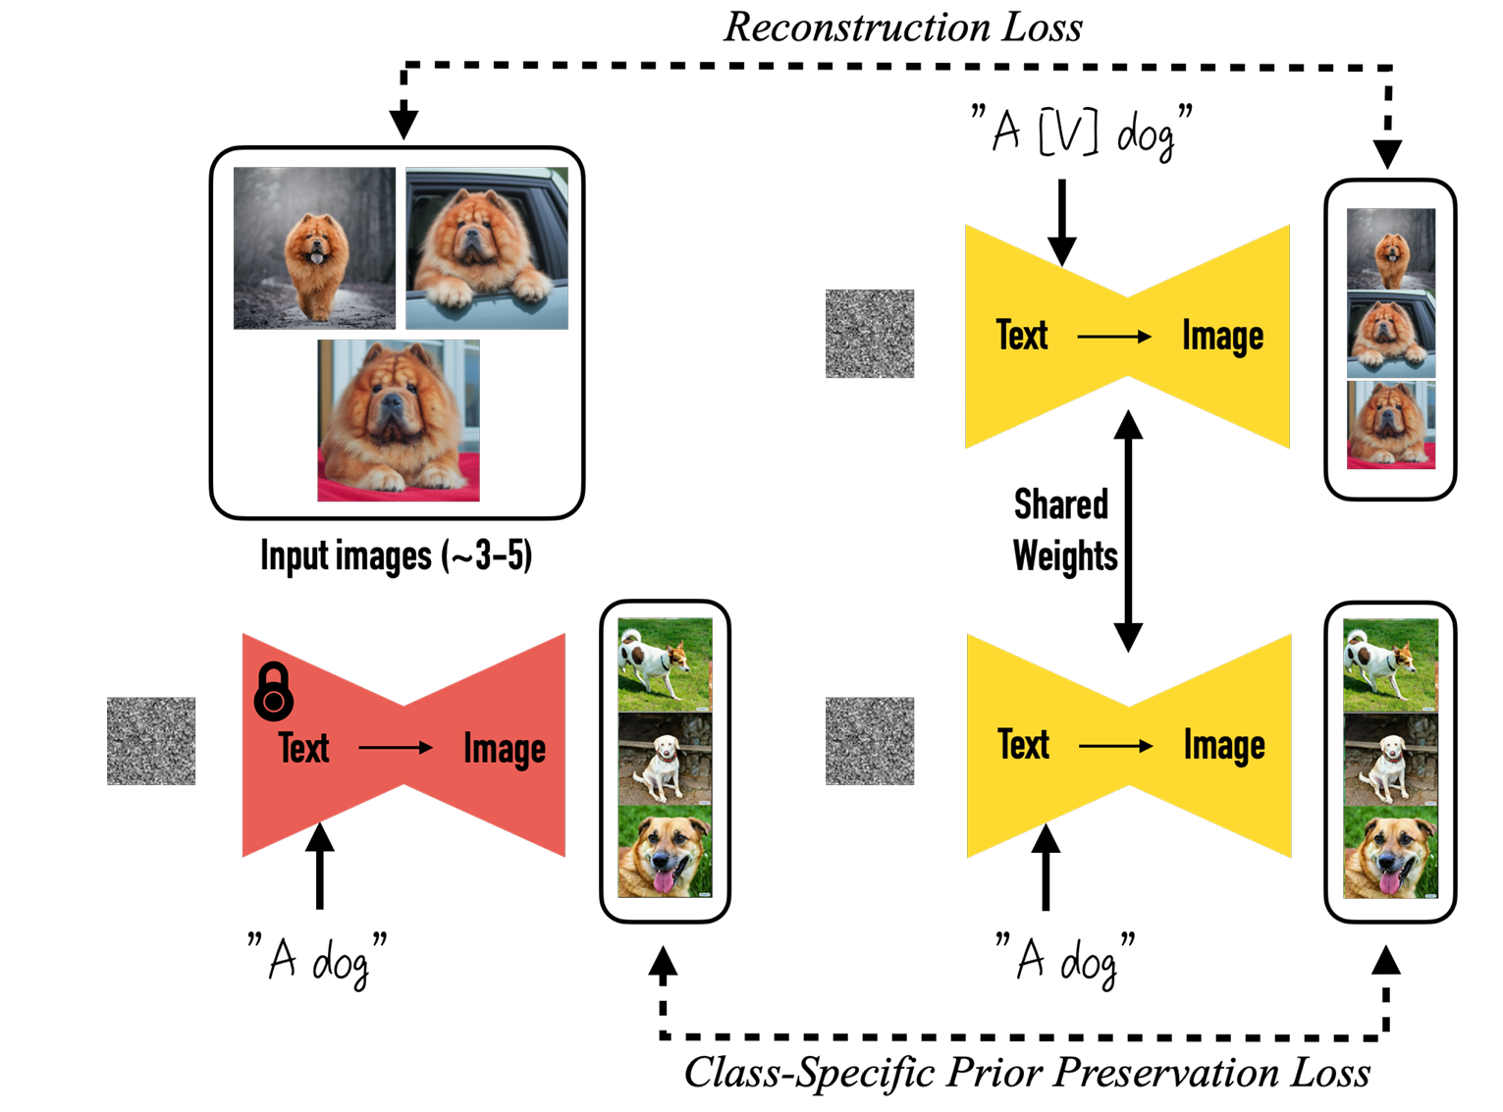
DreamBooth
Finetune the whole model
Language drift
Reduce output diversity
Class-Specific Prior Preservation Loss
Loss between the images of same class

Slide 31
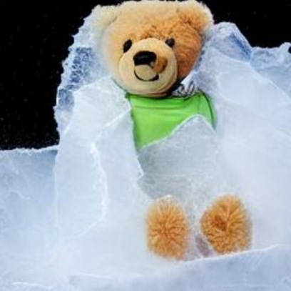
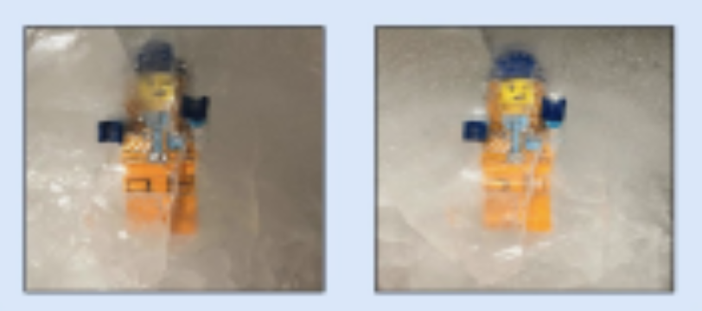
LEGO
Unable to directly learn abstract concept if there is an object in the images.
A photo of a $υ$ teddy bear
$υ$ should stand for frozen

Slide 32
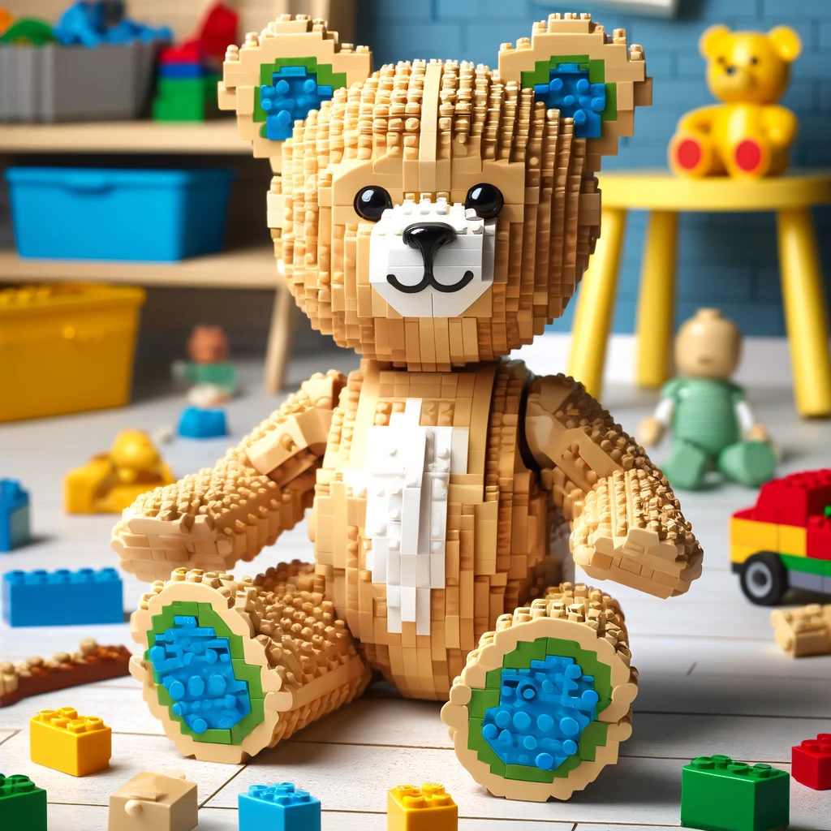
LEGO
Unable to directly learn abstract concept if there is an object in the images.
A photo of a $υ$ teddy bear
$υ$ should stand for being frozen
However, …
Textual inversion make $υ$ as LEGO style
A photo of a $υ$ teddy bear

Slide 33
LEGO
Unable to directly learn abstract concept if there is an object in the images.
First, find the special token of object in the image.
Then, extract the concept by excluding the object.
A photo of a $υ$ teddy bear
$υ$ should stand for being frozen
However, …
Textual inversion make $υ$ as LEGO style
A photo of a $υ$ teddy bear

Slide 34
LEGO
Prepare exemplar images and positive/negative concepts in advance.
Exemplar Images
Subject only image set
Subject + concept image set
Positive concepts and negative concepts
contrastive loss

Slide 35
Summary
Diffusion model
Iteratively denoise
Personalization
Make diffusion model know what you want
Object and concept personalization
Future work
Integral object and concept token
Integral image editing

Slide 36
Reference
Textual Inversion
DreamBooth
LEGO

