Slide 1
ADSP Final Report
Presenter: 余旻達

Slide 2
Outline
Spectrogram Decomposition for CNN-sensitive Speech Enhancement
Hao Shi, Interspeech 2022
Deep Complex U-Net with Conformer for Audio-Visual Speech Enhancement
Shafique Ahmed et al.,2023

Slide 3
Spectrogram Decomposition for CNN-sensitive Speech Enhancement
Hao Shi, Interspeech 2022

Slide 4
Motivation
Speech Enhancement in Real Applications
Noisy environments degrade speech quality
Important for ASR, communication, hearing aids
Need robust front-end DSP processing

Slide 5
Traditional vs Deep Learning
Traditional DSP:
Wiener filtering
Spectral subtraction
Deep learning:
DNN
RNN
CNN

Slide 6
Problem of CNN
Limitation of CNN in Speech Enhancement
CNN focuses on local texture
Noisy spectrogram destroys speech structure
Hard to capture formant and harmonic patterns

Slide 7
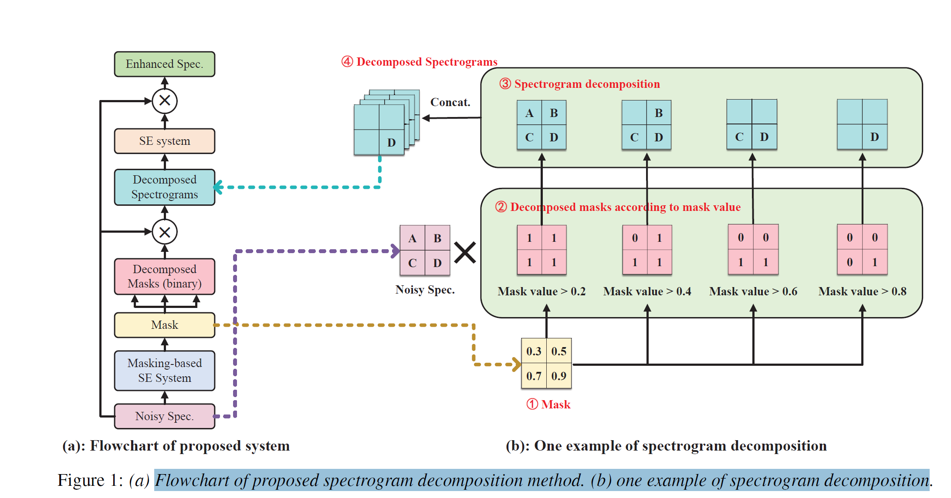
Network Architecture
Mask-based Speech Enhancement
Network estimates mask
Mask represents speech presence
Enhanced spectrogram = Mask × Noisy spectrogram

Slide 8
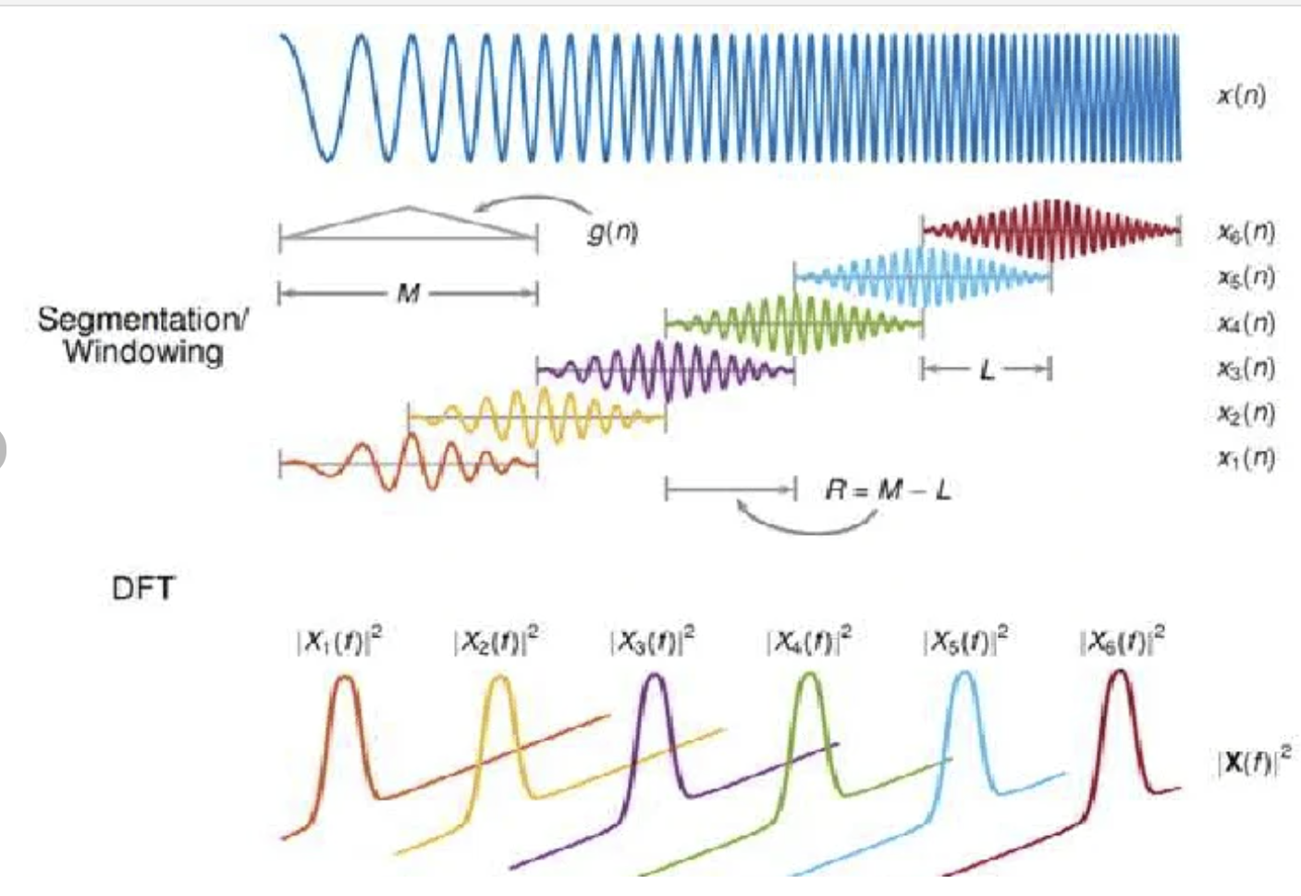
DSP Perspective
DSP Insight
Spectrogram = STFT magnitude
Decomposition emphasizes high SNR regions
Similar to time-frequency masking

Slide 9
Dataset
VoiceBank + DEMAND
16 kHz sampling rate
10k training utterances

Slide 10
Evaluation Metrics
PESQ (speech quality)
CSIG (speech distortion)
CBAK (noise intrusiveness)
COVL (overall quality)

Slide 11
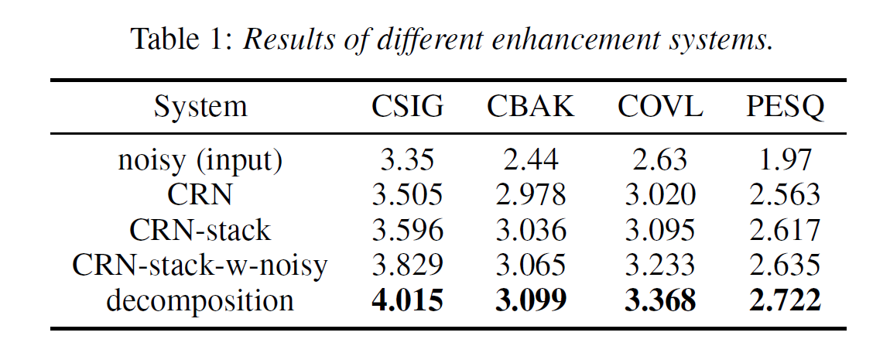
Results
Performance Comparison
Proposed method improves PESQ by ~0.15
Better speech detail recovery
Similar parameter size to stacked model

Slide 12
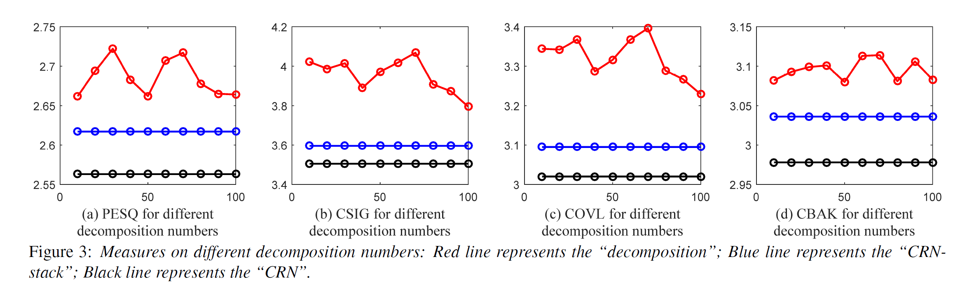
Effect of Decomposition Number
Effect of Decomposition Number
Too small → insufficient speech highlighting
Too large → fragmented features
Best around 30–70

Slide 13
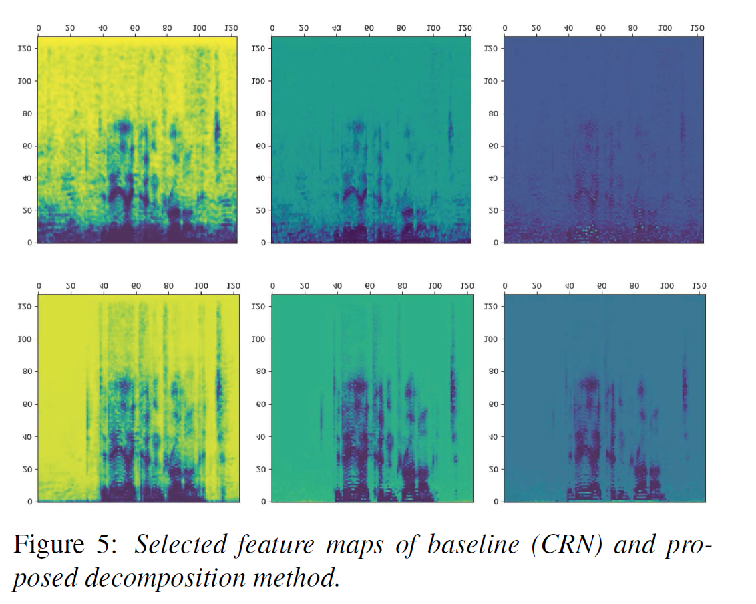
Feature Map Analysis
Feature Map Visualization
Less noise activation
Clear speech regions
Better high-frequency preservation

Slide 14
Advantages
Advantages
Improves CNN sensitivity
No need to change network
Simple preprocessing

Slide 15
Limitations
Limitations
Need mask estimation model
Decomposition number tuning
Still magnitude-only enhancement

Slide 16
Future Work
Future work
Automatic decomposition selection
Complex spectrum enhancement
Real-time deployment

Slide 17
Conclusion
Spectrogram decomposition improves speech enhancement
Provides structure-aware features for CNN
Effective and lightweight solution

Slide 18
My Thoughts
Related to mask-based T-F filtering
Could combine with DCCRN / Demucs
Potential for real-world DSP systems

Slide 19
Deep Complex U-Net with Conformer for Audio-Visual Speech Enhancement
Shafique Ahmed et al.,2023

Slide 20
Motivation
Speech quality degrades in noisy environments
Audio-only systems have limited robustness
Visual cues (lip movements) can improve performance

Slide 21
Key Idea
Propose DCUC-Net
Use complex features → preserve phase
Fuse audio + visual information
Use Conformer → capture long & short dependencies

Slide 22
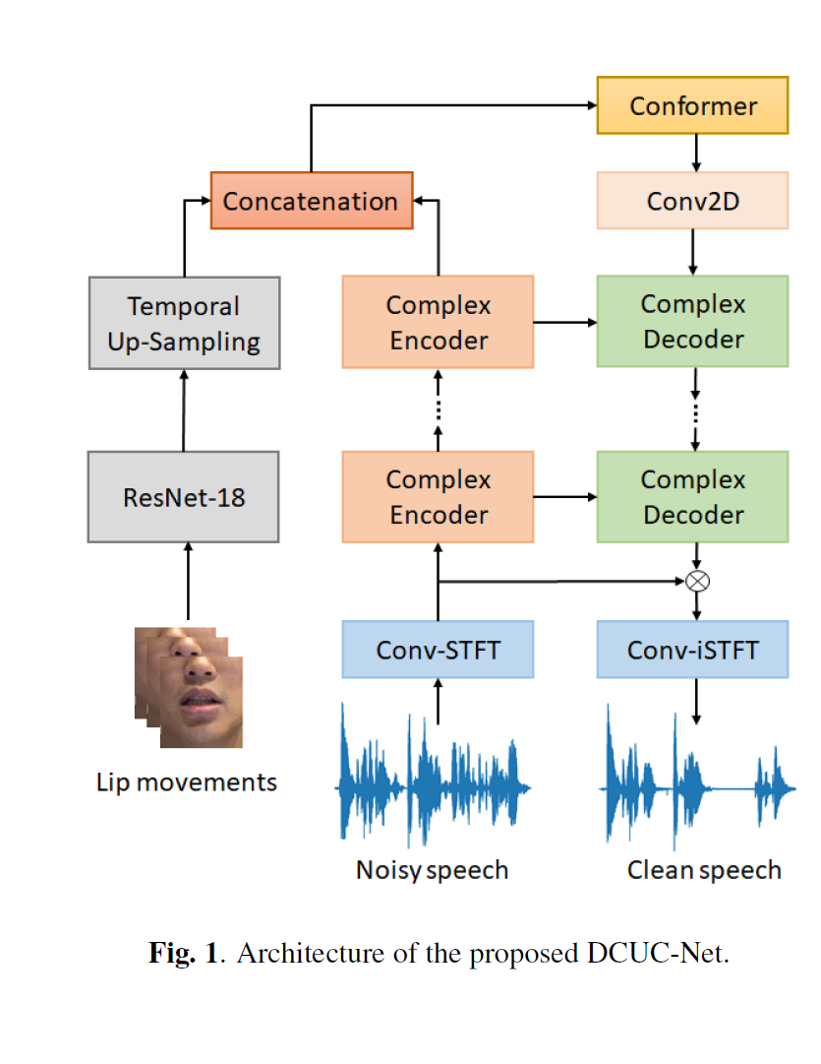
Overall Architecture
DCUC-Net Framework
ConvSTFT
Complex Encoder
Visual Encoder (ResNet-18)
Feature Fusion (Conformer)
Complex Decoder
Conv-iSTFT

Slide 23
Complex Processing
Operates in complex domain
Learns complex ratio mask (CRM)
Improves speech quality & intelligibility

Slide 24
Conformer Block
Self-attention → global dependency
Convolution → local context
Better audio-visual fusion

Slide 25
Dataset
COG-MHEAR AVSE Challenge dataset
TMSV Mandarin audio-visual dataset

Slide 26
Experimental Setup
Conv-STFT feature extraction
5 encoder + 5 decoder blocks
Loss: SI-SNR

Slide 27
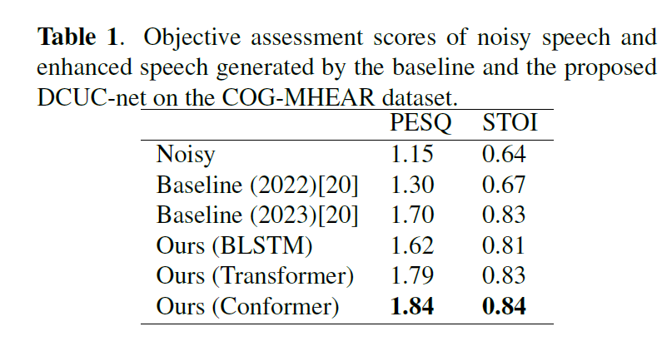
Results (COG-MHEAR)
DCUC-Net achieves best PESQ & STOI
Better noise suppression than baseline

Slide 28
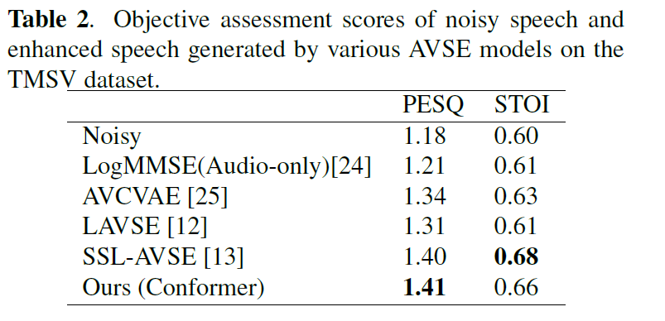
Results (TMSV)
Outperforms most AVSE models
Smaller model than SSL-AVSE

Slide 29
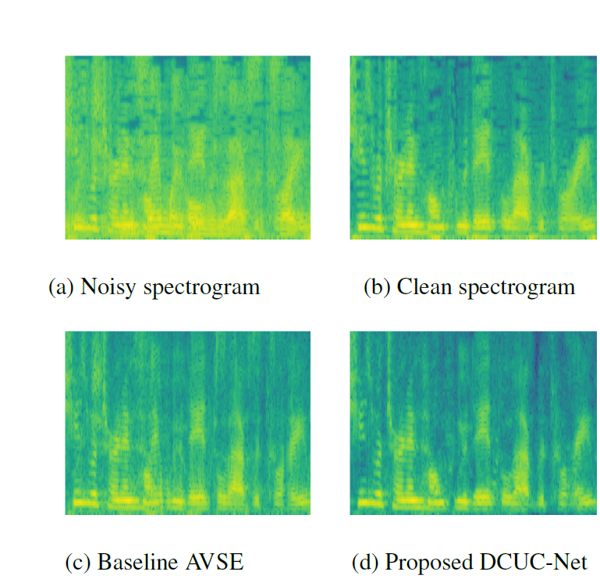
Spectrogram Comparison
Noisy vs Clean vs Baseline vs DCUC-Net
Proposed model removes noise more effectively

Slide 30
Conclusion
Fuse audio + visual cues
Complex U-Net preserves phase
Conformer improves dependency modeling
Achieves strong enhancement performance

